Slide 1
Agency Reimbursement 101
This training takes you through the flow of financial information during the various phases of Personal Property. Reporting officials can ensure a smooth and timely reimbursement by following the recommended steps in this slidedeck.

Slide 2
Property types
Property Type is intended to assist the user in identifying the property being reported using the Regular Utilization and Donation Screening or Exception Process, in terms of its reimbursability, and in terms of the user's intent to retain sales proceeds.
REGULAR UTILIZATION AND DONATION SCREENING OPTIONS
To select Regular Utilization and Donation Screening, you must select one of the three radio buttons:
No Special Requirements
Surplus Sales Proceeds Retention
Property Was Purchased With Working Capital or Revolving Funds
EXCEPTIONS OPTIONS
To select Exception options, you must select one of the four radio buttons
Exchange Sale (Replacement Authority)
Special legislative authority
Property was purchased with non-appropriated funds
Property is reported by a wholly owned or mixed-ownership Government corporation
For ALL options except "No Special Requirements" the associated financial information (Appropriation Code or Fund To Be Reimbursed and the Agency Location Code) must be provided. Agencies are also encouraged to report the fair market value for reimbursable sales.

Slide 3
What are the most common Property types?
No Special Requirements
Regular excess property; the agency just needs to get rid of it. In this case, no reimbursement is offered to the agency.
Exchange Sale
Property that the agency has a continuing need for (i.e. replacement property).
Surplus Sale Proceeds Retention
Property where the agency can be reimbursed for cost associated with preparing an item for sale.

Slide 4
How to select your sale type in gsaxcess
Exchange Sale
From the Create Property Report Screen:
Scroll down to “Property Type”
Click the radio button for “Exceptions” - this will show a drop down with addition options.
Select “Exchange Sale”
Surplus Sale Proceeds Retention
From the Create Property Report Screen:
Scroll down to “Property Type”
Select “Surplus sale proceeds retention”
In BOTH cases, you must enter the appropriate financial data in order to ensure timely reimbursement to your agency.

Slide 5
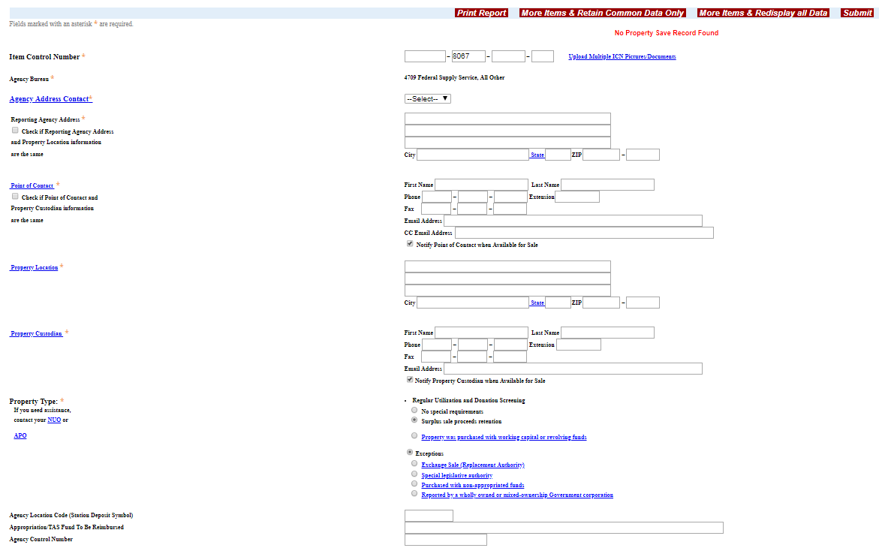

Slide 6
What financial information is required?
Agency Location Code (ALC)
Treasury Accounting Symbol (TAS) or Appropriation Fund Symbol (AFS)
For Military only:Fiscal Station Number (FSN)
Do NOT
Report the item if this information is not 100% accurate or valid
Input random characters just to satisfy the field requirements.
Reporting invalid or inaccurate information will delay or prohibit reimbursement back to your agency and will require additional time and resources to fix.

Slide 7
What is an Agency Location Code (ALC)?
An ALC is an eight digit identifier that is used to define agencies by setID for federal payment schedules and reporting purposes. This number acts as your payment’s routing number and is necessary for reimbursement.
Find your ALC here: https://cldcentral.usalearning.net/mod/page/view.php?id=15538

Slide 8
What is a Treasury Account Symbol (TAS)?
A Treasury Account Symbol (TAS) is a code that allows us to identify critical information about each transaction that you report.
A TAS includes eight meaningful pieces of data (for example, agency identifier, fiscal year, main account number, sub-account number, and so on).
Federal Program Agencies that must report transactions to Treasury's Bureau of Fiscal Services through a system like IPAC or FMS 224 must give both a TAS and a Business Event Type Code (BETC) for each transaction.
Do you need help finding your TAS? Find your agencies point of contact here: https://www.fiscal.treasury.gov/fsservices/gov/acctg/gtas/contacts.htm

Slide 9
What is a Fiscal Station Number (FSN)?
The Fiscal Station Number (FSN) is used for branches of the military only.
The FSN is six character figure that helps DFAS determine which office is handling the funds.
Not having the FSN will process through treasury, however, DFAS will reject the funds on their end.

Slide 10
U&D Process
For transfers of Exchange Sale items:
For transfers made between federal agencies, GSA doesn't handle the financial piece - we rely on the federal agencies to arrange and complete the payment process.
For donations of Exchange Sale items:
Exchange sale property cannot be donated. However, in certain circumstances, GSA can conduct a direct sale to an interested public body. The process as described for sales would apply.

Slide 11
SalES (PAYMENT PROCESS)
Once Payment HAS been made by successful buyer...
Purchaser’s Receipt generated to Buyer, Property Custodian and the Agency’s ALC Point of Contact.
Register package is put together by GSA’s Collection Officer.
Missing information prevents a register from being sent to finance for reimbursement.
The Sales Office will attempt to contact the owning agency to
find out what the correct information should be. The process starts all over again.
ALC and TAS information present?
No
Yes
Missing ALC or TAS
Register sent to
finance
for reconciliation &
reimbursement
IPAC created and submitted to Treasury
No
Yes
Reimbursement Complete
Was IPAC Rejected?
Invalid ALC or TAS

Slide 12
Agency reconciliation
Purchaser’s Receipt + IPAC = Match
Each Purchaser’s Receipt includes a Register Number (included in subject line of email and in body of email).
Each IPAC includes a Register Number.

