Slide 1
Foreign Gifts & Decorations
Title 5 USC 7342 & FMR 102-42
David Tran, CPPA

Slide 2
Agenda
Definitions
Retention
Processing of Foreign Gifts
Reporting
Processing of Foreign Gifts to Politicians
Gifts GSA Won’t Accept
Transfer
Donation
Sale
Foreign Gifts Stats
Foreign Gifts Screen
POC

Slide 3
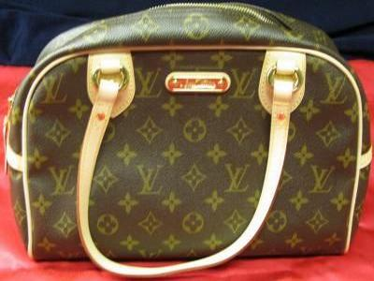
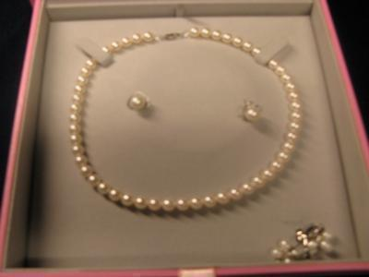
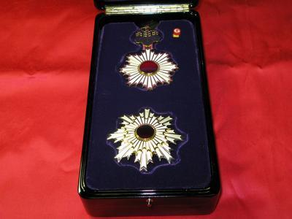
Definitions
Foreign Gift: tangible or intangible present received from a foreign government.
Decoration: an order, device, medal, badge, insignia, emblem, or award tendered by, or received from a foreign government.

Slide 4
Definitions
Foreign Government:
Any unit of foreign governmental authority.
i.e. National, state, local, & municipal.
Any international or multi-national organization whose membership is composed of any unit of foreign government.
Any agent or representative of any such unit/organization while acting on their behalf.

Slide 5
Retention
Minimum gift value establishes dollar threshold.
$390 (FY19)
You can retain a gift less than minimum value upon internal agency approval.
Gifts above minimum value are considered gifts to the agency, not the employee.
Some agencies have lower thresholds.
Consult your OIG or NUO.

Slide 6
Processing of Foreign Gifts
Consult internal agency directive, guidance & procedures.
Gift can be retained for official agency purposes.
Submit LOJ to GSA Foreign Gift PM.
Report to GSA within 30 days after terminating use.
Report to GSA as excess.
Employee has option to purchase (appraised value).

Slide 7
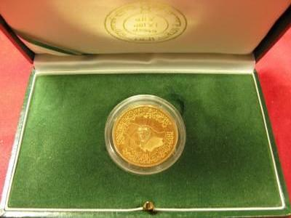
Processing of Foreign Gift
Monetary gifts with possible historic or collectible value must be reported to GSA.
Monetary gifts of no historic or collectible value must be deposited to Department of Treasury.

Slide 8
Reporting
Required information:
Description
Name of Recipient.
ID of government, name & title of person who presented gift.
Date of acceptance.
Presidential administration at time of gift.
Indicate if employee is interested in purchasing gift.
If yes, commercial appraisal must be prepared in U.S. & complete SF-120.

Slide 9
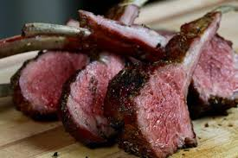
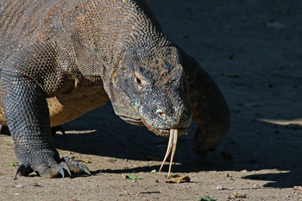
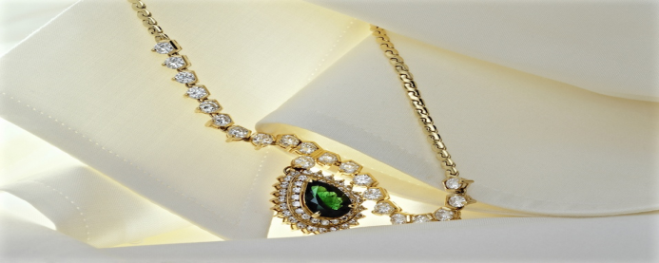
Processing of Foreign Gifts to Politicians
Foreign gifts to Pres., VP & family members are handled by National Archives and Records Administration (NARA).
GSA processes sale if they want to purchase.
Foreign gifts to members of Congress are handled by Commission of Arts & Antiquities of the U.S. Senate.

Slide 10
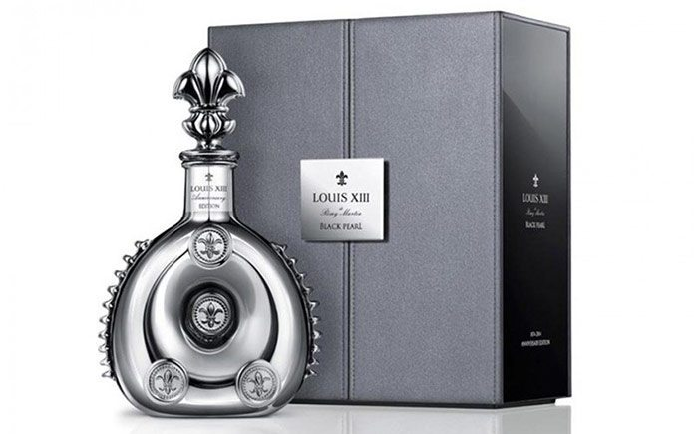
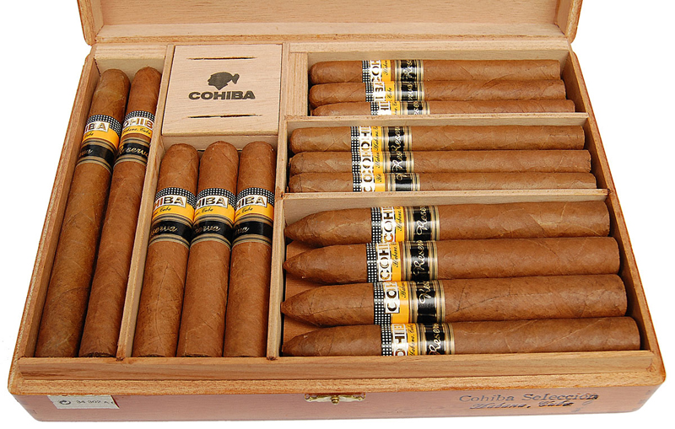
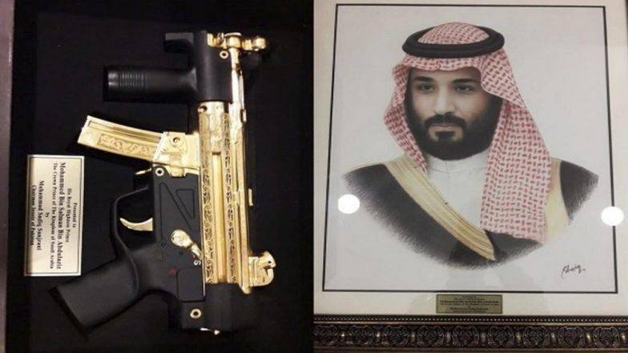
Gifts GSA Won’t Accept
A - Alcohol
T - Tobacco
F - Firearms
Must be disposed IAW CFR 101-42.

Slide 11
Transfer
Direct transfer must be approved by GSA.
Agencies may request for public display and/or bona-fide agency official display.
SF-122 must include the following statement:
“Foreign Gifts/Decorations, at such time as these items are no longer required, they will be reported to the General Services Administration, Utilization & Donation Program Division (QSCC), 6808 Loisdale Road, Springfield, VA 22150 and will be identified as foreign gift items and cross reference to this transfer order number.”

Slide 12
Donation
If there are no federal requirements & recipient does not want to purchase, GSA may offer to SASPs.
SF-123 must be submitted to:
GSA, Property Management Division, Foreign Gifts Program, 6808 Loisdale Rd, Springfield, VA 22150
LOI required and must be signed & dated by authorized representative of requesting agency.
Time restriction is 10 years.

Slide 13
Sale
May be sold to the public on GSAAuctions after:
Screening process
Not purchased by recipient
End of Presidential administration term
Approval by Secretary of State

Slide 14
Foreign Gift Stats
Lines Reported:
FY19: 144 (YTD)
FY18: 347
FY17: 486
FY16: 310
Top 3 Gifts:
Watches (FY18: 72 lines)
Jewelry (FY18: 66 lines)
Collector/Historical (FY18: 36 lines)
Top 3 Donors:
Qatar (FY18: 57 lines)
Saudi Arabia (FY18: 48 lines)
Jordan (FY18: 19 lines)
Top 3 Recipients:
State Department (FY18: 114 lines)
Air Force (FY18: 53 lines)
CIA (FY18: 50 lines)

Slide 15
Foreign Gifts Screen

Slide 16
POC
Paula Hardiman, CPPM
Foreign Gift Program Manager
703-605-2909
paula.hardiman@gsa.gov

Slide 17
Before the exam…

