Slide 1
My Sales
Deone McMillan
Sales Program Manager
Federal Acquisition Service

Slide 2
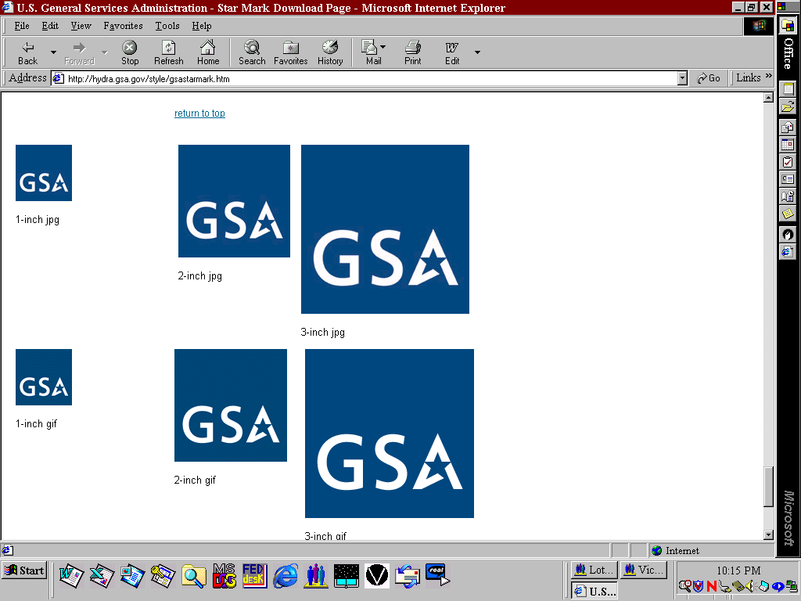
What does ‘MySales’ Do?
Provides status of property for sale
Withdraw property from sale
Helps with inventory management
Respond to email messages
Notes:
My Sales – affords federal agencies the means to maintain status of their property reported to GSA to sell and feature to withdraw items.

Slide 3
Gaining Access to ‘MySales’
You Need Access code & password
  Access code same as GSAXcess user code
Complete Access Request Form & submit
Notes:
My Sales – affords federal agencies the means to maintain status of their property reported to GSA to sell and feature to withdraw items.

Slide 4
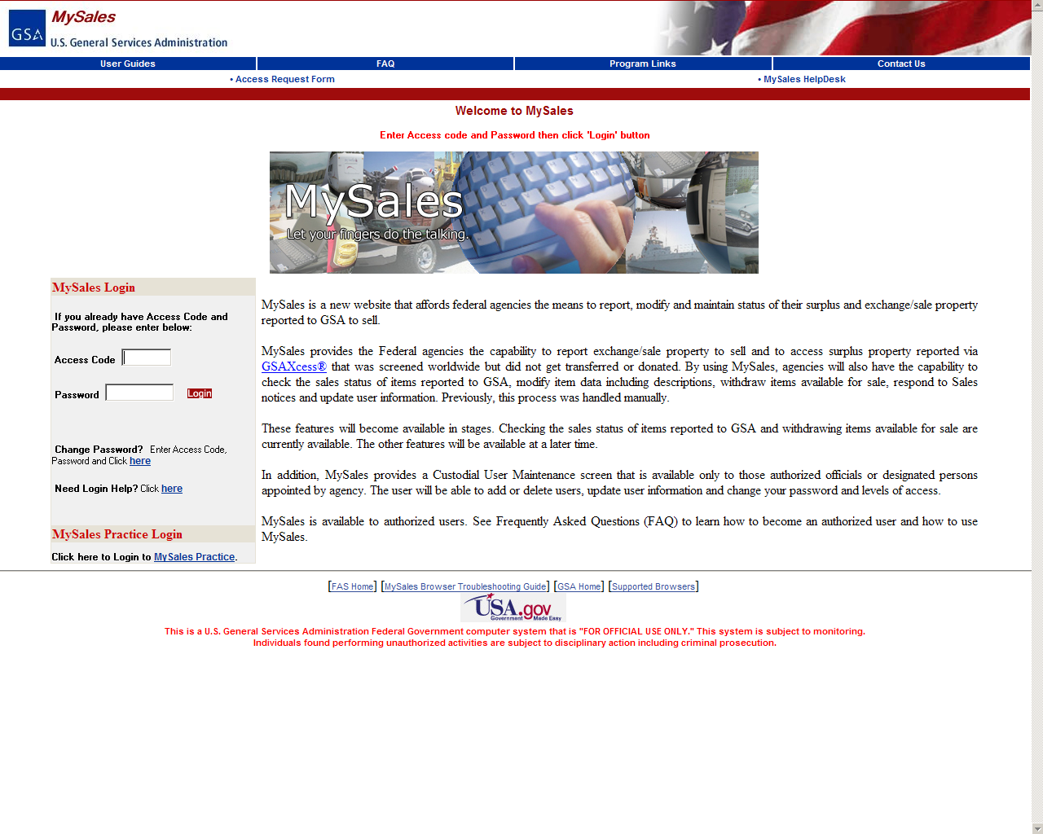
www.mysales.fss.gsa.gov
Notes:
Log in homepage for my sales; and link to access request form.

Slide 5
MySales
MySales Access
Request Form
PLEASE PRINT:
Agency Name: ____________________________________________________
Agency/Bureau Code:
(2-Digit Agency Code) (2-Digit Bureau Code)
Activity Address Code (6-Digits):
REQUESTING ACCESS FOR:
Name: ____________________________________________________
Mailing Address: ____________________________________________________
City _______________________________ State ______________ Zip Code _____________
Telephone Number (Including Area Code): _________________________________________
Fax Number (Including Area Code): _____________________________________________
Email Address: ______________________________________________________________
If you have an access code for GSAXcess and would like to use the same access code for MySales, please enter it here: _________ ,otherwise, you will be issued a new access code for MySales.
Select Screens to Access:
Review Your Sale Items
Withdraw Your Property Items From The Sales Process
Update Your User Information
Authorizing Official’s Name: ____________________________________________________
Title (Area Property Officer or National Utilization Officer): ____________________________
_______________________________________
Authorizing Official’s Signature
Please send your form to: Deborah Leith
MySales Coordinator
2200 Crystal Drive
Crystal Plaza 4, Room 706
Arlington, VA 20406
Telephone Number: (703) 605-2913 or (703) 605-5610
Fax Number: (703) 605-9833
Email Address: deborah.leith@gsa.gov
Access Request Form
Send or Fax
Notes:
Where and whom to send completed form.

Slide 6
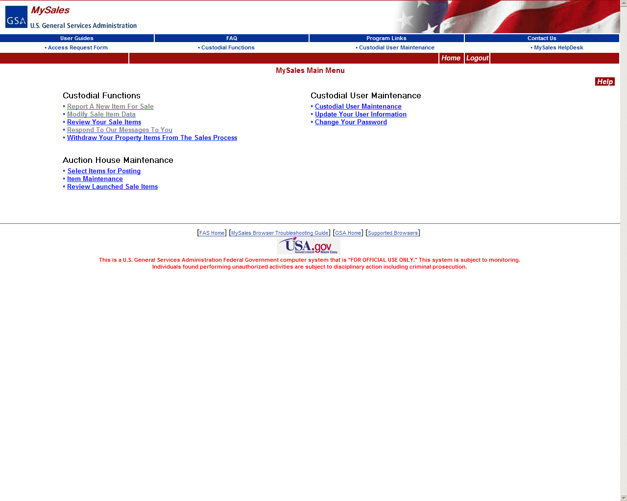
Persons Designated by Agency
Notes:
go to custodial user maintenance to enter info for agency property custodian.

Slide 7
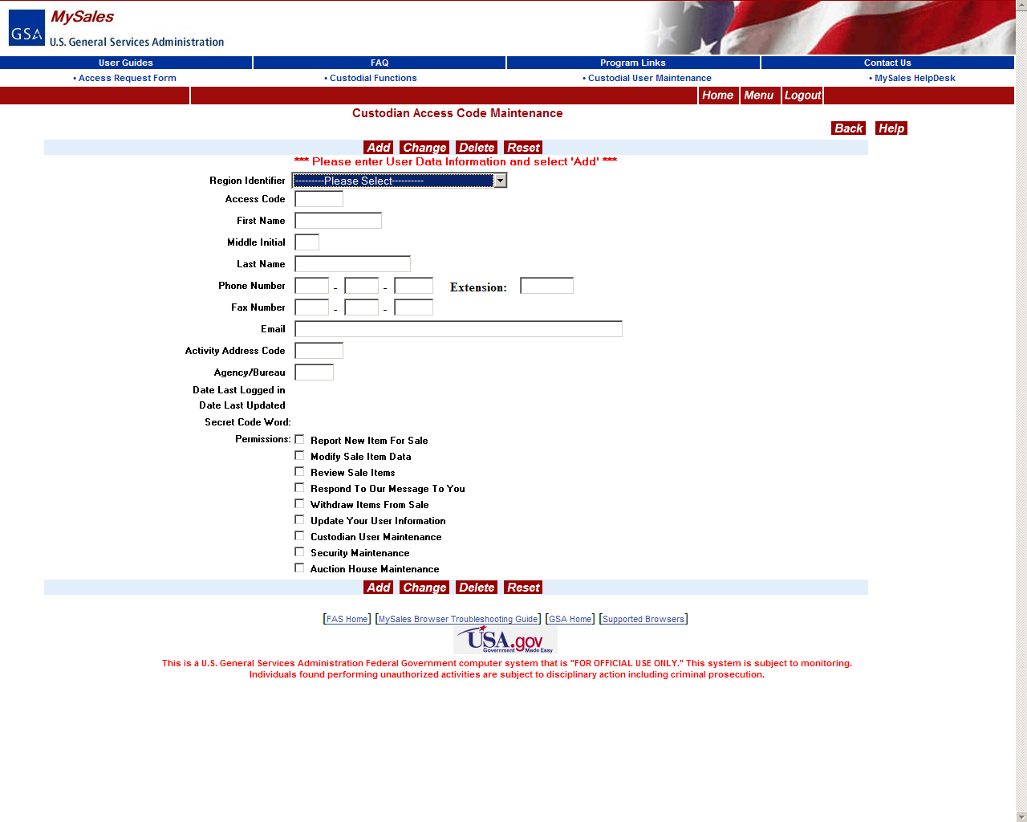
Permission Levels
Notes:
Fill out information and click “Add”

Slide 8

Update Your User Information
Notes:
Use this link if you need to update or change your user info

Slide 9
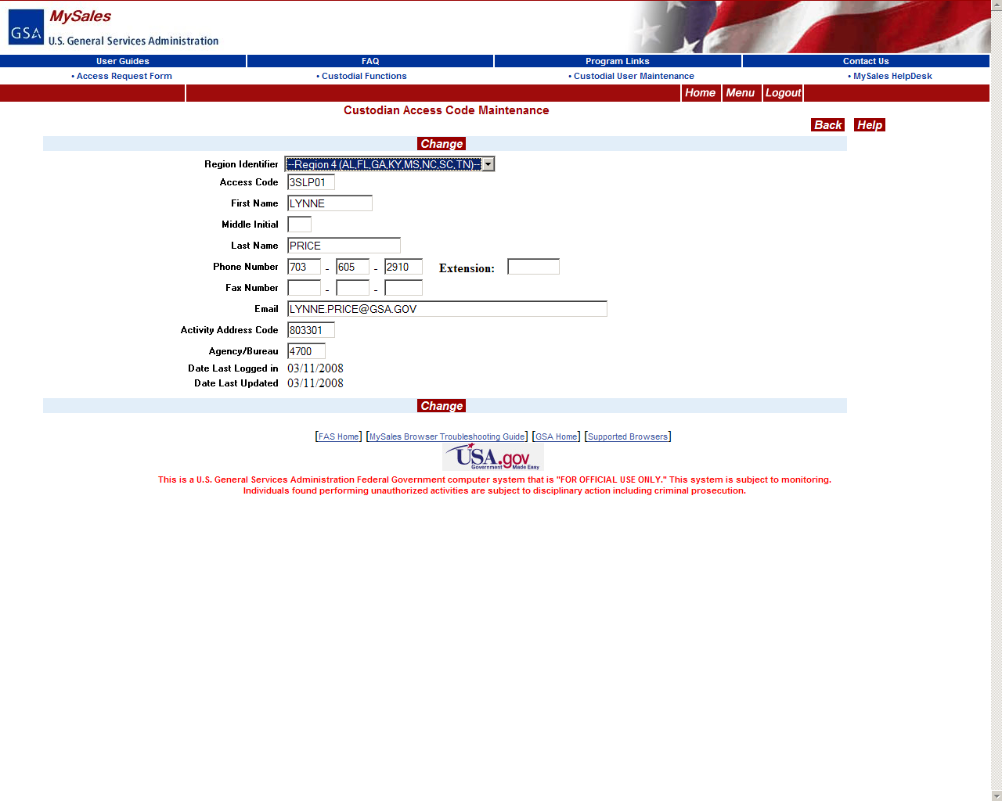
User Updates
Notes:
Your user information will be displayed for you to make changes. Make changes, then click “change”

Slide 10

Change Your Password
Notes:
use this link to change your password

Slide 11
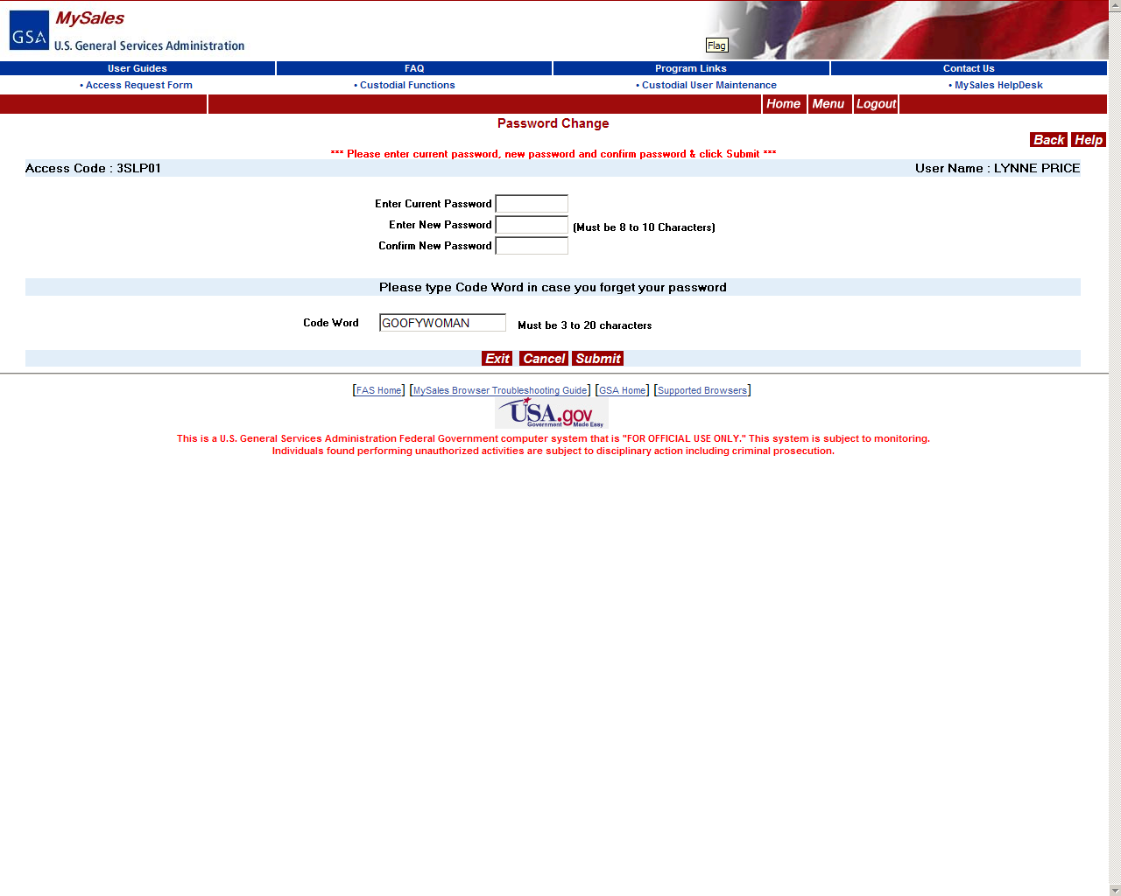
Notes:
Change password, then submit

Slide 12
Review Your Sale Items
Notes:
Use this link to review all current and past sales items

Slide 13
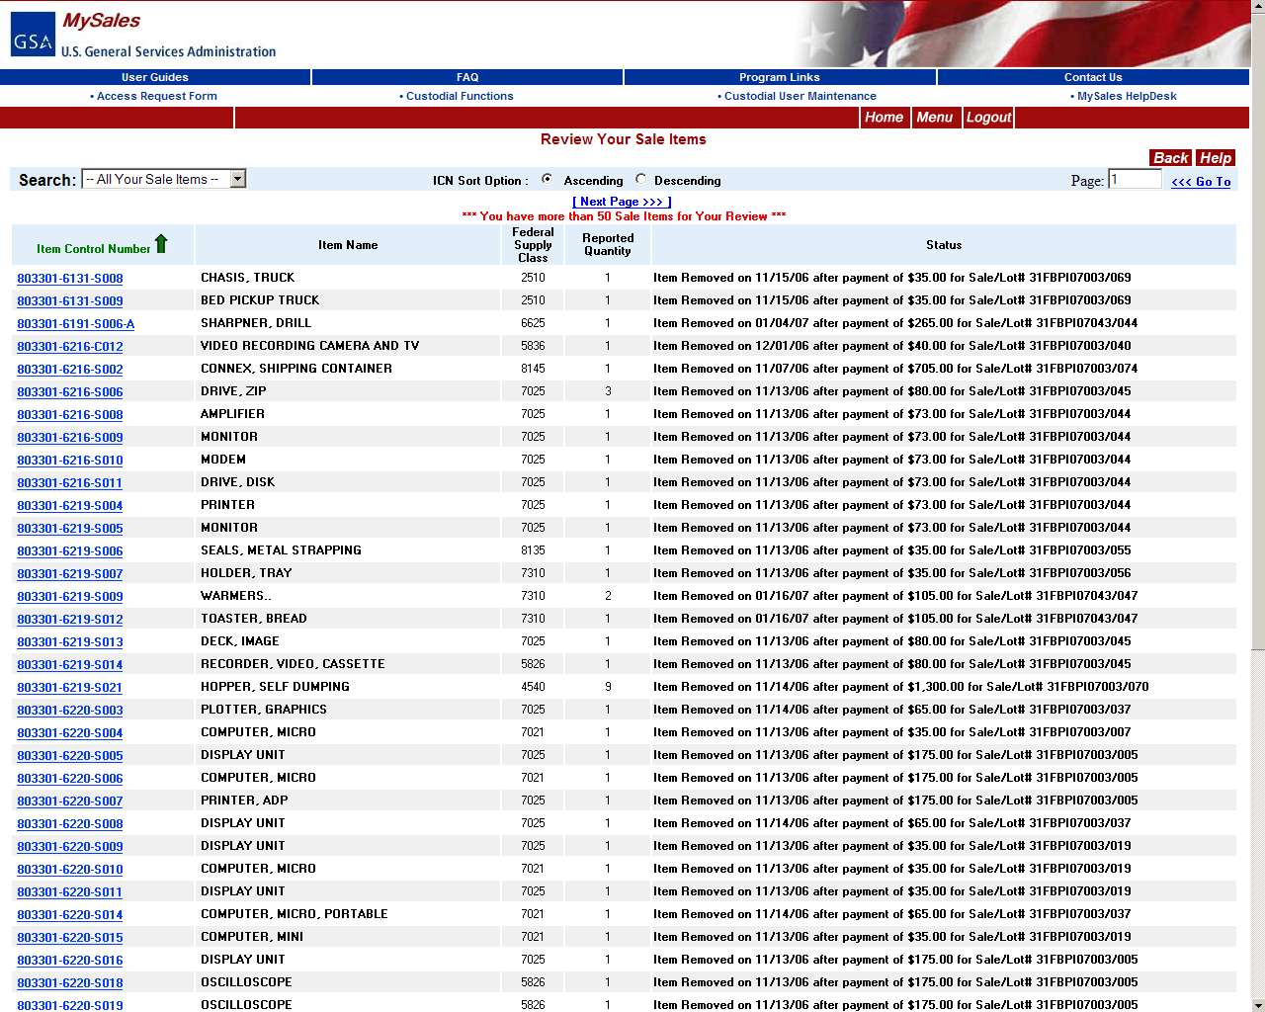
Listing of all items
Notes:
You can narrow your results by searching for specific items based on the item’s status.

Slide 14
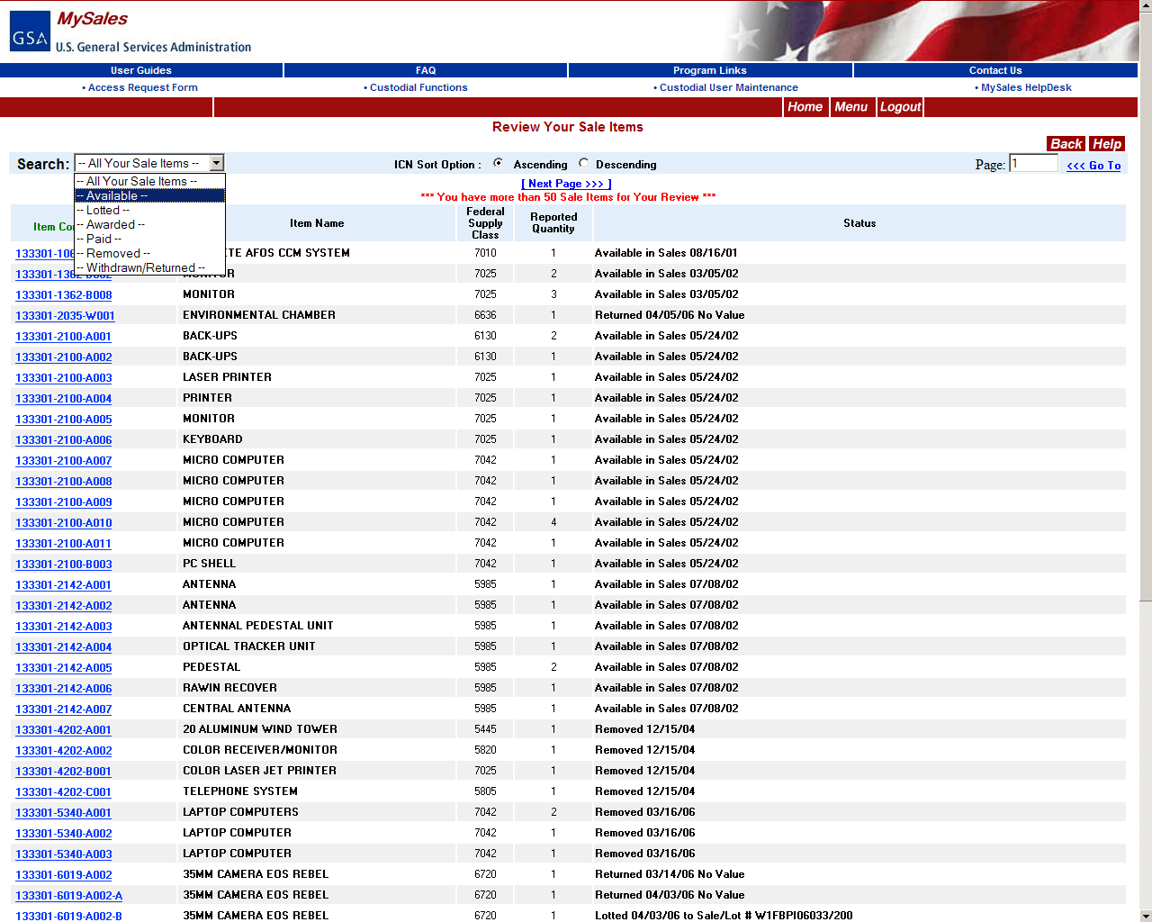
Search Options to List
Notes:
Click the search drop down menu, make a selection.

Slide 15
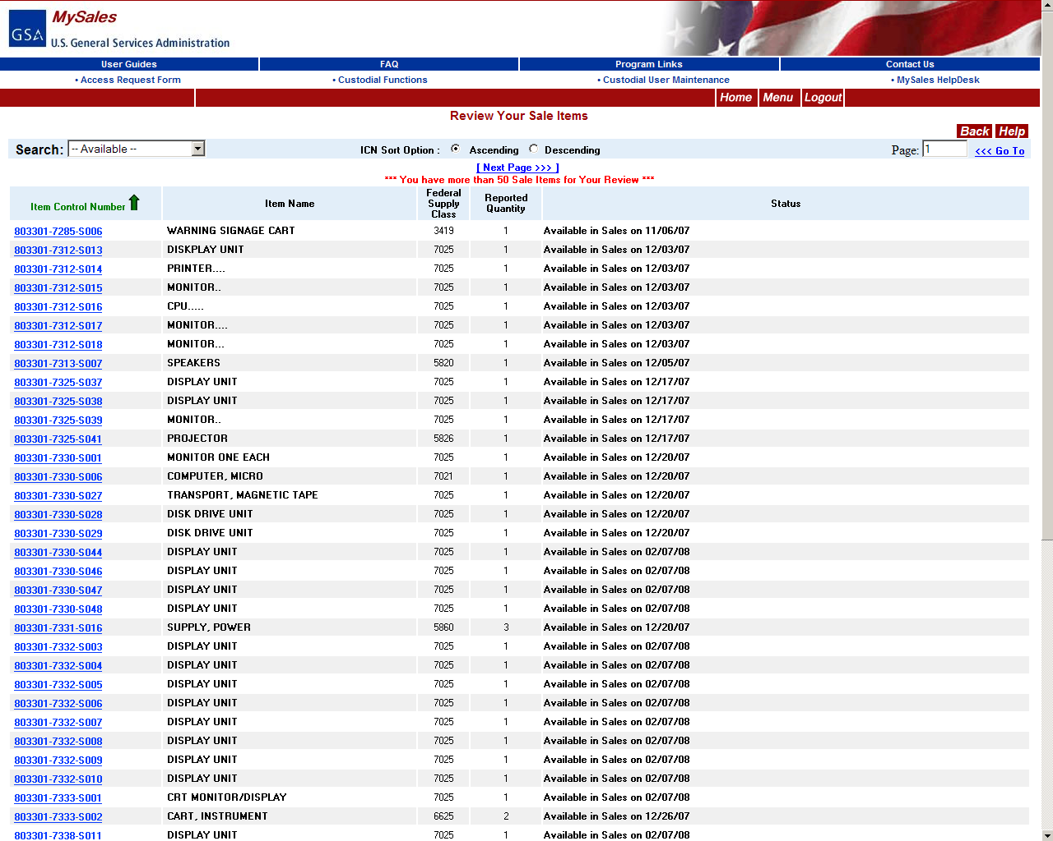
Available Items ONLY
Notes:
Results will display for the option you chose.

Slide 16
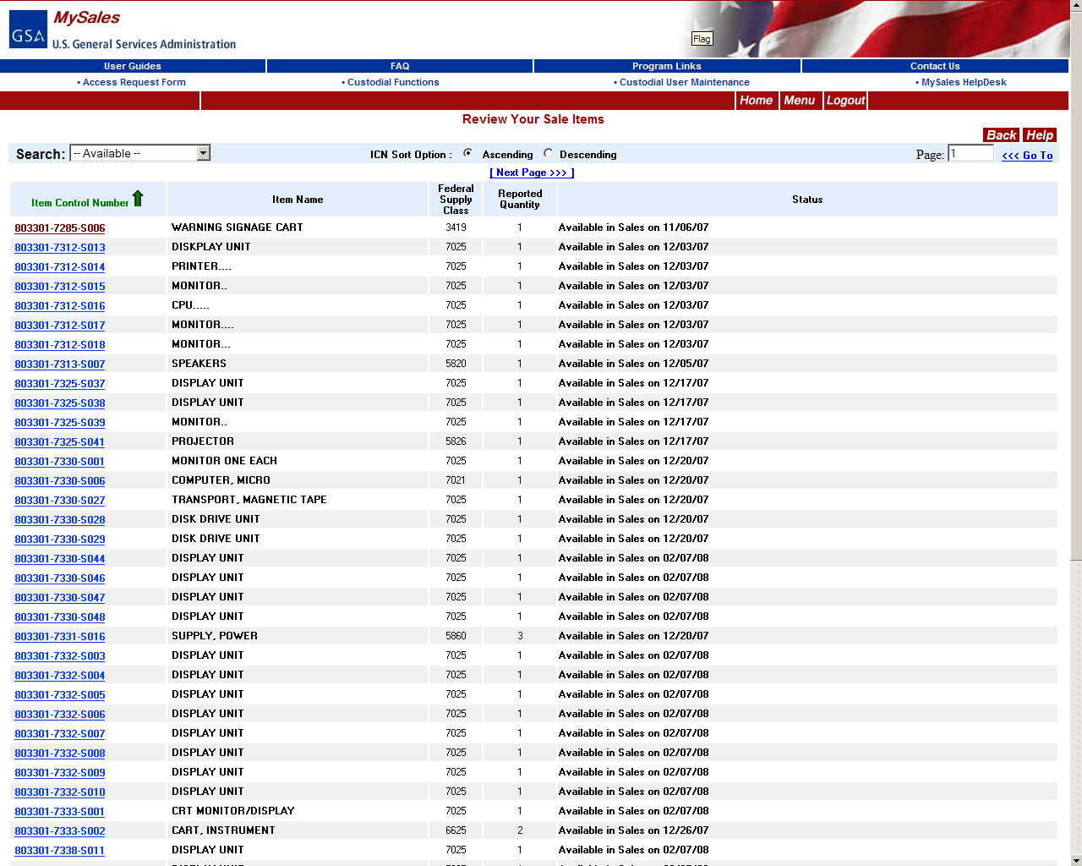
Select item to view
Notes:
Click on item of interest.

Slide 17
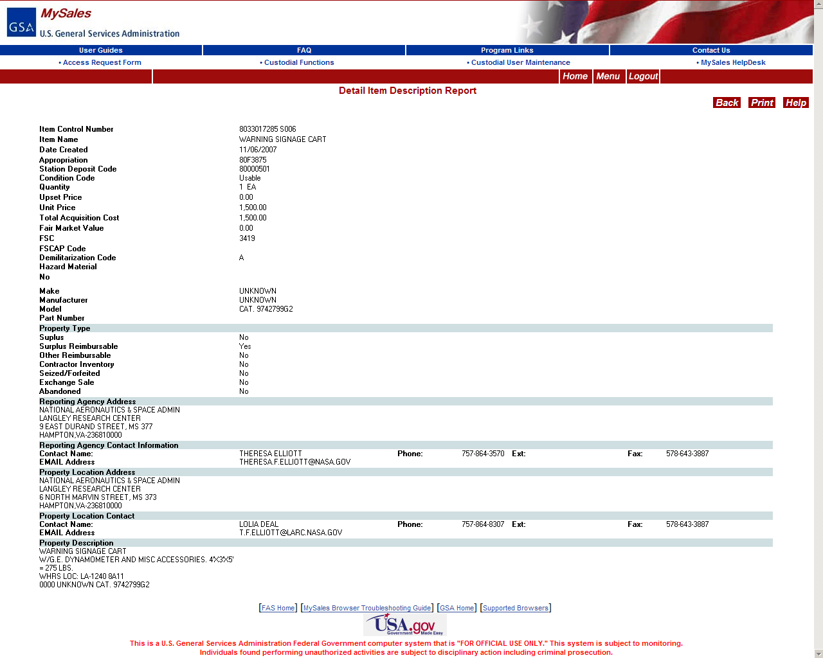
Detail Item page
Notes:
Will show all details about the item.

Slide 18

Withdraw Option
Notes:
Here is where you can withdraw your property from the sales process.

Slide 19
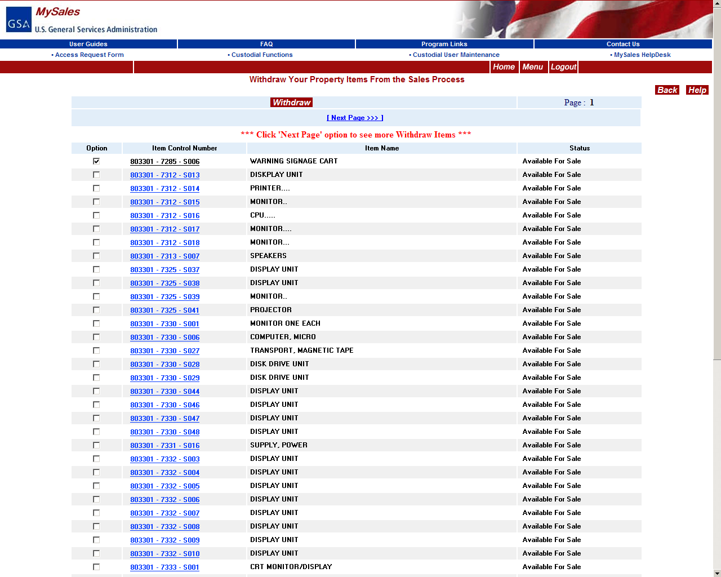
Select items to withdraw
Only AVAILABLE items
listed to withdraw
Notes:
Only the items that are available for sales will display and can be withdrawn; meaning items that have rolled over to sales from gsaxcess and have not been lotted or posted to a sale yet. You can not withdraw any items that have already begun the sales process, like being lotted to a sale or posted live on the sales website.

Slide 20
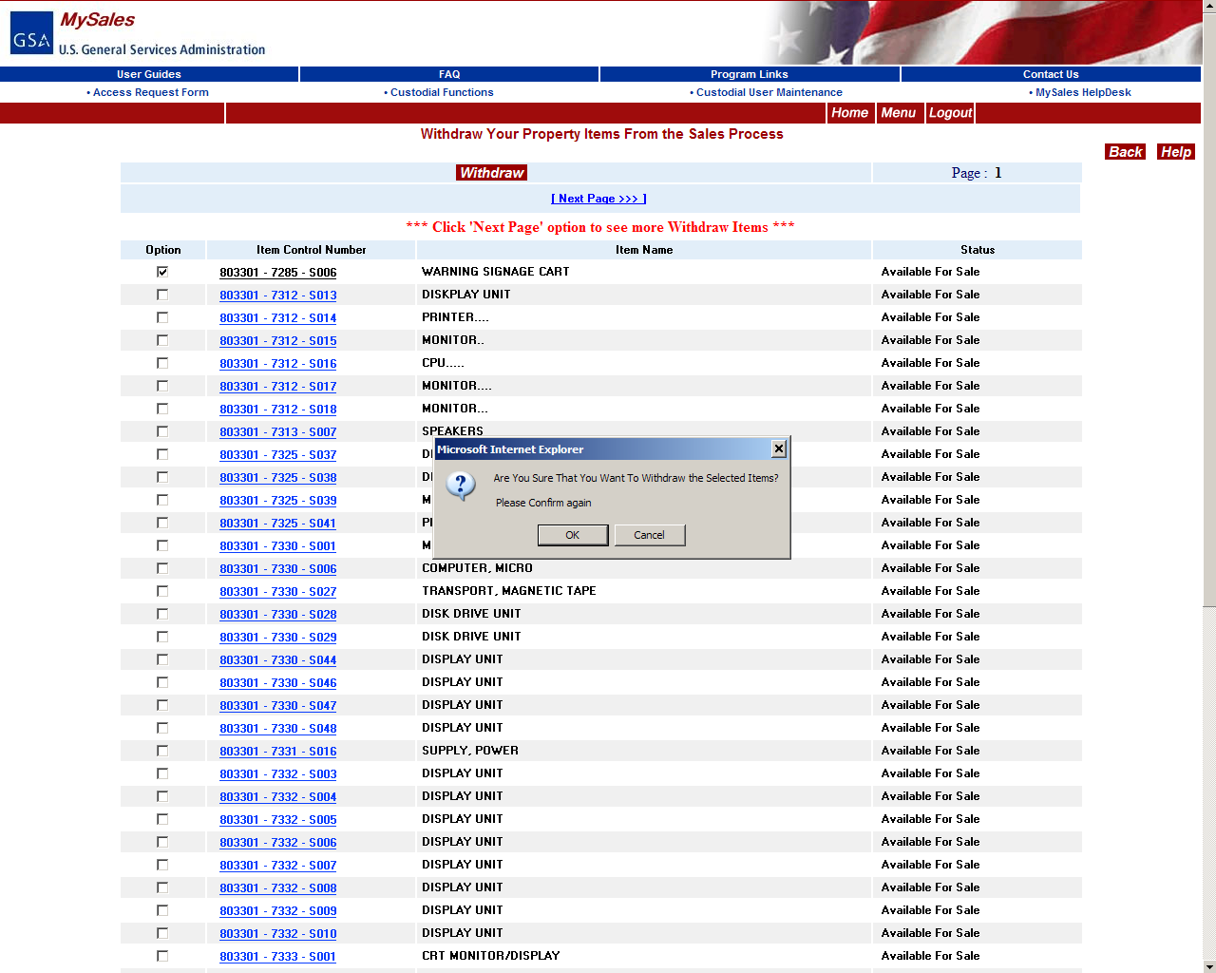
Confirm withdraw.
Notes:
Confirm that you want to withdraw this item from sales.

Slide 21
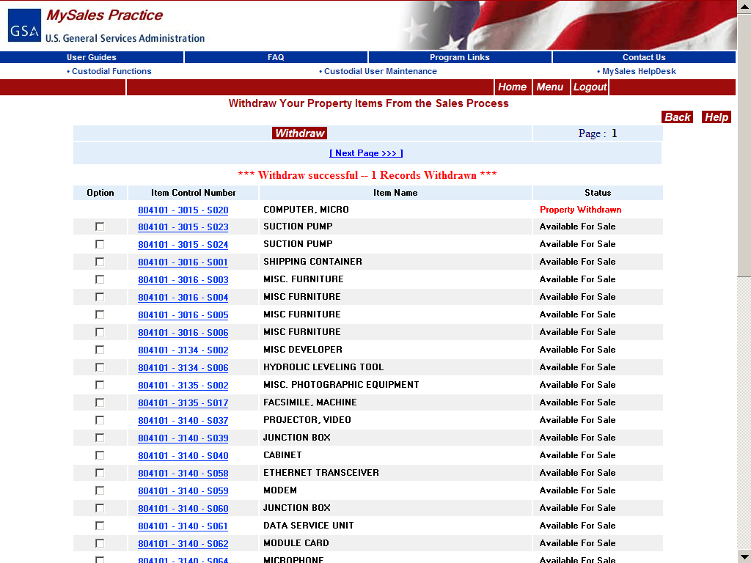
Confirmation
Notes:
Status will reflect that the item was withdrawn.

Slide 22
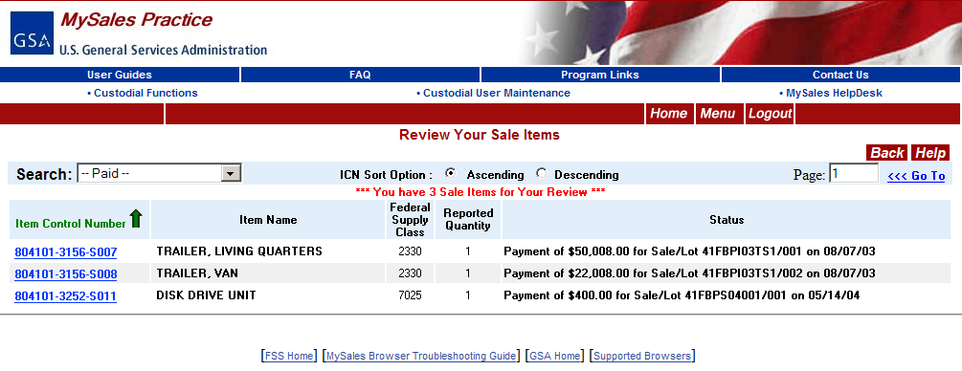
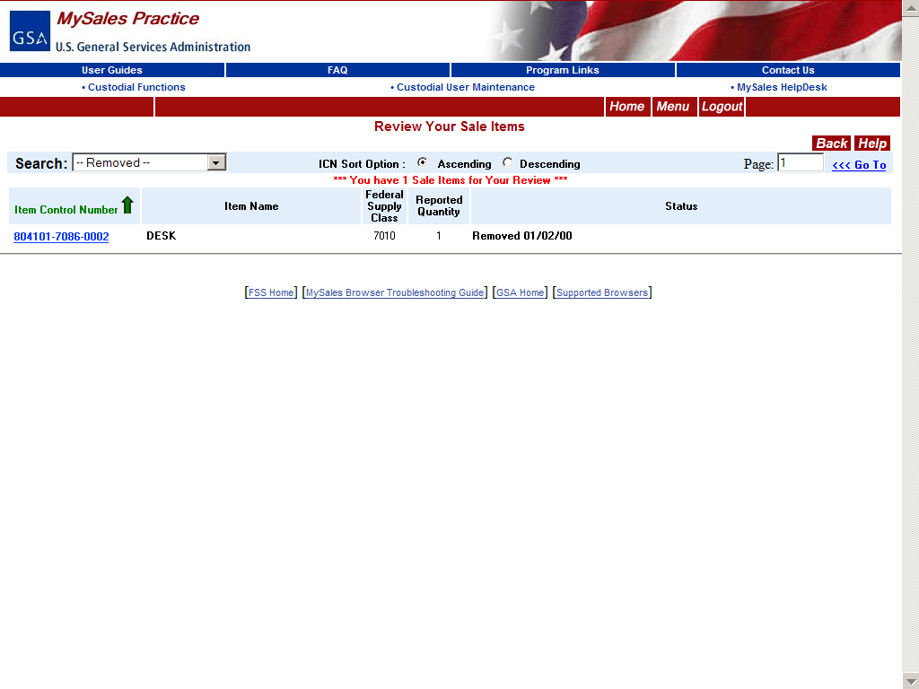
PAID
Ultimate Success of Disposal
REMOVED
Notes:
You can also search for paid and removed items and view details about payment and removal.

Slide 23

Questions???
Notes:
Any questions about mysales?

