Slide 1
Sale of Federal Property
Federal Acquisition Services
Personal Property Management

Slide 2
Laws and Regulations
Regulations that govern the sale of Personal Property
Federal Management Regulations (FMR)
  Subchapter B – Personal Property
    102-34 Motor Vehicle Management
      Subpart H – Disposal of Motor Vehicles
    102-38 Sale of Personal Property
    102-39 Replacement of Personal Property Pursuant to the Exchange/Sale Authority
    102-41 Disposition of Seized, Forfeited, Voluntarily Abandoned, and Unclaimed Personal Property

Slide 3
Laws and Regulations
United States Code (U.S.C)
  Title 40 U.S.C. 486 (c) Gives the Administrator of GSA the authority to prescribe and issue the FMR
Federal Acquisition Regulations (FAR)
  Establishes the Contracting Officer and Warrant Program

Slide 4
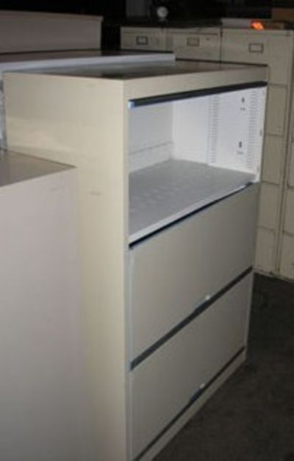
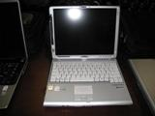
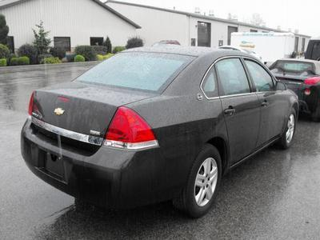
The Benefits of Property Sales
  Another disposal option for federal agencies.
  Opportunity for the taxpayer to purchase surplus property.
  Optimizes return to the US Government.
Notes:
Some benefits of selling used government property include additional disposal option; taxpayer benefits by getting surplus property at a great price and the government benefits by sell of surplus property.

Slide 5
Federal Asset Sales
Implementation
  All Executive Branch agencies:
    must use an approved Sales Center as their sales provider, or
    have an approved waiver.
Notes:
Explains who must use a Federal asset sales center; all federal agencies unless that agency has an approved waiver that allows them to sell their agency’s property.

Slide 6
Federal Asset Sales
Approved Personal Property Sales Centers
  General Services Administration--Federal Acquisition Service, Sales Program Division
  Department of Agriculture--Centralized Excess Property Operation
  Department of Justice--US Marshals Service
  Department of Treasury--Asset Forfeiture Division - IRS
  Department of Interior--Aviation Management Division
  Department of Defense--Defense Reutilization and Marketing Service
  GSA PBS Real Property Sales Centers
Notes:
These are the recognized and approved personal property sales centers that are allowed to sell govt surplus assets. All sales posted by these agencies can be accessed via govsales.gov

Slide 7
Approved Personal Property Sales Centers
Sales Center | Commodity | Sales Methods | Location
USDA | Personal Property | Live | DC Metro
DOI | Aircraft | Live/online | Nationwide
DOD | DOD Surplus | Live/online | Nationwide
Treasury | IRS Forfeiture | Live/online | Nationwide
Treasury | Vehicles | Live/online | Nationwide
USMS | Forfeited | Live/online | Nationwide
GSA | All Commodities | Online/Offline | Nationwide

Slide 8
Federal Asset Sales
GovSales.gov - Single Point of Entry for Citizens
  Linked to USA.gov
  Will display all government assets available for purchase
Encompasses:
  Real Property
  Personal Property
    Surplus
    Exchange/sale
    Forfeited
Notes:
Facts about govsales.gov; linked to usa.gov, can view all govt assets for sale, real and personal property.

Slide 9
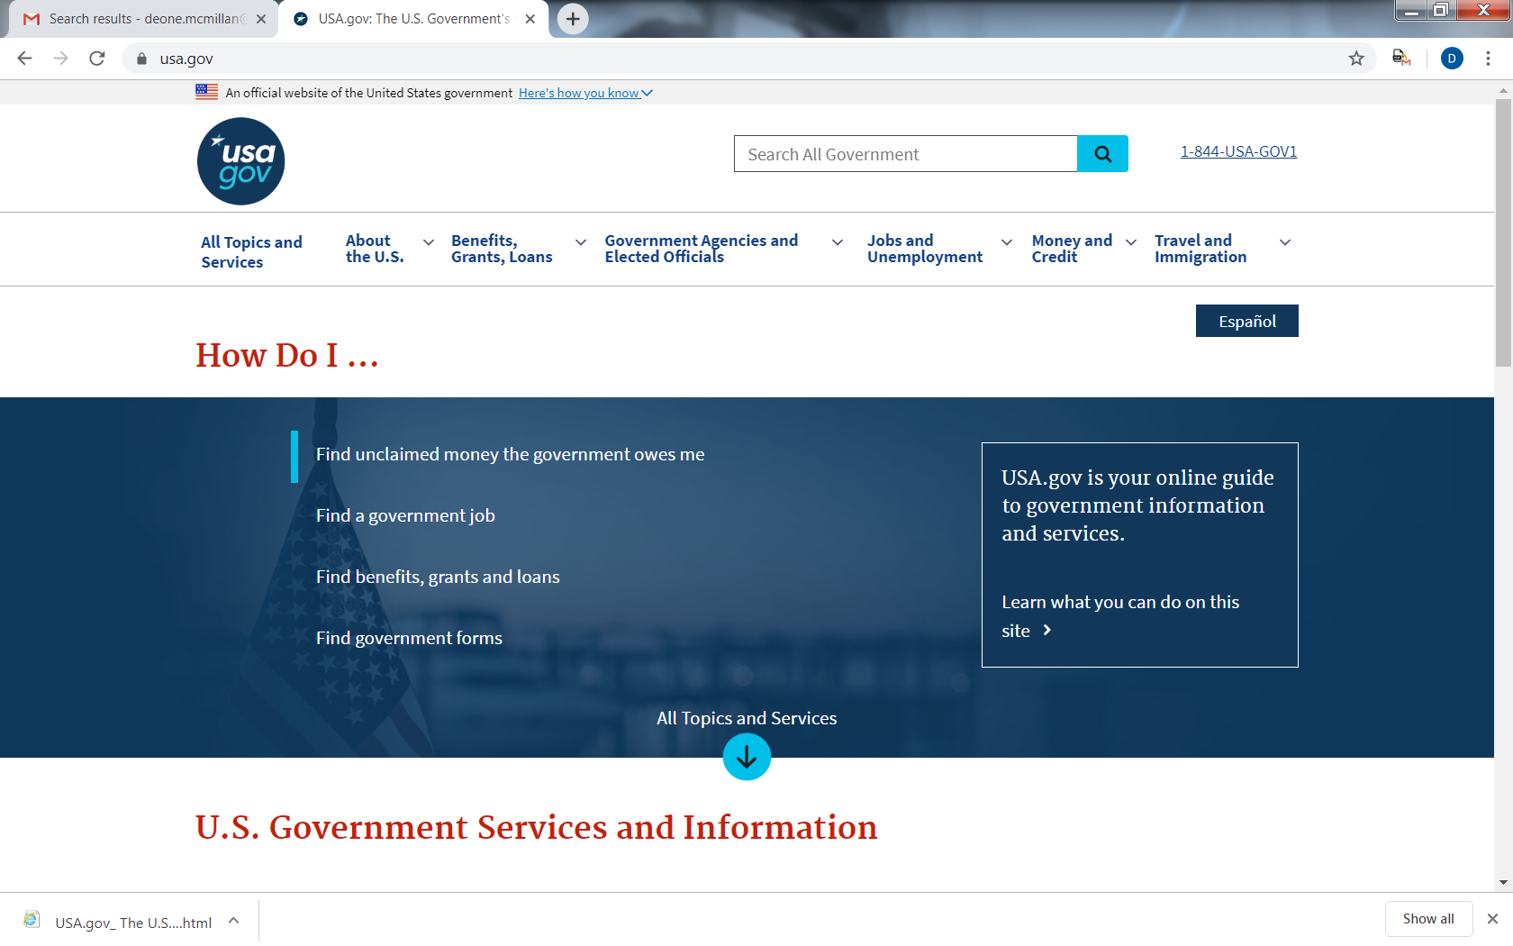

Slide 10
Federal Asset Sales
  GSA Auctions®
    Full Service Provider
    Online/Offline Sales
    All Commodities
    Nationwide Services
    Value Added Services
Notes:
Facts about gsaauctions.gov; full service provider, online sales, we sell all commodities, nationwide.

Slide 11
GSA Auctions®…a GovSales.gov
The GSA Auctions® Sales Center represents the entire breadth of the GSA personal property sales program including sales services for all commodities of personal property, through all authorized methods of sale such as:
GSA Auctions®
Sales Center
Internet
Auctions
Sealed
Bid
Spot
Bid
Live
Auctions
Drop
By
Fixed
Price
Negotiated
Notes:
Deone Slides 1 - 11

Slide 12
What is a Fixed Price Sale?
Methods of Sale
Fixed Price (Cash and Carry) - At fixed-price sales (also referred to as "Retail"), we post the selling prices on the property and sell the items on a first-come basis.

Slide 13
102-38.125—May we sell personal property at fixed prices to State agencies?
Methods of Sale
Yes, before offering to the public, you may offer the
property at fixed prices (through the State Agencies for
Surplus Property) to any States, territories,
possessions, political subdivisions thereof, or tax
supported agencies therein.

Slide 14
Fair Market Value
Fair Market Value to Federal Agencies
  Exchange sale property is acquired from one federal agency to another federal agency.
  Money usually is transferred from agency to agency by IPAC
  FMV’s are done on SF122’s.
Notes:
Delete

Slide 15
  Asset Sales Price (Exchange/Sale)
Low Range $ | High Range $ | Rate Per item
$0.01 | $500 | Award amount if less than $500
$500.01 | $1,000 | $500
$5,000.01 | $25,000.00 | 20% Proceeds
$25,000.01 | $50,000.00 | 17% Proceeds
$50,000.01 | $100,000.00 | 14% Proceeds
$100,000.01 | $150,000.00 | 11% of Proceeds
$150,000.01 | $250,000.00 | 8% of Proceeds
$250,000.01 | And Higher | 6% Proceeds
Note: GSA deducts its fees from the sales proceeds. Vehicle Sales $550.
Notes:
Update

Slide 16
Examples of Fee Structure
GSA conducts sales for various Federal agencies with fees
taken from sales proceeds.
Example of ladder -reported as exchange/sale
Sales price $40; Award amount under $500
Our minimum fee is $500 or award amount if below $500
No monies returned
Example of forklift- reported as exchange/sale
Sales price $610; Award amount between $0.01 and $500
Our fee is $500
Net proceeds returned to agency $110
Notes:
Update

Slide 17
What your agency’s fee to GSA pays for:
Basic Services Offered:
Asset lotting guidance
Sales preparation
Asset description and listing preparation assistance
Preparation of contract and award documents
Financial and property line item accountability
Contract administration
Collection and processing of bid deposits
Collection and deposit of proceeds
Distribution of proceeds
Great services at a great price!
Notes:
List of services offered included with agency’s fee for GSA to sell their surplus property.

Slide 18
What your agency’s fee to GSA pays for:
  On-line Sales
  Secure internet site
  Posting of items
  Posting of photos
  Featured items—listing and homepage
  Maintenance of registered bidders
  Electronic payment
  Automated closing
  Bid period extension
  Registration verification engine
  Collection of bid deposits
Notes:
Services provided for on-line sales include secure internet website, posting of items and photos, electronic payment, and collection of bids.

Slide 19

Savings to the Agency
No cashier
No on-site Contracting Officer
No additional cost for sale
site location
Reduces time and labor cost
Reduces storage fees
Notes:
Brian Slides 12 -19

Slide 20
Preparing to Report Property
You must determine…
  The Condition and Value of the Property:
      Abandonment and Destruction
      Report for Disposal
  The Property Type:
      Non-Reimbursable/Excess Surplus
      Reimbursable/Exchange Sale
  The Federal Supply Class (FSC):
      User Guide GSAXcess.gov

Slide 21
Condition Codes
1 New - Property which is in new condition or unused condition and can be used immediately without modifications or repairs.
4 Usable - Property which shows some wear, but can be used without significant repair.
7 Repairable - Property which is unusable in its current condition but can be economically repaired.
X Salvage - Property which has value in excess of its basic material content, but repair or rehabilitation is impractical and/or uneconomical.
S Scrap - Property which has no value except for its basic material content.

Slide 22
Describing Vehicles
When reporting vehicles for disposal you must provide the:
  Year of manufacture
  Make – Name of manufacture
  Model – Name of vehicle
  Body Style - Sedan (4 door), Coupe (2 door), Pickup, Truck, Cab/Chassis

Slide 23
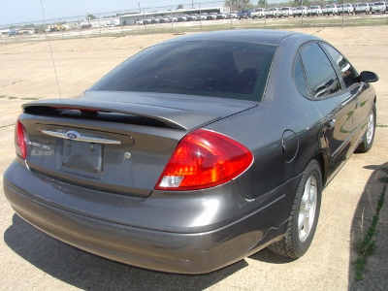
Describing Vehicles
  Vehicle Identification Number (VIN)
  Mileage (can be estimated)
  Number of Cylinders
  Fuel Type – Gasoline or Diesel
  Color

Slide 24
Describing Vehicles
Your description should also include:
  Number of Doors
  Transmission Type – Automatic (AT), Standard (ST)
  (can include 4 or 5 speed)
  Options List - Air Conditioning (AC), Power Steering (PS), Power Brakes (PB), Etc.
  Driveline – 4X2, 4X4, 6X6
  Tonnage – ¾ Ton, 2 Ton, 5 Ton
  License or ID Number

Slide 25
Describing Vehicles
Condition codes 7, S and X should include as much information as possible. All repairs and deficiencies should be listed.
  Is the vehicle operable or inoperable.
  Repairs list should include problems with:
    Mechanical – Engine, Transmission, Drive Train
    Electrical - Heat and Air, Power Options
    Cosmetic - Cracked Windshield, Paint, Interior
    Accident/Frame Damage (may require salvage title)
    Flood Damage (must be disclosed on title)

Slide 26
Describing Miscellaneous Property
Descriptions for miscellaneous property should include:
  Manufactures name
  Model number
  Serial Number/Part Number
  Quantity
  Other details such as color and size
  Condition of property should indicate any known repairs or deficiencies such as parts that are missing or broken.

Slide 27
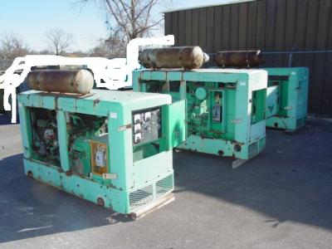
Describing Generators
Generator descriptions should include all the information required for miscellaneous property…
  Manufacture Name
  Model Number
  Serial Number
  Quantity
They will also include:
  Fuel Type – Gasoline, Diesel
  Kilowatts
  Hours

Slide 28
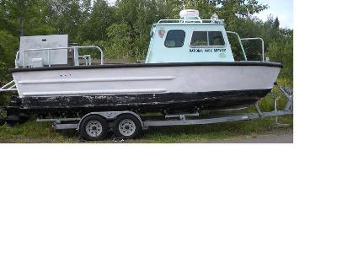
Describing Boats and Boat Motors
When reporting boats for disposal you will be required to provide:
Hull ID Number
Year
Manufacture/Make
Model
Body Style (such as pontoon or runabout)
Fuel Type
Number of Cylinders
This information is necessary for the Certificate to Obtain Title (SF97).

Slide 29
Describing Boats and Boat Motors
Your property descriptions should also include the:
Engine type (inboard or outboard)
Engine size
Length
Horse power
Number of hours on the engine
And trailer information if necessary
Some states require outboard boat motors to be titled.

Slide 30
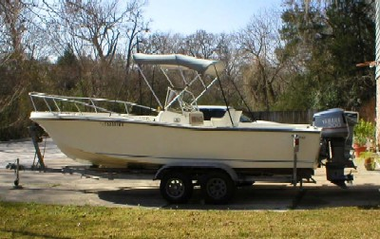
Agency Requirements:
Provide digital picture and detailed description
Provide Custodian for inspection and pickup
Coordinate with GSA on reserve/upset prices
Notes:
Adrian Slides 20 -30

Slide 31
Pictures
Providing pictures with your property report can make a big difference in the final selling price.
Your pictures should be detailed and clearly display…
  only items included in the disposal report
  any damage to property
Pictures can be edited before the sale if necessary.
Pictures entered in GSAXcess® are forwarded to sales.

Slide 32
Picture Quality
Lighting –
  Sufficient to show color and details.
  Avoid shadows.
Detail
  Fill the entire frame with the detail.
  Show the entire item plus sectional views.
Clutter
  Avoid background distractions.
  Use a plain colored fabric backdrop if possible.

Slide 33
Descriptions and Photos
Providing accurate and complete descriptions along with clear detailed pictures of your excess and surplus property will….
Ensure Maximum Return on Investment
Save you time
Limits Rejection/Claims

Slide 34

Custodial Duties
Provides the following:
  Contact information
  Property location
  Inspection dates and times
  Special requirements for removal
  Removal of agency and government ID tags
Available during inspection and removal periods
Accountable for the care and handling of property prior to its removal
GSA does the rest!!
Notes:
Things agency custodian needs to do to get items ready for sale; provide poc info, inspection dates/times, account for item before removal.

Slide 35
What can I expect after my property completes U&D screening?
Notes:
Explain process for property that completes u&d screening with no requests. Property is made available for sell to the public on online auction website. Item will transmit from gsaxcess.gov to SASy, our sales system.

Slide 36
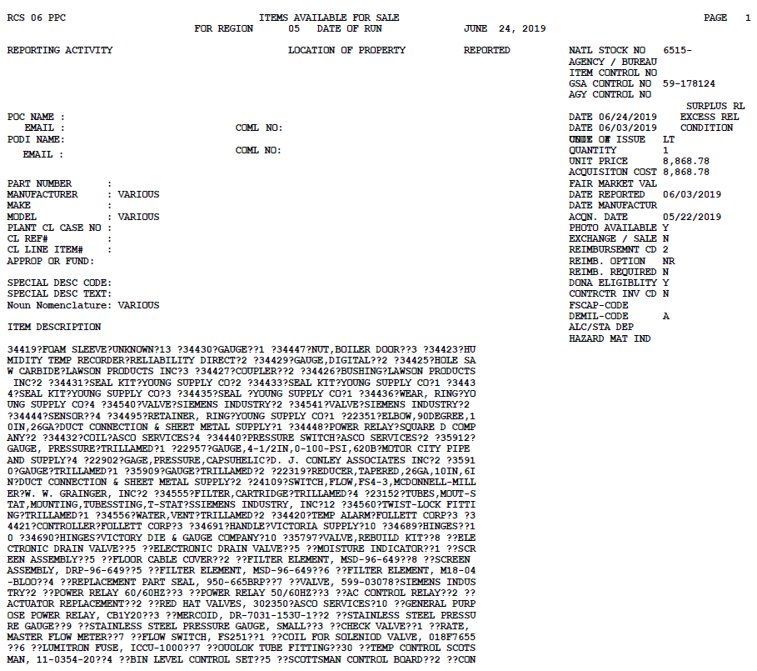

Slide 37
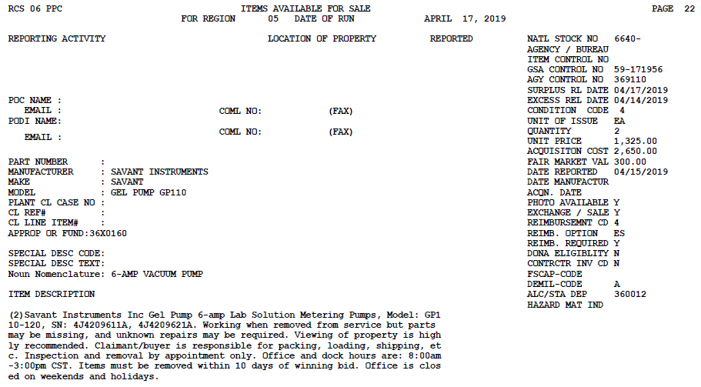

Slide 38
This lot consists of 2 each Savant Instruments Inc. Gel Pump 6-amp Lab Solution Metering Pumps, model# GP1 10-120, SN: 4J4209611A, 4J4209621A. Working when removed from service but parts may be missing, and unknown repairs may be required. Viewing of property is highly recommended. Claimant/buyer is responsible for packing, loading, shipping, etc. Inspection and removal by appointment only. Office and dock hours are: 8:00am -3:00pm CST. Office is closed on weekends and holidays.

Slide 39
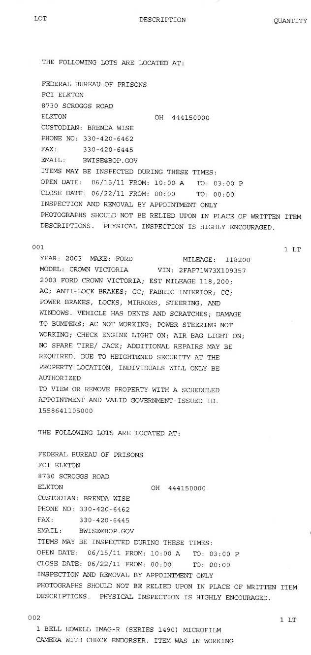
How to read the IFB
Custodian Contact Information
Sale Dates
Removal Information
Property Description
Next Lot of Property
Notes:
The IFB will tell you the custodian contact information, sale date, removal information, and property description. Custodian should read the IFB in entirety to check for accuracy and let the SCO know of any discrepancies before the item is placed online.

Slide 40
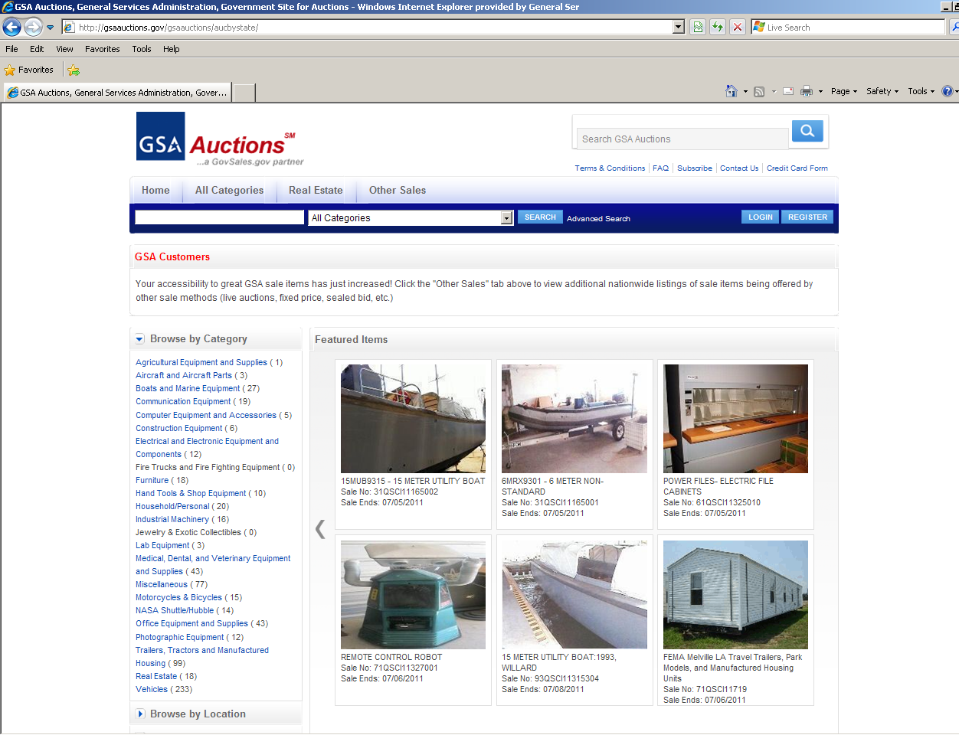
Homepage -gsaauctions.gov
Notes:
Joel 31- 40

Slide 41

Upset Prices/Time Frames
Reserve/Upset price is the lowest price the agency is willing to accept
If upset is not met (GSA will contact you with highest bid)
Our timeframes for online sales are usually 7 or 15 days
2 business days for payment
10 business days for removal
Notes:
explanation of upset prices and sales timeframes for online auctions.

Slide 42
Preferred Sales Method
www.gsaauctions.gov
How does it work?
  Registration & verification online
  Featured items
  Flat or Proxy bidding
  Overtime features
  Bid deposit option
  Online Payment
Notes:
Facts and benefits about how gsaauctions.gov works; online registration/verification, proxy bidding, bid deposit option and online payment.

Slide 43
Extensions
  Types of Extensions
  Bid Extensions
  Technical problems which interrupt the bidding process.
  Payment Extensions
  Payments over $3 million must be approved by the Attorney General.
  Removal Extensions
  Items that require special handling.

Slide 44
What Can I Expect to Receive if the Item Sells?
When an item sells a copy of the Purchaser’s Receipt will be sent via email at the time of payment to the custodian.
Upon pick up of the property, the custodian should have the bidder or shipping company sign the receipt for pick up, and fax this back to the GSA sales contracting officer.
Very Important!
Notes:
Things you should expect if the item does not sell

Slide 45
What can I expect if the bidder does not pay for or remove the property?
Notes:
What if the bidder doesn’t pay for or pick up the property? You should contact your SCO as soon as possible, do not let time pass before you notify your SCO that the bidder has not picked up the property.

Slide 46
Mis-Description/Property Not Available
ADR – Alternative Dispute Resolution
Issue Refund
Claims
Notes:
Mis-descriptions lead to Alternative Dispute Resolutions and Claims. ADR usually leads to Refunds.

Slide 47
What happens when an item does not sell?
When an item does not sell, the Sales Contracting Officer (SCO) will contact the owning agency’s property custodian to ask if a second attempt to sell is desired.
If the item does not sell after a couple of attempts, the SCO will provide a return letter or an email issuing local disposal authority to the owning agency point of contact.
Notes:
Brian 41 -47

Slide 48
Abandonment & Destruction
Property that has no value…. Normally, property reaches the abandonment and destruction stage only after utilization, donation, and sales efforts have produced no results thus demonstrating the property has no commercial value.
Notes:
Definition of abandonment and destruction.

Slide 49
Abandonment/Destruction – Donation and Public Notice
You may donate such property only to a public body without going through GSA (102-36.320)
You must provide public notice of intent to A/D personal property (102-36.325), except as provided in 102-36.330
Public Notice not required when:
  Value of property is so little or cost of care and handling is so great that its retention for advertising is not economical
  A/D is required because of health, safety, or security reasons
  Original acquisition cost is less than $500
Notes:
Explanation of A&D process, regulations. In lieu of A/D, the item can be donated to a public body only, abandoned in place if prior approval is given by building management or landlord, or destroyed in a safe manner.

Slide 50

Questions???
Notes:
Adrian 48 -50

