Slide 1
State-Managed Property Centers
Large Move Best Practices
Lisa Moghazy, CPPS

Slide 2
Agenda
State Managed Property Centers
Concept
How Does it Work?
When is it a Good Fit?
Pros and Cons
Participating SASPs
Large Move Best Practices
Plan Ahead
Coordinate with Stakeholders
Property Removal
Disposal Process and Timeline
Recap

Slide 3
State Managed Property Centers Concept
Some State Agencies for Surplus Property (SASPs) serve as Managed Property Centers assisting federal agencies with disposal of personal property.

Slide 4
State Managed Property Centers How Does it Work?
The SASP
Provides storage of federal excess property
Acts as property custodian during disposition
Coordinate inspections and removal of property
Federal Agency
Coordinates availability through GSA (contact your APO)
Reports property into GSAXcess or on SF-120
Transports property to SASP warehouse
Provides an accurate inventory of property

Slide 5
State Managed Property Centers When is it a Good Fit?
Who can use this option?
All federal agencies can utilize
All types of property accepted except
Hazmat
Scrap
Conducted in Coordination with GSA and SASP
When would an agency use this option?
Large move with short timeline
Large quantity of items excessed at once
Limited access / restricted storage area

Slide 6
State Managed Property Centers Pros and Cons
Pros
It’s FREE storage
One-stop / move all property at once
SASP coordinates inspections and pick-ups
Cons
Owning agency arranges and pays transportation
SASP may be far away
SASP may not have availability

Slide 7
State Managed Property Centers Participating SASPs
Alabama
Alaska
Arizona
Arkansas
Illinois
Kansas
Michigan
Minnesota
Mississippi
Missouri
Montana
Nebraska
North Dakota
Oregon
South Carolina
South Dakota
Tennessee
Texas
Washington

Slide 8
Before we proceed…

Slide 9
Agenda
Large Move Best Practices
Plan Ahead
Coordinate with Stakeholders
Property Removal
Disposal Process / Timeline
Recap

Slide 10
Large Move Best Practices Plan Ahead
Whether moving to a new location or vacating space always plan for the disposal of excess property.
Planning in advance helps to
keep you organized
avoid last minute removal costs or penalties
save taxpayer dollars by reutilizing unneeded property
Reach out to your APO!

Slide 11
Large Move Best Practices Communicate with Stakeholders
Know and communicate with your stakeholders
Agency tenants being moved
Agency’s real property office
GSA’s Public Building Service (PBS) and /or Landlord
Building Security / Loading Dock Attendant
Agency National Utilization Officer (NUO)
GSA Area Property Officer (APO)
Who else?

Slide 12
Large Move Best Practices Property Removal
Are elevators accessible? Padded?
What is the loading dock accessibility?
Dates and times
Are after hours pick ups possible? Required?
Cost for dock security?
Do security restrictions exist?
Is a certificate of insurance for the moving provider required?
Will pick-up of excess overlap with agency move?

Slide 13
Large Move Best Practices Disposal Process and Timeline
Determine your move date
What date can excess property removal begin?
What date must the building be cleared out?
Create inventory of excess property and take photos
Named to coordinate with each other
Pre-marketing applicable?
Consider lead time
Requires SF120
Transfer on SF122 or SF123
Consider State Managed Property Center
Requires upload into GSAXcess or SF120
Agency to move the property

Slide 14
Large Move Best Practices Disposal Process and Timeline
GSAXcess
Create Property Records
Is more staff needed? Additional training?
Internal screening (2 - 15 days)
Federal and State screening (14 - 21 days)
15 calendar days for removal
GSAauctions
Sales prep (7 days)
Public Sale (7 days)
Buyer payment / PU (10 business days)
Abandonment and Destruction
Unrequested / unsold property / buyer defaults
GSA Schedule 899 5 for removal
Donation in lieu of abandonment
Activity | Days
Internal screening | 2 - 15
GSAXcess screening (based on FSC) | 14 - 21
State Allocation | 1
Federal and State removal | 15
Auction Prep | 7
Public Sale | 7
Buyer payment and PU | 14
Disposition of unrequested / abandoned property | 2 - ?
Internal screening through transfer or donation | 1 - 52
Public auction | 32 - 64
Post auction A&D | 30 - 65+

Slide 15
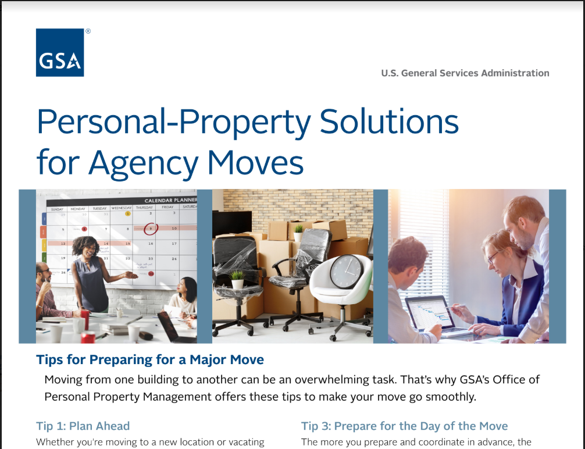
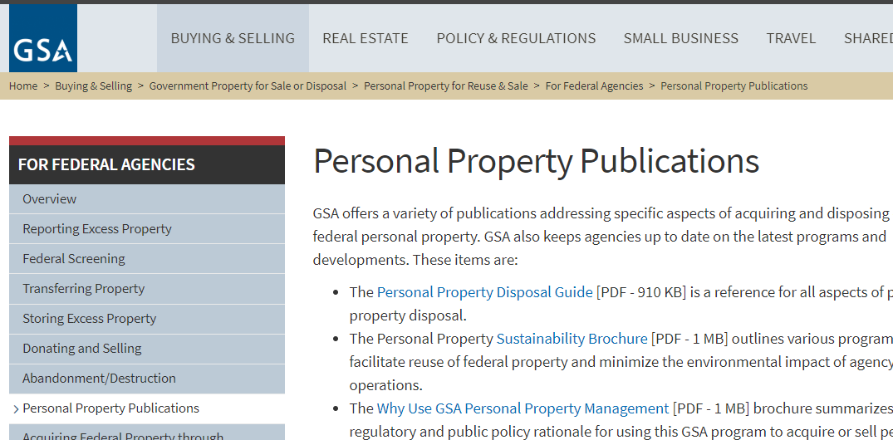
Slipsheet – Coming Soon!
https://www.gsa.gov/buying-selling/government-property-for-sale-or-disposal/personal-property-for-reuse-sale/for-federal-agencies/personal-property-publications
. . . or from the GSAXcess.gov homepage

Slide 16
Large Move Best Practices Recap
Plan Ahead
Communicate with stakeholders
Create your inventory and take photos
Know your move timeline
Review the excess property process
Reach out to your APO as soon as possible!

