Slide 1
CFL Functions
Notes:
Welcome to CFL Functions

Slide 2
The CFL program implements Executive Order (EO) 12999
“Educational Technology: Ensuring Opportunity for all Children in the Next Century.” EO 12999 directs federal agencies to give “highest preference to schools and nonprofit organizations in the transfer of educationally useful federal equipment.”

Slide 3
computersforlearning.gov
Notes:
This is what schools see. The CFL homepage is where schools and educational non-profits can find out everything they need to know about CFL. The Executive Order, eligibility requirements, FAQ’s, and instructional documents are all located on this page. A school or education non-profit can register and login to view all available federal computer equipment throughout the nation.

Slide 4
computersforlearning.gov
Notes:
Registration is simple. A school or educational non-profit can register by clicking “Register” on the right side of the page.

Slide 5
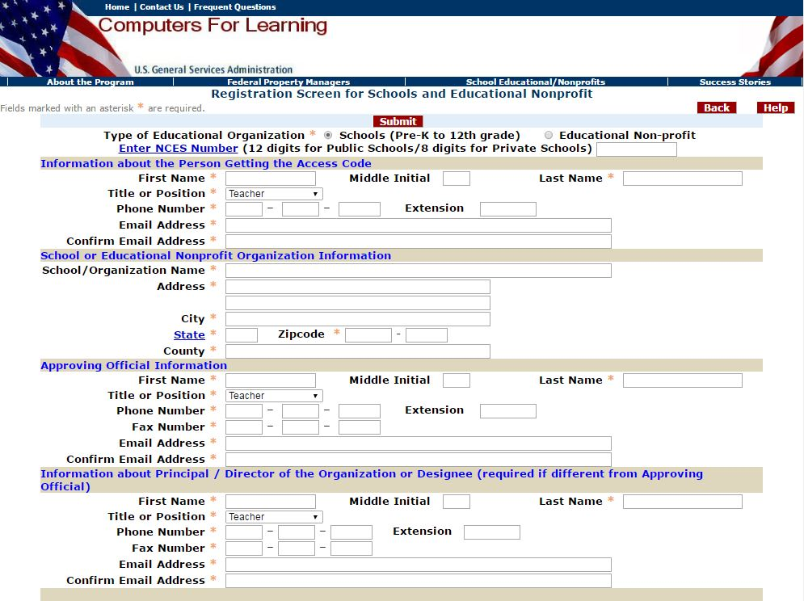
CFL School Registration
Schools must have a valid NCES number that matches the NCES database in GSAXcess®
Notes:
To register, a school must have a valid National Center for Educational Statistics (NCES) number. The input field will vary depending on which radial dial is selected (school or educational non-profit).

Slide 6
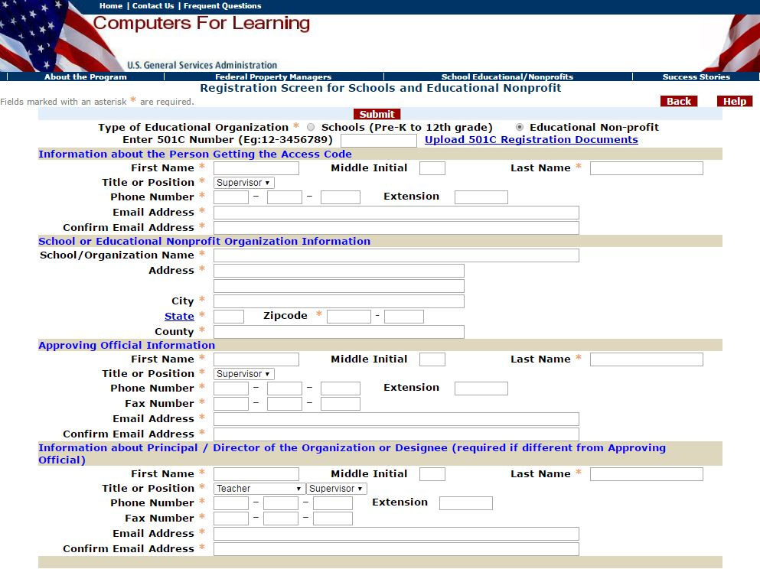
CFL Non-Profit Registration
Educational non-profits will not be allowed to register unless they upload a valid 501 (C) document
Notes:
To register, an educational non-profit must have a valid 501 (C) Tax Identification number. The non-profit must also upload their IRS Tax Exemption letter. The input field will vary depending on which radial dial is selected (school or educational non-profit).

Slide 7
Note: CFL is not managed by GSA. GSA hosts the www.computersforlearning.gov website which aims to facilitate transfers between federal agencies and eligible recipients. It is each agency's responsibility to verify eligibility and make allocation determinations.

Slide 8
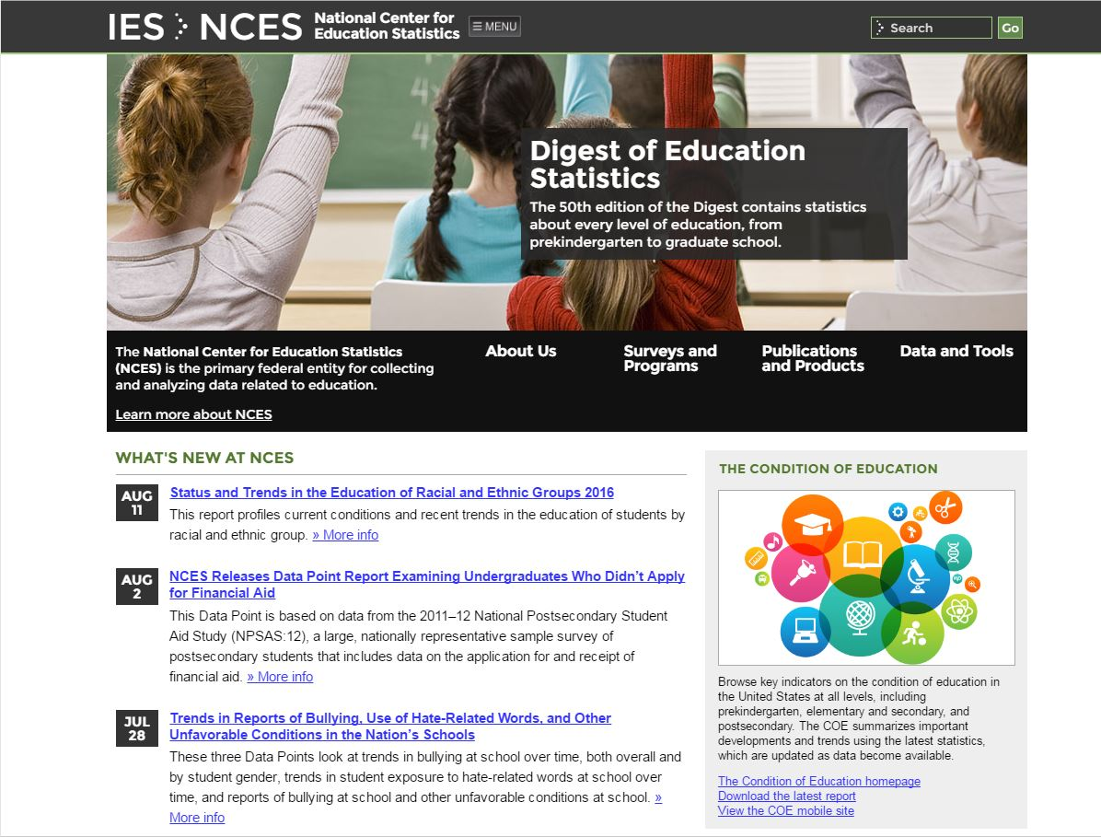
Nces.ed.gov
Website resource for Property Managers to verify registration accuracy, http://nces.ed.gov, click on Data and Tools to search
Notes:
The Department of Education’s National Center for Educational Statistics website is a resource where Agency CFL allocators can verify the status of a school and view information such as demographic info.

Slide 9
NCES School Search
Notes:
You can perform a search of all public and private schools on the Data Tools page.

Slide 10
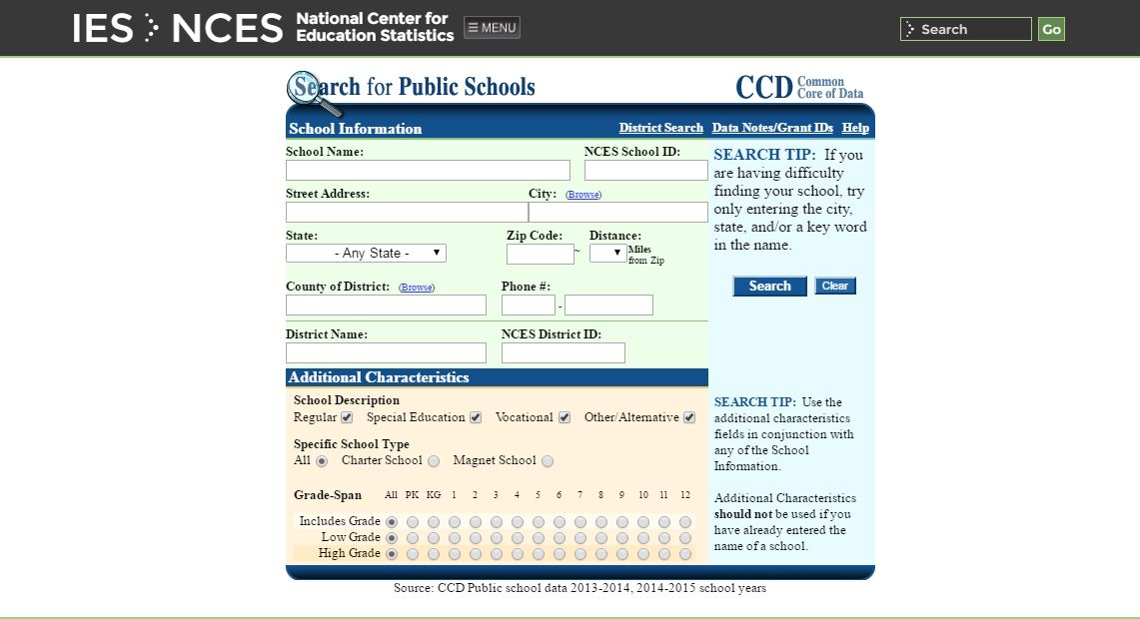
NCES School Search
Enter Criteria and
Click Search
Notes:
Enter the school criteria and click “Search”.

Slide 11
NCES Number
Notes:
Click on the hypertext school name for additional information.

Slide 12
School Information
Demographic info
Notes:
Current data regarding demographics are displayed.

Slide 13
NCES Number
NCES Number
Displayed
Lunch Assistance
Student to
Teacher Ratio
Notes:
The NCES is displayed along with any District ID numbers. You can also find the Student-to-Teacher ratio and students eligible for Lunch Assistance.

Slide 14
CFL School Registration
Questions to help the Property Manager make an allocation decision
Notes:
To register, schools and Educational Non-profits must answer specific questions that help make the allocation process easier.

Slide 15
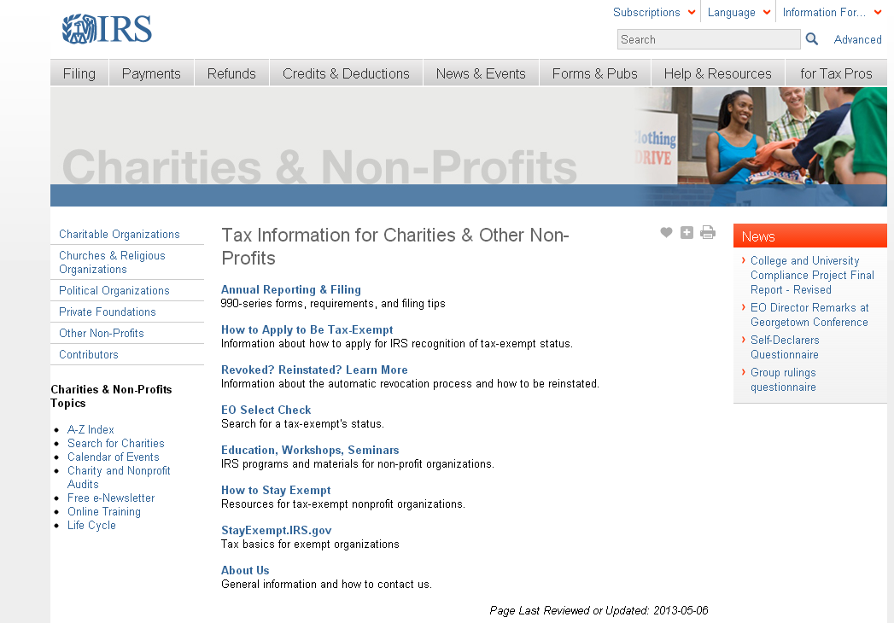
IRS 501 (C) – irs.gov/Charities-&-Non-Profits
Resource To Verify
501 (C) Status
at www.irs.gov
Notes:
To help verify authenticity of an Educational Non-profit, you can go to irs.gov and look up the organizations 501 (C) information. The organization can also do this so there is no reason that they can not produce this document. GSAXcess/CFL requires that all educational non-profits upload their 501 (C) document in order to register, thus enabling faster viewing of documents and faster transfer.

Slide 16
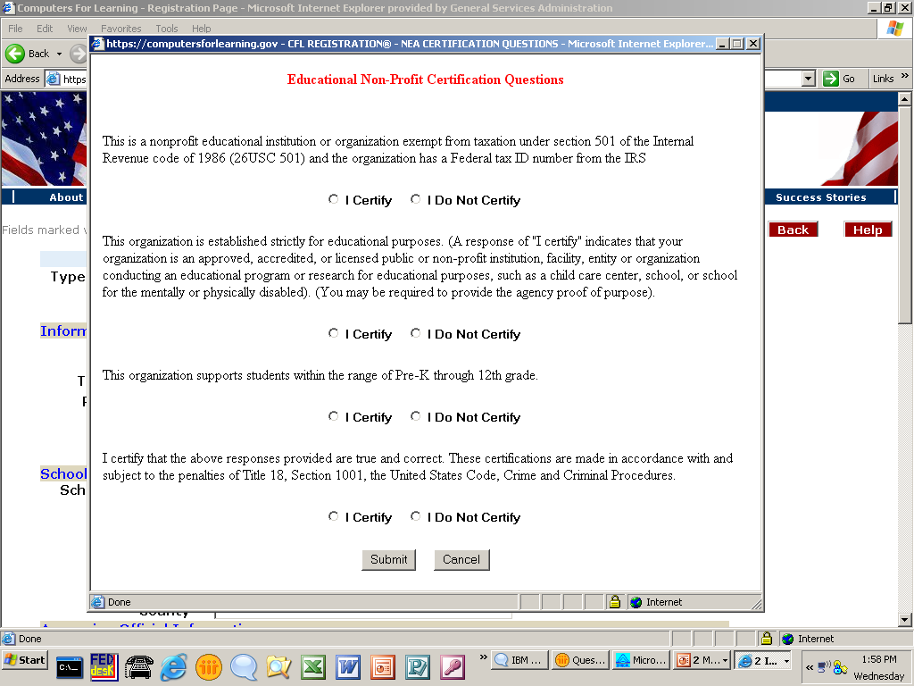
CFL Non-Profit Certification Questions
Non-profit organizations certify under penalty of law
Notes:
If the Educational Non-Profit does not select “I Certify” on every question, they are not permitted to register.

Slide 17
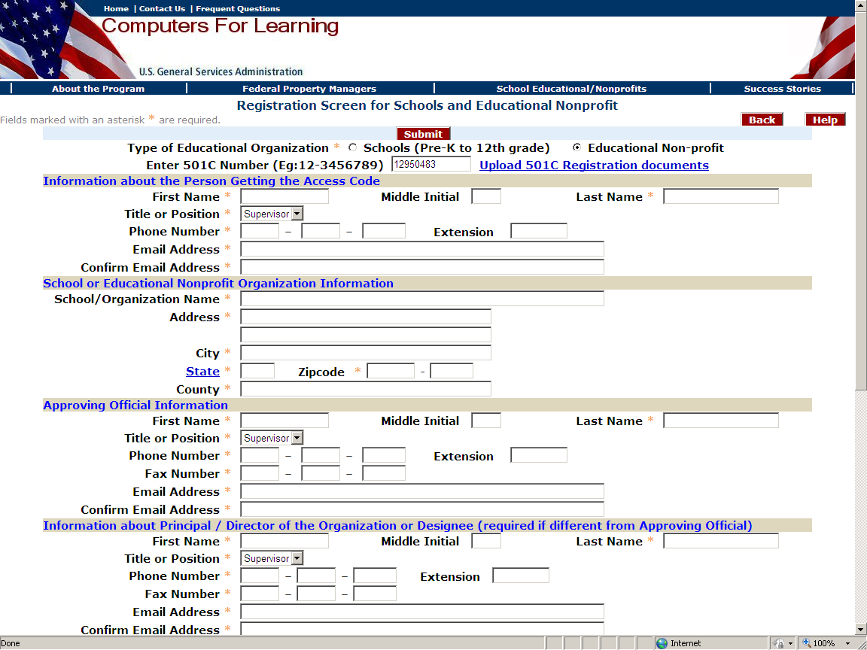
CFL Non-Profit Certification Questions
Non-profit organizations MUST upload their current 501 (C) to register
Notes:
If the Educational Non-Profit does not upload their 501 (C) document issued by the IRS, they will not be permitted to register. In addition to the 501(C) document, the registrant may upload documents which may help federal agencies to evaluate the nonprofit’s eligibility (license, certification, or acknowledgement from local, state or federal government).

Slide 18
VALIDATION
SCHOOL:
Valid NCES number
Must serve grades Pre-K through 12th
U.S. students
Notes:
Even with all the safeguards in the CFL system, sometimes unqualified registrants can find a way to manipulate the system. Therefore, the above guidance is to help protect your Agency when allocating computer equipment.

Slide 19
VALIDATION
EDUCATIONAL NON-PROFIT:
Must have a 501 (C)
AND their primary business must be education
Must serve grades Pre-K through 12
U.S. Students
Should have a license, certification, or
acknowledgement from local, state or federal
government
Notes:
Even with all the safeguards in the CFL system, sometimes unqualified registrants find a way to manipulate the system. Therefore, the above guidance is to help protect your Agency when allocating computer equipment.

Slide 20
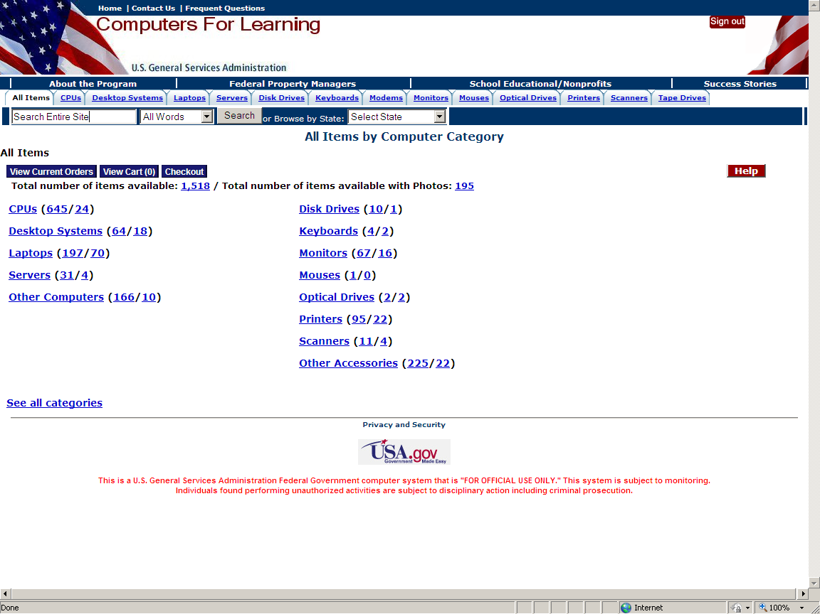
CFL Selection Screen – What Schools See
Property Manager Enters CFL Property Reports in GSAXcess®; Schools see it immediately on the CFL Website
Notes:
When the property manager enters reports into GSAXcess and selects CFL, once the report is submitted, it is viewable by the School in CFL as shown above. It is also viewable in GSAXcess/CFL for the property manager.

Slide 21
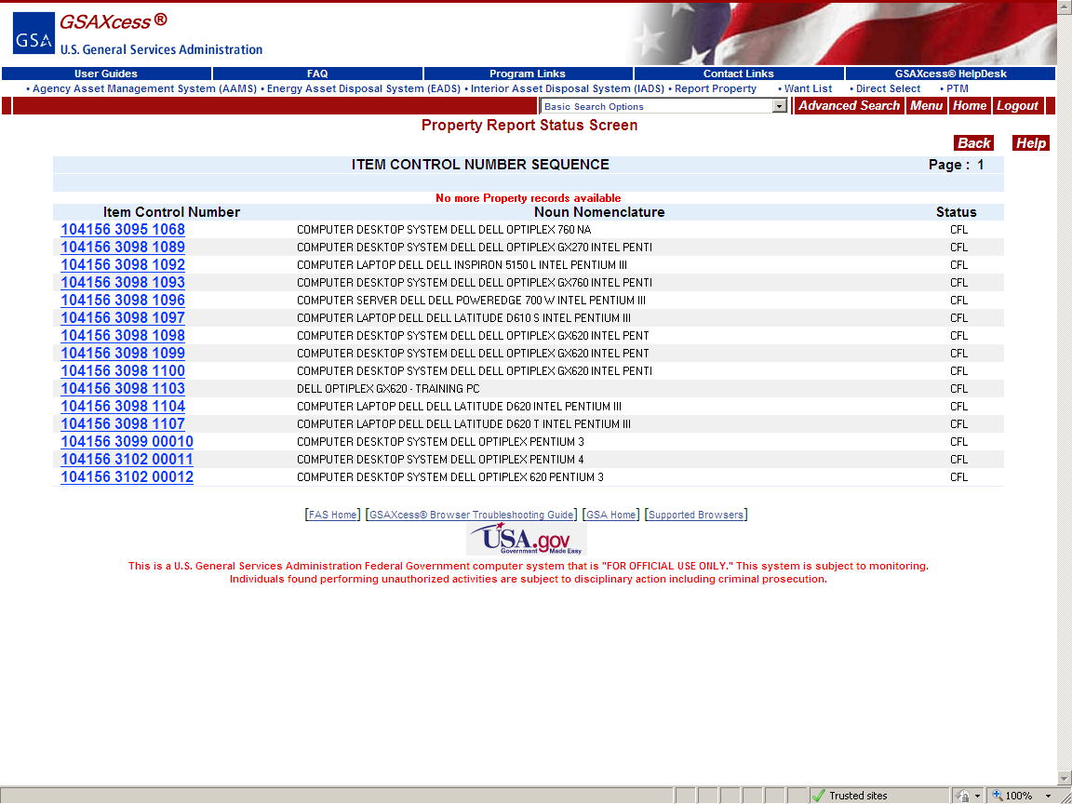
Entered in GSAXcess®
Notes:
View in GSAXcess for the property manager.

Slide 22
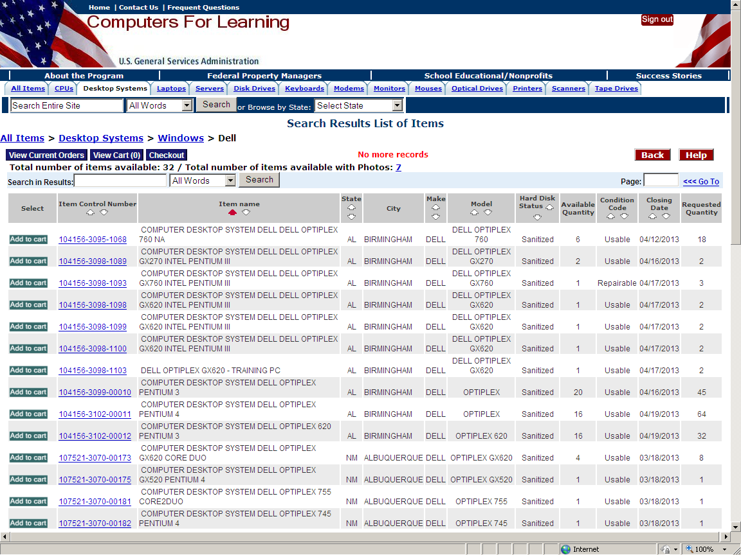
Immediately Visible in CFL
Notes:
View in CFL for the schools.

Slide 23
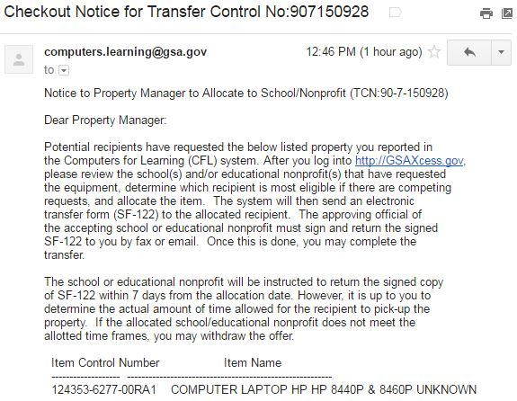
Property Manager Notification
The agency Property Manager will receive an email alerting them to school interest
Notes:
Once an item has been selected by a school or educational non-profit, the reporter of the property will receive notification that a school or educational non-profit has indicated interest.

Slide 24
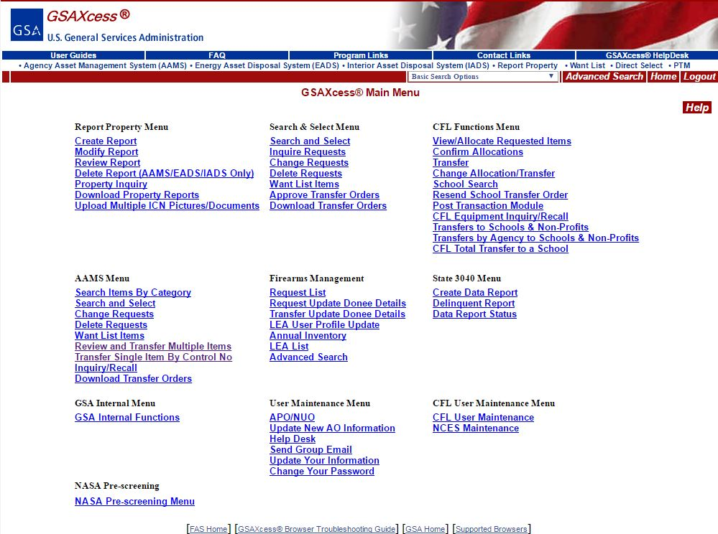
Property Managers - View/Allocate Requested Items
Property Manager must log into GSAXcess® to utilize CFL functions
Notes:
To begin the allocation process, the property manager must log into GSAXcess and go to the CFL Functions Menu. The first step is to allocate or choose which school or educational non-profit will receive the property. To view all the interested parties, click on View/Allocate Requested Items.

Slide 25
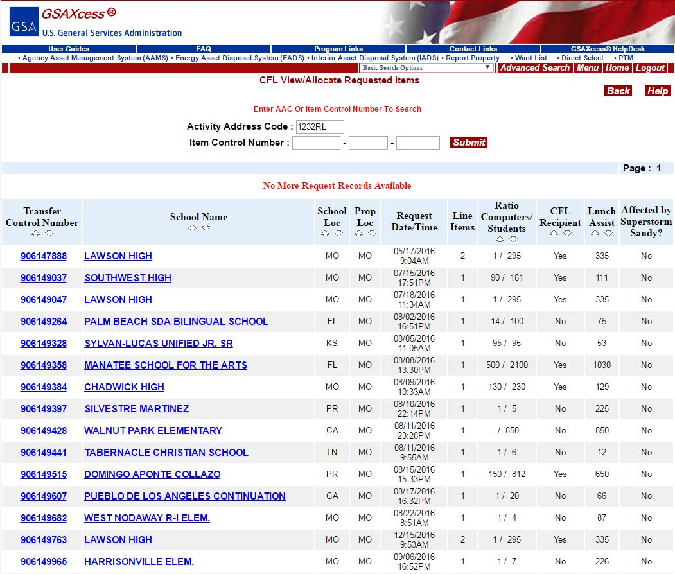
View/Allocate Requested Items
By clicking on the blue hypertext, you see additional information and can perform transfers of computer equipment. The hypertext changes colors once you have clicked on it.
Notes:
The reporter’s Activity Address Code (AAC) will display. All items that have been selected by schools or educational non-profits will display by Transfer Control Number (TCN) and school name. The system displays other pertinent allocation information such as: Request date/time, Recipient Type, Lunch Assistance, Ratio of Computers to Students, Location, School Location, etc.

Slide 26
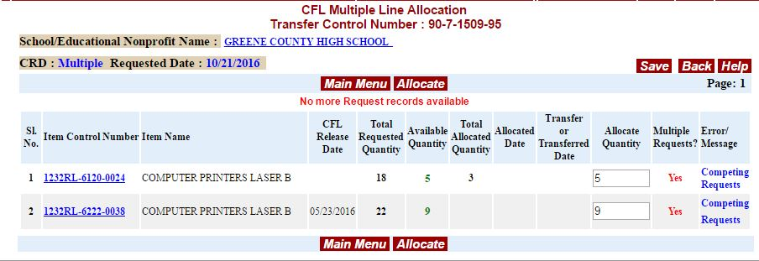
View/Allocate Requested Items by Transfer Control Number
Notes:
By clicking the transfer control number, the allocator sees the actual items and quantity requested. If there are other interested parties in this property, in the message column it will display a “Competing Requests” message. The total requested quantity is displayed versus what is available to further indicate competition. At any time you can return to the Main Menu by clicking the red Main Menu button or you can begin the allocation process by clicking on the red Allocate button.

Slide 27
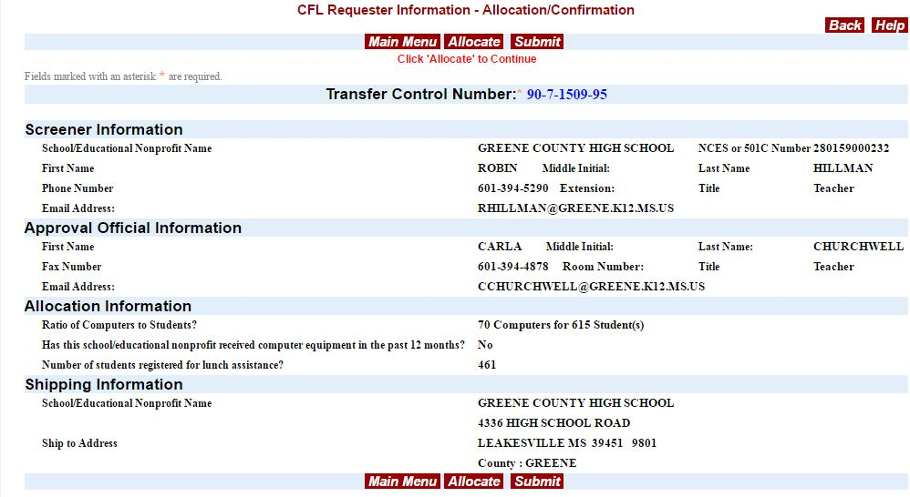
View/Allocate Requested Items by School Name
Notes:
When you click on the School hypertext from any screen, you see all the school and approver information.

Slide 28
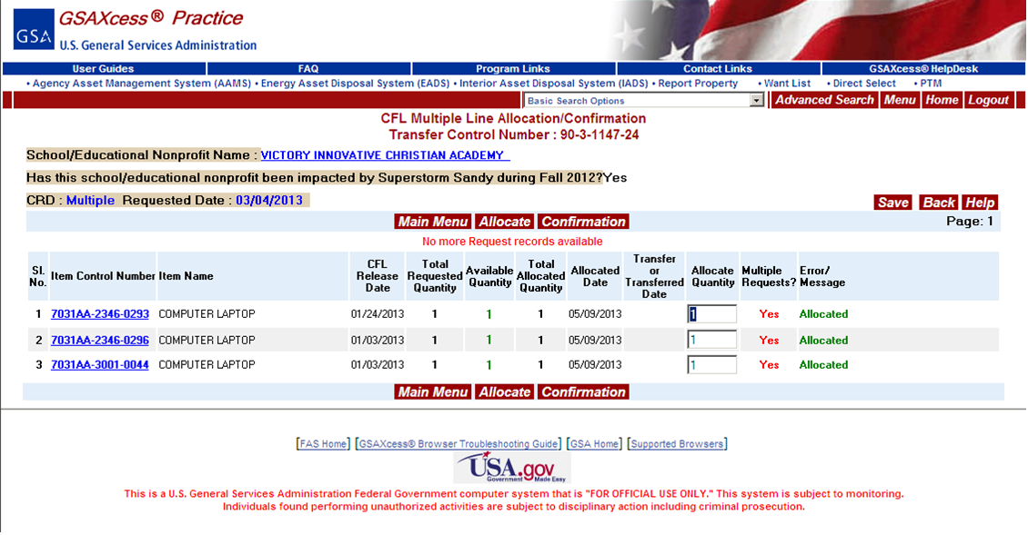
Allocation Confirmation
Whenever you see this Confirmation button, you can Confirm your allocation from the same screen
Notes:
Once it says Allocated in the message column, you need to click the red Confirmation button to complete the Allocation.

Slide 29
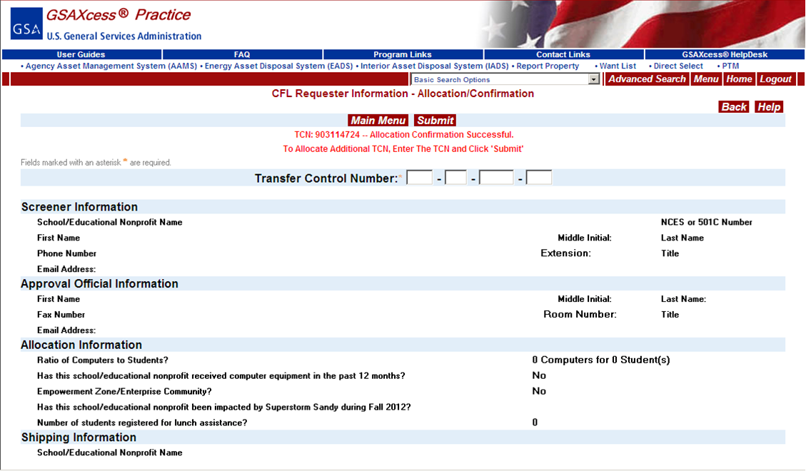
Confirmation Allocation
Notes:
You will see this message upon successful allocation.

Slide 30
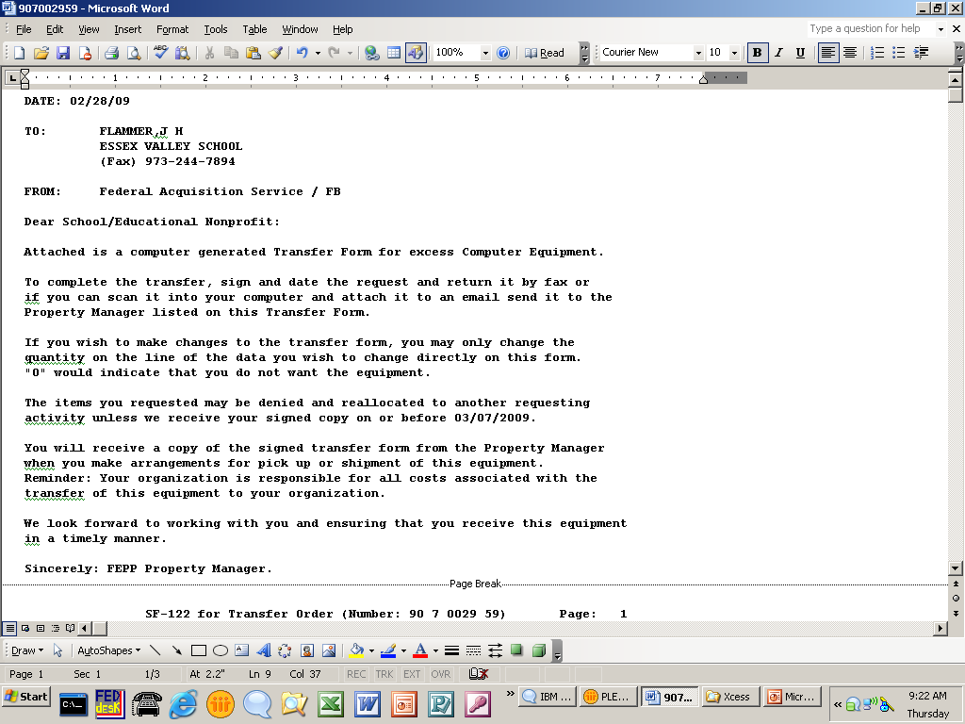
Transfer Order
Schools receive an email after allocation and confirmation.
Notes:
The school will receive an email similar to the example explaining the next steps and who to contact.

Slide 31
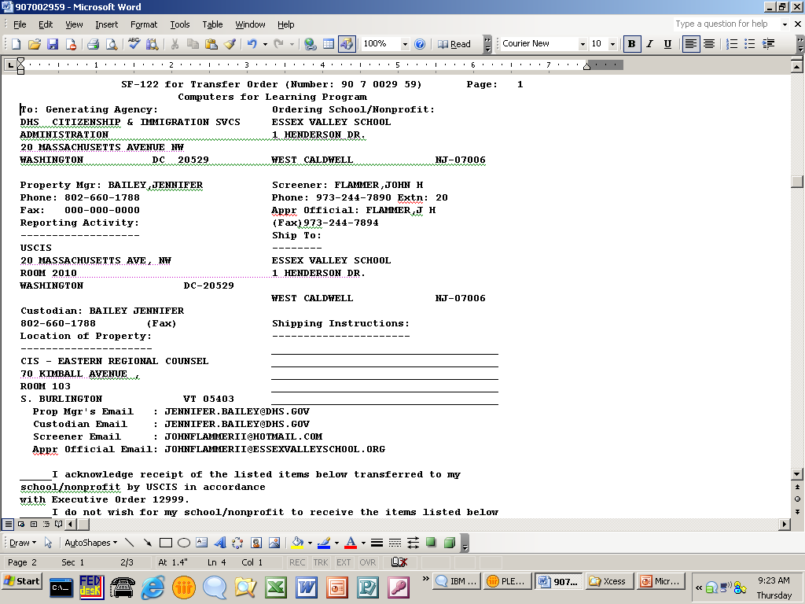
Transfer Order
Transfer Order
Notes:
SF-122 details and contact info.

Slide 32
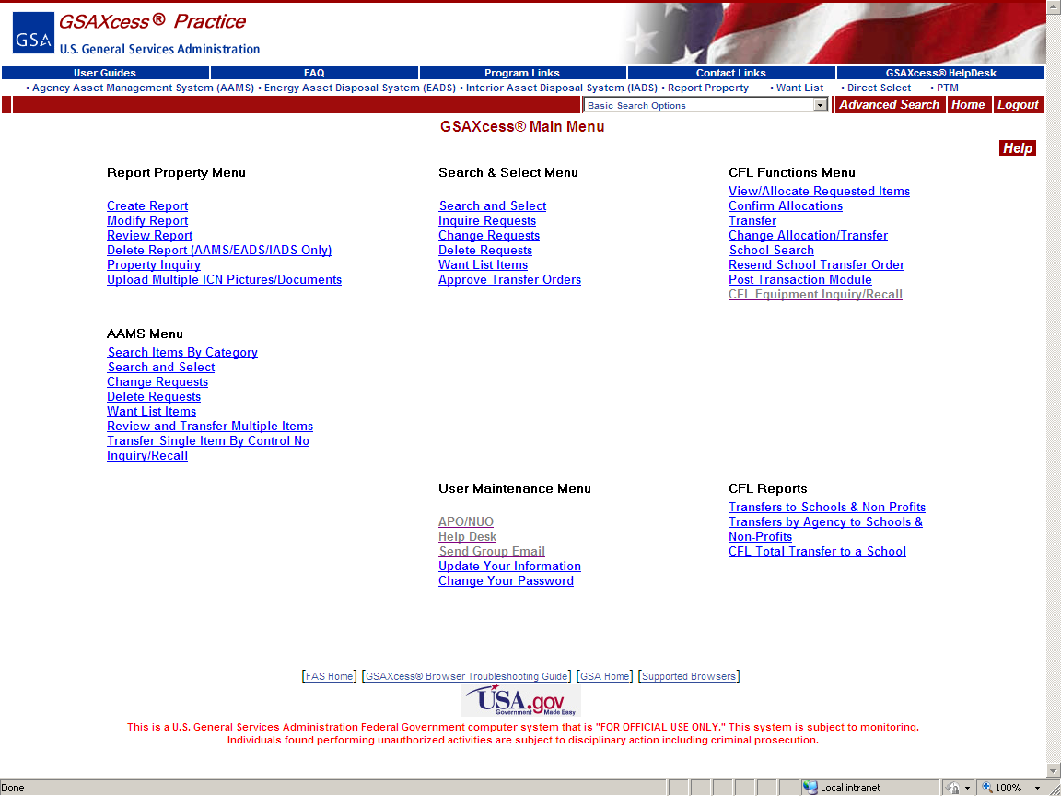
Transfer Requested Items
The transaction is not complete until the
School or educational non-profit picks up the
Property and you go into the CFL Functions
Menu to the Transfer function and select
Transfer.
Notes:
Once the school or educational non-profit has the property, complete the final step in the transfer process and notify the system that the property has been transferred by going to the Transfer function.

Slide 33
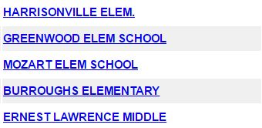
Transfer Requested Items
Click on the Transfer Control Number that
you want to transfer
Notes:
Any items that have not been completed will display in the Transfer function for your Activity.

Slide 34
Transfer Requested Items
The Transfer screen displays. Make any
adjustments as needed and click the red
Transfer button.
Notes:
Make any adjustments as needed and then click the red Transfer button to complete the transaction.

Slide 35
Transfer Requested Items
The system displays a confirmation message.
You can only change your transfer information
the day of the transfer action. If you transfer
before pick-up and the organization changes
their mind, you will need to contact your
GSA Area Property Officer for assistance.
Notes:
1 Item Transferred confirmation message displays. At this point, you can still zero out the amount in order to deny the transfer.

Slide 36
QUESTIONS?
Notes:
If you have questions, contact CFL Staff by email: Computers.Learning@gsa.gov or by phone: (866) 333-7472, Option 2.

