Slide 1
PICTURES
Kenya Crosson
Senior Property Disposal Specialist
Personal Property Management

Slide 2
“When words become unclear, I shall focus with photographs. When images become inadequate, I shall be content with silence.”
- Ansel Adams

Slide 3
FMR B-14
Use of Photographs When
Reporting Property for Disposal
Purpose: Guides Federal agencies in the use of photographs when reporting excess property and selling excess property.
Result: Plan for photographs or digital images of excess property in compliance with FMR B-14

Slide 4
Picture Criteria
Property reported for utilization or sale meeting.
The following criteria has a requirement to link informative and good quality photographs to the property.
Property at or above the agency financial accountability threshold; or
Property in specific Federal Supply Groups (FSG) or Federal Supply
Classes with an original acquisition cost of $300.00 or greater.

Slide 5
Specific FSG/FSC
Group 19 ~ Ships, Small Craft, Pontoons, and Floating Docks
Group 23 ~ Ground Effect Vehicles, Motor Vehicles, Trailers and Cycles
Group 24 ~ Tractors
Group 34 ~ Metalworking Machinery
Group 38~ Construction, Mining, Excavating, and Highway Maintenance
Equipment

Slide 6
Specific FSG/FSC (continue)
Group 39 ~ Materials Handling Equipment
Group 42 ~ Firefighting, Rescue, and Safety Equipment; Environmental
Protection Equipment and Materials
Group 54 ~ Prefabricated Structures and Scaffolding
Class 6115 ~ Generators, Generator Sets and Electrical Items
Class 6515 ~ Medical and Surgical Instruments Equipment Supplies

Slide 7
Picture Criteria
Type ~ Digital or Scanned
Format ~ Jpg, Joint Photographic Experts Group (JPEG)
Size ~ Rectangular Format 600 X 400 Pixels
Thumbnails ~ 11 thumbnails 70 X 70 pixels showing different views of the items will be displayed on the same screen
Quantity ~ No more than 12 photographs per Item Control Number (ICN)

Slide 9
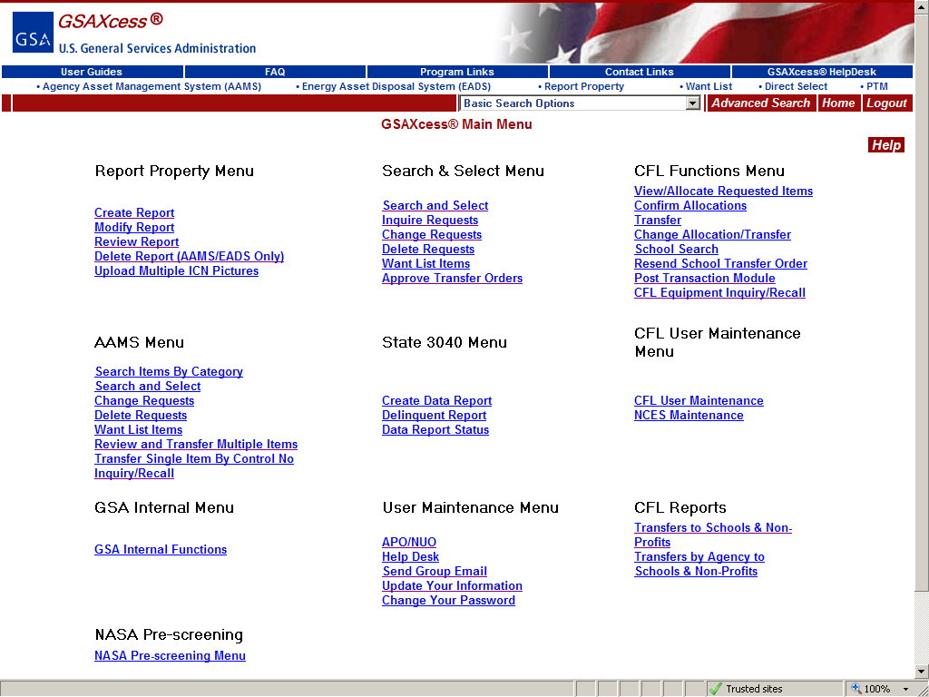
There are 3 Methods for Uploading Pictures
Method #1 Click on the Main Menu button at the top of the GSAXcess Page.
Method #2 and 3 are done from the Create or modify Report Screen.

Slide 10
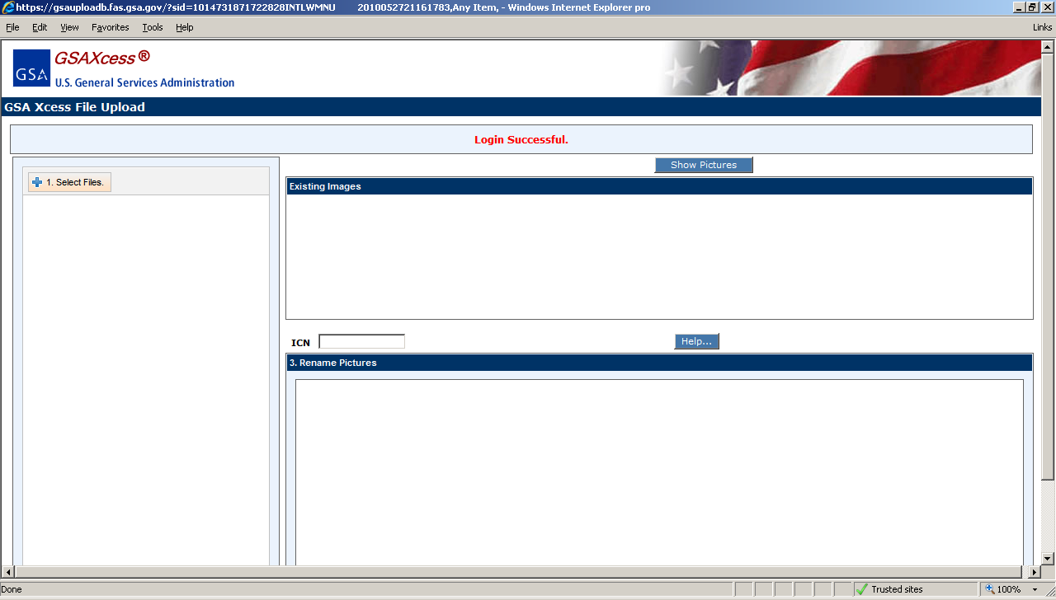

Slide 12
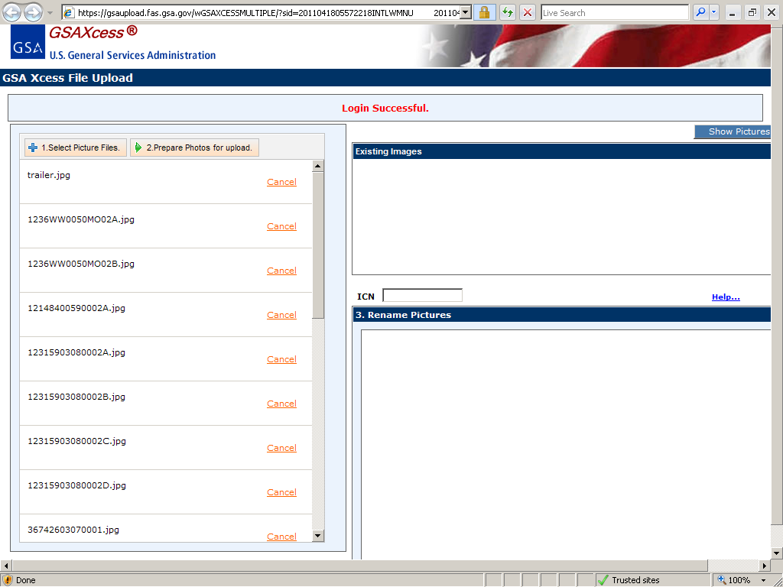

Slide 14
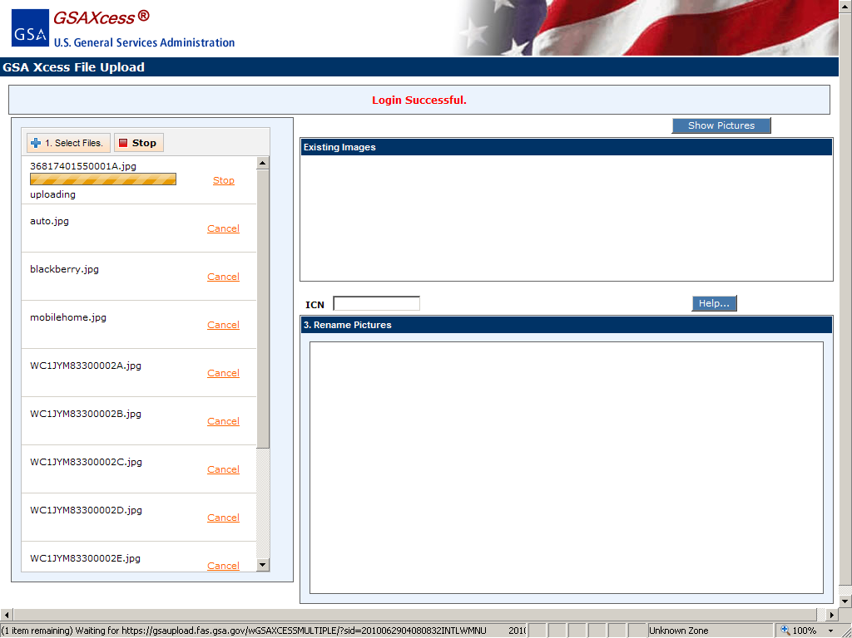

Slide 15
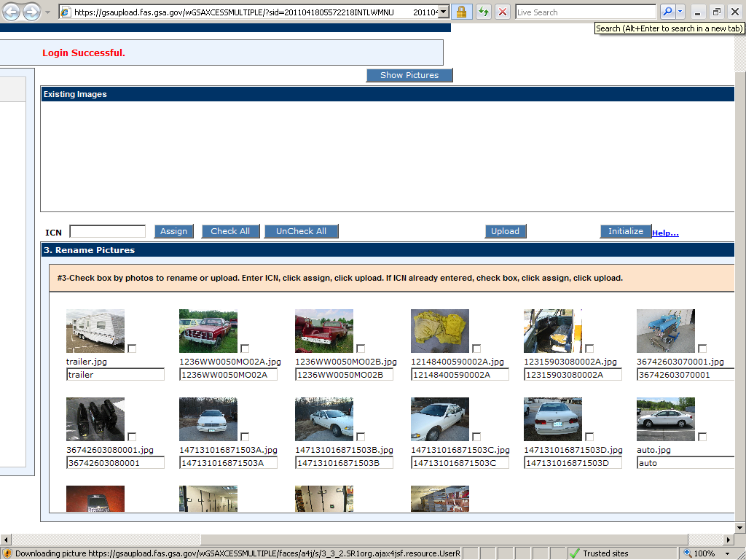

Slide 16
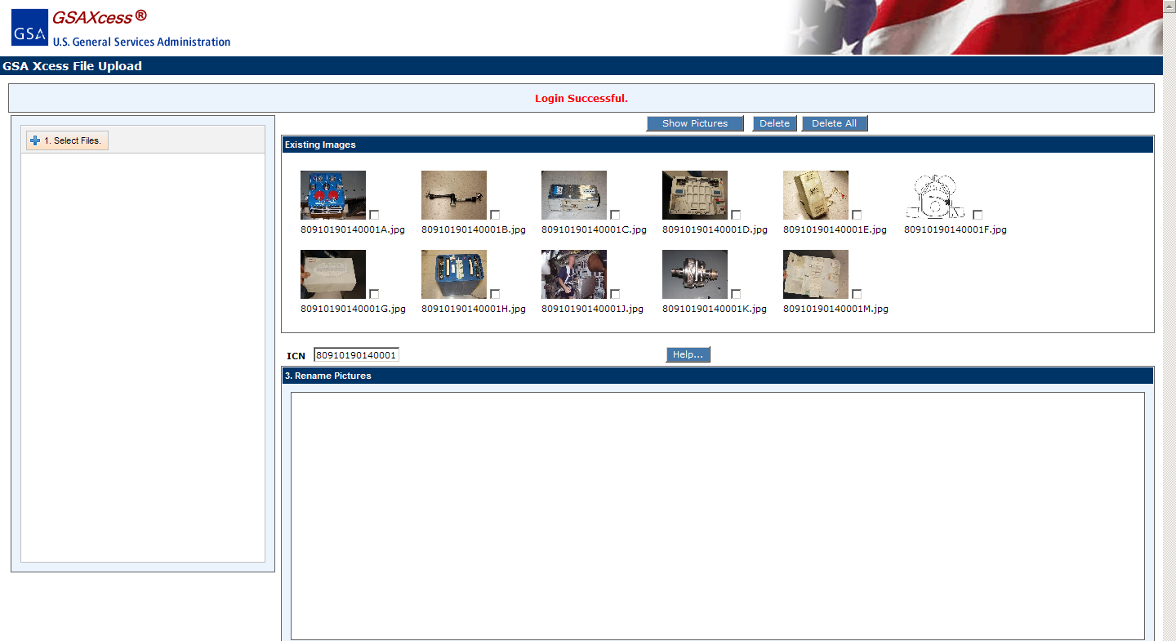

Slide 17
Other Ways to Submit Pictures
Send email with attached .jpeg files to gsaxcess.pictures@gsa.gov

Slide 18
Step by Step Instructions
For
Uploading Pictures
Log onto www.gsaxcess.gov

Slide 19
Questions

