Slide 1
Abandonment & Destruction (A&D)
FMR 102-36.305 to 330
Lisa Moghazy, CPPS

Slide 2
Agenda
Criteria / Documentation
Caution
Electronics
Environmental Services
R2 Recyclers & e-Stewards
No-Cost Options

Slide 3
Criteria / Documentation
To abandon or destroy excess personal property
An authorized agency official must make a written determination that either
Property has no commercial value
(Or)
estimated cost of continued care & handling exceeds the expected proceeds of sale
The written determination must be approved by a reviewing official who is not directly accountable for the property

Slide 4
Criteria
Property has no commercial value
Gone through disposal process (demonstrates no commercial value)
Determination can be made at any point during disposal process
Owning Agency must make determination

Slide 5
Caution
Must not abandoned or destroyed in a manner dangerous to public health or safety (FMR 102-36.315)

Slide 6
Electronics
Must not be
Thrown in trash
Must be
Recycled in an environmentally-safe manner
Must use certified R-2 (Responsible Recycling) or e-Stewards Program
Refer to internal agency policy

Slide 7
No-Cost Options
Unicor (Federal Prison Industries)
http://www.unicor.gov
For large QTY
USPS Blue Earth
http://blueearth.usps.gov/
For small QTY
Your agency must have MOU to use
Donate to a public body in lieu of abandonment
FMR 102-36.320
GSA approval not required

Slide 8
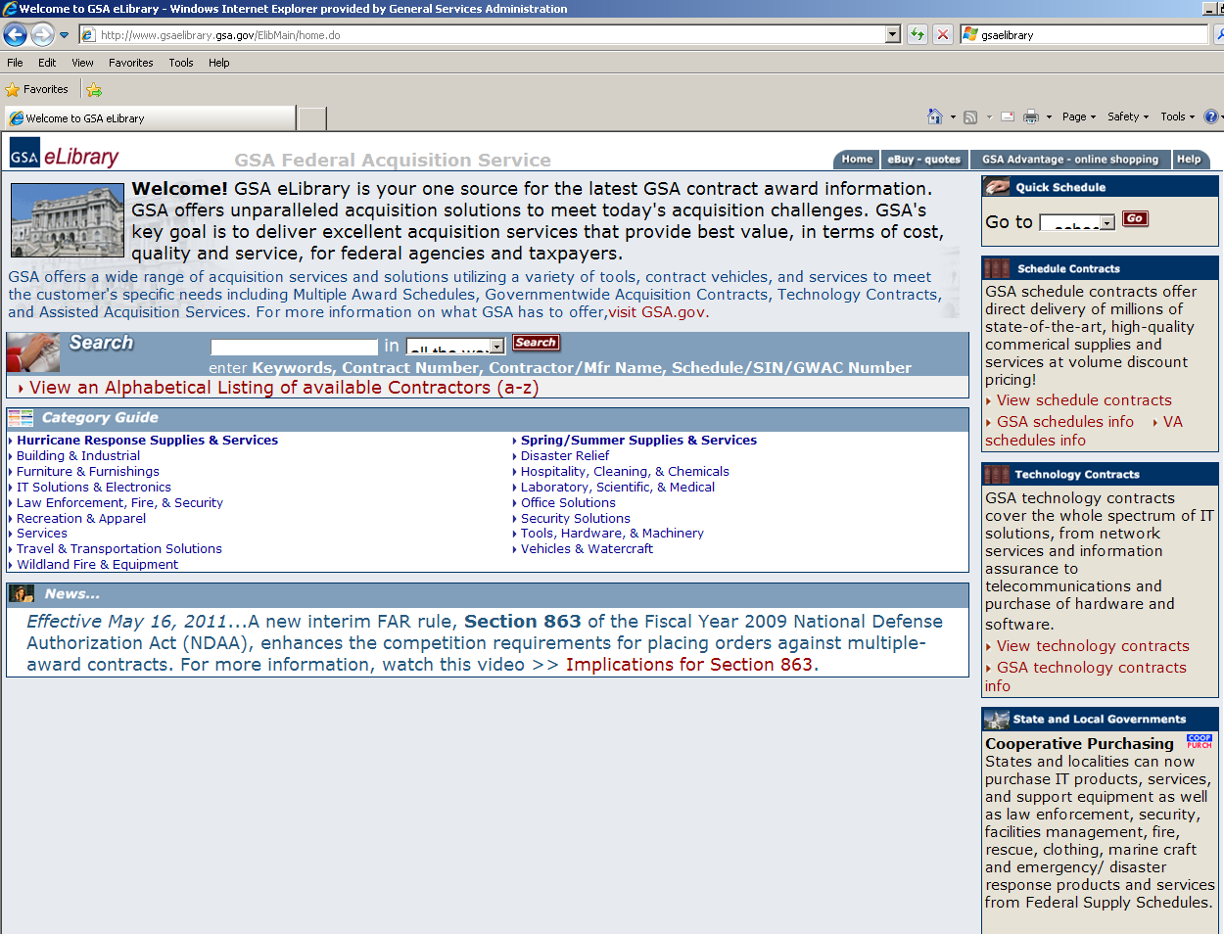
Environmental Services
www.gsaelibrary.gsa.gov
Type “899-5” in search engine
Materials and Waste Recycling and Disposal Services

Slide 9
R2 Recyclers & e-Stewards
R2 Recyclers
https://sustainableelectronics.org/recyclers
https://www.epa.gov/smm-electronics/certified-electronics-recyclers#04
E-Stewards (Find a Recycler)
http://e-stewards.org/find-a-recycler/

Slide 10
Before the exam…

