Slide 1
Disposal of Specialized Categories of Property
Phar`is D. Allen, Ph.D., DRM
Georgia, North Carolina, South Carolina
Area Property Officer
Personal Property Management
Notes:
Disposal of Specialized Categories of Property

Slide 2
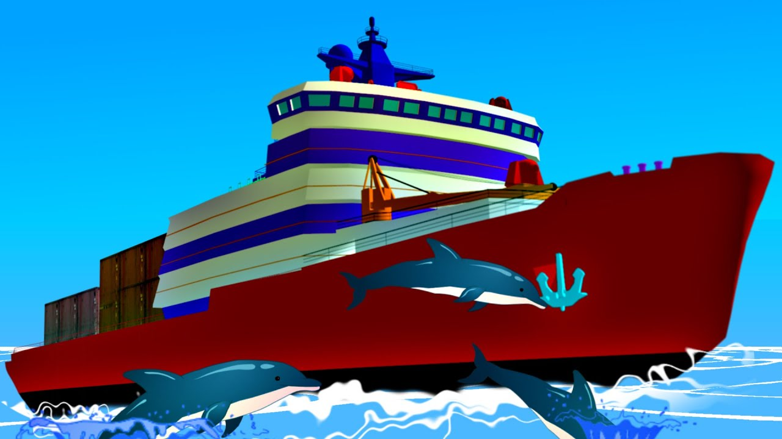
Disposal of Specialized Categories of Property
Categories of Property Requiring Special Handling:
Firearms
Aircraft
Vessels
Animals

Slide 3
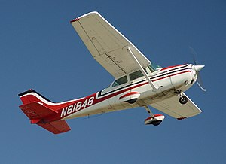
Reporting Aircraft & Federal Screening Region 9
POC: Sandra Klar Email: sandra.klar@gsa.gov
Telephone: 415-522-3041 Fax: 415-422-3043
Field and Customer Support Branch
450 Golden Gate Ave
San Francisco, CA 94012
*FSC 1510 ~ Fixed Wing
*FSC 1520 ~ Rotary Wing
*41 CFR 102-36-340
*Aircraft Components & Engines – Regional Property Office
Notes:
Disposal of Specialized Categories of Property

Slide 4
Aircraft Donation and Screening Region 9
POC: Lisa Schrad Email: lisa.schrad@gsa.gog
Telephone: 415-522-3041 Fax: 415-422-3043
Field and Customer Support Branch
450 Golden Gate Ave
San Francisco, CA 94012
Notes:
Disposal of Specialized Categories of Property

Slide 5
Firearms Region 8
POC: Debbie Rojas Cook Email: debbie.rojascook@gsa.gov
Telephone: 303-236-7707 Fax: 303-236-7544
Property Management Division (7FP-8) National Firearm Program Manager
Notes:
Disposal of Specialized Categories of Property

Slide 6
Reporting Process
*GSAXcess.gov
*Report as a single line item (GSA Bulletin
FPMR H-75)
*Drop-down menu feature allows you to select type of firearm from existing lists
*Manual paper submission on SF-120
Notes:
Disposal of Specialized Categories of Property

Slide 7
Who is Eligible to Acquire Firearms
Unless the agency has specific statutory authority to do so, excess firearms may be transferred only to those federal agencies authorized to acquire firearms for official use, reference Section 101-42.1102-10(a)(2). Firearms not transferred or donated must be destroyed and sold as scrap, Section 102-36.375.
Notes:
Disposal of Specialized Categories of Property

Slide 8
Regulatory Change
Federal Register - July 28, 1999
Removed the prohibition on donation of surplus Federal firearms to eligible law enforcement activities
Notes:
Disposal of Specialized Categories of Property

Slide 9
Donation Program
*Requires participation of State Agency for Surplus Property
*Open to state/local law enforcement with the primary
Function of enforcement of federal, state, and local laws
*Officers must have apprehension and arrest authority
Notes:
Disposal of Specialized Categories of Property

Slide 10
Donation Program Controls
*Prequalification process
*Federal government retains title
*Special terms and conditions apply
*Yearly inventory report required
*Must comply with applicable registration
and use requirements

Slide 11
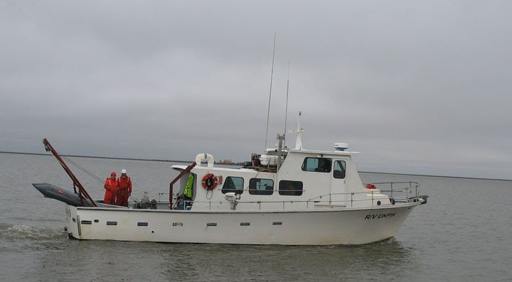
Vessels 50 Feet or Larger and Civilian Agency
POC: Brent Crawley Email: brent.crawley@gsa.gov
Telephone: 404-331-3052 Fax: 404-331-1877
GSA, FAS Property Management
77 Forsyth St. SW Suite 100
Atlanta GA 30303

Slide 12
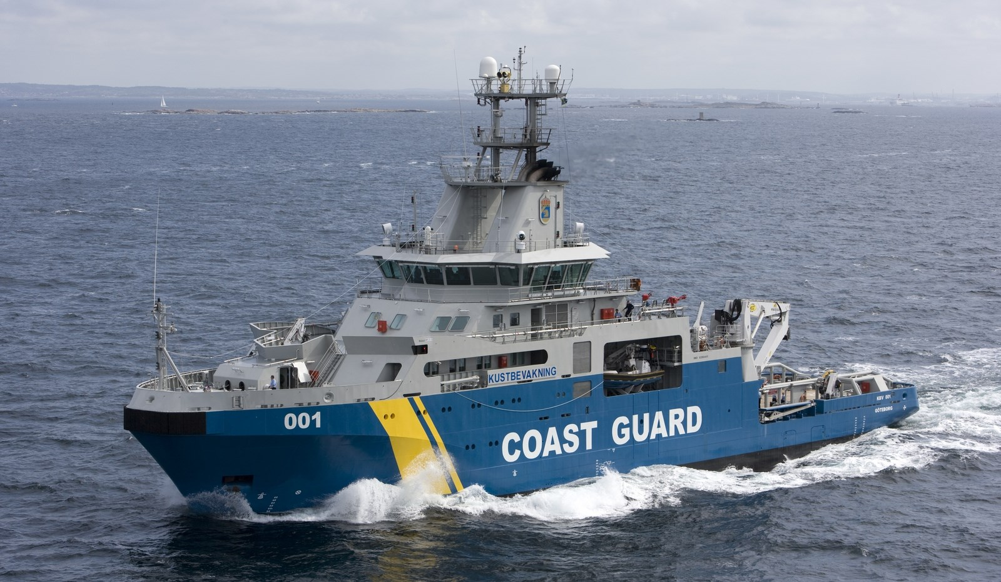
Vessels 50 Feet or Larger and Military
Karen Craig Email: karen.craig@gsa.gov
Telephone: 215-446-5071 Fax: 215-829-2771
GSA, FAS Personal Property
20 North 8th Street, 10th Floor
Philadelphia, PA 19107

Slide 13
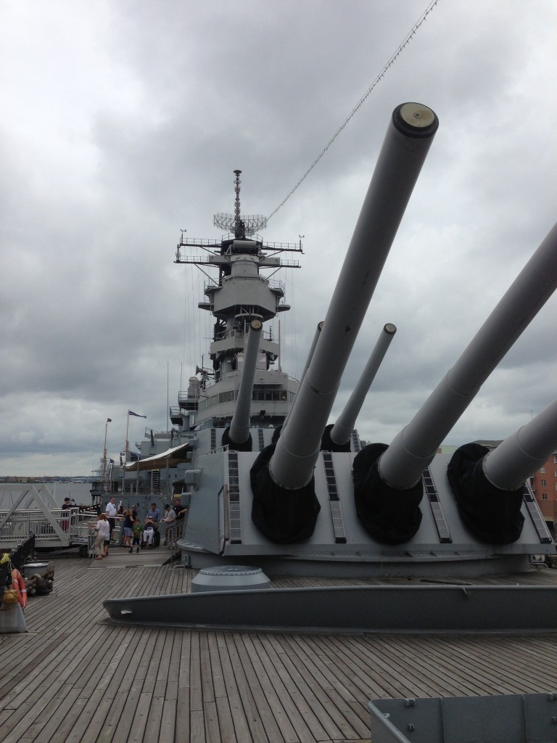
Disposal of Vessels Merchant Marine Act 1936.
*Battleships
*Cruisers
*Aircraft Carriers
*Destroyers
*Submarines

Slide 14
Disposal of Vessels Merchant Marine Act 1936.
VESSELS 1,500 GROSS TONS OR MORE:
*These vessels are reported to GSA
*GSA will then offer them first to the Federal Maritime
Administration
* The Maritime Administration will determine if the vessel is capable of conversion to merchant use

Slide 15
Animals

Slide 16
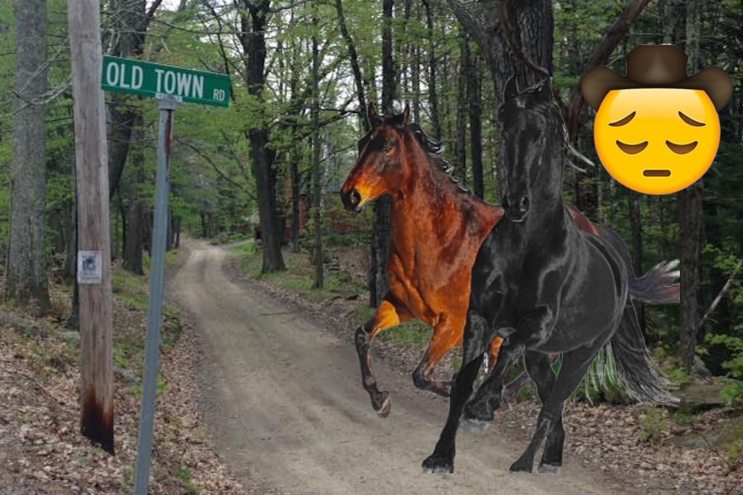
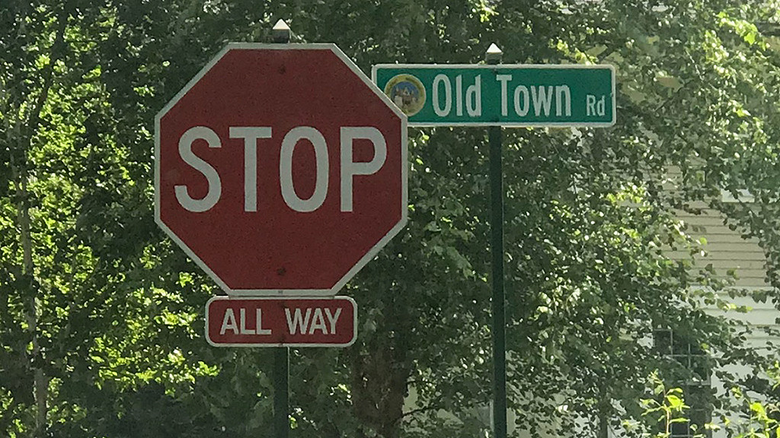
Animals

Slide 17
Animals
POC: John Breen
Telephone: 215-446-5070
Email: john.breen@gsa.gov
Fax: 215-829-2878
GSA, FAS, Property Division
20 North 8th Street, 10th Floor
Philadelphia, PA 19107

Slide 18
Animals
FMR102-36 does not stipulate special handling requirements for most animals, so the traditional disposal process typically applies. However, optional methods exist for some species and may be exercised without GSA’s approval or involvement
Notes:
Special disposal authorities exist for Unfit Horses and Mules, Canines and Non-human primates and may be exercised without GSA’s approval or involvement.

Slide 19
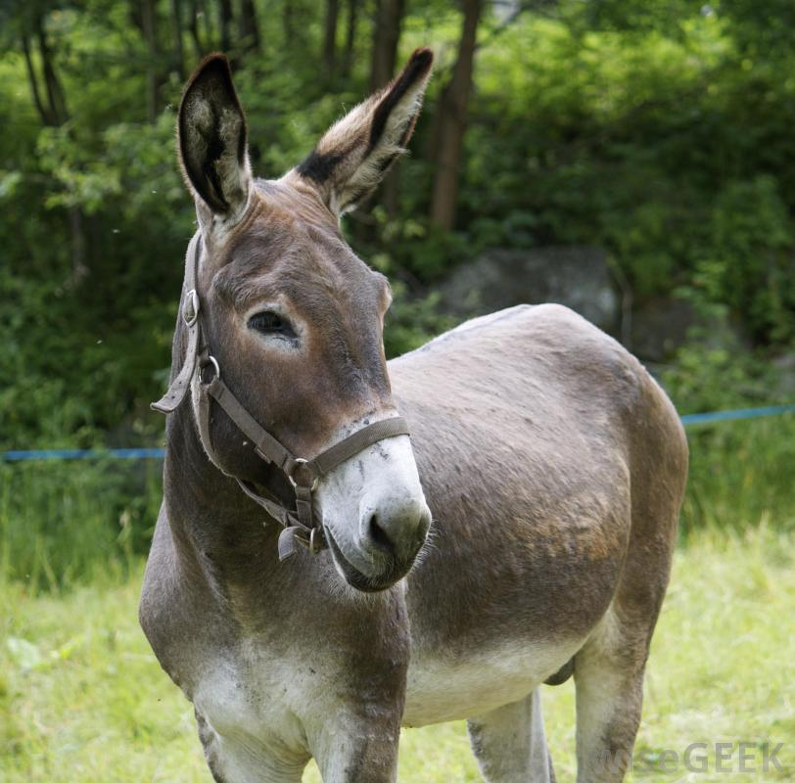
Animals
*40 USC 1308 - Unfit Horses and Mules
*41 CFR 102-36.365 - Canines (allows for direct donation to an individual who has experience handling K9s in the performance of those official duties)
*42 CFR 71 - Non-human primates

Slide 20
Animals (continue)
*Canines may be donated to an individual who has experience handling canines in the performance of those official duties FMR 102-36.365
*Typical disposal process applies to nonhuman primates but transfer, donation, and sale documents must address appropriate uses of non-human primates per 42 CFR 71.53
1. Scientific Research
2. Education
3. Exhibition

Slide 21
Questions

