Slide 1
Special Programs
David Tran, CPPA

Slide 2
Agenda
NASA
U.S. Census Bureau

Slide 3
NASA
Artifacts Disposition Program
Goals are historic preservation & educational outreach.
For use or display.
Screening for 42 days.
Property is free, but requesting entity responsible for S&H.
Eligibility
Non-profit museums, university, schools & libraries must apply through SASP.
Direct Request
Universities & schools can acquire directly from NASA.
Need to provide NCES# if school or IPEDS# if university.

Slide 4
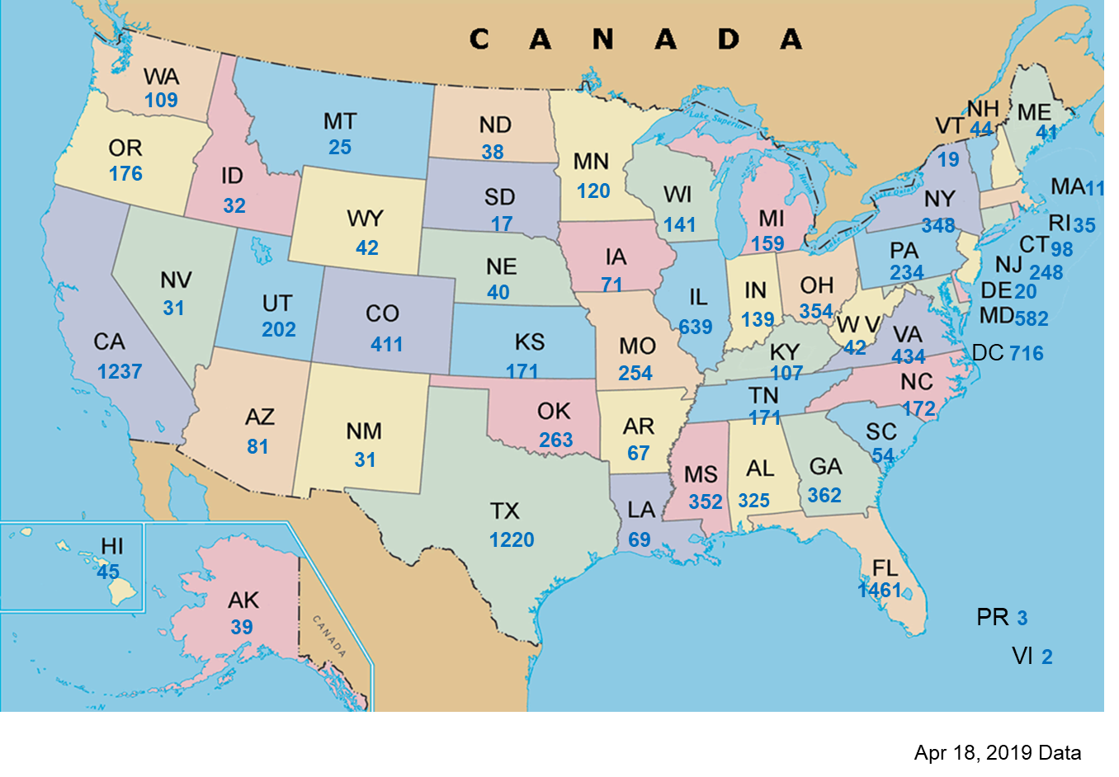
NASA (cont.)
Distribution by state & territory:

Slide 5
NASA (cont.)
Allocation by Organization:

Slide 6
NASA (cont.)
POC:
Sharrief Wilson, NASA NUO
sharrief.wilson@nasa.gov
(202) 358-0875
https://gsaxcess.gov/NASAWel.htm

Slide 7
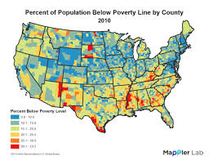
U.S. Census Bureau
Every decade, Census Bureau sends form to each household to collect population data.
Census 2010 National Population
308.7M people living in USA.

Slide 8
U.S. Census Bureau (cont.)

Slide 9
U.S. Census Bureau (cont.)
Purchase large amounts of property & distribute among their offices.
After Mission is Over:
Report excess in phases into their internal system.
GSA can expedite screening per request.
Property disposed via transfers, donations & sales.

Slide 10
Before the exam…

