Slide 1
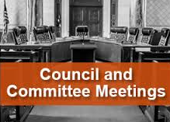
Gary Thompson Office of Asset & Transportation Management Office of Government-wide Policy March 5, 2018
GSA’s Office of Governmentwide Policy
Office of Asset & Transportation Management
(MA)
Notes:
In December 1995, GSA created the Office of Government-wide Policy (OGP) to consolidate its policy functions into a single organization. OGP's policymaking authority covers the areas of personal and real property, travel and transportation, information technology, regulatory information and use of federal advisory committees. OGP's strategic direction is to ensure that government-wide policies encourage agencies to develop and utilize the best, most cost effective management practices for the conduct of their specific programs. To reach the goal of improving government-wide management of property, technology, and administrative services, OGP builds and maintains a policy framework, by (1) incorporating the requirements of federal laws, Executive Orders, and other regulatory material into policies and guidelines, (2) facilitating government-wide reform to provide federal managers with business-like incentives and tools and flexibility to prudently manage their assets, and (3) identifying, evaluating, and promoting best practices to improve efficiency of management processes. Guided by the principles of the President's Management Agenda and the Office of Management and Budget (OMB), some of OGP's recent efforts have been devoted to providing leadership in the development of a policy environment and key enablers for electronic government, and supporting OMB in the implementation of various E-Gov initiatives to standardize and streamline government processes. The new model calls for involvement of other federal agencies, the private sector, interested parties, and other stakeholders from the very onset of policy review and/or formulation. Such collaborative efforts are seen to offer numerous advantages, not least of which is to ensure "buy-in" from the policy customers.

Slide 2
Mission
Develop new and interpret existing Government-wide evidence-based policies for Federal Agencies to effectively and efficiently manage their assets and transportation while promoting transparency, accountability, innovation, with a focus on pro-active partnership and customer service excellence.
Office of Asset and Transportation Management
Notes:
The Office of Asset and Transportation Policy develops government-wide policies and guidance to provide a structured framework for agencies to achieve economical and effective management processes for government assets Policy program areas include aircraft and motor vehicles, personal property, real property, transportation, mail, passenger travel, and relocation allowances and entitlements. This office also oversees agencies' adherence to established policies for these programs. The office maintains liaisons with state and local governments, industry, and professional organizations and participates in the work of boards, committees, and groups related to the responsibilities of the office. The office promotes the government-wide use of alternative workplace arrangements to increase space utilization efficiency and reduce carbon footprint. The office also manages the Federal Real Property Database of all Federal Government real property assets and supports the Federal Real Property Management Council in its efforts to promote effective asset management government-wide. The office operates a Center of Policy Evaluation to assess OGP’s impact on formulating policies, programs, and tools to ensure that policies are useful to government customers and achieve desired results.

Slide 3
Vision and Goals
Vision
Serve as the Government-wide source and experts in Asset and Transportation related policies, while developing policies that influence and promote behavior and activities for effective, efficient, transparent, and innovative asset and transportation management.
Goals
Draft new and interpret existing OGP policies resulting in agency internal policies effectiveness, transparency, accountability, and efficiencies.
Continue emphasis on data standardization, analysis, reporting, and customer engagement resulting in innovative, evidenced based policy and benchmarking.
Providing staff with the opportunity to acquire the skills and tools to effectively serve GSA, our Federal partners, and stakeholders.
Office of Asset and Transportation Management

Slide 5
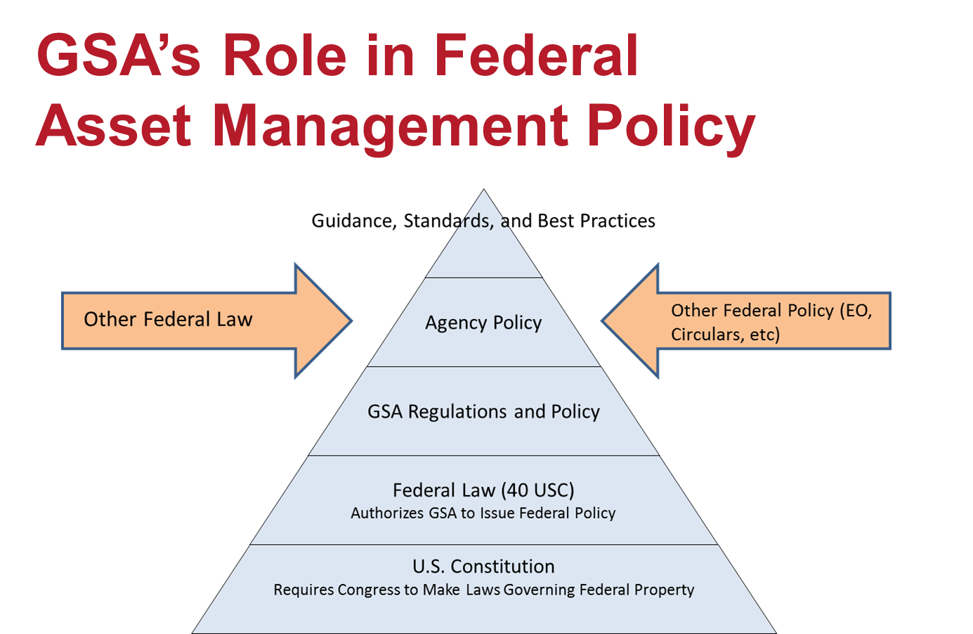

Slide 6
Federal Regulations
Topic Where it can be found
General FMR 102-35
Utilization FMR 102-36
Donation FMR 102-37
Sale FMR 102-38
Exchange/sale FMR 102-39
Hazardous FMR 102-40
Abandoned/forfeited FMR 102-41
Foreign Gifts FMR 102-42
Supply/Procurement Subchapter E (FPMR)

Slide 7
GSA FMR Bulletins (Guidance) (Selected Examples)
Topic Where it can be found
Foreign Gift Minimal Value Bulletin B-41
Bulletins “In Effect” Bulletin B-40
Disposal of Electronic Equipment Bulletin B-34
Annual Reports Bulletin B-27
Accountability/Stewardship Bulletin B-26
Property Obtained w/ Charge Card Bulletin B-25
Use of Voluntary Consensus Bulletin B-18
Standards

Slide 8
What’s New?
Recent/Imminent
Revised Bulletin on Annual Reports
Bulletin on Warehousing Practices
ASTM Standard on Warehousing
Bulletin on Activity Address Codes (AACs)

Slide 9
For Further Information
Bob Holcombe
(202) 821-7555
robert.holcombe@gsa.gov
Gary Thompson
(202) 208-7433
gary.thompson@gsa.gov

Slide 10
Questions?

