Slide 1
Federal Personal Property Disposal
Office of Personal Property Management March 2018

Slide 2
PPM Program and Tools
Excess Property Reutilization
Surplus Federal Personal Property Donation Program
Surplus Firearms Donation Program
GSA-hosted Computers for Learning Website
Foreign Gifts Program
Sales Program
Surplus
Exchange/Sale Property
Forfeited Property
Treasure Trove
Agency Asset Management System (AAMS)
Computers for Learning Website
Foreign Gifts Module
Firearms Inventory Module
NASA Modules
MySales
GovSales

Slide 3
Mission Statement
To provide the services, expertise, and tools that will ensure the timely, effective, and efficient disposition of the Federal government’s excess and surplus personal property assets, yielding the greatest return on investment to the taxpayer

Slide 4
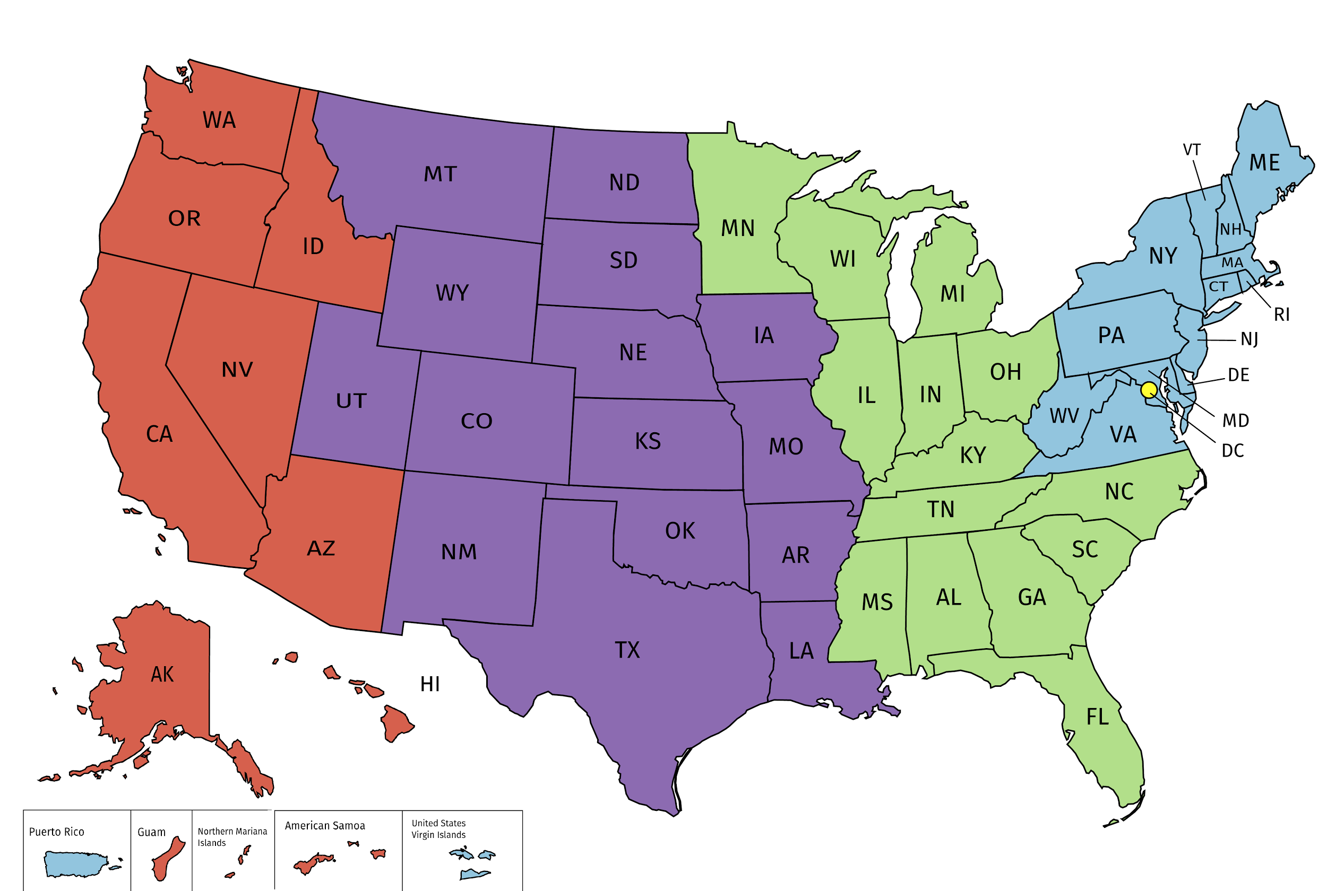
PPM National Footprint
MID-ATLANTIC ZONE 1 Center of Expertise for Naval Vessels and Animals; Performs Eligibility, Compliance and State Agency Reviews for Eastern States
SOUTHEAST-GREAT LAKES ZONE 2 Center of Expertise for Civilian Vessels; Performs Sales Collections for Eastern States
SOUTHWEST-CENTRAL ZONE 3 Center of Expertise for Firearms; Performs Eligibility, Compliance, and State Agency Reviews for Western States
PACIFIC RIM ZONE 4 ICenter of Expertise for Aircraft; Performs Sales Collections for Western States
NATIONAL CAPITAL ZONE 5 Center of Expertise for Foreign Gifts; Springfield Personal Property Center (warehouse operations)

Slide 5
How We Measure Success
FY17 Results:
Facilitated the reutilization and donation of over $1.6B in excess personal property
83% of total proceeds reimbursed to agencies
Achieved one of the highest customer loyalty scores in the Federal Acquisition Service
Some of Our Metrics:
Revenue (Sales/Cost Recovery Program)
Cycle Time
# of Line Items Processed
% of dollars reimbursed to agencies
Customer Loyalty Score

Slide 6
What is Personal Property
Personal property: Any property, except real property. Includes assets ranging from common office equipment and furniture to more specialized products like scientific equipment, heavy machinery, airplanes, vessels, and vehicles.

Slide 7
Definitions
Excess personal property: Any personal property under the control of any federal agency that is no longer required for that agency's needs, as determined by the agency head or designee.
Surplus personal property: Excess personal property not required for the needs of any Federal agency, as determined by GSA.

Slide 8
Authority
United States Constitution, Article IV, Section 3
Title 40 of the United States Code
Subtitle I—Federal Property and Administrative Services
Chapter 5—Property Management
Implemented by Federal Management Regulation
Title 41 of the Code of Federal Regulations
Subchapter B - Personal Property
Part 102-35 - Disposition of Personal Property
Part 102-36 - Disposition of Excess Personal Property
Part 102-37 - Donation of Surplus Personal Property
Part 102-38 - Sale of Personal Property
Part 102-39 - Replacement of Personal Property Pursuant to the Exchange/Sale Authority
Part 102-41 – Disposition of Seized, Forfeited, Voluntary Abandoned, and Unclaimed Personal Property
Part 102-42 - Utilization, Donation, and Disposal of Foreign Gifts and Decorations

Slide 9
The 4 Steps of Disposal
Step 1 Internal Screening (Redistribution)
Step 2 Excess Screening (Federal Transfers/CFL)
Step 3 Surplus/Donation (SASPs/Eligible Non-federal Entities)
Step 4 Sales (General Public)

Slide 10
Step 1: Internal Screening/Redistribution
Agencies follow internal procedures
Reassign unneeded property within the agency
Systems for internal screening vary by agency
GSA offers AAMS (Agency Asset Management System) to support internal screening/redistribution

Slide 11
Step 2: Utilization – Federal Transfers
Promote and process transfers of excess property among federal agencies
Property is available for screening by and transfer to:
Federal agencies
Their contractors, cooperatives and grantees
Senate and House of Representatives
DC Government
Mixed-ownership Government corporations
Authority
40 USC 521
41 CFR 102-36

Slide 12
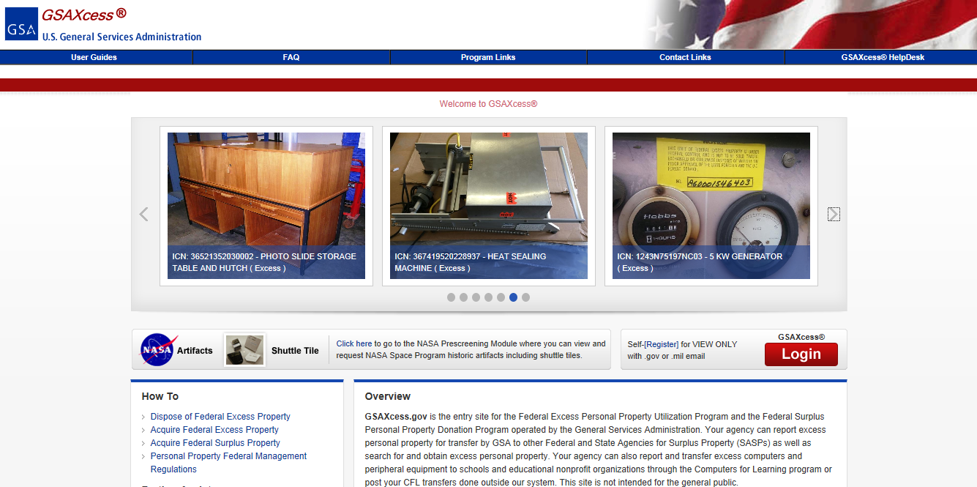

Slide 13
Step 3: Surplus Donations
Extends useful life of property in which we, as taxpayers, have already expended funds to acquire
Participants in the Surplus Donation Program include:
State and local public agencies
Nonprofit educational and public health institutions
Nonprofit and public programs for the elderly
Educational activities of special interest to the Department of Defense
Public airports
Veterans organizations
Authority
40 USC 549
41 CFR 102-37

Slide 14
Step 3: Surplus Donations (continued)
Property is donated through a State Agency for Surplus Property (SASP)
Established in each state, territory, and the District of Columbia
Property is transferred to the SASP at no cost
SASPs are generally self-sufficient and charge a service and handling fee
SASPs are responsible for:
Determining eligibility
Distributing property fairly, equitably, and promptly
Enforcing compliance with terms and conditions of donation

Slide 15
GSAXcess Video
https://youtu.be/ItJWetjxg6o

Slide 16
Step 4: Sales
GSA sells property on behalf of other federal activities:
Surplus
Exchange/sale
Forfeited
Agencies must sell via an approved Sales Center or have waiver
Property not transferred or donated during the surplus phase becomes eligible for sales
Authority
40 USC 545
41 CFR 102-38

Slide 17
The GSA Auctions® Sales Center represents the entire breadth of the GSA personal property sales program including sales services for all commodities of personal property, through all authorized methods of sale such as:
GSA Auctions®…a GovSales.gov partner
GSA Auctions®
Sales Center
Internet
Auctions
Sealed
Bid
Spot
Bid
Live
Auctions
Drop
By
Fixed
Price
Negotiated
www.gsaauctions.gov

Slide 18
GSA Does the Rest
On-line Sales
Secure internet site
Posting of items
Posting of photos
Featured items—listing and homepage
Maintenance of registered bidders
Electronic payment
Automated closing
Bid period extension
Registration verification engine
Collection of bid deposits
Basic Services Offered –
-Asset lotting guidance
-Sales preparation
-Channel management and selection
-Asset description and listing preparation assistance
-Preparation of award documents
-Contract awards
-Financial and property line item accountability
-Contract administration
-Collection and processing of bid deposits
-Collection and deposit of proceeds
Distribution of proceeds
Off-line Sales
Advertising of sale event
Maintenance of specialized mailing lists
Distribution of IFBs
Bid opening
Registration of bidders
Auctioneer
On-site Sales Contracting Officer
On-site collection of payments
Follow up collection of defaults/late payments

Slide 19
Sales Video
https://www.youtube.com/watch?v=oAUHTqZJdjk

Slide 20
Personal Property Websites
https://www.gsa.gov/portal/category/25570
www.gsa.gov/portal/content/101823

Slide 21
Points of Contact
Susanne Combs, Director, PPM
susanne.comb@gsa.gov
Michael Wyckoff, Director, Sales
michael.wyckoff@gsa.gov
Cynthia Gardiner, Director, U&D
Cynthia.gardiner@gsa.gov
Matthew Manger, Special Projects
matthew.manger@gsa.gov

