Slide 1
Federal Acquisition Services
Personal Property Disposal
April 2016

Slide 2
WHY MUST I REPORT?
Federal Executive agencies are legally required (FMR 102.36) to report excess personal property to GSA for screening and disposal.
Legislative and Judicial branches are encouraged to report their excess personal property to GSA.
Notes:
Two reporting methods. Batch and on-line.

Slide 3
Federal Asset Sales
GSAXcess®
Federal Asset Sales
http://gsaxcess.gov/
Notes:
Because the agency now has a choice of Sales Centers, this screen has been modified to allow for the choices provided by eFAS. If you check GSA, the result is world-class disposal services. If you check another Sales Center, the property record will be passed to that Sales Center for processing, and the user will be notified that screening is complete and the record has been transmitted.
It is at this point in the electronic reporting process that you are able to mark the category of the property that you are reporting.
If you elect Surplus or Surplus reimbursable the items will be made available for 21 days of screening by Federal and State agencies as well as eligible donees; Exchange Sale items are only available for a maximum 2-day screening period.

Slide 4
Categories of Property
Notes:
Normally when personal property completes screening and goes to GSA Sales the monies go back to the U.S. Treasury unless the Agency has special authority to receive reimbursement.

Slide 5
Categories of Property for Sale
Surplus Property and Surplus Reimbursable – FMR Part 102-38 – Sale of Personal Property
Ninety-five percent of all reported property is Regular Utilization and Donation screening.
Notes:
95% of property reported is regular utilization and donation property and has no special requirements such as reimbursement or sale proceeds retention.

Slide 6
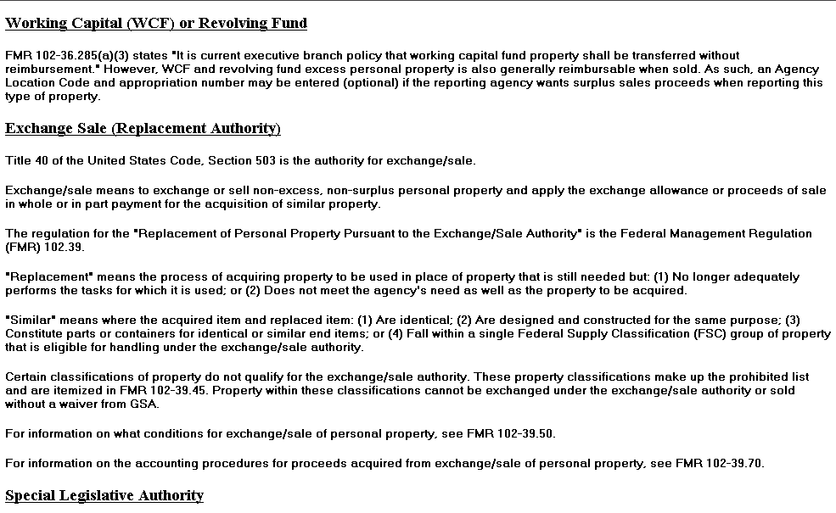
Categories of Property for Sale
Notes:
If your Agency wants reimbursement for personal property, they must be eligible under the requirements listed under Exceptions displayed by clicking the blue hypertexted titles.

Slide 7
Exchange/Sale Property – FMR Part 102-39 – Replacement of Personal Property Pursuant to the Exchange/Sale Authority
A separate category of federal property
It’s not excess……
Its functional
is still required
but it maybe
Outdated
Notes:
Property that was purchased under the Exchange Sale authority may be sold with the exclusive intention of using the recovered funds to purchase like items.

Slide 8
Exchange/Sale Property – FMR Part 102-39 – Replacement of Personal Property Pursuant to the Exchange/Sale Authority
Exchange/Sale authority allows agencies to….
“exchange or sell non-excess, non-surplus personal property and apply the exchange allowance or proceeds of sale in whole or in part payment for the acquisition of similar property”
Notes:
Property in this category is not required to be made available for re-utilization
Screening.

Slide 9
Exchange/Sale Property – FMR Part 102-39 – Replacement of Personal Property Pursuant to the Exchange/sale Authority
You must determine whether an exchange or sale will provide the greater return for the Government.
When estimating the return under each method, consider all related administrative and overhead costs.

Slide 10
Reimbursable Property
If and agency’s property is an “Exception” then the Agency Location Code and Appropriation Fund is required to send proceeds back to reporting agency.
Notes:
If your Agency has special authority to receive reimbursement, the Agency Location Code and Appropriation Fund to be Reimbursed must be filled in or the property report cannot be submitted. This is needed so that the correct fund can be credited when the property is transferred or sold.

Slide 11
Report Property (FSC)
To help identify your Federal Supply Classification, click on the “FSC” hypertext for a searchable listing

Slide 12
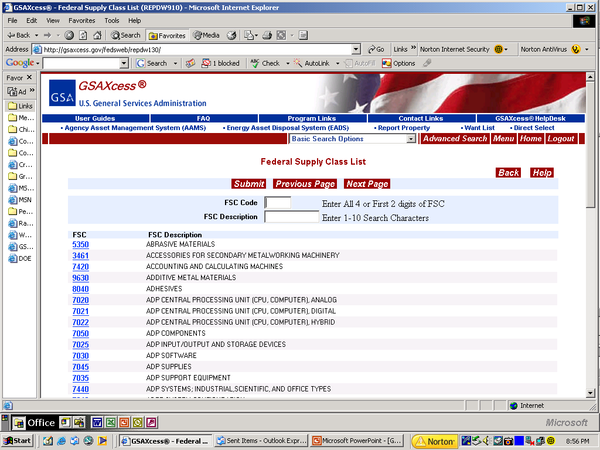
FSC List
You can search by FSC or FSG code or description

Slide 13
Fair Market Value/Upset Prices
The upset price, also called the reserve price, is the fair market value or lowest price the agency is willing to accept for the item.
It may be determined independently by the agency.
Based on previous sales history.
Calculated as a percentage of the Acquisition cost/rate of depreciation.
If the reserve price is not met, we are not obligated to sell the item.
GSA will contact the agency to discuss acceptance of the highest bid.
Notes:
Property that survives both utilization and donation screening becomes available for sale.
If the items are reported electronically they will automatically roll into our automated system (SASy) to be programmed for sale. A sales associate will contact your offices within 7-10 days to begin the process of programming your items for sale.
Items reported manually are input into the sales system manually and the reporting agency is contact to establish a sale date. Keep in mind the manual reporting is subject to the timeliness of mail delivery and the availability and workload priority of associates to input the reports into the system.

Slide 14
Agency Requirements for manual reporting
Completes SF126 for Exchange/Sale property not required for screening through GSAXcess®.
The Agency Location Code and Appropriation Fund is required to send proceeds back to reporting agency.y.
Notes:
Agencies may also complete a manual report of property (an SF 126, which may be found on –line).
The hard copy may be sent directly to the regional sales offices based on the regional location of the property (unless otherwise requested).

Slide 15
Custodial Duties
Provides the following:
Contact information
ACCURATE DESCRIPTION AND INFORMATION
Property location
Inspection dates and times
Special requirements for removal
Available during inspection and removal periods.
Accountable for the care and handling of
property prior to its removal.
GSA does the rest!!
Notes:
This is all that we ask you to do, to assist us in selling your property:
Provide accurate contact information
Property location
Inspection dates and times or advise us if inspections cannot be held.
If there are special requirements for removal (Security measures, pre-certifications, identification, etc..
Make sure that there is personnel available during inspection and removal periods.
Make sure that your offices are accountable for the care and handling of property prior to its removal.

Slide 16
GSA Does the Rest
On-line Sales
Secure internet site
Posting of items
Posting of photos
Featured items—listing and homepage
Maintenance of registered bidders
Electronic payment
Automated closing
Bid period extension
Registration verification engine
Collection of bid deposits
Basic Services Offered –
Asset lotting guidance
Sales preparation
Channel management and selection
Asset description and listing preparation assistance
Preparation of award documents
Contract awards
Financial and property line item accountability
Contract administration
Collection and processing of bid deposits
Collection and deposit of proceeds
Distribution of proceeds
Off-line Sales
Advertising of sale event
Maintenance of specialized mailing lists
Printing and distribution of IFBs
Bid opening
Registration of bidders
Auctioneer
On-site Sales Contracting Officer
On-site collection of payments
Follow up collection of defaults/late payments

Slide 17
Asset Sales Price
Low Range $ | High Range $ | Rate Per Item
$0.01 | $1,000.00 | $250 or award amount if less than $250
$1,000.01 | $5,000.00 | 25% of Proceeds
$5,000.01 | $25,000.00 | 20% of Proceeds
$25,000.01 | $50,000.00 | 17% of Proceeds
$50,000.01 | $100,000.00 | 14% of Proceeds
$100,000.01 | $150,000.00 | 11% of Proceeds
$150,000.01 | $250,000.00 | 8% of Proceeds
$250,000.01 | And Higher | 6% of Proceeds
Note: GSA deducts its fees from the sales proceeds. Supplemental services (including transportation, storage, maintenance, vehicle preparation security services, travel expenses, portable restroom facilities, and special media advertising) are negotiated and billed separately. To address special circumstances, contact the regional GSA Sales Office.
Vehicles
GSA has special rates for servicing vehicles. There are two types:
Vehicles sold resulting from seized and forfeited laws. Agencies must negotiate rates.
GSA Vehicle sales for exchange/sale and other reimbursable sales (Federal Supply Classes 2310 and 2320 only). These prices are set:
GSA Conducted Sales: $275 per vehicle
Commercial Contract: $200 per vehicle plus cost of contract
Notes:
These are our basic sale rates or Surplus Reimbursable and Exchange Sale property.
Please note that vehicles are priced separately.

Slide 18
POST SALE AWARD NOTIFICATION
When an item sells, a copy of the Notice of Award will be sent via email, and a Purchaser’s Receipt/Authority to Release Property will be sent via email at the time of payment to -
Purchaser
Property location (custodian)
Owning agency’s finance office when payment is processed.

Slide 19
What Happens if an Item Does Not Sell?
When an item doesn’t sell, the Sales Contracting Officer (SCO) will contact the owning agency’s Point of Contact (POC) and coordinate a second attempt.
If the item doesn’t sell after agreed attempts by the owning agency and SCO, a return letter or an email from the Sales Contracting Officer will be sent to the owning agency POC.

Slide 20
GSA Regional Sales Offices
Mid-Atlantic Region NY, NJ, PR, VI, CT, DE, MA, MD, ME, NH, PA, RI, VA, VT, WV DC and Metro MD, VA
Southeast Sunbelt Region AL, FL, GA, IA, IL, IN, KS, KY, MI, MN, MO, MS, NC, NE, OH, SC, TN, WI
Greater Southwest Region AR, LA, NM, OK, TX, CO, MT, ND, SD, UT, WY
Pacific Rim Region AK, AS, AZ, CA, CM, GU, HI, ID, NV, OR, WA
Notes:
The Sales Managers or points of contact, phone numbers and addresses are available.

Slide 21
Please address any questions regarding policy, any sale guidance or SCO related matters to you Regional Sales Manager or contact your Central Office Sales Team:
Iris Wright-Simpson
Denise Hicks
Corey Tilley
Melissa Brown
Pat Mahone
Michelle Reed
Notes:
Please contact our Central Office should you have additional questions.

