Slide 1
EXCHANGE/SALE FMR 102-39
REMINDER:
Be sure to update the slide with your name and region!
Sharon Gorospe Personal Property Management Federal Acquisition Service
05/19/2022

Slide 2
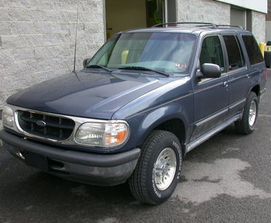
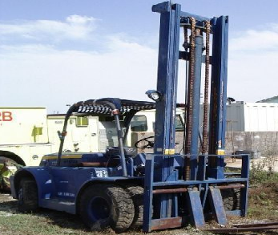
What is Exchange/Sale?
To exchange or sell replacement personal property and apply the exchange allowance or proceeds of sale in whole or in part payment for the acquisition of similar property.
Notes:
Definition of exchange sale.

Slide 3
Important Definitions
Acquire - to procure or otherwise obtain personal property, including by lease.
Replacement - means the process of acquiring property to be used in place of property that is still needed but:
No longer adequately performs the tasks for which it is used; or
Does not meet the agency’s need as well as the property to be acquired.
Similar - where the acquired item and the replaced item:
Are identical;
Are designed and constructed for the same purpose;
Constitute parts or containers for identical or similar end items; or
Fall within a single Federal Supply Group (FSG) of property that is eligible for handling under the exchange/sale authority.
Notes:
Here are two primary definitions of when to use exchange sale.

Slide 4
Why use Exchange/Sale?
Exchange/Sale is used to reduce your Agency’s cost of replacing personal property.
REDUCE
COSTS
Notes:
Reason why to use exchange sale.

Slide 5
Ways to Utilize the Exchange/Sale Authority
Exchange
Agency can exchange (trade in) the property for a credit towards the replacement property
Between VA and the vendor (no GSA involvement)
Sale
Agency can sell the replacement property through GSA and apply the proceeds towards the purchase of the new property.
GSA Sales Fee: $500 minimum
How do I determine whether to do an exchange or a sale?
You must determine whether an exchange or sale will provide the greater return for the Government. When estimating the return under each method, consider all related administrative and overhead costs.
Notes:
These are the two methods of exchange sale used.

Slide 6
When NOT to use Exchange/Sale…
If the estimated sales proceeds will be unreasonably low.
Exempt Categories:
10 Weapons.
11 Nuclear ordnance.
42 Firefighting, rescue, and safety equipment.
44 Nuclear reactors (FSC Class 4470 only).
51 Hand tools.
54 Prefabricated structure and scaffolding (5410, 5411 & 5419).
68 Chemicals and chemical products, except medicinal.
84 Clothing, individual equipment, and insignia.
Do not acquire property with the sole intent of exchange or selling it for a new asset.
Notes:
Instances when you should not use exchange sale.

Slide 7
Conditions for using Exchange/Sale
The property exchanged or sold is similar to the property acquired
The property exchanged or sold is not excess or surplus, and you have a continuing need for that type of property;
The property exchanged or sold was not acquired for the principal purpose of exchange or sale;
When replacing personal property, the exchange allowance or sales proceeds from the disposition of that property may only be used to offset the cost of the replacement property, not services; and
Except for transactions involving books and periodicals in your libraries, you document the basic facts associated with each exchange/sale transaction.
Notes:
Examples of conditions for using exchange/sale

Slide 8
Documentation Requirements
At a minimum, the documentation must include:
FSC Group of items exchanged or sold, and items acquired;
Number of items exchanged or sold, and number of items acquired;
Acquisition cost, exchange allowance or net sales proceeds of items exchanged or sold, acquisition cost of the items acquired;
The date of the transaction(s);
The parties involved; and
A statement that the transactions comply with the requirements of this part 102-39.
Notes:
Conditions for using Exchange/Sale continued

Slide 9
How Long do You have to Obligate the Proceeds?
Current FY + 1 FY
The proceeds from Exchange/Sale Authority sales is available to the Agency during the Fiscal Year the item was sold; and for one Fiscal year thereafter, from award date.
If the proceeds are not used during this time period, it must be sent to the General Fund of the U.S. Treasury.
Notes:
Tells when the proceeds from exchange/sale can be used.

Slide 10
Questions?
?
Notes:
Any questions on the exchange/sale authority?

Slide 11
​For further information, please contact your local Area Property Officer, found here: gsa.gov/apo Thank you!
Personal Property Management Federal Acquisition Service

