Slide 1
Disposition of Seized, Forfeited, Voluntarily Abandoned, and Unclaimed Personal Property FMR Subchapter B – Personal Property Part 102-41

Slide 2
DEFINITIONS
Forfeited – Acquired through summary process or court order pursuant to a US law.
Seized – Confiscated property agency is responsible for until final ownership is determined.
Unclaimed – Unknowingly abandoned and found on government premises (i.e. lost and found).
Voluntarily Abandoned – Abandoned so that title immediately vests in the government. Must be clear written or circumstantial evidence that the property was intentionally and voluntarily abandoned. Must be clear that the property was not simply lost by the owner.

Slide 3
What are Your Agency’s Responsibilities for these types of Property?
Normally, you retain custody.
You are responsible for reporting to GSA the property not being retained for official use.
Also, you are responsible for the care and handling of the property.

Slide 4
SEIZED PROPERTY
Can not be placed into official use until title is vested in the U.S. Government.

Slide 5
FORFEITED PROPERTY
May be retained for official use – unless required by law to be sold.

Slide 6
FORFEITED PROPERTY RETAINED FOR OFFICIAL USE
Loses its identity as forfeited property.
When no longer needed, reported to GSA for disposal like any other personal property.

Slide 7
VOLUNTARILY ABANDONED PROPERTY
If your agency needs the property, it may be retained for official use.
If not retained, should the property be abandoned/destroyed (FMR 102-36.305 – 330)?
If not abandoned/destroyed, report the property to GSA – annotating the report as voluntarily abandoned property.

Slide 8
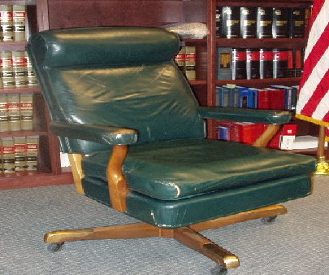
RETAINED FOR OFFICIAL USE, OR TRANSFERRED TO ANOTHER AGENCY
Voluntarily abandoned property loses its identity as such and becomes normal personal property.

Slide 9
SALE OF VOLUNTARILY ABANDONED PROPERTY
Your Agency may not retain the proceeds from the sale.
Proceeds must be deposited in the U.S. Treasury unless your Agency has specific statutory authority to do otherwise.

Slide 10
UNCLAIMED PERSONAL PROPERTY
Generally, you must retain the property for 30 days from the date it is found.
Unless the previous owner files a claim, title then vests in the U.S. Government.

Slide 11
WHAT ARE MY AGENCIES CHOICES?
May retain for official use after 30 days and no claim by former owner.
If not retained, Agency must decide if abandonment/destruction should be done immediately (not required to wait 30 days).
Otherwise, property should be reported to GSA.

Slide 12
WHAT IF AGENCY RETAINS THE PROPERTY FOR OFFICIAL USE?
Records must be retained for 3 years on property retained for official use.
Funds from the disposal of the property must be deposited in a special account for this 3 year period to cover any future valid claim.
When the property is no longer required, report it as excess to GSA.

Slide 13
WHAT IF THE FORMER OWNER FILES A CLAIM FOR THE PROPERTY?
If the property was sold, reimbursement must not exceed sales proceeds less government’s cost of care and handling.
If the property is abandoned/destroyed, retained for official use, or, transferred, former owner’s reimbursement must not exceed estimated resale value at time of vesting, less cost of care and handling.

Slide 14
WHAT IF THE PROPERTY IS TRANSFERRED TO A FEDERAL AGENCY?
May only be done after 30 days of date of finding the property and no claim being filed by former owner.
Acquiring Agency must pay fair market value to Holding Agency.
Proceeds must be deposited in a special account for a 3 year period pending a claim from the former owner.
After 3 years, money is deposited in the U.S. Treasury.

Slide 15
CAN UNCLAIMED PERSONAL PROPERTY BE DONATED TO THE STATES?
No, this property can not be donated to the States because a fair market value reimbursement is required.

Slide 16
QUESTIONS?

