Slide 1
Property Disposal Process Overview

Slide 2
Do you have any property disposal questions?
Ever wonder what to do with personal property once you no longer need it?
Am I obligated to acquire excess property if it is available rather than buy a similar item new?
Notes:
The Federal government faces the challenge of disposing of excess and surplus property on a continual basis. GSA’s Office of Personal Property Management helps federal agencies dispose of personal property that is no longer needed. At the same time, it helps Other Federal Agencies and certain non-federal entities acquire these items.
The Federal Management Regulations require that Executive agencies fill requirements for personal property by using existing agency property or by obtaining excess property from Other Federal Agencies in lieu of new procurements, to the maximum extent practicable. As a result, Federal property managers save millions of taxpayer dollars each year by acquiring and using excess personal property.

Slide 3
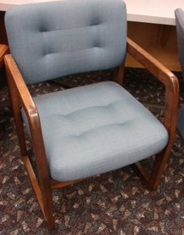
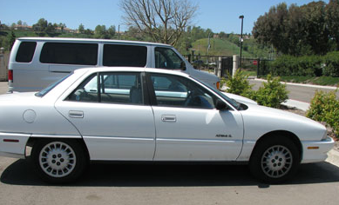
What does the Property Division do?
We assist agencies in acquiring and disposing of excess personal property. (41 CFR 102-36.55)
Notes:
More specifically, GSA Property: a) Screens and offers available excess personal property to Federal agencies and their eligible non-appropriated fund activities, contractors, cooperatives, and project grantees, b) Approves and processes transfers of excess and surplus personal property to eligible activities, c) Conducts sales of surplus and exchange/sale personal property, d) Maintains the GSAXcess and GSAAuctions automated systems to facilitate the reporting, transferring and sale of excess and surplus personal property. We also provide training on our programs, regulations, procedures and systems.

Slide 4
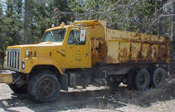
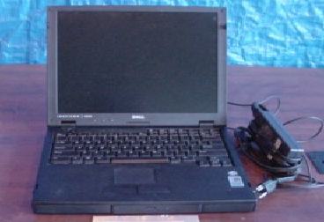
Personal property includes:
Any item that is not real property --
Office Equipment, furniture, computers,
scientific devices, heavy machinery,
medical equipment and supplies, Foreign
Gifts, Firearms, Aircraft, and Vessels.
It does NOT include:
Land or Permanent Buildings
Battleships, Cruisers, Submarines
Aircraft Carriers or Destroyers
Notes:
Personal property means any property, except real property. It includes anything your agency may need to successfully perform their mission.
Real property
Federal land, office buildings, warehouses, lighthouses, mineral rights, etc, come under the purview of the GSA Public Buildings Service, Real Property Utilization and Disposal Division
Batteships, Cruisers, Submarines , Aircraft Carriers and Destroyers cannot be transferred/donated or sold and must be decommissioned when no longer needed.

Slide 5
Authority/Law
Section 521 of title 40, United States Code, authorizes GSA to prescribe policies to promote the maximum use of excess Government property.
Federal Executive agencies are legally required
(41 CFR 102-36) to report excess personal property to GSA for screening and disposal.
Notes:
Government regulations mandate that federal agencies acquire excess personal property first, before purchasing new items. This ensures that property already paid for with taxpayers’ money is used to its fullest extent and allows agencies to avoid the expense of new procurements. Before purchasing new property, check with the appropriate regional GSA Personal Property Management office or access GSAXcess® for any available excess personal property that may be suitable for your needs. You must use excess personal property unless it would cause serious hardship, be impractical, or impair your operations.
Reporting excess personal property to GSA helps assure that the information on available excess personal property is accessible and disseminated to the widest range of reuse customers.

Slide 6
Acquiring Excess Personal Property
It’s the law (FAR Subpart 8.102)
When practicable, agencies must use excess personal property as the first source of supply for agency and cost-reimbursement contractor requirements. Agency personnel must make positive efforts to satisfy agency requirements by obtaining and using excess personal property (including that suitable for adaptation or substitution) before initiating a contract action.
Notes:
The various regulations contained within U.S. Code, the Code of Federal Regulations and the Federal Acquisition Register authorize the Administrator of General Services to prescribe regulations and policies to promote the maximum use of excess Government personal property by executive agencies before initiating new procurements.

Slide 7
What must we consider when acquiring excess personal property?
There must be an authorized requirement.
The cost of acquiring and maintaining the excess personal property (including packing, shipping, pickup, and necessary repairs) does not exceed the cost of purchasing and maintaining new material.
You must not acquire excess personal property with intent to sell or trade for other assets.
(41 CFR 102-36.70)
Notes:
Consider the following when acquiring excess personal property: (a) There must be an authorized requirement, (b) The cost of acquiring and maintaining the excess personal property (including packing, shipping, pickup, and necessary repairs) does not exceed the cost of purchasing and maintaining new material, (c) The sources of spare parts or repair/maintenance services to support the acquired item are readily accessible, (d) The supply of excess parts acquired must not exceed the life expectancy of the equipment supported, (e) The excess personal property will fulfill the required need with reasonable certainty without sacrificing mission or schedule, (f) You must not acquire excess personal property with the intent to sell or trade for other assets.

Slide 8
Importance of Reporting Property as Excess (41 CFR 102-36.210)
Mandated by law
Saves Tax Payer’s Money
Agency Budget Cuts – Provides them a way to acquire property reported as excess without purchasing new.
Supports Sustainability and Going Green - Personal Property is considered the “Original Green Program”
Keeps Agency’s inventory current
Notes:
§102-36.210 Why must we report excess personal property to GSA?
You must report excess personal property to promote reuse by the government to enable federal agencies to benefit from the continued use of property already paid for with taxpayers' money, thus minimizing new procurement costs. Reporting excess personal property to GSA helps assure that the information on available excess personal property is accessible and disseminated to the widest range of reuse customers.

Slide 9
FEDERAL DISPOSAL PROCESS
EXCESS
SURPLUS
AAMS/EADS/IADS
FEDERAL & STATE SCREENING 21 DAYS
DONATION
NOTIFICATION
5 DAYS
INTERNAL AGENCY
SCREENING
SALES
CFL SCREENING/ 7 DAYS
Internal
Agencies/Bureaus
of your Dept
USDA - 15
VA - 10
GSA - 2
DOE – 12
DOI – 15
DHS - 15
Agencies choose to participate in CFL. Qualified Schools Screen Computer Equip. First 7 Days of 21 Day Screening Period. Fed & State can’t see items during this time.
Federal Agencies
Cost Reimbursable Contractors
Grantees
Only if donation request. After allocated, 15 Days to Remove
Sales 10 - 30 days
Public Airports
State Agencies for Surplus Property
Nonprofit Educational & Public Health Activities
Service Educational Activities
(14 days if CFL equipment)
Notes:
This is a Personal Property Disposal flow chart that graphically depicts the disposition process. The chart shows the distinction of excess and surplus property as well as highlighting the overall screening timeframes and the systems that GSA offers to support these functions.
Internal agency screening is the first step. Some agencies have a system they use for internal screening AAMS – Agency Asset Mgmt System (DOC, VA, USDA, DHS), EADS – Energy Asset Disposal System, IADS – Interior Asset Disposal System. If no one within the agency requests the property, it becomes “Excess”.
Second, is the concurrent screening for Federal and donation customers and federal removal. Listed are the major categories of eligible activities. If the item is computer related equipment with an FSG of 70, then you can choose to have it screened by schools and educational non-profits for 7 days before Federal and Donation screening.
Next, the 5 day notification period allows GSA’s allocating regions to make proper allocation of property to donation customers. The 5 days only come into play if a State Agency for Surplus Property or donation customer makes a request. After that, property is available for public sale, by GSA or the owning agency. 7 Sale Methods: Online, Live, Sealed Bid (term contract), Spot Bid, Drop By, Negotiated, and Fixed Price

Slide 10
How long does the disposal process take?
U & D Screening Time Frames
Internal screening varies by agency
21 calendar days GSA Federal/Donation screening
First 7 days of 21 day period - Computers For Learning (CFL)
14 calendar days – Office Furniture (FSC 7110)
2 business days – Exchange/Sale Property
Removal – 15 days normal, 21 days for DOD excess
Sales Time Frames
30 calendar days average sales cycle time
(includes verifying availability, posting, collection & removal)
Notes:
Average total cycle time is does not include internal screening time frames.

Slide 11
How does GSA Property assist agencies with disposal?
Property is first offered to other Federal agencies
This helps to avoid Federal agencies from buying something that another agency already has but does not need.
It also helps in disposing of property that is not needed but would otherwise have to be stored if a new home is not found.
Notes:
***PAUSE FOR QUESTIONS***UTILIZATION

Slide 12
Next, the property is offered to the State Agencies for Surplus Property
If no Federal requests, GSA can give the property to the States.
This helps save taxpayer money within the States and U.S. Territories
The property is only given to one agency in each State – the State Agency for Surplus Property (SASP)
Each State and Territory has a SASP
www.nasasp.org

Slide 13
State Agency for Surplus Property’s Role
Distributes Federal surplus personal property to eligible donees for a service fee
The SASP determines who is eligible for Federal property based on Federal laws, rules and regulations.
Conducts compliance checks to ensure the property is used for the purpose for which it was given.
(41 CFR 102-37.130)
Notes:
§102-37.130 What are a SASP's responsibilities in the donation of surplus property?
As a SASP, your responsibilities in the donation of surplus property are to:
(a) Determine whether or not an entity seeking to obtain surplus property is eligible for donation as a:
(1) Public agency;
(2) Nonprofit educational or public health institution; or
(3) Program for older individuals. (Older Americans Act provides grants to agencies that provide assistance to older Americans with programs such as: long-term care facilities and agencies that address rehabilitation, chronic pain, malnutrition, screenings for disease, etc.
(b) Distribute surplus property fairly, equitably, and promptly to eligible donees in your State based on their relative needs and resources, and ability to use the property, and as provided in your State plan of operation.
(c) Enforce compliance with the terms and conditions imposed on donated property.

Slide 14
Who qualifies for property under the SASP? (41 CFR 102-37.380)
Public Agencies - Local, County, Regional, or State
Supported by tax dollars
Created by law
Certain Non-Profit, Tax Exempt Organizations
Educational, Health, or Elderly
Homeless or Impoverished
Veterans Service Organizations
SBA 8(a) Contractors
Notes:
Public agencies include libraries, park districts, police/fire departments, schools, cities, townships, county boards, etc. Nonprofit Organizations: IRS 501(c)(3) recognized tax exempt entities primarily in health or education. Nonprofits include childcare centers, volunteer fire departments/rescue squads, homeless/needy providers, museums, historic light stations, rehab centers, hospitals, Older American Act Fund recipients, schools, veterans groups with health or educational programs, etc. Veteran – Ex. Wounded Warrior Project, SBA – minority business owner, woman owned business, or small disadvantaged business.

Slide 15
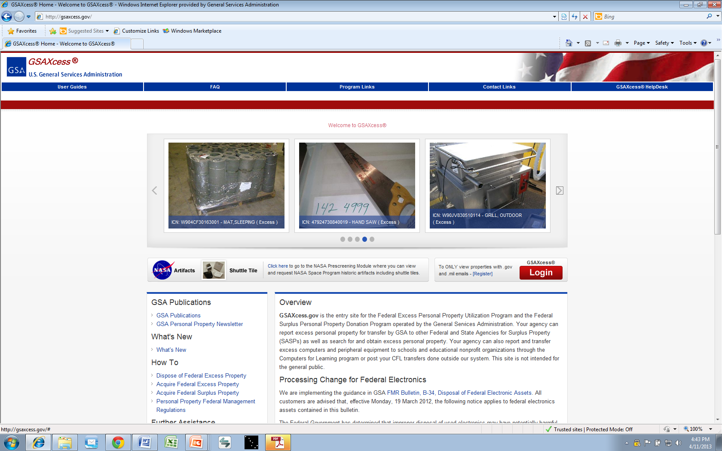
How do Federal agencies and the States find out what property is available?
GSA’s internet database of all excess property
www.GSAXcess.gov
Notes:
Authorized screeners may access GSAXcess® for any available excess personal property that may be suitable for their needs. They may also check with their local Area Property Officer or schedule onsite screening at various Federal facilities.

Slide 16
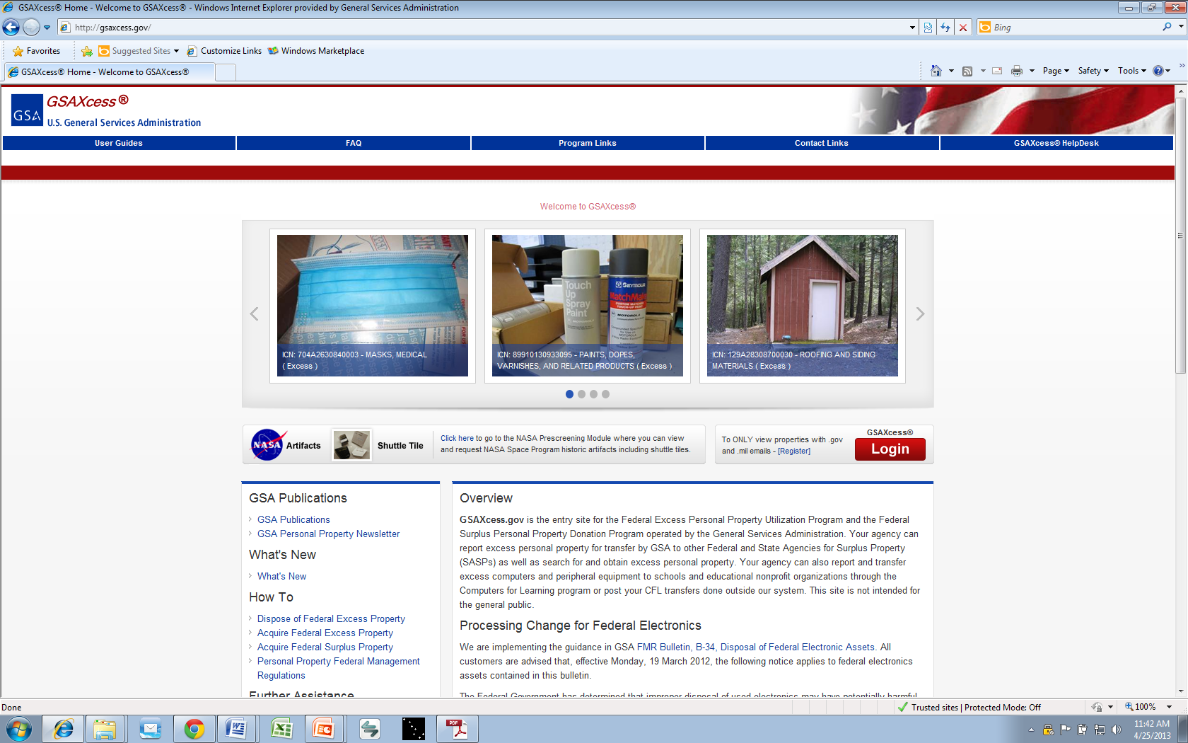

Slide 17
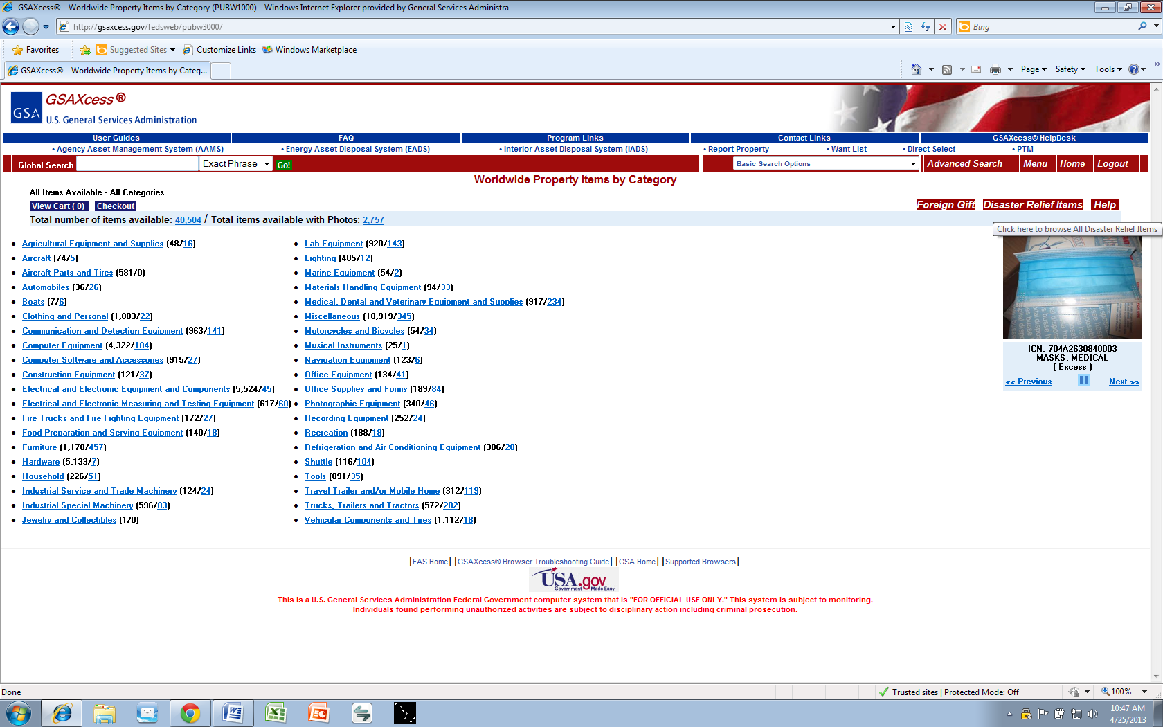

Slide 18
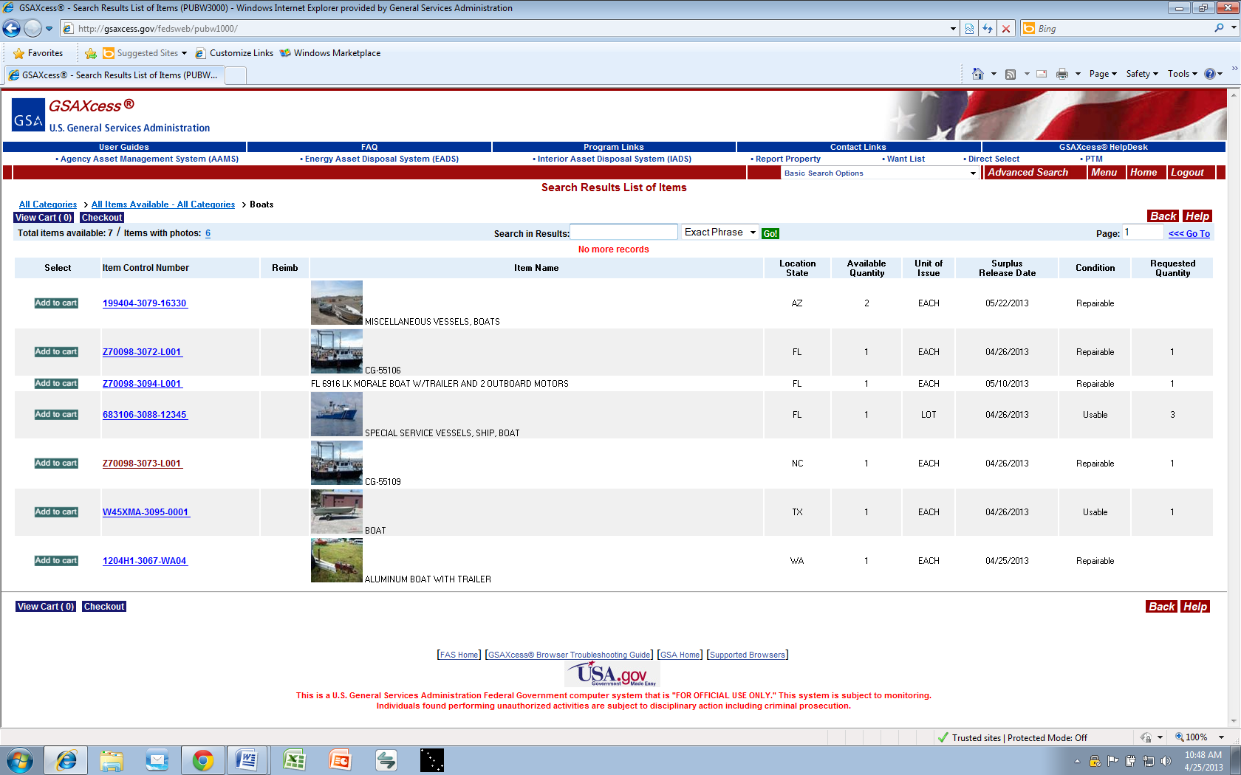

Slide 19
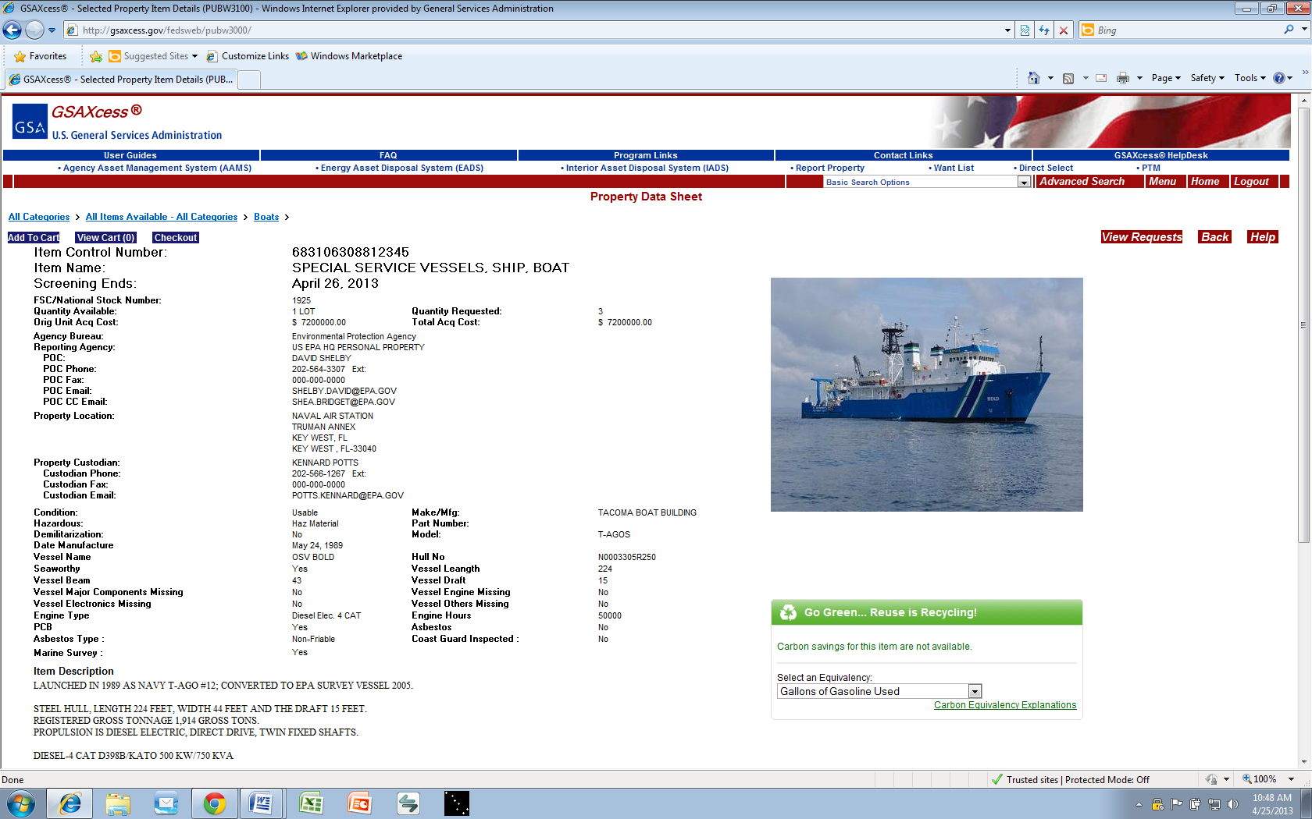
Notes:
***PAUSE FOR QUESTIONS*** DONATION

Slide 20
GSAXcess.gov Highlights
Approximately 6,000 individual associates currently accessing GSAXcess.gov
Cost Avoidance: FY19 Nationwide (Oct 2018 – July 2019):
Total Transfers - $525,393,039
Total Donations - $328,563,479
Total CFL - $ 44,092,858
Notes:
Where do you get number of associates currently accessing GSAXcess?
RCS 08 – Transfers & CFL
RCS 84 - Donations

Slide 21
What if no Federal Agency or State wants the property?
The Personal Property Management Division will then offer the property for auction to the general public on GSA’s internet auction site:
GSAAuctions.gov

Slide 22
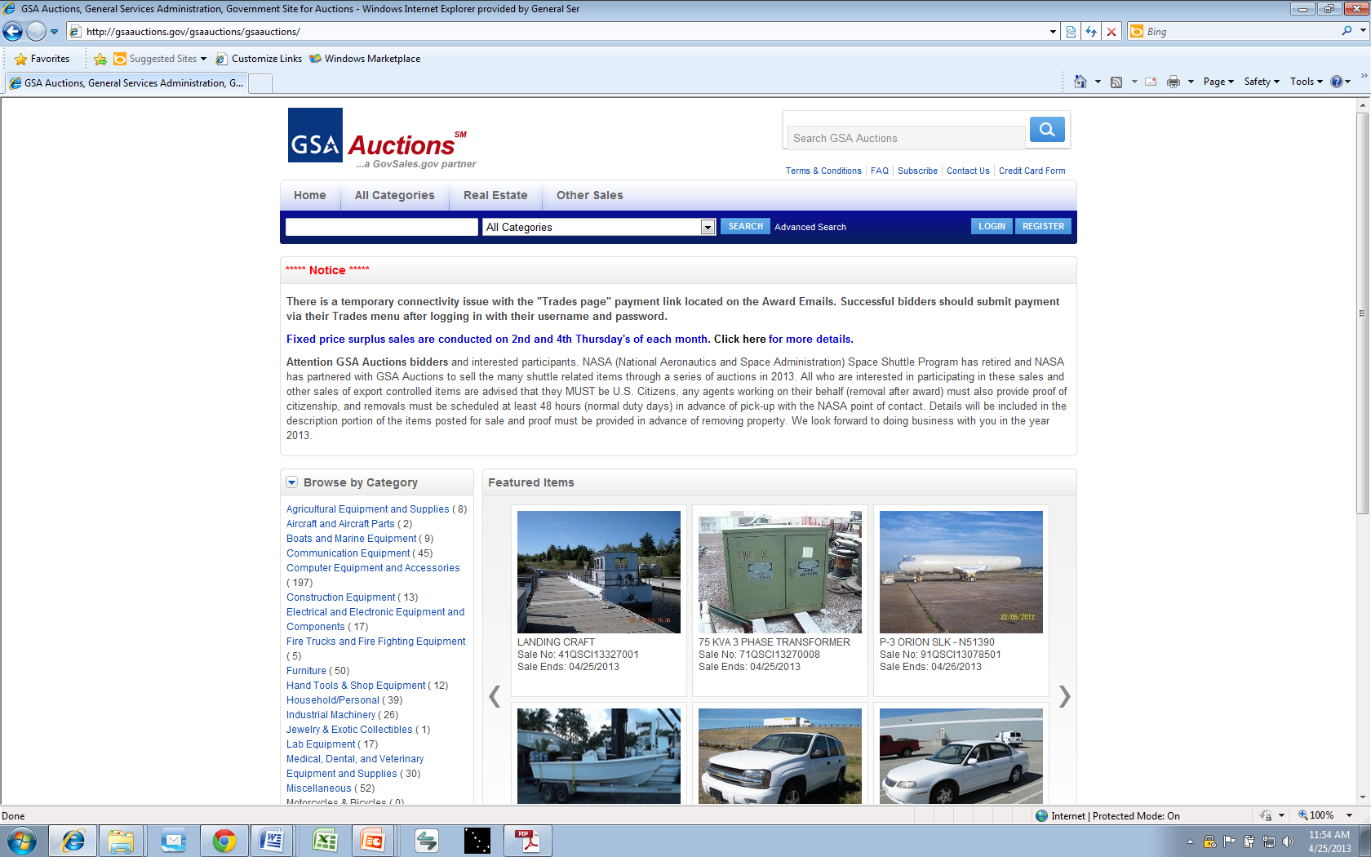

Slide 23
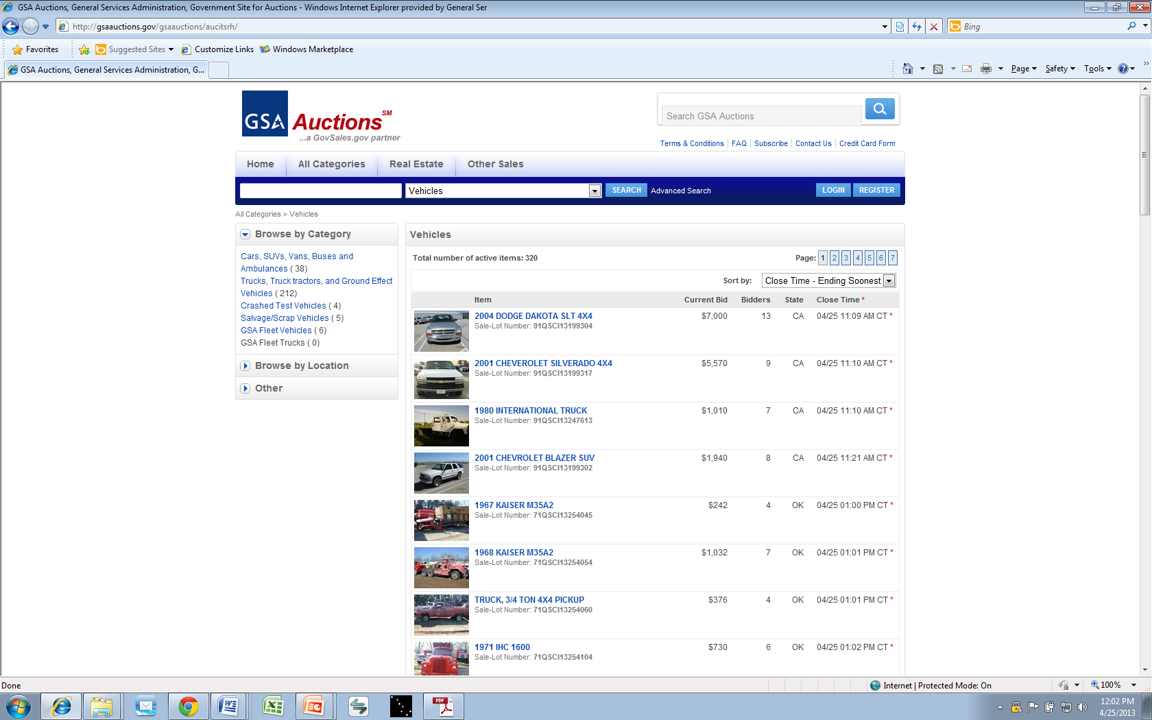

Slide 24
Who can bid on GSAAuctions.gov?
The general public
Private individuals
Businesses and companies
GSA employees are not allowed to bid on anything being sold on GSAAuctions.gov

Slide 25
Who in GSA should I contact for help in answering my disposal questions?
For questions and help in answering disposal questions, you contact the APO responsible for the state where the property is located.
https://gsaxcess.gov/htm/xcesscontlinks.htm

Slide 26
In Summary….
The Property Division assists Federal Agencies in disposing of property by:
Offering excess property to other Federal Agencies
If no Federal interest, the property is then offered to the State Agencies for Surplus Property
Finally, if still no interest, the property will be offered for sale to the general public by GSA.

Slide 27
Questions

