Slide 1
GSA, Pacific Rim Zone,
Personal Property Management

Slide 2
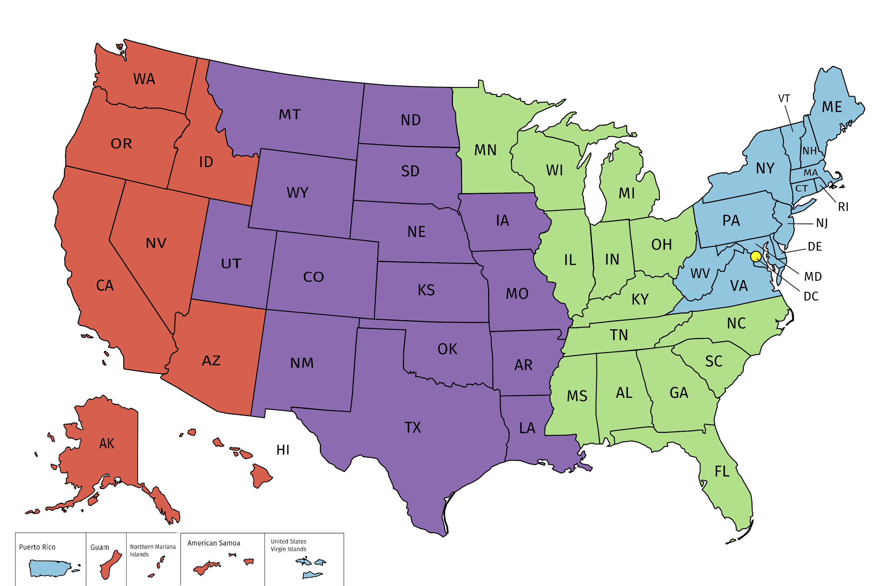
Personal Property Management Centers of Expertise
Mid-Atlantic
COE for Naval Vessels, animals El/Com/SAR - Eastern States
Southeast GL
COE for Civilian Vessels; Donation Allocations and Sales Collections - Eastern States
Southwest Central
COE for Firearms, El/Com/SAR - Western States
Pacific Rim
COE for Aircraft, Donation Allocations and Sales Collections - Western States,
National Capital
COE for Foreign Gifts
Notes:
We are the Center of Expertise for Eligibility and Compliance for the SASP’s in the western half of the US.
We manage the National Firearms Program to LEAs.
We are the Sales Center for: Bureau of Land Management (BLM), Army & Air Force Exchange Service (AAFES) and US Army/TACOM

Slide 3
Pacific Rim Zone U&D TEAM Intro!
Billie Hayes
Francine McCollister
Gerry Giauque
Jerry Penrose
Randal Patterson
Sandra Klar
Sharon Gorospe

Slide 4
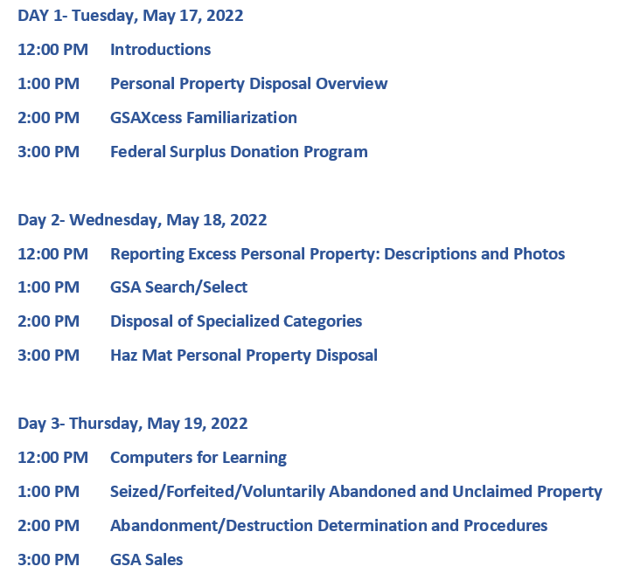
AGENDA OVERVIEW

Slide 5
THANK YOU!

