Slide 1
Acquiring Excess Personal Property

Slide 2
Acquiring Excess Personal Property
Who Can Acquire Excess Personal Property?
Federal agencies;
The Senate;
The House of Representatives;
The Architect of the Capitol and any activities under his direction;
The DC Government and Mixed ownership government corporations.
FMR: 102-36.60 through .75

Slide 3
Why must we use excess personal property instead of buying new property?
It maximizes the return on Government dollars spent and minimizes expenditures for new procurement.
FMR 102-36.65

Slide 4
What must we consider when acquiring excess personal property?
There must be an authorized requirement.
The cost of the property does not exceed the cost of purchasing and maintaining new materials.
You must not acquire excess personal property with intent to sell or trade for other assets.

Slide 5
When property is disposed of by another agency under the exchange/sale authority, how much do we pay?
The amount of reimbursement is normally the fair market value.

Slide 6
How to Acquire Excess Personal Property
Using GSAXcess;
Submit a “Want List” in GSAXcess;
Conduct on-site screening at various federal facilities;
Contact GSA Area Property Officer;
Direct Transfer.

Slide 7
Requesting Agency’s Responsibilities
The requesting agency is responsible for shipping and transportation costs.
Arranging the pickup by the 15th day the transfer document is approved.

Slide 8
Checkout Email Confirmation
A Checkout Confirmation does not mean that you will automatically receive the property. Since this item was checked out as a Priority Situation, GSAXcess includes a reminder in case it was selected in error.
Notes:
Once you successfully checkout, you will receive a confirmation email detailing what your checked out. The GSA Area Property Officer will now be able to see your request and allocate the property among the requestors. When you receive a checkout email, that does not necessarily mean that you will automatically receive the property. If there are competing requests the GSA Area Property Officer uses a set of pre-determined criteria and property experience to allocate the item.

Slide 9
GSAXCESS PROPERTY TRANSFER ORDER “ALLOCATED”

Slide 10
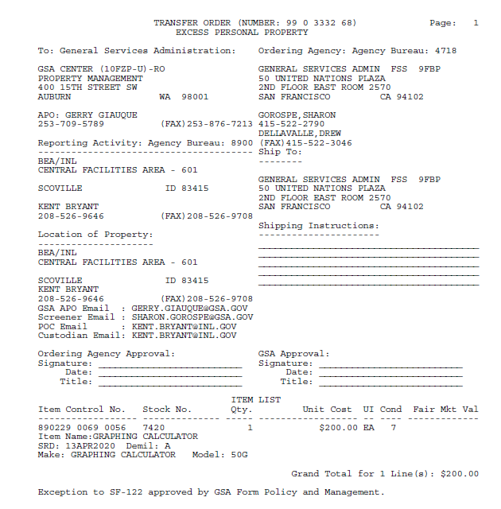

Slide 12
COMPLETELY APPROVED

Slide 14
GSA Starmark Logo

