Slide 1
GSA Online Platforms for Market Research
presented by
Mark Reiss
US General Services Administration
June 15, 2017

Slide 2
Agenda
Overview of GSA
GSA provides eTools to assist agencies during each phase of the acquisition process and to help with performing effective market research. These eTools include:
GSA Advantage!
GSA eLibrary
GSA eBuy
Green Procurement Compilation in the Sustainable Facilities (SF) Tool
Acquisition Gateway

Slide 3
GSA Contract Vehicles
Schedules -
Largest and most preferred acquisition program
Commercial products and services
IDIQ Contracts -
Technical expertise
A&E, construction, professional services
OASIS
GWACS -
Information technology contracts
Alliant, 8(a) STARS

Slide 4
Market Research
Cornerstone of smart procurement
Understand requirement. What is minimum needed?
Define salient features – form, fit and function
Review preferred sources of supply, existing contracts, top performers, competitors and more.
Conduct price analysis
Seek best value - reasonable price and timely/reliable/quality service.

Slide 5
Sources for Market Research
Internal databases
Spend reports
Search Engines - Google (trade terminology)
General Information Sources
Trade Journals, catalogs
Recent acquisitions of comparable type.

Slide 6
GSA Advantage!
Search
Seek Sources
Check availability
Compare
Seek discounts
_{www.gsaadvantage.gov}
A collection of digital catalogs from GSA vendors with product descriptions, pricing and terms.

Slide 7
GSA Advantage!
Easy to find what you need
Advanced search filters; e.g. green or business size filters
Extensive products and services; 30 Million+
Other search tools
Competitive pricing
Ceiling pricing for one each
Competitive marketplace driven by 20,000+ vendors
Flexible payment and delivery options
Integration with other GSA platforms and services

Slide 8
Federal Strategic Sourcing
Directive from Office of Management and Budget (OMB)
Joins requirements across agencies and leverages buying power.
Cost savings government-wide for commonly purchased commodities, thereby saving taxpayer funds.
Blanket Purchase Agreements implement Strategic Sourcing on GSA Advantage

Slide 9
eLibrary
Schedules listings
Vendor data
Descriptions
Clauses
_{eLibrary}
_{www.gsaelibrary.gsa.gov}
eLibrary - The official online source for complete GSA contract information – a great market research tool.

Slide 10
GSA eLibrary
Robust database of latest GSA contract awards.
Updated daily.
Sorted by GSA schedule and contract type.
Provides points of contact.
Solicitation and contract terms and conditions.
Ability to search by: Contract Number, Schedule/SIN/GWAC Number, Contractor/Manufacturer, Name or NAICS
Notes:
GSA e-Library is a powerful search engine that can help you find what you’re looking for in multiple ways.

Slide 11
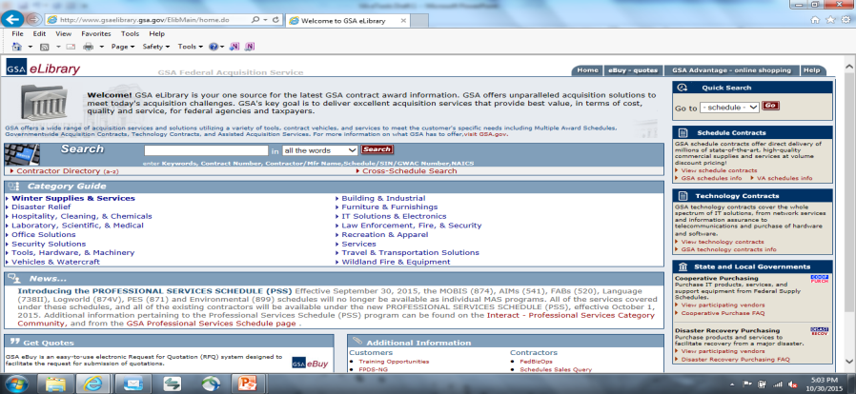
GSA eLibrary
Notes:
You can search by keywords, contract number, contract/manufacturer name, schedule name, NAICS or special item number. If you know the schedule number you can use the drag down menu on the web site and go directly to the contract information you need.

Slide 12
eBuy
Post Requirements
Issue RFI/RFQ
Forward RFI/RFQ
_{www.ebuy.gsa.gov}
eBuy - An online RFI/RFQ system that allows contracting representatives to post requirements, seek sources, and forward documents.
Notes:
Services (highly customizable, attach requirements)
Obtaining volume discounts beyond contract pricing for high quantity or high dollar purchases
Purchases with complex requirements or combination product/service
Determining sources of supply (Request For Information)
Place RFQs directly against Blanket Purchase Agreements (BPAs)

Slide 13
What are the benefits?
Allows buying agencies to maximize buying power, by leveraging the power of the Internet to obtain quotations from GSA federal contractors.
eBuy provides:
a fast, efficient, and easy-to-use electronic RFQ system that streamlines the acquisition process
an interactive capability for all buyers to communicate requirements and for sellers to respond and quote via the web and email
the ability to negotiate further discounts at the order level.

Slide 14
Green Procurement Compilation
Identifies applicable federal green purchasing requirements
Organizes information by product and service categories
Consolidates federal green purchasing information in one location, including:
Legal requirements
Environmental program links
Potential purchasing options
Sample contract language
sftool.gov/GreenProcurement

Slide 15
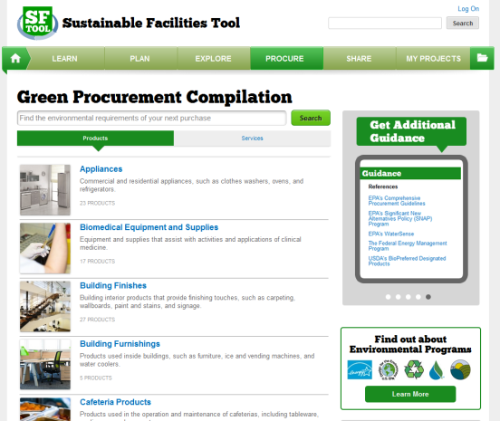
A Complete Purchasing Guidance Tool
sftool.gov/greenprocurement
Notes:
A great way to learn more about these programs and the products they cover is GSA’s Green Product Compilation (GPC) (http://sftool.gov/greenprocurement). GPC is a user-friendly guide to help you search for and identify green products, and also understand the environmental programs and federal purchasing requirements that relate to those products. GPC also offers a green services portal with guides for 8 service categories, including: Cafeteria & food services, Electronic leasing, Fleet maintenance, Janitorial services, Landscaping services, Laundry services, Meetings and conference services, and Pest management.

Slide 16
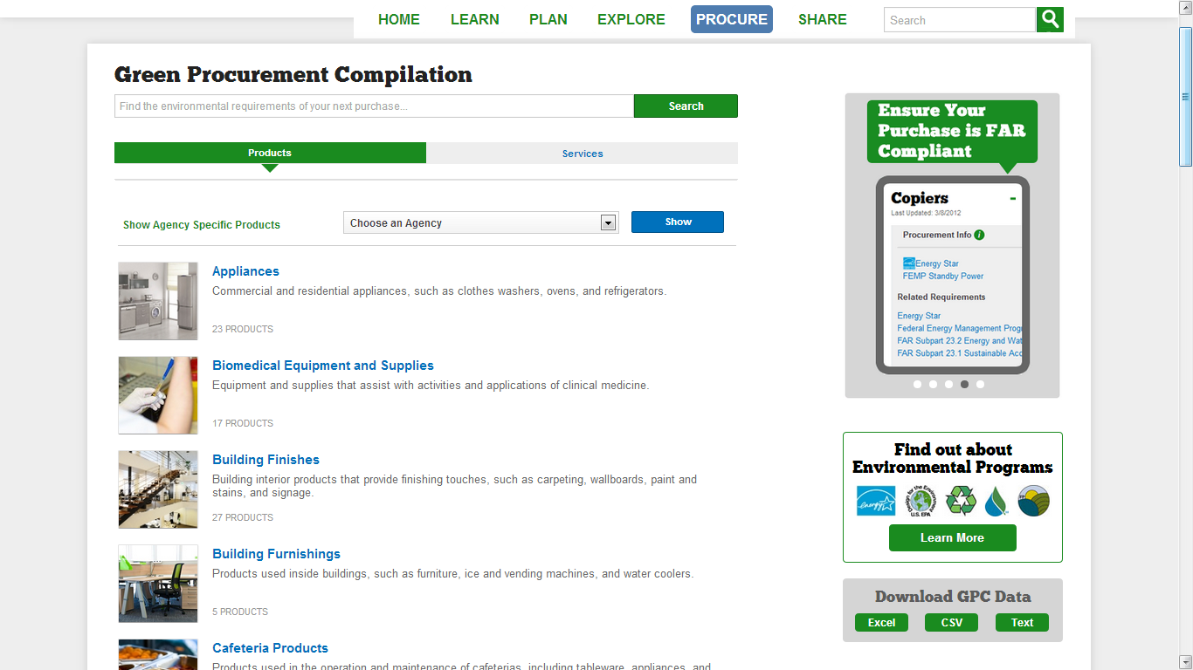
GPC Home Page
View products or services
Search for products
View agency-specific product information
Browse by product category
Notes:
http://sftool.gov/greenprocurement

Slide 17
Environmental Programs Page
Learn more about federal programs
Notes:
http://sftool.gov/learn/about/371/environmental-programs

Slide 18
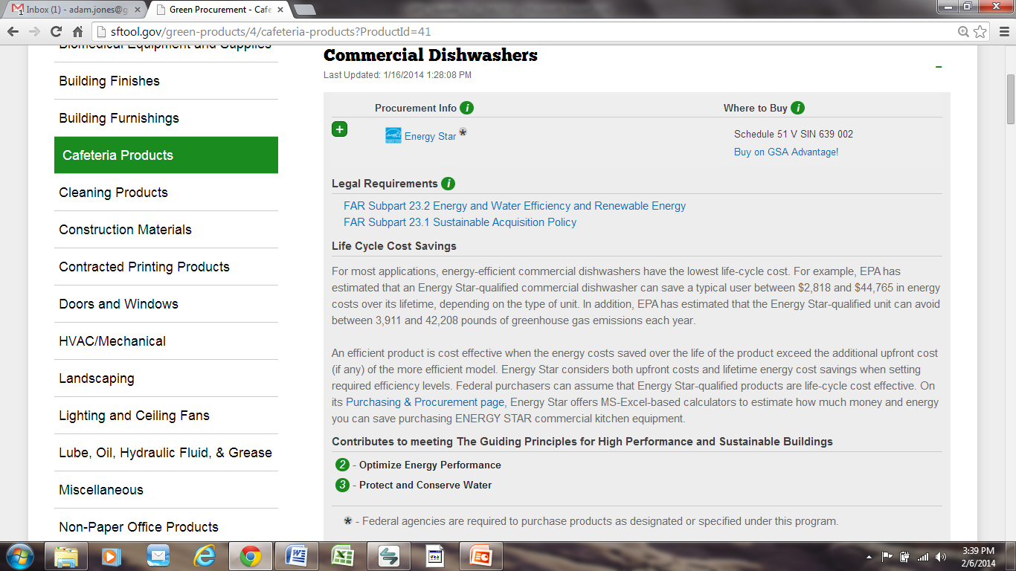
Product View
Identify the applicable environmental program
Find potential purchasing options
Find basic life cycle cost information for energy-consuming products
Identifies applicable Guiding Principles
Notes:
http://sftool.gov/green-products/4/cafeteria-products?ProductId=40

Slide 19
What is a Green Service?
Requires the use or supply of green products
May incorporate other sustainable features
Common examples include:
Building Construction, Renovation, & Repair | Landscaping Services
Building O&M Services | Laundry Services
Cafeteria Services | Meeting & Conference Services
Electronic Equipment Leasing | Pest Management
Fleet Maintenance | Transportation Services
Notes:
No standard definition at this time
For purposes of the 95% requirement…

Slide 20
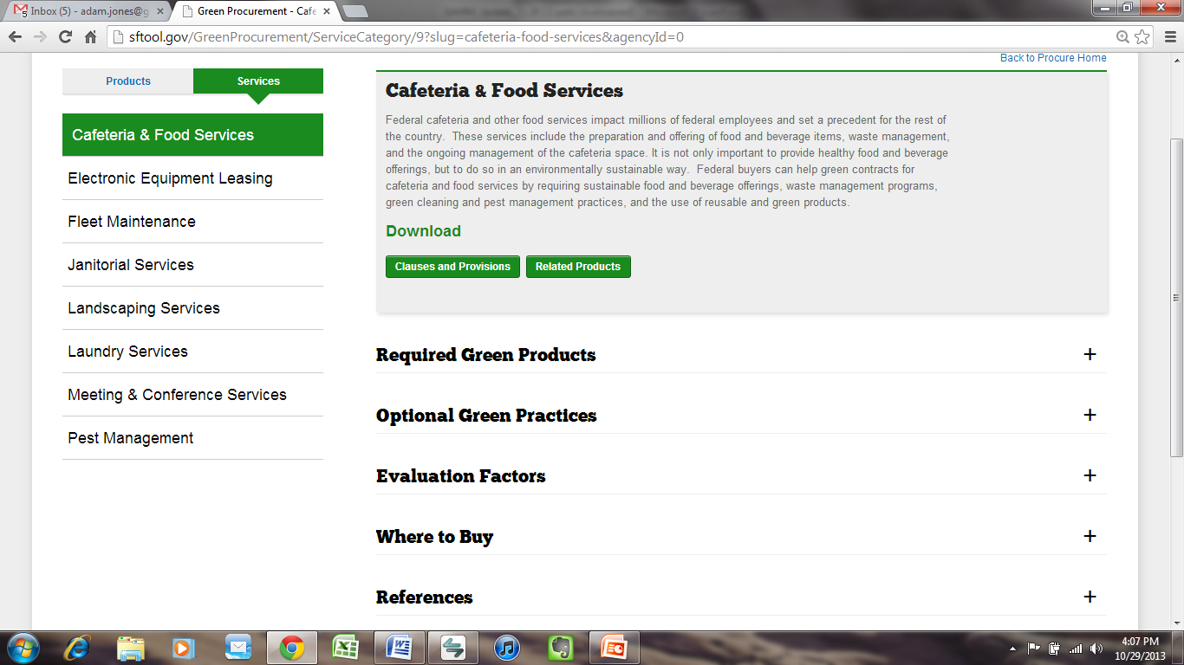
Service View
Download applicable clauses/provisions and related products lists
Click headers to expand
Notes:
http://sftool.gov/greenprocurement/ServiceCategory/9?slug=cafeteria-food-services&agencyId=0

Slide 21
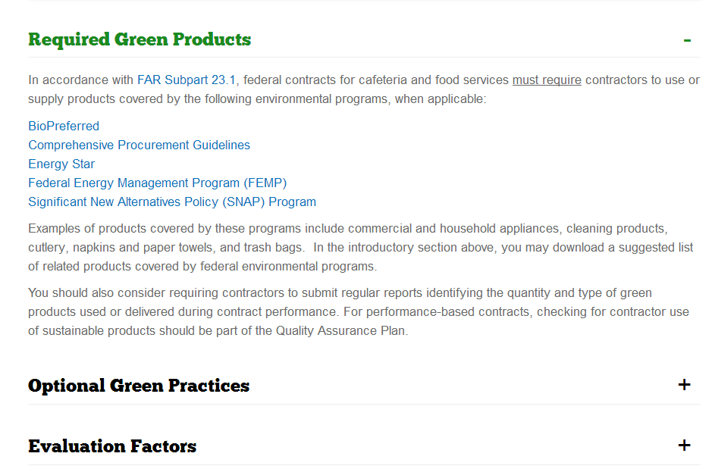
Services: Required Green Products
Identifies applicable environmental programs

Slide 22
Acquisition Gateway
hallways.cap.gsa.gov
Notes:
The Acquisition Gateway is a workspace for the Federal acquisition workforce. The Gateway helps acquisition professionals learn how to do their jobs better. They connect with peers and experts to collaborate and help each other. They act confidently to accomplish their tasks effectively. Our users find solution comparisons, tools, templates, success stories, prices paid data, and more that support successful outcomes at each step of the acquisition lifecycle.

Slide 23
Category Management
A purchasing approach to buy smarter and more like a single enterprise.
Enables the government to eliminate redundancies, increase efficiency, and deliver more value and savings from the government’s acquisition programs.

Slide 24
Category Management Goals
Category management seeks to achieve the following goals around cost savings, knowledge sharing, relationship-building, and efficiency:
Increase Cost Savings
Increase spend under management
Achieve volume savings
Achieve administrative savings
Foster Knowledge Sharing
Share best practices
Grow and share expertise
Promote Efficiency
Reduce contract duplication
Enhance transparency
Create better contract vehicles
Manage data collection and analysis
Enable better decisions
Improve Relationships
Maximize purchasing agency relationships
Leverage supplier relationships
Optimize buying channels
Manage the solution landscape

Slide 25
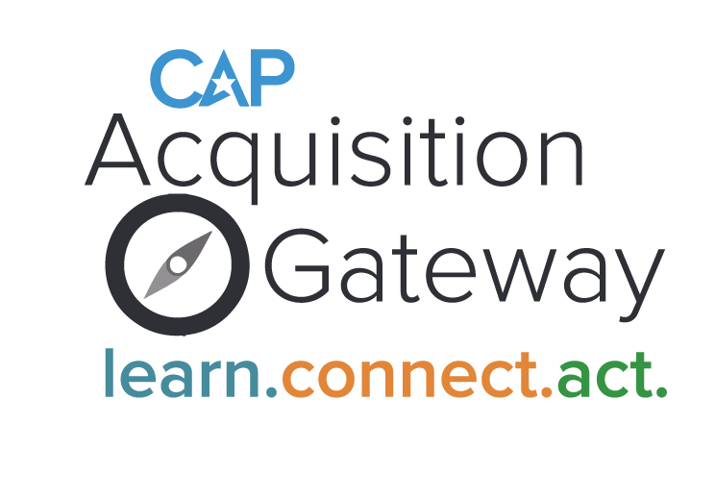
Acquisition Gateway
The online platform that implements category management.
The resource center that aims to improve and sustain federal agency performance by empowering agency professionals across the government with access to acquisition information, data, and tools.

Slide 26
Acquisition Gateway Features
Hallways - Contain information and tools specific to each category management category or sub-category
Project Center - A personal location in the Gateway where users can save statements of work, community posts, and other information relevant to their acquisitions
Solutions Finder - Search tool to allow federal buyers to locate “best-fit” contract vehicles across federal agencies
“My Community” - A series of forums on specific acquisition topics, allowing users to ask questions of experts and participate in discussions with cross-agency peers
Documents Work Library - Users can share statements of work in a centralized location and have the ability to “upvote” their favorites
8

Slide 27
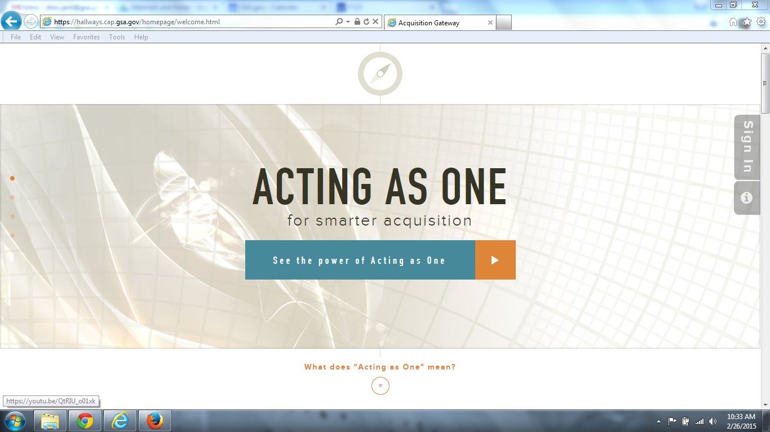
Registering on the Acquisition Gateway
1
Go to https://hallways.cap.gsa.gov
2
Click the Federal Employees Sign-in button
Federal employees/contractors with a non-government email address as well as non-federal employees performing Federal activities should contactMAXSupport@omb.eop.gov or 202-395-6860.
2

Slide 28
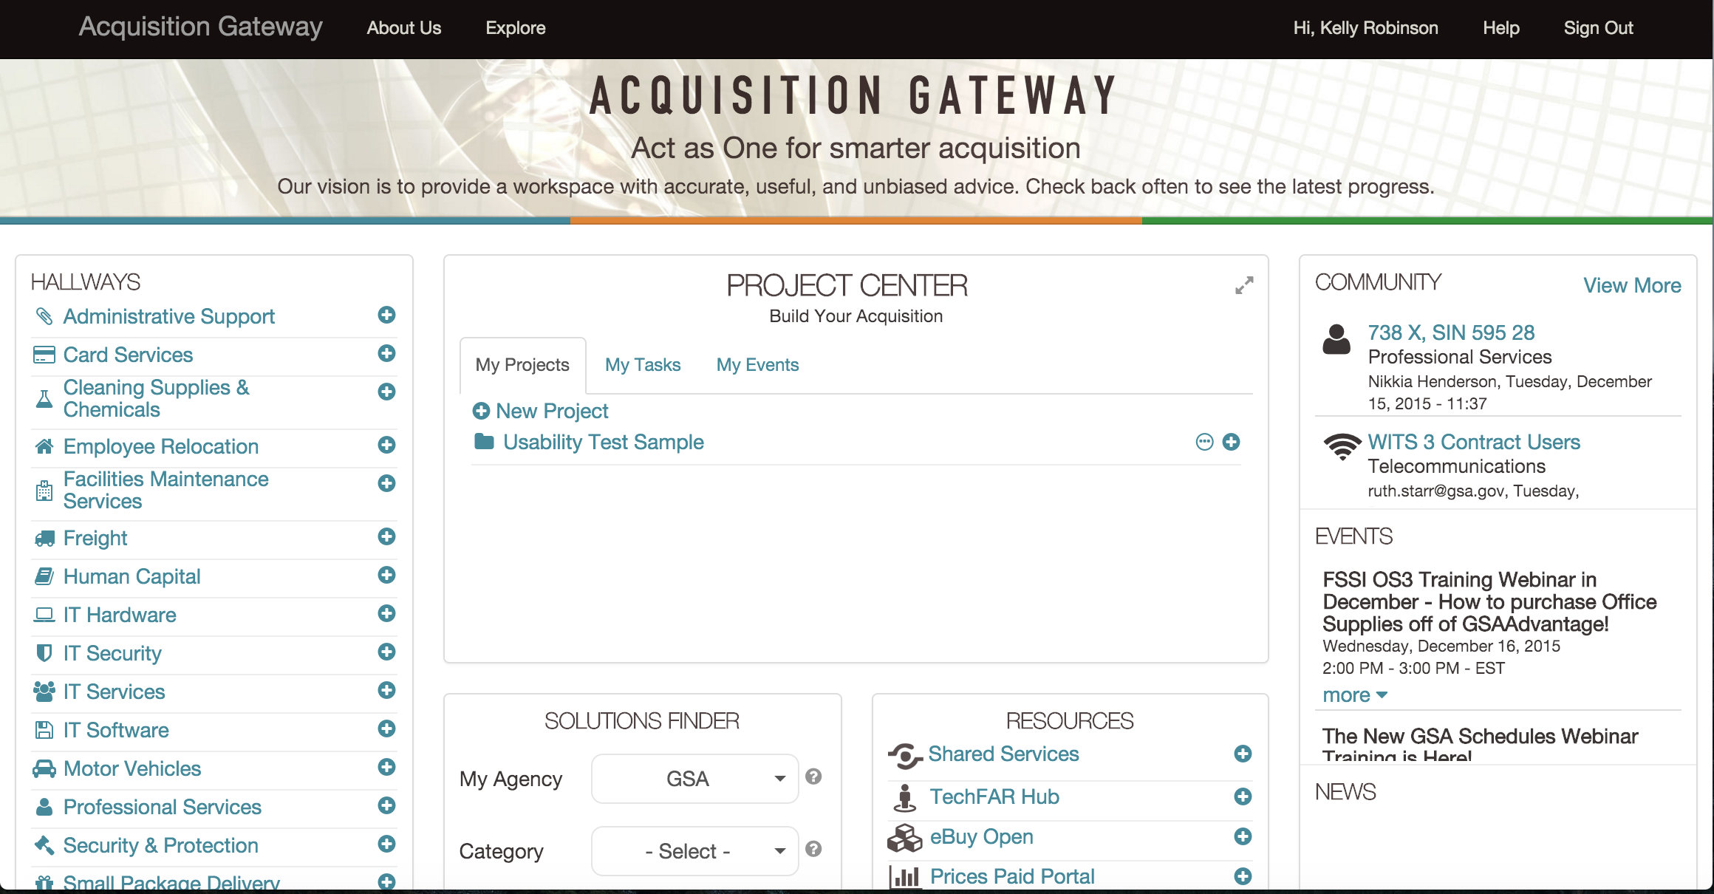
Acquisition Gateway - hallways.cap.gsa.gov
Notes:
Inside the Acquisition Gateway at hallways.cap.gsa.gov, users can explore product and service category hallways, connect with their peers, and use the resources.
Acquisition professionals will find solution comparisons, expert articles, templates, market research tools, prices paid data, and more to achieve successful outcomes at each step of the acquisition lifecycle.
For now, we are encouraging two behaviors as we build awareness of the Acquisition Gateway.
New users can log in and explore at hallways.cap.gsa.gov
Innovators are being asking to help us build.

Slide 29
Assisted Acquisition Services
AAS offers Federal agencies, contract and contract management support through the entire procurement process, from requirement definition to contract close-out.
AAS services are customized for the mission, providing full acquisition project management, and financial management support.
AAS specializes in large / mid-size, complex information technology, professional services and other requirements.

Slide 30
Why Partner With AAS:
Knowledgeable and Professional Staff
Team-based approach
Timeliness
Predictable Timelines Consistently Met
Demonstrated Cost Savings
On average, AAS negotiates a 10-percent savings
Best Practices
Internal QA reviews and checks
Best value awards
Life Cycle Partner
We’re there to provide support throughout the project

Slide 32
Contact Information
Mark Reiss
GSA Customer Service Director
50 United Nations Plaza
San Francisco, CA 94102
mark.reiss@gsa.gov
415-522-2799

