Slide 1
Sustainable Purchasing
Mark Reiss
GSA Customer Service Director
SF Bay Area June 15, 2017
Notes:
Federal agencies are required by statute and executive order to purchase certain products with specific environmental or energy attributes. This course will explore federal approaches for minimizing the environmental impact of purchased goods and services.

Slide 2

This presentation covers:
Environmental benefits of buying green products
Federal green purchasing laws and requirements
Green purchasing programs
GSA tools and resources
Buying commercial interior!

Slide 3


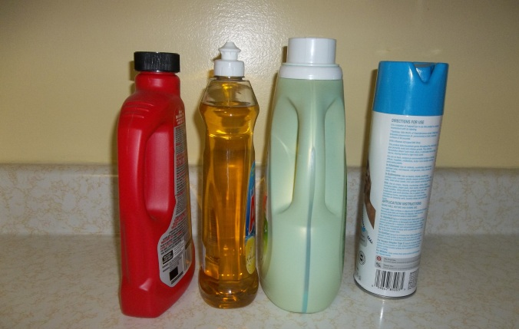
What is Green Purchasing or Sustainable Acquisition?
Purchasing products with specific environmental attributes
Purchasing services under which those products are used or supplied
Notes:
In terms of Federal procurement, “sustainable acquisition” or “green purchasing” refers to purchasing products with specific environmental attributes and purchasing services under which those products will be supplied or used. These environmentally sustainable products have less impact on human health and the environment compared to conventional products.

Slide 4
GREEN PURCHASING
Showing preference for products that are:
  - Made with recycled content
  - Bio-based
  - Energy efficient
  - Reusable – excess from other agencies
Notes:
The US Government uses its purchasing power, through the buying habits of its thousands of cardholders, to drive the market to produce a wider variety and greater number of products, services, and workspaces that are more sustainable.
Now, when shopping GSA, it is way easier to “go green”, since you can only find recycled copy paper and energy star appliances on GSA Advantage.

Slide 5




The Many Benefits of Going Green
Protects public health
Conserves natural resources
Reduces waste
Saves money
Creates new markets
Notes:
There are substantial benefits to buying green, including:
Human health and environmental benefits e.g., low- or non-toxic products
Savings of energy, water, etc. and resultant cost savings over the product life
ability to create markets and drive innovation. Green buying can create markets for materials and products

Slide 6
NASA
Earth Video

Slide 7

The Federal Footprint
The federal government:
  Spent $450 billion on goods and services in FY13
  Spends $74 billion annually on IT equipment and services
  Spends $3.5 billion annually to provide energy to its facilities
  Owns/leases 650,000 vehicles worldwide
  Manages or owns nearly 1 of every 5 acres in the U.S.
Notes:
A few facts….The U.S. government is one of the world’s largest consumers and the nation’s largest buyer and user of energy. With this buying power, federal purchasing decisions have a major effect on the environment. The Federal government has the opportunity and responsibility to procure sustainable products.

Slide 8



Green Purchasing: Rooted in Law
Legislative Act | Environmental Benefit
Clean Air Act (1970) | Reduces air pollution
Resource Conservation and Recovery Act (1976) | Reduces waste and promotes recycled content products
Pollution Prevention Act (1990) | Reduces use of toxic substances during production
Energy Policy Act (1992; 2005) | Energy efficiency and conservation
Farm Security and Rural Investment Act (2002) | Promotes biobased products
Notes:
The requirements to purchase sustainable products and services are addressed in three types of guidance: Federal laws, Executive Orders (EOs) and the Federal Acquisition Regulation (FAR).
Examples shown, goes back to 70s

Slide 9

Implemented through Rules and Guidelines
Executive Order 13693 (2015)
Planning for Federal Sustainability in the Next Decade
  Includes new green purchasing requirements
  Reduce federal GHG emissions 40% from 2008 baseline
  Supply chain GHG reporting requirement

Slide 10

The Federal Acquisition Regulation (FAR)
FAR consolidates many laws guiding acquisition.
Part 23 requires federal agencies to purchase products that are:
  Energy-efficient
  Biobased
  Non-ozone depleting
  Water-efficient
  Environmentally preferable
  Made with recovered materials
Notes:
Acquisition professionals must also comply with the Federal Acquisition Regulation (FAR). The FAR consolidates requirements from Federal laws, executive orders and other regulations into a single source. As a result, procurement professionals do not need to keep track of every law and executive order that affects the Federal acquisition process.
The FAR addresses environmental issues in various parts, most notably in FAR Part 23. FAR Part 23 identifies the Federal Government’s sustainable acquisition policy. It requires Federal agencies to ensure that 95% of new contract actions require products that are:
Energy-efficient
Biobased
Non-ozone depleting
Water-efficient
Environmentally preferable
Made with recovered materials
This policy applies to the acquisition of products and services of all dollar values, provided that the applicable green product(s) meets agency performance requirements. How to determine when applicable – GPC.
Note that most agencies also have internal policies and programs related to green purchasing, so additional requirements or goals may be specified in a Green Purchasing Plan or other regulation or policy at the agency level.
Part 7 and 10, Acquisition Planning –
-Part 8 - Required Sources of Supplies and Services,
-Part 10, Market Research,
-Part 11, Describing Agency Needs,
-Part 12, Acquisition of Commercial Items

Slide 11
GSA can help you go green!
Green Procurement Compilation
  Identify green purchasing requirements and find related guidance
GSA Advantage!® Environmental Program Page
  Find and purchase green products and services
GSA Buy Green Page
  Get basic information on buying green products, services, and vehicles through GSA
  https://gsa.gov/sustainability/#/products-services
Notes:
The Environmental Program aisle GSA Advantage! provides easy access to green products and services to help you meet your environmental purchasing goals.
GSA’s Buy Green page is a great place to start to get an overview about buying green products, services and vehicles. The page gives a short description of green purchasing programs and federal requirements and provides links for more information.

Slide 12


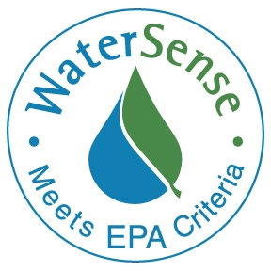
What is an environmental program?
Help buyers identify products and services with positive environmental attributes.
Many of these attributes are associated with specific environmental programs
  Example: ENERGY STAR and FEMP help buyers identify energy-efficient products
Visit the Green Procurement Compilation to determine which are required for federal purchases
  www.sftool.gov/greenprocurement
Notes:
Many of the environmental attributes identified in the Government’s sustainable acquisition policy are associated with specific environmental programs. These programs help buyers identify sustainable products and services.
For example, ENERGY STAR and the Federal Energy Management Program (FEMP) help buyers identify energy-efficient products. When acquiring energy-consuming products, agencies must purchase ENERGY STAR or FEMP-designated products, as applicable.
The Government’s environmental programs are managed by the Environmental Protection Agency (EPA), the Department of Energy (DOE) and the Department of Agriculture (USDA). As we’ll see later, the Green Procurement Compilation (GPC) consolidates information on products covered by these programs in one location.

Slide 13
Environmental Program Considerations
Buyers must be aware of issues related to:
  Quantity: There are more than 400 standards, labels, and claims
  Verification: Environmental claims may be “verified” or “self-designated”
  Number of Attributes: Programs may cover single or multiple environmental attributes
Notes:
In addition to the Federal environmental programs, there are third-party standards and labeling programs, which are not created or managed by the Federal Government. Environmental programs can simplify green purchasing, but there are a number of issues that program officials and buyers must be aware of.
Quantity
There are more than 400 environmental standards, labels and other claims in the commercial marketplace, and sorting through them can be daunting. As a Federal buyer, you should first determine if any of the Federal environmental programs are required for your purchase. After that, market research should point you to any additional programs that should be considered in your best value determination.
Verification
Environmental claims may be either verified or self-claimed. “Verified products” have been confirmed to meet specific environmental criteria. Examples of verified claims include ENERGY STAR, WaterSense and EPEAT. For example, products must receive independent, 3rd party certification in order to qualify for the WaterSense label.
Buyers must be aware of “self-claims,” whereby marketers may claim broad, unqualified environmental benefits like “environmentally safe” or “eco-friendly”. Some self-claims are difficult, if not impossible, to substantiate and can be misleading or outright false. Buyers should look for specific environmental benefits to accompany any general claim. For example, a claim of “reduced packaging” should be qualified by a statement that the packaging is reduced “compared to other similar products.”
The Federal Trade Commission (FTC) offers Facts for Consumers (available at http://www.consumer.ftc.gov/articles/0226-shopping-green) to guide them in shopping for environmentally sustainable products and services.
Number of Attributes
Most Federal environmental programs address a single attribute. For example, ENERGY STAR refrigerators are about 15% more energy efficient than other models (single attribute). However, the ENERGY STAR label says nothing about other phases of the product life cycle, such as how the product was manufactured. On the other hand, the EPEAT program covers multiple environmental attributes. EPEAT-qualified electronic equipment is not only energy efficient, it also meets a wide range of environmental criteria across the product life cycle – from material selection to end-of-life management.
Third-party standards and labels often address multiple attributes – ranging from product content to packaging to corporate sustainability policies. In general, buyers should look to address multiple environmental attributes across multiple phases of the product life cycle while still complying with policy requirements.
Right now, federal specifiers and buyers are on their own to determine which 3rd party programs are suitable, but help is on the way. EPA has draft guidelines out for public comment that, once implemented, should help identify which programs are suitable for federal use.

Slide 14




Comprehensive
Procurement
Guidelines
Designates products that contain recovered materials
Products made with recycled and recovered materials
Recommends purchasing practices and recycled content for products
Federal agencies must purchase products with the highest content of recycled material
Notes:
Under the Comprehensive Procurement Guidelines (CPG) Program, the EPA designates products that are or can be made with recovered materials and recommends practices for buying these products. Recovered materials are waste materials and by-products that have been recovered or diverted from solid waste, so the aim is to reuse these materials in the manufacture of new products. Like the BioPreferred program, EPA generally specifies a minimum percentage of recovered materials to be used in designated products.
EPA has designated over 60 products into eight categories
Landscaping Products (e.g., garden hoses made from 60-65% minimum recovered plastic/rubber)
Paper and Paper Products
Transportation Products
Miscellaneous Products
Construction Products
Non-Paper Office Products
Park and Recreation Products
Vehicular Products
Federal agencies are required to purchase products with the highest recovered material content level that is practicable. There is no CPG label for compliant products.

Slide 15


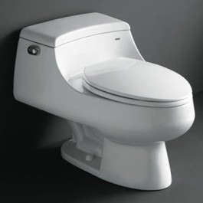
WaterSense®
Saving water reduces energy costs
Certifies water-efficient products
WaterSense® products are 20% more water efficient
Federal agencies are required to reduce water consumption by 26% between 2007-2020
Notes:
EPA’s WaterSense program qualifies water-efficient products and services. Labeling program! Products and services that earn the WaterSense label:
Are at least 20% more water-efficient than average
Are equal to or superior in performance to competing products
Receive independent, third-party certification
Provide measurable water savings
Examples include:
Bathroom sink faucets and accessories; showerheads
Toilets

Slide 16


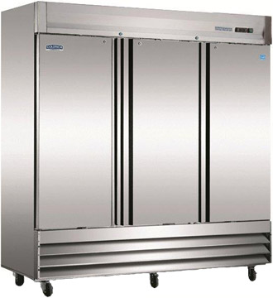
ENERGY STAR®
Reduces greenhouse gas emissions
Certifies and promotes
energy-efficient products
Federal agencies are required to purchase ENERGY STAR products
Products generally represent the top 25% of energy efficient products in the market
Notes:
The ENERGY STAR label helps consumers identify energy-efficient products and practices in over 65 product categories for the home and office. These products deliver the same or better performance as comparable models while using less energy and saving money.
Examples of ENERGY STAR products include:
Household appliances
Air conditioners and heat pumps
Light bulbs and light fixtures

Slide 17

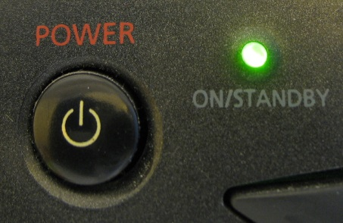
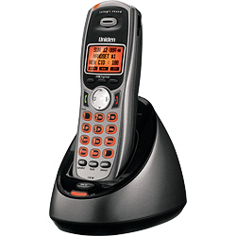

Federal
Energy
Management
Program
FEMP-designated products are in the upper 25% of their class for energy-efficiency
Also sets low standby power requirements
Sets energy efficiency
requirements for
product categories
Helps Federal agencies meet energy-efficiency purchasing requirements
Notes:
For certain product categories not covered by ENERGY STAR, DOE’s Federal Energy Management Program (FEMP) sets minimum energy-efficiency requirements. Products that meet FEMP requirements may be assumed to be cost-effective over their lifetimes. Unlike Energy Star, there is no FEMP label. You generally have to refer to manufacturer specifications to determine if a product meets the required level of performance. Examples of products covered by FEMP include:
Boilers and chillers
water heaters
Lighting controls
Larger, more industrial products

Slide 18



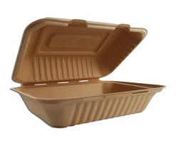
BioPreferred
Designates categories of products with biobased content
Promotes purchase of biobased products
Sets a minimum biobased content
Federal Procurement Preference
Notes:
The purpose of USDA’s BioPreferred program is to increase the purchase and use of biobased products. Biobased products, which replace petroleum-based products, are made from renewable agricultural materials, biological materials or forestry materials.
The BioPreferred program includes a Federal Procurement Preference initiative, where USDA designates categories of biobased products that Federal agencies and contractors must give preference to when making purchasing decisions. They also establish minimum biobased content levels for each product category. (e.g., hand sanitizer – 73% minimum biobased content)
There are over 100 BioPreferred designated categories required for preferred Federal purchasing. Examples include:
Disposable tableware
Cleaning solutions and products
Packing and insulating materials

Slide 19

Example of Sustainable Acquisition
Penn State use of biobased hydraulic fluid for on-campus elevators:
http://www.youtube.com/watch?v=Ts9vOsi9sU8
Notes:
Penn state has 109 hydraulic elevators on campus, which use 17,000 gallons of hydraulic fluid.
Occasionally the hydraulic fluid would leak out of the elevator, fall 5 or 6 stories to the bottom of the elevator shaft, and since it was petroleum based they’d have to clean the spill to prevent it from entering their groundwater system.
They estimated this was adding up to hundreds of thousands of dollars over a long period of time, in addition to the environmental concerns and the disruption of services.
Their university has a scientific expert on biobased lubricants and he recommended they move from petroleum to a biobased hydraulic fluid.
This switch has eliminated their clean-up expenses; it was an improvement from an environmental perspective; and it increased the efficiency of the university’s operations.

Slide 20


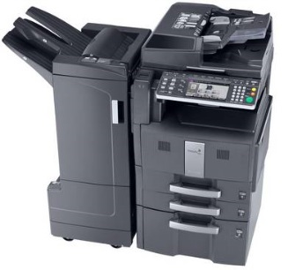

Electronic
Product
Environmental
Assessment
Tool
Products are rated on a combination of required and optional criteria
Products earn gold, silver, or bronze rating based on how many optional criteria they meet
Life cycle rating system for
electronic products
Federal agencies are required to purchase EPEAT products
Notes:
EPEAT® is a comprehensive environmental rating system that makes it easy for purchasers to select environmentally preferable electronic products. Products categories covered by EPEAT include:
Computers & Displays
Imaging Equipment
Televisions
Under the EPEAT system, products are measured against both required and optional criteria that cover the full life cycle of electronic products, including:
Reduction/elimination of environmentally sensitive materials
Material selection
Packaging
Product longevity
Energy conservation
Design for end of life
End-of-life management
Corporate performance
EPEAT products are rated Bronze, Silver or Gold, depending on the number of optional criteria they meet.

Slide 21
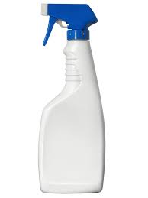



Safer Choice®
Identify and select products with safer chemical ingredients
Certifies and promotes
safe cleaning (and other) products
Formerly Design for the Environment (DFE)
Over 2,000 products!

Slide 22



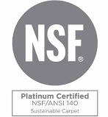
EPA Recommended Standards and Ecolabels
Furniture
  BIFMA level
  UL 2818 Greenguard
Flooring
  FloorScore
  UL 2818 Greenguard
Carpet (nylon)
  NSF 140
Notes:
http://www2.epa.gov/greenerproducts/epas-recommendations-specifications-standards-and-ecolabels
Greenguard; Forest Stewardship Council; FloorScore; GreenSeal; UL 126; BIFMA
Furniture
Flooring
Nylon carpeting
Imaging equipment

Slide 23


Slide 24
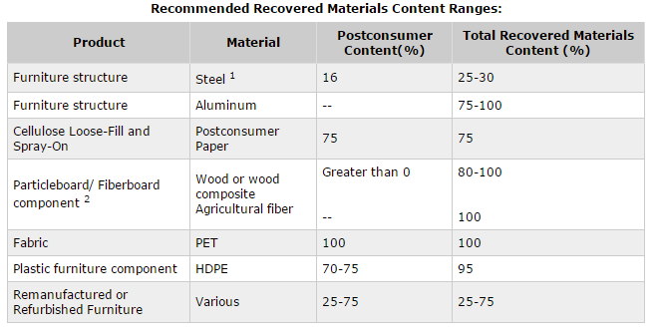
Statutory Requirements

Slide 25


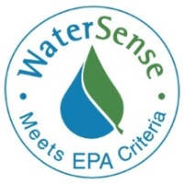

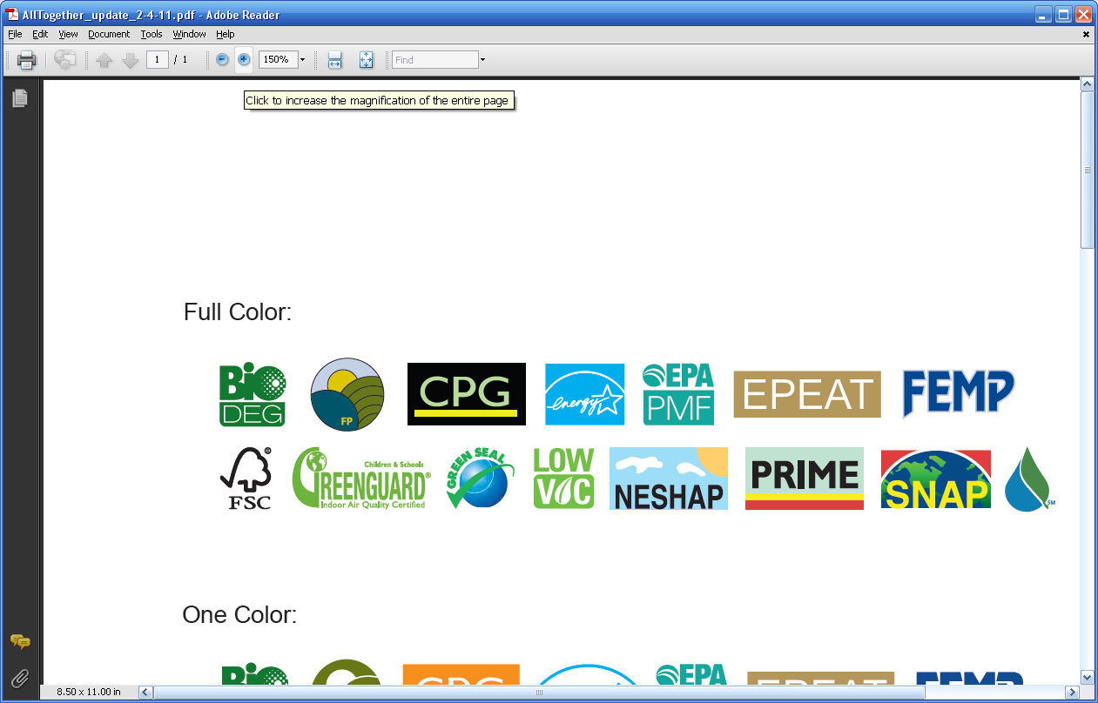
GSA Advantage!®
An online shopping and ordering system for federal agencies
Provides access to thousands of contractors and millions of products and services
Allows users to select icons to identify compliant products
gsaadvantage.gov
Notes:
GSA Advantage! is an online purchasing portal connecting Federal agencies to 1000s of contractors and millions of products and services.
Environmental icons on green aisle

Slide 26











Green Icons on GSA Advantage!®
CPG Compliant
Energy Star
FEMP
WaterSense
BioPreferred
SNAP Approved
NESHAP
EPEAT
PRIME
Low VOC
EPA Primary Metals Free
26
Notes:
This slide provides a listing of some of the more common industry labels and standards that are considered to be environmentally preferable products. Although these apply to products only, the mandatory usage of these products can be easily incorporated into service solicitations as well- and should be wherever possible.
If time allows, lets briefly go over them. If time permits and the discussion is going to be primarily based on products, use the following slides to speak in depth about the more common icons.
Recycled-content Products – Replacement of virgin materials with recycled materials
EPA designates products that are or can be made with recovered materials, and recommends practices for buying these products (RCRA). Once a product is designated, procuring agencies are required to purchase it with the highest recovered material content level practicable – don’t endorse specific products, but provide specifications that products must meet.
Examples: paper, playground equipment, engine coolants, office furniture
Energy Star and FEMP-designated products – both pertain to energy efficiency requirements – required to purchase unless exception applies
Energy Star voluntary labeling program designed to identify and promote energy-efficient products to reduce greenhouse gas emissions – manufacturers must submit Qualifying Product Information to participate
Products in more than 60 categories
FEMP – not specific products – DOE sets purchasing specifications, including standby power levels, for energy-efficient product categories commonly purchased by Federal agencies.
Examples: things that use energy – refrigerators, televisions, light bulbs, ovens, air conditioners
Electronic Product Environmental Assessment Tool (EPEAT) - not only energy-efficient but also have other environmental attributes, such as recycled content components or the elimination of toxic components (sponsored by EPA)
Products evaluated on 51 environmental criteria and rated as bronze, silver, or gold based on optional criteria
Examples: desktop and laptop computers, computer monitors
WaterSense - qualifies water-efficient products and services (partnership program sponsored by EPA)
EPA establishes specifications for water efficiency and performance
Submitted products are tested and verified by an independent third party
Examples: toilets, showerheads, landscape irrigation professionals (service)
BioPrefferedSM:
The Department of Agriculture qualifies biobased products through their BioPreferred program. Federal acquisition of biobased products is required by Executive Order 13514 and the Farm Security and Rural Investment Act of 2002, Section 9002. Not necessarily environmentally preferable!!
Under the voluntary labeling program, biobased products that meet the BioPreferred program requirements will soon carry a distinctive label for easier identification by government, businesses and consumers.
Significant New Alternatives Policy (SNAP) Program – related to ozone-depleting substances
EPA's program to evaluate and regulate substitutes for the ozone-depleting chemicals that are being phased out under the stratospheric ozone protection provisions of the Clean Air Act (CAA).
identify and publish lists of acceptable and unacceptable substitutes for class I or class II ozone-depleting substances – not specific products (substitute substances)
Examples: aerosols, adhesives, cleaning solvents
http://www.fedcenter.gov/Documents/index.cfm?id=11767&pge_prg_id=20257
Created by the Office of the Federal Environmental Executive (OFEE), this is a compilation of the products for which EPA, DOE, and USDA have provided environmental or energy attribute recommendations. For the first time, purchasing officials can find all of the designated products in an easy to use series of spreadsheets.

Slide 27
Green Procurement Compilation
Identifies applicable federal green purchasing requirements
Organizes information by product and service categories
Consolidates federal green purchasing information in one location, including:
  Legal requirements
  Environmental program links
  Potential purchasing options
  Sample contract language
sftool.gov/GreenProcurement

Slide 28
Global Supply – GSA Managed Supply Program
Online:
  www.GSAglobalsupply.gsa.gov
  www.gsaAdvantage.gov (use Global Supply filters)
Contractor = GSA Global Supply
Phone: 800-525-8027

Slide 29
Assisted Acquisition Service (AAS)
Complete Acquisition Services
  From requirement definition to contract close-out
Knowledgeable and Professional Staff
  Team-based approach
Timeliness
  Predictable Timelines Consistently Met
Demonstrated Cost Savings
  On average, AAS negotiates a 10-percent savings
Best Practices
  Internal QA reviews and checks
  Best value awards
  Sustainable acquisition compliance
Notes:
Region 9 AAS offers Federal agencies, contract and contract management support through the entire procurement process; from requirement definition to contract close-out. AAS services are customized for the mission, providing full acquisition project management, and financial management support. AAS specializes in large / mid-size, complex Information Technology, Professional Services and other requirements.

Slide 30

Questions?
Mark Reiss
Customer Service Director
415-522-2799
mark.reiss@gsa.gov

