Slide 1
Special Programs

Slide 2
Special Programs
NASA
FEMA
Census

Slide 3

NASA Shuttle Tile/Artifacts Program
Notes:
Photo of NASA Shuttle during take-off

Slide 4
NASA Artifacts Prescreening Register
Universities and Schools can acquire an artifact directly from NASA without the aid of the State Agency for Surplus Property (SASP).
You must first Register to receive a User ID and password.
To register, schools will need the Department of Education’s statistics tracking number – National Center for Education Statistics (NCES).
Notes:
NOTE: If you are acquiring NASA program artifacts by registering with an NCES or IPEDS number, DO NOT request the same artifact through the SASP.

Slide 5

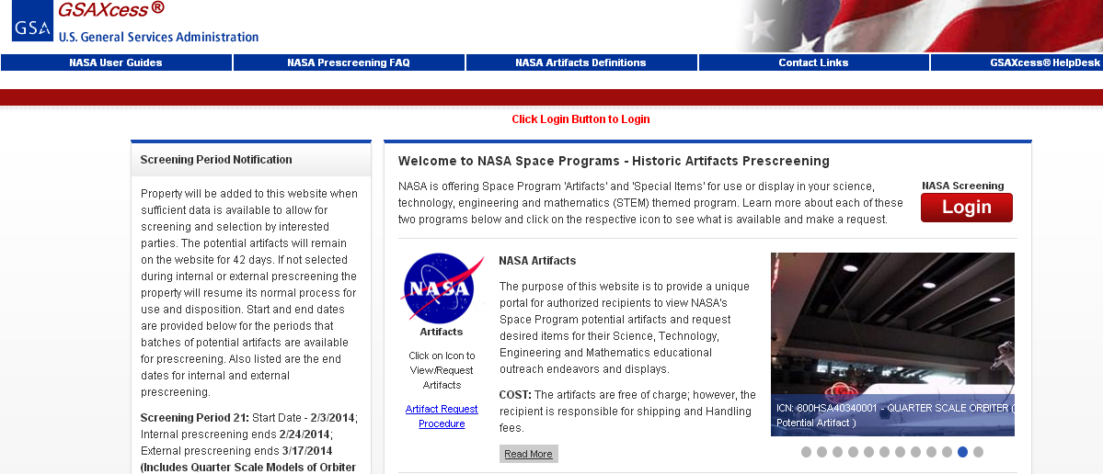
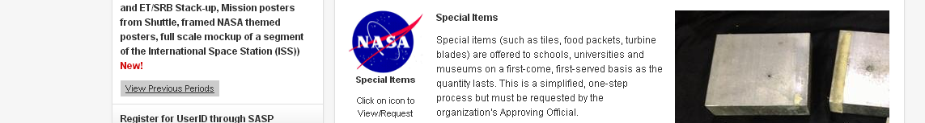
NASA Artifacts Prescreening
Artifacts will remain on the website for 42 days.

Slide 6
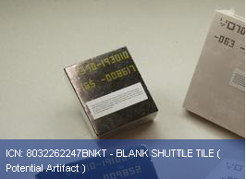
NASA
Shuttle Tile
Notes:
Photo of NASA Shuttle Tile

Slide 8
Shipping and Handling Costs
The ONLY fee incurred by the recipient for a shuttle tile is for shipping and handling.
For Federal property accounting purposes, we list the Original Acquisition Cost of the tile, which should not be construed as an additional charge to the recipient.

Slide 9
Shuttle Tile Frequently asked Questions
For additional information log onto
www.GSAXcess.gov and click on
Shuttle Tile Frequently asked Questions.

Slide 10
Federal Emergency Management Agency
Trailers for Katrina Disaster
What happens after the disaster?

Slide 11
FEMA continue….
FEMA purchased hundreds of thousands of trailers
Trailers were stationed in various states for distribution
GSA Regions hosted many special live screenings between Federal and State Agencies for Surplus Property (SASPs)
Remaining trailers were advertised by GSAAuctions.gov

Slide 12

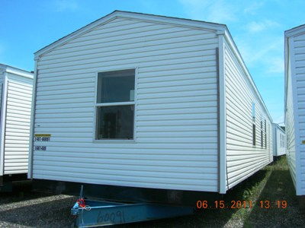
FEMA Park Model Trailers and Mobile Homes
Notes:
Photos of FEMA trailers

Slide 13
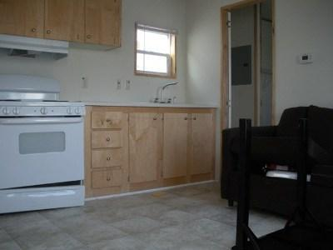
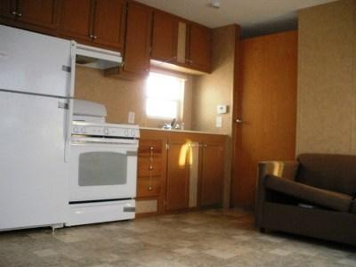
FEMA Park Model Trailers and Mobile Homes
Notes:
Photos of inside of FEMA trailers

Slide 14
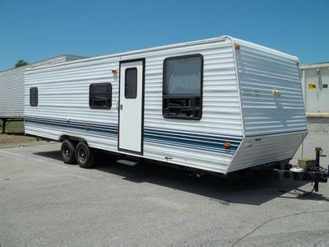
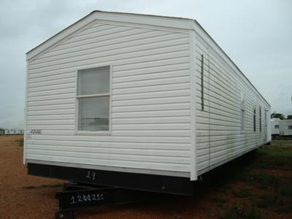
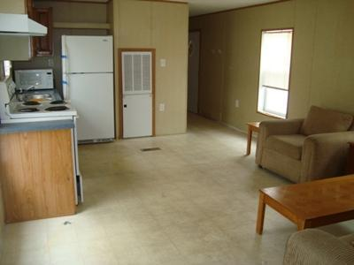
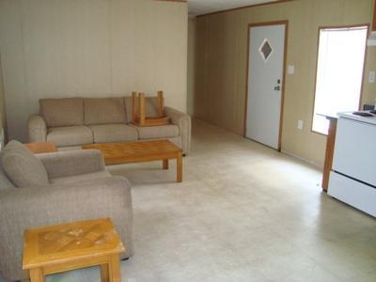
Notes:
Pictures of FEMA Park Model Trailers (Inside and outside).

Slide 15
U.S. Census 2010
National Population
Every 10 years, the United States Census Bureau submits a form to each house-hold for completion and see how the nation has changed. On April 1, 2010, there were 308,745,538 people living in the United States, 27.3 million more than in 2000—a 9.7 percent increase.
The estimate for 2015 was 321,418,820, the next census is set for 2020.
Notes:
http://www.prb.org/pdf11/reports-on-america-2010-census.pdf

Slide 16
U.S. Census continues…
They purchase large amounts of Government property
Property is distributed amongst U.S. Census offices.
What occurred with all the Government property after the report was completed?
Where did the Census station all their Excess Property?

Slide 17
U.S. Census continues…
Census reported items, in phases, into their internal system
  GSA reduced the internal screening, per their request
Property was approved for:
  Computers for Learning (CFL)
  Transferred to Federal agencies
  Donated to SASPs
  Advertised on GSAAuctions website to the Public

Slide 18
Questions?

