Slide 1
Abandonment & Destruction FMR 102-36.305 - 330
August 2014
Notes:
Last step in the disposal process, after all other efforts are unsuccessful.

Slide 2
Abandonment/Destruction - Criteria
Property may be abandoned or destroyed when an authorized agency official has made a written determination that:
  Property has no commercial value
  Cost of care, handling, and sales prep would exceed expected sales proceeds
FMR 102-36.305 and 310
Notes:
The property can be abandoned in place, meaning left on-site to be disposed of by the landlord; bldg manager if they agree to it; or the property can be thrown away.

Slide 3
When Does Property Not Have Commercial Value?
If utilization, donation, and sales efforts produce no results
Determination can be made at any time during disposal
Owning Agency makes the determination to abandon/destroy
Notes:
A/D is the final stage in the disposal process; when all other disposal efforts have been exhausted.

Slide 4
Who must approve the written determination to abandon/destroy?
A written finding must be approved by a reviewing official who is not directly accountable for the property
Notes:
The decision to A/D property should be properly documented by the reviewing official. This can be written or attached to the SF120 or the notice to A/D issued by the GSA APO or SCO.

Slide 5
Public Notice for A/D
You must provide public notice of intent to A/D personal property (102-36.325)
Public Notice not required when:
  Value of property is so little or cost of care and handling is so great that its retention for advertising is not economical
  A/D is required because of health, safety, or security reasons
  Original acquisition cost is less than $500
Notes:
Another requirement for A/D is public notice. Agency can type a notice stating that property will be abandoned or destroyed and notice shall be placed in a location where public can see it. Notice should state the property to be A/D, date and time and location of A/D.

Slide 6
In lieu of A/D:
You may donate such property only to a public body without going through GSA
If an entity wants to buy the property, you must implement sales procedures
FMR 102-36.320
Notes:
There are other things your agency can do instead of abandoning or destroying the property. The definition and examples of public body that were given earlier still apply here.

Slide 7
But remember…
You must not A&D property in a manner that is dangerous to public health or safety
FMR 102-36.315
Notes:
Always be cautious of how and where you dispose of property.

Slide 8
Electronic items…
Should NOT be thrown in the trash
Recycled in an environmentally safe
manner
Choose a Recycler that will disassemble
property into raw components
Notes:
Refer to your agency’s internal policy regarding how to properly dispose of and recycle electronic items.

Slide 9
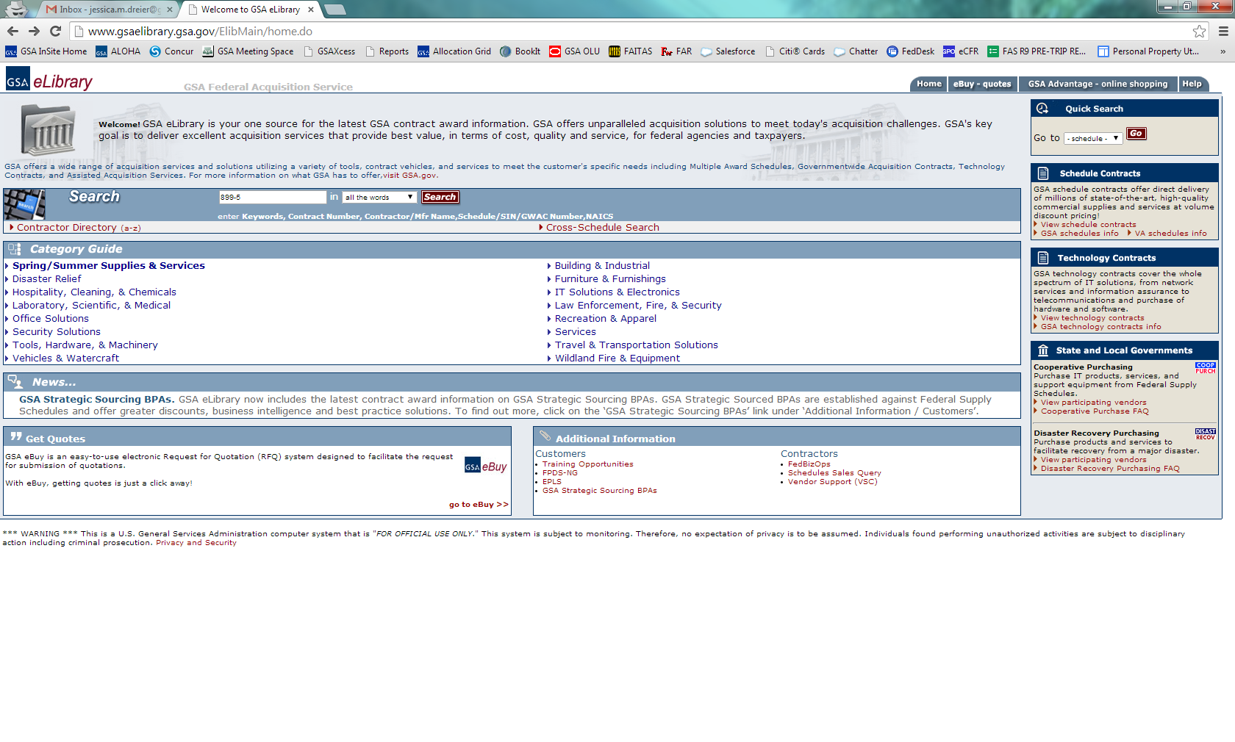
Go to www.gsaelibrary.gsa.gov and search for Schedule 899-5.
Notes:
Another good source to use to locate recycling companies.

Slide 10
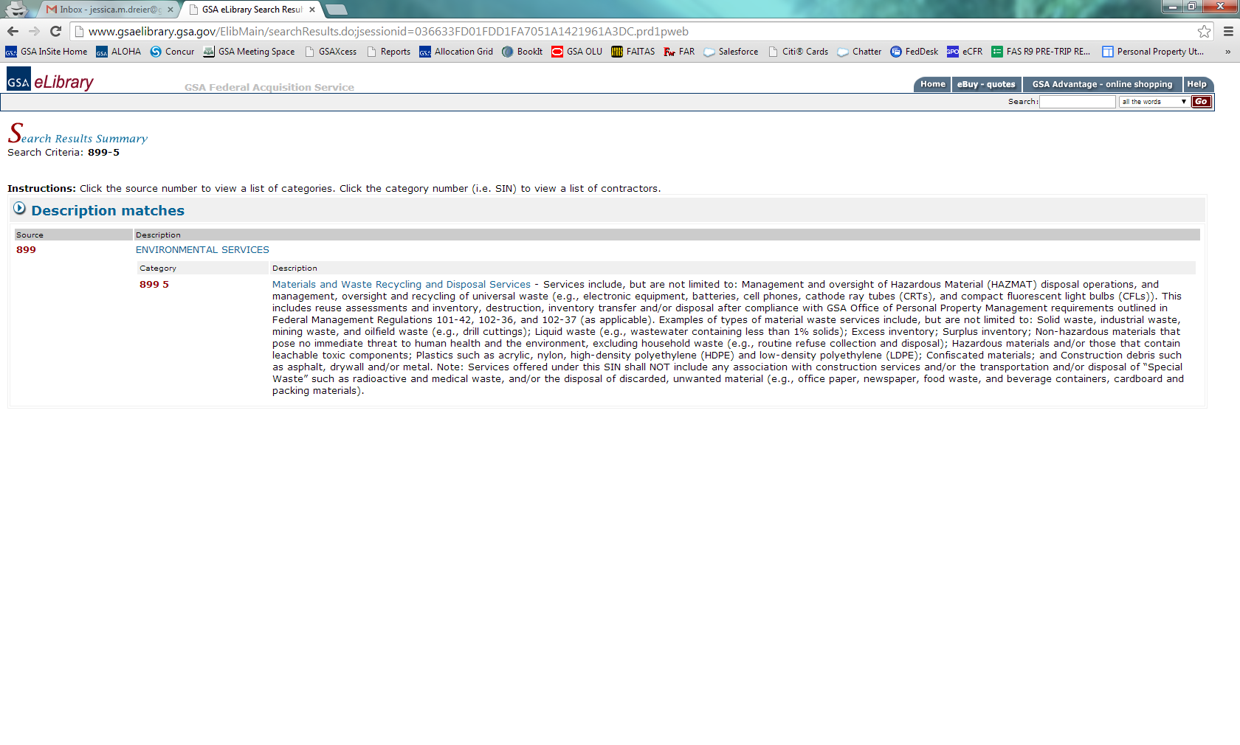

Slide 11
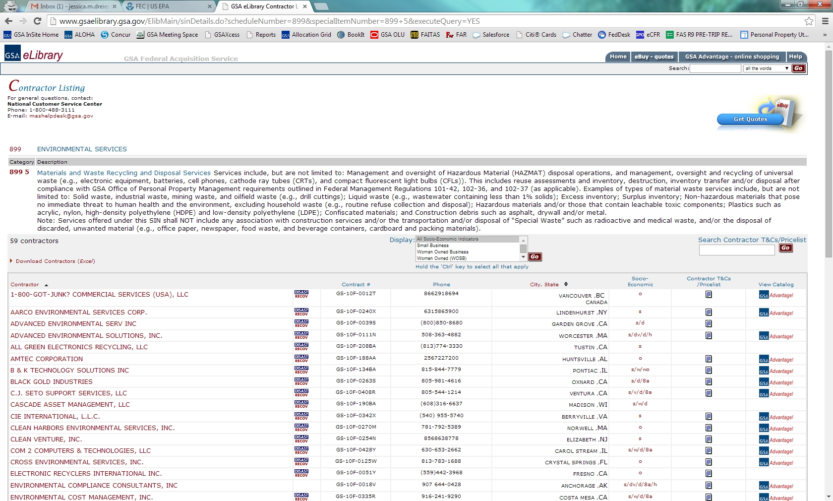

Slide 12
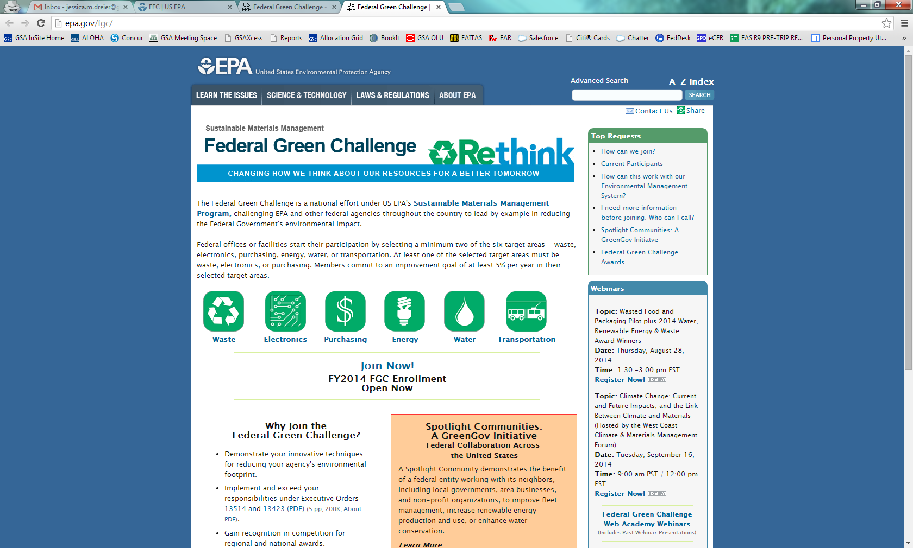
www.epa.gov/fgc/
Notes:
A good source to contact for information on electronics recycling.

Slide 13
Pacific Southwest (Region 9) – AZ, CA, HI, NV
Andre Villasenor (R9federalgreenchallenge@epa.gov)
(213) 244-1813
FAX: (415) 947-3530
Timonie Hood (R9federalgreenchallenge@epa.gov)
(415) 972-3282
FAX: (415) 947-3530

Slide 14
Questions?
Notes:
Any questions about the A/D process?

