Slide 1
Disposal of Computers, Electronics and Special Items
August 2014
Notes:
GSA has set an agency wide goal for achieving “zero environmental footprint”. Personal property plays an important role and has been a leader in the reuse of property since the inception of GSA in 1949. Personal property is often referred to as the “original green program” and accordingly has adopted the “Reuse is Recycling” green theme for Personal Property.

Slide 2
LET’S TALK TRASH
According to the U.S. Environmental Protection Agency (EPA), an estimated 30 to 40 million PCs will be ready for "end-of-life management" in each of the next few years.
Worldwide PC shipments were projected to total 366.1 million units in 2010, a 19.7 percent increase from 305.8 million units shipped in 2009
According to the UN Environment Program, the worldwide total for e-waste could be as much as 50 million tons per year
CPUs Fax Machines Laptops Scanners Printers Cell Phones
Notes:
http://www.epa.gov/osw/conserve/materials/ecycling/manage.htm

Slide 3
Learning Objectives
Basic review of regulations
What are our responsibilities in the disposal process?
Options for responsible electronic disposal
Computers for Learning Program

Slide 4
Executive Order 13514
Federal Leadership in Environmental, Energy, and Economic Performance
Section 1, Policy:
“In order to create a clean energy economy that will increase the nation’s prosperity, promote energy security, protect the interest of the taxpayers, and safeguard the health of our environment, the Federal Government must lead by example.”

Slide 5
Executive Order 13514
Federal Leadership in Environmental, Energy, and Economic Performance
Section 2(i): promote electronics stewardship, in particular by:
(iii): employing environmentally sound practices with respect to the agency’s disposition of all agency excess or surplus electronic products
Notes:
-to “create a clean energy economy that will increase the nation’s prosperity, promote energy security, protect the interest of the taxpayers, and safeguard the health of our environment.”

Slide 6
Executive Order 13423
Strengthening Federal Environmental, Energy, and Transportation Management
Section 2: Goals for Agencies
(h)(iv)-Uses environmentally sound practices with respect to disposition of agency electronic equipment that has reached the end of its useful life

Slide 7
New FMR Bulletin B-34 Disposal of Federal Electronics
Defines the universe of electronic items
Encourages maximum use of electronics within the Federal government and with state/local donation customers to minimize the waste stream
Prohibits Federal agencies from disposing of electronic waste in landfills or by incineration
Notes:
The following guidance is being provided to protect the interests of taxpayers, protect human health and the environment from the potentially harmful effects associated with the unsafe disposal of Federal Electronic Assets (FEA).

Slide 8
First Priority - Protect Information
Hard drive…remove or wipe clean?
Always remove all external storage media
Certify sensitive and PII information has been removed prior to reporting property as excess
Notes:
Based on security and sensitivity issues, agencies use various methods for protecting information on computers being disposed of.
Some agencies physically destroy hard drives to secure them- others have hard drives wiped clean
Clear/delete numbers and address book information

Slide 9
How to dispose of the property?
Agencies have several options depending on:
Type of Property
Condition of the Property
Volume of the Property
Value of the Property
Hazardous characteristics of the property

Slide 10
Internal Reuse
Can the equipment be used by someone else in your office or within your Agency?
Notes:
Basic steps for disposal of excess computer equipment.

Slide 11
Stevenson-Wydler Technology Innovation Act
15 USC 3710(i) Research equipment
… the head of any Federal agency or department, may loan, lease, or give research equipment that is excess to the needs of the laboratory, agency, or department to an educational institution or nonprofit organization for the conduct of technical and scientific education and research activities. Title of ownership shall transfer with a gift under this section.
Notes:
This authority can be used by Federal agencies directly without approval from GSA.

Slide 12
Computers For Learning (CFL)
Executive Order 12999
Educational Technology: Ensuring Opportunity for All Children in the Next Century
Notes:
The EO streamlines the transfer of excess Federal computer equipment to the nation’s classrooms for the purpose of making modern computer technology an integral part of every classroom.

Slide 13
CFL: Executive Order 12999
Promotes the reuse of federal excess computers and peripheral devices among needy schools and educational nonprofit organizations
Reduces the landfill disposal of toxic wastes
Maximizes the taxpayer’s investment in computer equipment

Slide 14
Public, Private Schools and Day Care Centers
A school is eligible to receive donations through the Computers for Learning program if it is public, private, or parochial, serving pre-kindergarten through grade 12 students
Day care centers must provide a state approved preschool curriculum

Slide 15
Educational Nonprofits
An educational nonprofit is eligible if it is classified as tax-exempt under section 501(c) of the United States tax code and serves pre-kindergarten through grade 12 students
Must meet ALL of the following criteria to participate in the CFL program:
Be tax exempt under section 501(C) of the U.S. tax code
Serve some portion of the pre-kindergarten through grade 12 population
Operate primarily for the purpose of education

Slide 16
Educational Nonprofits
By completing the registration form, the organization is attesting that their educational nonprofit organization meets ALL of the eligibility requirements
Any federal agency that selects the educational nonprofit organization for donation will also ask to provide proof of eligibility (Agencies determine what this should be, so it may vary)

Slide 17
Option 2: Stevenson-Wydler Technology Innovation Act
15 USC 3710 (i) Research equipment
The authority allows the head of any agency to loan, lease, or transfer research equipment to educational institutions or certain nonprofit organizations.
Title of ownership shall transfer with a gift under this section.

Slide 18
Normal Disposal Process
Transfer property to other Federal agencies
Donate property to eligible recipients through a State Agency for Surplus Property (SASP)
Sales
Notes:
This is a graphic portrayal of the current disposition process. The chart shows the distinction of excess and surplus property as well as highlighting the overall screening period and the systems that GSA offers to support these functions.Internal agency screening is the first step and we offer AAMS to support agencies in this effort. Second, is the simultaneous screening for Federal and donation customers and federal removal. Listed are the major categories of eligible activities.Next, the 5 day notification period allows GSA’s allocating regions to make proper allocation of property to donation customers. After that, property is available for public sale, by GSA or another approved Sales Center.

Slide 19
Condition Code Requirements
Stevenson-Wydler Act, Computers for Learning, Transfers and Donations
Condition Code 1
Condition Code 4
Condition Code 7
Notes:
Explain the condition codes: Code 4 sold as a lot. Code 7 has to be sold individually. Code x and s has to be sold to recyclers.

Slide 20
Condition Code Requirements
Sales
Condition Code 1 and 4 can be sold individually or as a lot
Condition Code 7 must be sold individually
Condition Code X and S can only be sold to recyclers

Slide 21
Abandonment/Destruction
Must follow the regulations as outlined in FMR 102-36.305-330
Determination can be made at any time during disposal
Abandon/Destroy property has no commercial value or the estimated cost of care and handling would exceed the expected proceeds from its sale
Notes:
A review of information and step-by-step process …….

Slide 22
Restrictions on Abandonment/Destruction
Must not abandon or destroy property in a manner which is detrimental or dangerous to public health or safety
If you become aware of an interest from an entity in purchasing the property, you must implement sales procedures in lieu of abandonment/destruction
FMR 102-36.315
Notes:
Note bulltent in packet

Slide 23
Additional Restrictions for A/D
Vendor take-back program that uses certified recyclers or refurbishers
Disposal using certified recyclers or refurbishers
**Recyclers and refurbishers must be Responsible Recyclers (R2) or e-Stewards certified

Slide 24
Who makes the determination to A/D?
An authorized official from your agency submits a written finding that must be approved by a reviewing official who is not directly accountable for the property
Notes:
Federal Management Regulation 102-36.310

Slide 25
Public Notice and A/D
You must provide public notice of intent to abandon or destroy excess personal property in a format and timeframe specified by your agency’s regulations
There are occasions when public notice is not needed
Notes:
Public notice can include publishing a notice in a local newspaper, posting of signs in common use facilities available to the public, or providing bulletins on your website through the internet.

Slide 26
Abandonment and Destruction Options
FMR 102-36.320: Agencies may donate to a public body in lieu of abandonment
Unicor (Federal Prison Industries) is a public body and has a computer/electronics recycling program
Information on locations and contact:
http://www.unicor.gov/recycling

Slide 27
UNICOR

Slide 28
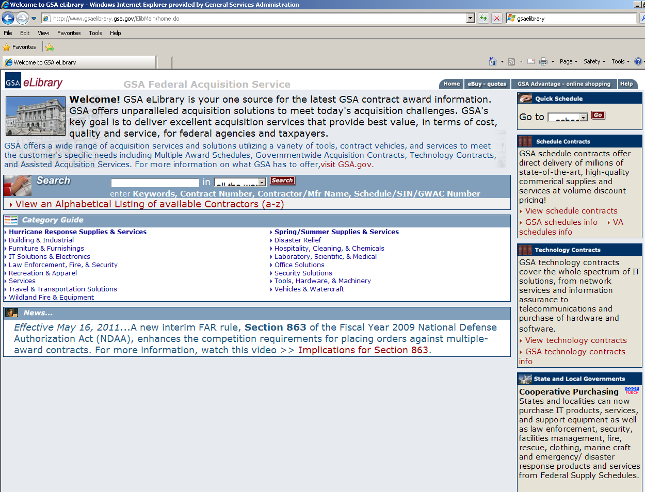
www.gsaelibrary.gsa.gov
899-5
Notes:
Another good source to use to locate recycling companies.

Slide 29
Environmental Services, Schedule 899-5
Services include, but are not limited to:
Management and oversight of Hazardous Material (HAZMAT) disposal operations
Management, oversight, and recycling of universal waste (e.g., electronic equipment, batteries, cell phones, cathode ray tubes (CRTs), and compact fluorescent light bulbs (CFLs))
Notes:
The only certification programs currently recognized for disposal of FEA are the Responsible Recycling (R2) program and the e-Stewards program. FEA should not be disposed of in landfill or incinerators.

Slide 30
Environmental Services, Schedule 899-5
This includes:
Reuse assessments and inventory
Destruction
Inventory transfer and/or disposal after compliance with the FMR 101-42, 102-36, and 102-37 (as applicable)

Slide 31
Contact Information for Schedule 899-5
Phone: 1-800-241-RAIN
Email: environmental@gsa.gov
Notes:
http://www.gsa.gov/property
http://www.computersforlearning.gov
http://www.gsaxcess.gov
http://www.gsa.gov/apo

Slide 32
Resources
CFL Helpdesk: 866-333-7472 (option 2)
http://www.gsa.gov/property
http://www.computersforlearning.gov
http://www.gsaxcess.gov
http://www.gsa.gov/apo
ww.gsa.gov/property

Slide 33
Notes:
Questions and Answers?

