Slide 1
Processing Hazardous Materials

Slide 2

Overview
Regulations
Property Requiring Special Handling
Reporting Requirements
Federal Disposal Process
Hazardous Materials Characteristics
Hazardous Materials Transportation
How to locate vendors
Notes:
Other items requiring special handling addressed by the FMR/FPMR

Slide 3
Governing Regulations
CFR 29-OSHSA ( workplace )
CFR 49-DOT ( transportation )
CFR 40-Hazardous Waste (EPA)
CFR 41-101.42 ( GSA FPMR )
  FMR 102-40 (DRAFT) will replace FPMR 101-42
RCRA - Resource Conservation and Recovery Act.
TSCA-Toxic Substance Control Act.
HMTA-Haz Mat Transportation Act.
Notes:
The guidance in the FPMR 101-42 is in essence is an extraction of all of the requirements found in specific regulations of DOT, EPA and OSHSA. FMR 102-40 is in draft status and will replace FPMR 101-42 when it receives final approval.
RCRA: This act established cradle to grave responsibility BY EPA for the proper disposal of HW and waste minimization provisions.
TSCA: Regulates Asbestos, Lead Paint, PCB’s, CFC’s and other Toxic materials.

Slide 4
Property Requiring Special Handling
FPMR 101-42
  Utilization and Disposal of Hazardous Materials and Certain Categories of Property
FMR 102-40 (DRAFT)
  Disposition of Personal Property with Special Handling Requirements
Notes:
FMR 102-40 (Draft) is titled “Disposition of Personal Property with Special Handling Requirements” and will incorporate hazardous materials and some additional categories of property requiring special handling.

Slide 5
Property Requiring Special Handling
Status of 102-40 (Draft)
  OGP has drafted as Final Rule
    - Still requires internal GSA approval by Office of General Counsel
    - Then goes to Office of Management and Budget for final clearance
  So, timeline uncertain
    - But we need to begin to posture our systems to support all certification and signature requirements
Notes:
OGP has drafted FMR 102-40 as Final Rule. It still requires internal GSA approval by Office of General Counsel, then goes to Office of Management and Budget for final clearance. So, timeline is uncertain. But we need to begin to posture our systems to support all certification and signature requirements.

Slide 6
FMR 102-40 (Draft)
  Revision of last remaining FPMR citations
    PART 101-42 — UTILIZATION AND DISPOSAL OF HAZARDOUS MATERIALS AND CERTAIN CATEGORIES OF PROPERTY
    PART 101-45 — SALE, ABANDONMENT, OR DESTRUCTION OF PERSONAL PROPERTY
      Section 101-45.001, “Demilitarization and decontamination”
      Section 101-45.002, “Gold”
      Section 101-45.004, “All terrain vehicles.”
Notes:
FMR 102-40 (Draft) is a revision of last remaining FPMR citations: PART 101-42 — UTILIZATION AND DISPOSAL OF HAZARDOUS MATERIALS AND CERTAIN CATEGORIES OF PROPERTY, and PART 101-45 — SALE, ABANDONMENT, OR DESTRUCTION OF PERSONAL PROPERTY, including Section 101-45.001, “Demilitarization and decontamination”, Section 101-45.002, “Gold”, and Section 101-45.004, “All terrain vehicles.”

Slide 7
Property Requiring Special Handling
Acid-contaminated and explosive-contaminated
All-terrain vehicles
Ammunition
Animals and Plants
Asbestos
Controlled substances
Drugs, biologicals, and reagents
Electronic products
Lead-containing paints & items bearing lead-containing paints
Medical devices
National stockpile material
NRC controlled materials
Ozone depleting substances
Polychlorinated biphenyls
Precious metals
Vehicles not suitable for highway use
FPMR 101-42
Notes:
Property requiring special handling addressed by the FMR/FPMR

Slide 8

FMR 102-40 (Draft)
Additional definitions
  Ammunition
  Commerce Control List Item (CCLI)
  Demilitarization
  Electronic Products
  Material Safety Data Sheet (MSDS)
  Medical devices
  Precious metals
Revised definitions
  Firearms
  Perishables
Notes:
Other items requiring special handling addressed by the FMR/FPMR

Slide 9
Categories Requiring Special Handling
Acid-contaminated and explosive-contaminated
All-terrain vehicles
Ammunition
Animals and plants
Asbestos
Controlled substances
Drugs, biologicals, and reagents
Electronic products
Firearms
Hazardous materials (MSDS)
Perishables
Lead-containing paints & items
bearing lead-containing paint
Medical devices
Munitions List Items (MLIs)
Commerce Control List Items
National stockpile material
NRC controlled materials
Ozone depleting substances
Polychlorinated biphenyls PCB
Precious metals
Vehicles not suitable for
highway use
Notes:
Other new and revised categories requiring special handling addressed by the FMR/FPMR

Slide 10
FMR 102-40 (Draft)
  §102-40.15 Who must comply with the provisions in this part?
    All executive agencies must comply with the provisions of this part unless authorized by separate statutory authority to do otherwise.
    State Agencies for Surplus Property and surplus property donation recipients must comply with the provisions of this part related to the donation of surplus property with special handling requirements.
    Legislative and judicial agencies are encouraged to follow these provisions.
Notes:
All executive agencies, State Agencies and surplus property donation recipients must comply with provisions of part 102-40. Legislative and judicial agencies are encouraged to follow these provisions.

Slide 11
FMR 102-40 (Draft)
  §102-40.35 What types of personal property require special handling?
  Property containing hazardous materials
  Exhibits dangerous characteristics such that inadequate use, storage, transportation, or disposal may lead to potential safety, health, environmental, economic, or national security risks.
  In many situations - the use, storage, transportation, or disposal of these items are covered by Federal, State, and local laws.
Notes:
Types of property requiring special handling addressed by the FMR/FPMR

Slide 12
FMR 102-40 (Draft)
  §102-40.50 What must we do when we no longer need personal property with special handling requirements?
  Except for the items listed in §102-40.55, you must report personal property to GSA for Federal and donation screening.
  The report to GSA must clearly identify property requiring special handling, and all related hazards, precautions, and handling requirements related to this property.
  Property not required to be reported to GSA, must be disposed of in accordance with applicable Federal, State, and local laws and regulations, and your agency procedures. See §102-40.120
  Disposal must be accomplished so as to preserve as much as possible any civilian utility or commercial value of the property
Notes:
Requirements for reporting property requiring special handling requirements to GSA addressed in 102-40.50.

Slide 13
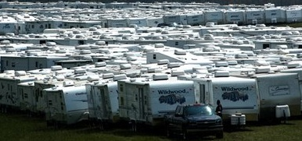
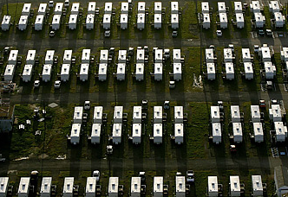
FEMA Trailers – Hazardous?
Housed victims of Hurricane Katrina
10,000 units (est.) acquired by FEMA
But, Trailers - hazardous??
Notes:
Additional information required when reporting Travel Trailers and Mobile Home Trailers. Special Certification required for Transfer, Donation and Sales of Travel Trailers.

Slide 14

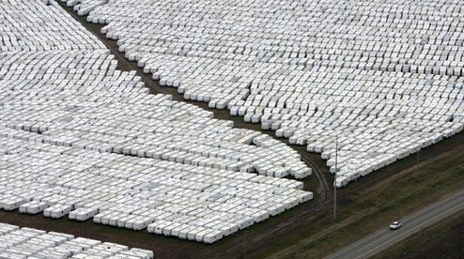
FEMA Trailers (cont.)
Manufactured with formaldehyde (material commonly used in mobile trailers)
Exposed to excessive heat -- 100+ degrees (f)
Limited ventilation
Result:
National headlines
Notes:
Lessons Learned: Travel trailers manufactured with materials containing formaldehyde (material commonly used in mobile trailers). FEMA trailers were exposed to excessive heat and humidity (100+ degrees fahrenheit) with limited ventilation and resulted in excessively high levels of formaldehyde inside travel trailers. High concentrations of formaldehyde in confined areas can be an irritant and potential cancer hazard.
Result:
National headlines

Slide 15
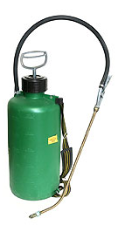
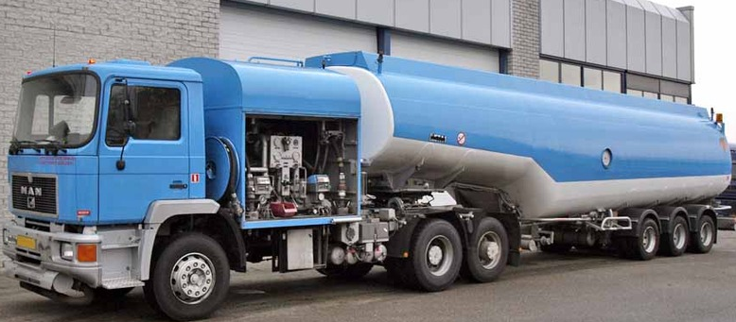
Gas/Pesticide Tanks – Hazardous?
General Rule of Thumb for GSA Sales
  Rinse three (3) times
  Includes truck tanks

Slide 16
FMR 102-40 (Draft)
  §102-40.55 Do we report all excess personal property with special handling requirements to GSA?
  No….. You should not report to GSA any of the categories listed below.
    Extremely hazardous personal property
    Hazardous wastes
    Perishables: You may dispose of perishables with no further utility by abandonment/destruction when it is not detrimental to public health or safety. Perishables still usable should be reported to GSA in accordance with 102-36 of this subchapter B.
    EPA research and cleanup materials
Notes:
Categories with special handling requirements not reportable to GSA addressed in 102-40.55.

Slide 17
FMR 102-40 (Draft)
Highlights
  ATVs
    - Incorporates FSS guidance from 1990s on mutilation
    for sale
    - Propose continuing discussions with OGP, research on current CPSC guidance
  Animals and Plants
    - Incorporates
      40 USC 555 regarding law enforcement canines
      40 USC 1308 regarding unfit horses and mules
Notes:
Highlights from 102-40 for ATV’s and Animals and Plants.

Slide 18
FMR 102-40 (Draft)
Highlights
  Electronic products
    - Complete new guidance with additional notifications and certifications
    Current certification for donees and buyers that, if recycled, they will use “any national standards, best management practices, or existing certification programs for recyclers in addition to Federal, State, and local laws, ordinances and regulations”
    New language provides “alternative” as “In the absence of national standards, best management practices, or a national certification program for recyclers, the purchaser/donee should use ‘EPA’s Guidelines for Materials Management”
Notes:
Highlights from 102-40 for Electronic Products

Slide 19
FMR 102-40 (Draft)
Highlights
  Commerce Control List Items (CCLIs)
    - Distinct from Munitions List Items
    - Although system to identify them is “combined”
    - “When being sold, completed end-use certificates are required of all bidders. An end-use certificate is a statement signed by a prospective recipient indicating the intended designation and disposition of CCLIs to be acquired, and acknowledging U.S. export licensing requirements.”
Notes:
Highlights from 102-40 for Commerce Control List Items (CCLI).

Slide 20

Hazardous Materials: Characteristics
Ignitability: Flash point below 200 F
Corrosivity: Causes first degree burns in a short period of time.
Reactivity: Subject to polymerization, strong oxidizer or reducer agent.
EP Toxicity: Causes 50 percent fatalities in test animals (LD50), toxic by skin contact, causes chemical dermatitis.
Notes:
The Dept. of Transportation designates what is a hazardous material and EPA designates what is a hazardous waste. Hazardous Materials characteristics include ignitability, corrosivity, reactivity and EP (Extracted Procedure) Toxicity.

Slide 21
Hazardous Materials: Characteristics
PCB’s: < 50 PPM Not Restricted
50 - 499 PPM, RTD/Sale
500 > PPM, Restricted A & D
Asbestos: Friable = End item to A & D
    Non-friable = RTD/Sales OK
Lead Paint/Items: Banned with exceptions:
  Exceptions: Mirrors, Artist Paint, Metal Furniture, Traffic Paint, Industrial touchup paint.
  Eligible for RTD/Sales with labeling and hold harmless clause.
Notes:
Toxic Substances Control Act, (TSCA ) designated EPA to regulate known and future Toxic Substances such as PCB’s, Asbestos and Lead Paint.

Slide 22

Hazardous Materials: Characteristics
Radioactive: controlled by the NRC
OSHA recognized carcinogen
Special characteristics that could be hazardous to health, safety or the environment.
Notes:
Source material in excess of .05 percent uranium/thorium by weight, or manufactured products containing in excess 2 microcurries. OSHA recognized carcinogens and property with special characteristics that could be hazardous to health, safety or the environment are also considered Hazardous Materials.

Slide 23
The HMR of the Federal Hazardous Materials Transportation LAW (49 CFR) apply to:
  Responsibilities for offering and accepting shipments
  Classification of hazardous materials
  Packaging standards
  Shipping papers
  Labels, marks and placards
  Emergency response requirements
  Training requirements
  Registration
  Segregation and modal requirements
  WWW.MYREGS.COM/DOTRSPA/
Notes:
The Hazardous Materials Regulations (HMR) of the Federal Hazardous Materials Transportation LAW (49 CFR) apply to: Responsibilities for offering and accepting shipments; Classification of hazardous materials; Packaging standards; Shipping papers; Labels, marks and placards; Emergency response requirements; Training requirements; Registration; Segregation and modal requirements.

Slide 24
Reporting Criteria
Clearly identify property requiring special handling on SF120
report including all related hazards / precautions
MSDS-Material Safety Data Sheets
Containers are unopened ( factory sealed )
Containers are in good condition and safe to handle and
transport.
DOT approved shipping containers.
Containers properly marked and labeled.
Shelf life items are not expired. (date of expiration)
Certification by the owning agency per HMTA.
Notes:
Reporting Criteria for Hazardous Materials are: Clearly identify property requiring special handling on SF120 report including all related hazards / precautions; MSDS-Material Safety Data Sheets; Containers are unopened ( factory sealed ); Containers are in good condition and safe to handle and transport; DOT approved shipping containers; Containers properly marked and labeled; Shelf life items are not expired (date of expiration); Certification by the owning agency per HMTA—Hazardous Materials Transportation Act.

Slide 25
Transfers of Hazardous Material
Transfers from one federal agency to another is permissible.
Transfer Order (SF-122) must properly describe hazard associated with the handling, storage, or use of the property and include Material Safety Data Sheets (MSDS).
The holding agency is responsible for packaging, labeling, shipping papers, and certification.
Notes:
Transfers of Hazardous Material from one federal agency to another is permissible. The Transfer Order (SF-122) must properly describe hazard associated with the handling, storage or use of the property and include MSDS. The holding agency is responsible for packaging, labeling, shipping papers and certification.

Slide 26
Shipper’s Certification
“This is to certify the above named materials are properly classified, described, packaged, marked and labeled, and are in proper condition for transportation according to the applicable regulations of OSHA and the Department of Transportation.”
----------------------------------- -----------------
signature date
Notes:
Dept. of Transportation requires the holding agency to provide a shipper’s certification.

Slide 27
Donation of Hazardous Material
Hazardous Materials may be transferred to a SASP for donation to an eligible donee organization.
SASP’s must have a known donee which a need exists for the property.
Transfer Order properly identifies the Hazardous property w/MSDS.
Must have donee signed certification acknowledging hazardous nature of property and waiver of liability.
SASP may assume responsibility for proper transport, temporary storage and safety until donee accepts custody.
Notes:
Hazardous Materials may be transferred to a SASP for donation to an eligible donee organization. SASP’s must have a known donee which a need exists for the property. The Transfer Order must properly identify the Hazardous property w/MSDS. A donee signed certification acknowledging hazardous nature of property and waiver of liability is required. The SASP may assume responsibility for proper transport, temporary storage and safety until donee accepts custody.

Slide 28
FMR 102-40 (Draft)
Certifications:
  §102-40.80 Is donee certification required on the donation of personal property requiring special handling?
  Yes, GSA will not approve a donation to a State Agency for Surplus Property (SASP) unless an eligible donee has been identified. The transfer document must contain a full description of the actual or potential hazard(s) and restriction(s) associated with the handling, storage, use, transportation, or disposal of the item. In addition, the following certification (or an equivalent) must be signed by the donee:
Notes:
Donee certification is required on the donation of personal property requiring special handling.

Slide 29
    I (We), the undersigned, hereby certify that the donee has knowledge and understanding of the hazardous nature of the property hereby donated and will comply with all applicable Federal, State, and local laws, ordinances, and regulations with respect to the care, handling, storage, shipment, and disposal of the hazardous material(s). The donee agrees and certifies that the United States shall not be liable for personal injuries to, disabilities of, or death of the donee or the donee’s employees, or any other person arising from or incident to the donation of the hazardous material(s) or its final disposition. Additionally, the donee agrees and certifies to hold the United States harmless from and shall indemnify the United States against any or all debts, liabilities, judgments, costs, demands, suits, actions, or claims of any nature arising from or incident to the donation of the hazardous material(s), its use, or final disposition.
    _________________________________________________
    Name and title of Donee (print or type)
    ________________________________________________
    Signature of Donee
Notes:
Example of Hazardous Certification that must be signed by donee.

Slide 30
FMR 102-40 (Draft)
Certifications:
§102-40.80 Is donee certification required on the donation of personal property requiring special handling?
  This subpart does not prohibit a SASP from bringing an item requiring special handling into its warehouse or other place of storage; provided that this storage is of a temporary nature, that the storage arrangement is agreeable to all parties involved in the donation, and that the storage location has the necessary facilities, gear, and trained personnel to handle, store, protect, and transport the property.
Notes:
A SASP is not prevented from bringing an item requiring special handling into its warehouse or other place of storage provided that this storage is of a temporary nature, that the storage arrangement is agreeable to all parties involved in the donation, and that the storage location has the necessary facilities, gear, and trained personnel to handle, store, protect, and transport the property.

Slide 31
Sales of Hazardous Material
Hazardous Materials not transferred/donated becomes eligible for GSA Sales action.
Property properly reported for U & D may be programmed for sales without delay and without further documentation.
If reported manually on SF-126, owning agency shall comply with hazardous materials reporting requirements and certification.
Notes:
• Property not donated, now becomes eligible for sale. An agency has the opportunity to use GSA as a sales option – to conduct sales for not only un-donated property, but for sales of items in special categories such as “exchange/sale” property, and “reimbursable” property.
• GSA provides many sales methods, including site auctions, fixed price, sealed bids, and the popular GSA AuctionsTM.
• GSA AuctionsTM provide user-friendly options, optimum exposure, state-of-the-art elements, competitive bidding, and maximum returns.
Notes: At this point of the process when property remains un-transferred, un-donated, or un-sold, it may become eligible for “Abandonment/Destruction.”
Key Element(s): GSA AuctionsTM process offers internet versatility and competitive sales.
Key Definitions(s):
“Exchange/Sale Property” – property not excess to the needs of the agency, but eligible for replacement (some restriction on classes).
Trade-in value or sales proceeds are used to acquire a replacement.
“Reimbursable Property” – property that because of its funding source or exchange/sale designation allows an agency to be compensated from proceeds (I.e., trust funds or special funding such as the Superfund.)

Slide 32
Sales Procedures: Lotting
Use separate IFB # for Haz Mat for file retention purposes.( 10 years )
Only lot compatible property in the same sale lot
( only one FSG ).
Limit lot size to consumer quantities.
Prequalify bidders for lots containing large quantities with Statement of Intent.
Notes:
A separate IFB # for hazardous material must be used for file retention purposes. File retention for Haz Mat is 3 years onsite and 7 years archives.

Slide 33
Sales: Item Descriptions
Provide detailed information from the MSDS.
Reference the online special terms & conditions relative to Haz Mat.
The successful bidder must sign the hold harmless clause, prior to receiving the purchasers receipt.
Notes:
Detailed information from MSDS is required when reporting hazardous materials. Successful bidder must sign the hold harmless clause prior to receiving the purchaser’s receipt.

Slide 34
A&D (Abandonment/Destruction) of Hazardous Materials
Property unsuitable for U & D or Sales.
  Expired shelf life
  Opened, partially used containers
  Hazardous Mmaterial that survives RTD/Sales
Notes:
Property unsuitable for U & D or Sales includes Expired shelf life items, Opened or partially used containers, and Haz Mat that survives RTD/Sales.

Slide 35
Methods of Abandonment & Destruction
Services Requirements Contract to an EPA licensed vendor for the ultimate packaging, manifesting, treatment and disposal in accordance with all Federal, State and local Hazardous Waste standards.
Notes:
All service requirements contracts for disposal of Haz Mat must be with an EPA licensed vendor.

Slide 36
Locating Vendors
GSA’s Schedules e-Library currently has 384 vendors available to provide Hazardous Waste disposal services.
www.gsaelibrary.gsa.gov
Notes:
Use GSA’s Schedules e-library to locate qualified vendors available to provide Hazardous Waste disposal services. Website is www.gsaelibrary.gsa.gov

Slide 37
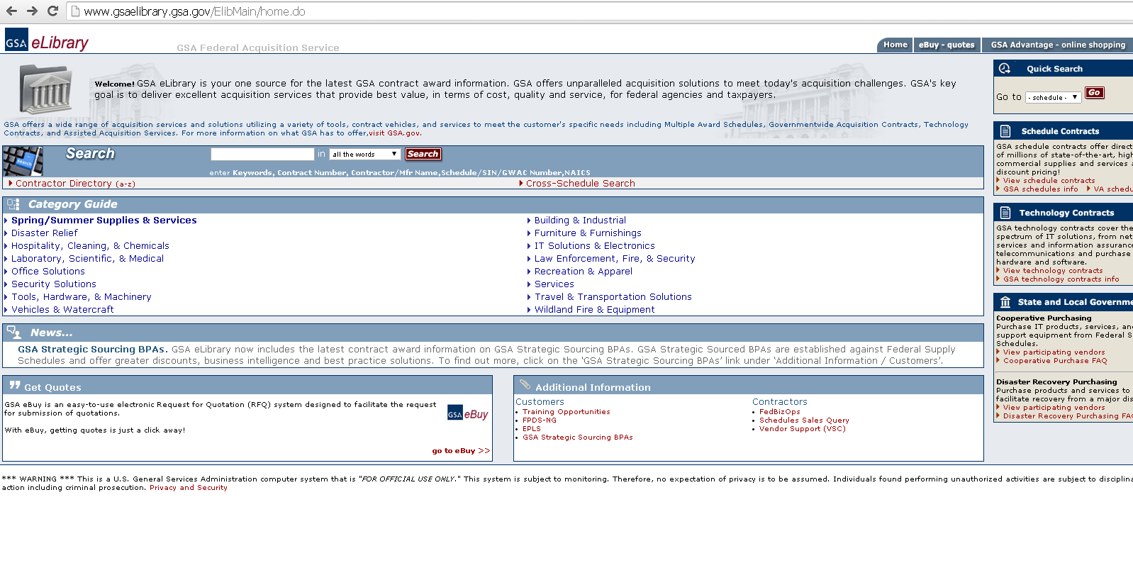
Search for Hazardous Waste Disposal Services

Slide 38
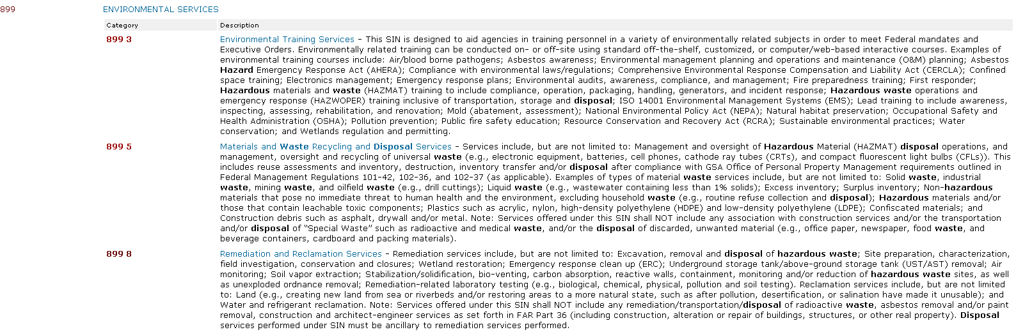

Slide 39
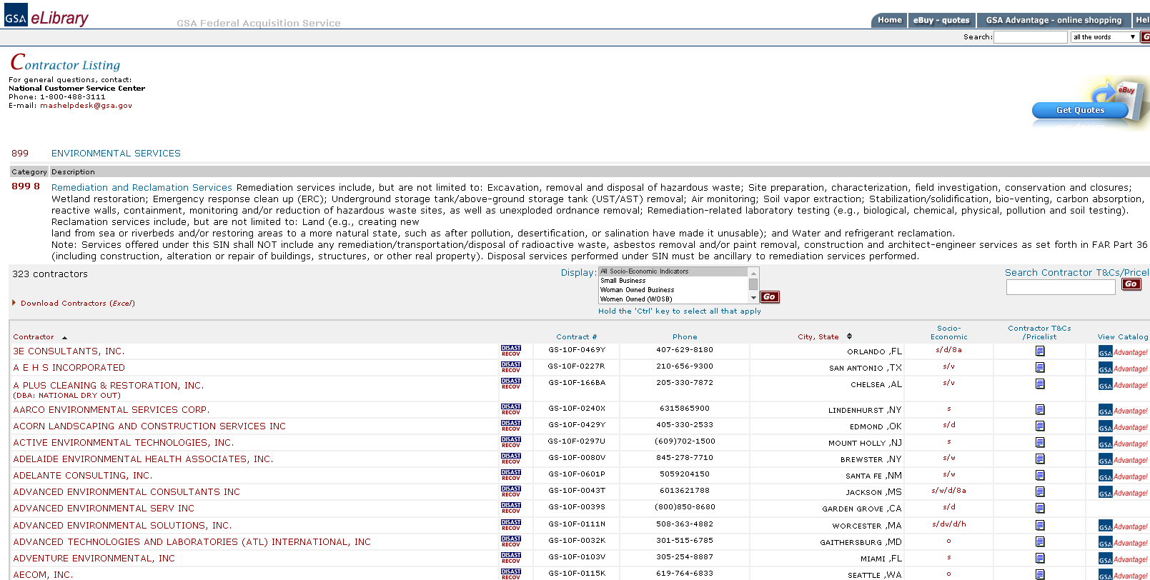

Slide 40
Responsible Decisions
We as government employees have a stewardship to make responsible decisions that ensures compliance with all Federal, State and Local regulations.
Minimize Future Liability: Under CERCLA, EPA has the authority to recover the cost of disposing of abandoned HM/HW from deep pockets.
State EPA’s also have the authority to assess fines and penalties to federal agencies.
Notes:
As government employees, we all have a responsibility to make responsible decisions that ensure compliance with all Federal, State and Local regulations. Federal and State EPA’s have authority to assess fines and penalties to federal agencies.

Slide 41

So, who is liable for the proper identification and disposal of hazardous materials?
You, the reporting agency!
  Contact your local GSA APO
  for support
  http://gsa.gov/apo
Notes:
Locate your local GSA APO at http://gsa.gov/apo

Slide 42

Questions?
Notes:
Questions and Answers?

