Slide 1
PICTURES/DOCUMENTS
Notes:
Welcome to How to Upload Pictures and Documents in GSAXcess.

Slide 2
DESIRED PICTURES - GSA BULLETIN FMR B-14 UTILIZATION AND DISPOSAL - 12/1/2006
Purpose - Guide Federal agencies in the use of photographs when reporting excess property and when selling property.
Result – Plan to provide photographs or digital images of excess property, which meets the criteria specified by this bulletin.
Notes:
GSA Bulletin FMR B-14 strongly encourages customers to use pictures. Pictures are worth a thousand words and help speed the disposal process by either showing what a great item it is or showing a customer that they don’t really want it.

Slide 3
DESIRED PICTURE CRITERIA
Property reported for utilization or sale meeting the following criteria should be accompanied by informative and good quality photographs.
Property at or above the agency financial accountability threshold; or
Property in the following Federal Supply Groups (FSG)/Classes (FSC) with an original acquisition cost exceeding $300.

Slide 4
DESIRED FSGs and FSCs PICTURES
Group 19 – Ships, Small Craft, Pontoons, and Floating Docks
Group 23 – Ground Effect Vehicles, Motor Vehicles, Trailers, and Cycles
Group 24 – Tractors
Group 34 – Metalworking Machinery
Group 38 – Construction, Mining, Excavating, and Highway Maintenance Equipment

Slide 5
DESIRED FSGs and FSCs PICTURES
Group 39 – Materials Handling Equipment
Group 42 – Firefighting, rescue, and Safety Equipment; and Environmental Protection Equipment and Materials
Group 54 – Prefabricated Structures and Scaffolding
Class 6115 – Generators and Generator Sets, Electrical
Class 6515 – Medical and Surgical Instruments, Equipment and Supplies

Slide 6
TAKING THE PICTURE
Type: Only digital or scanned photographs are acceptable.
Format: Only the .jpg, Joint Photographic Experts Group (JPEG), file extension is acceptable.
Size: Submit any size photograph; the large (full view) picture is displayed in GSAXcess® in a rectangular format at 600 X 400 pixels. Reporting activities should submit rectangular pictures.

Slide 7
TAKING THE PICTURE
Additional photos: Up to 11 thumbnails showing different views of the item will be displayed on the same screen in a square format at 70 X 70 pixels.
Quantity: No more than 12 photographs can be submitted per Item Control Number (ICN).

Slide 8
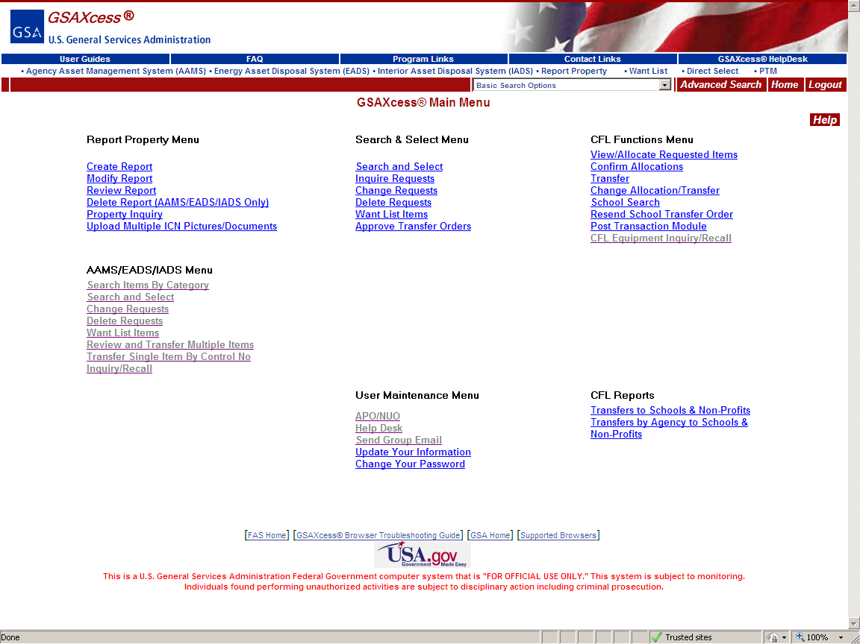
Upload Picture Button – (Main Menu)
Three methods to upload new or change existing pictures – Upload Multiple ICN Pictures; Create Report; Modify Report

Slide 9
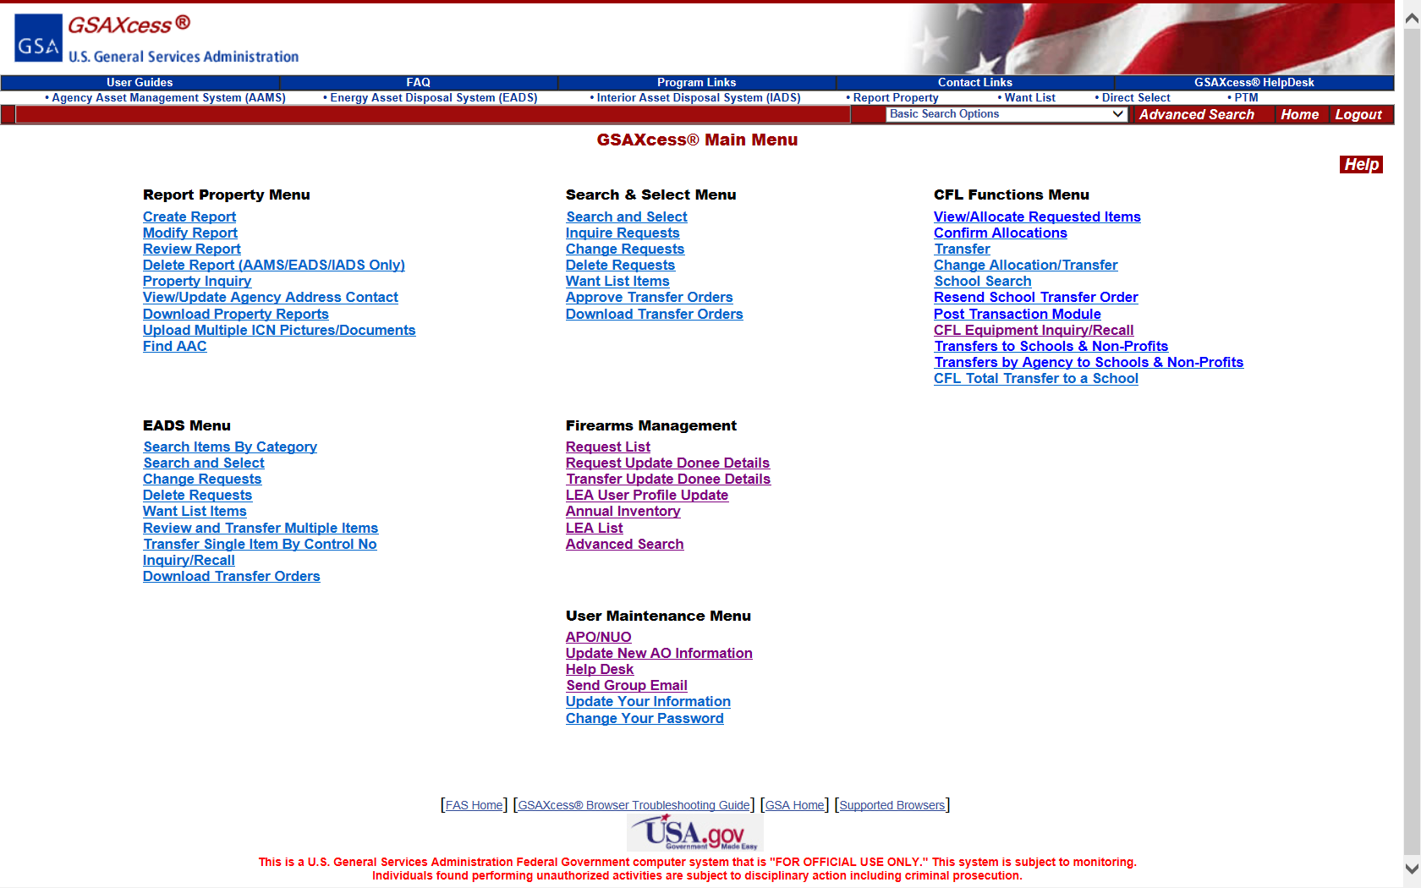
Upload Picture Button – (Main Menu)

Slide 10
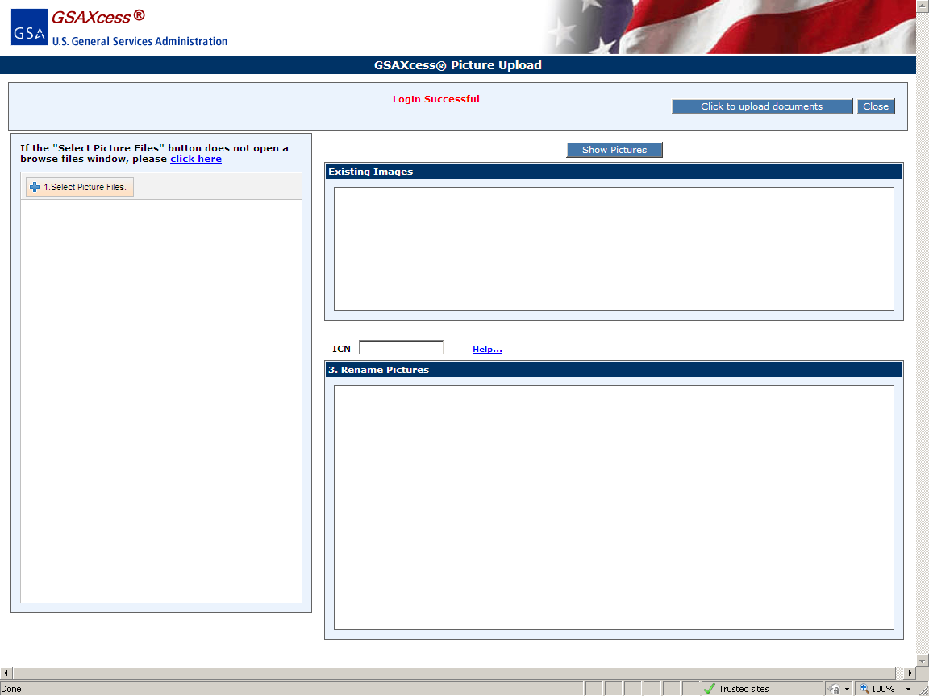
Upload Pictures
Notes:
Start by clicking #1, Select Picture Files.

Slide 11
Upload Pictures

Slide 12
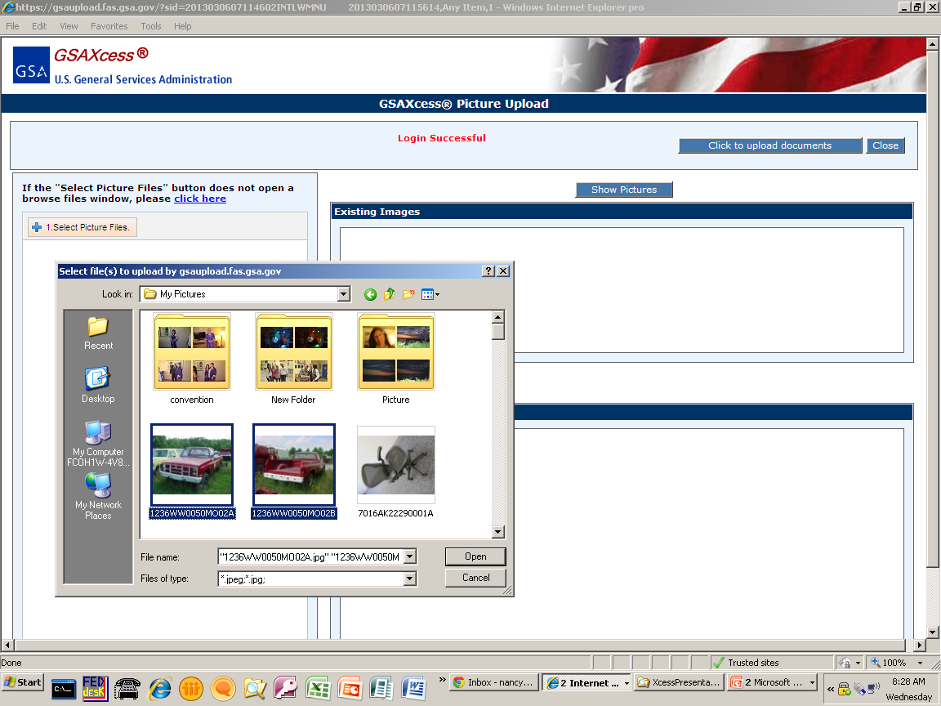
Upload Pictures
Notes:
Select your pictures and click “Open”.

Slide 13
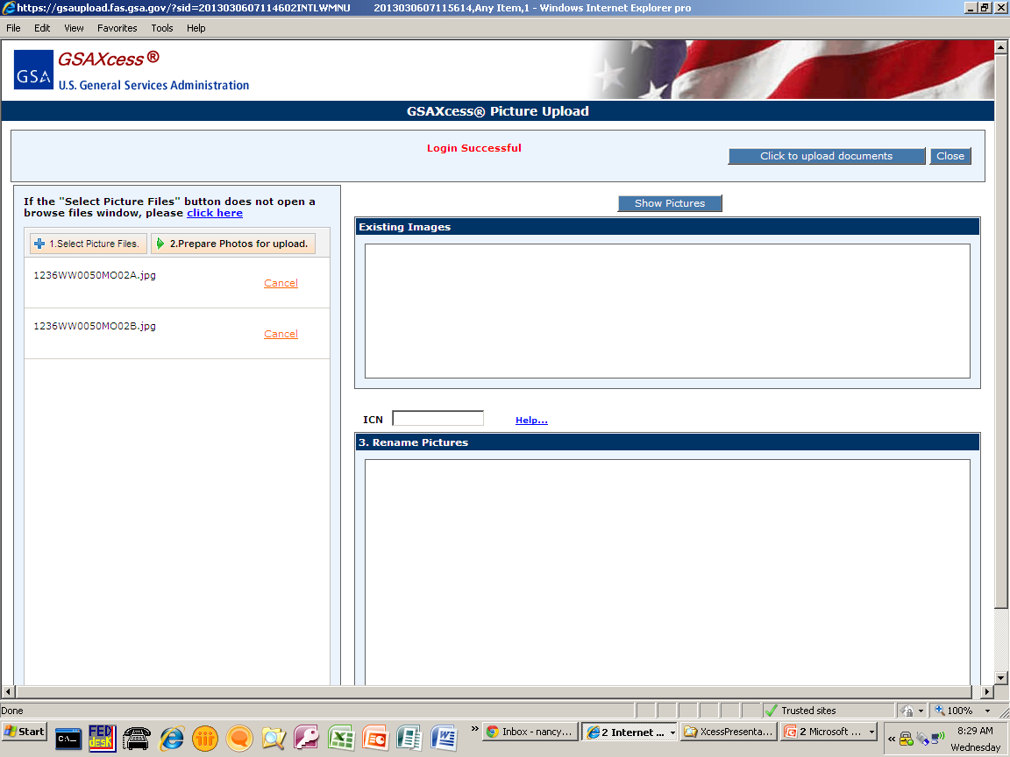
Select Picture Files
Notes:
The picture files selected will appear in the screen below #1. Select Picture Files. #2 will appear, that says prepare photos for upload. Click #2 and the system automatically resizes your pictures and transfers them to the Rename pictures area to be renamed if needed.

Slide 14
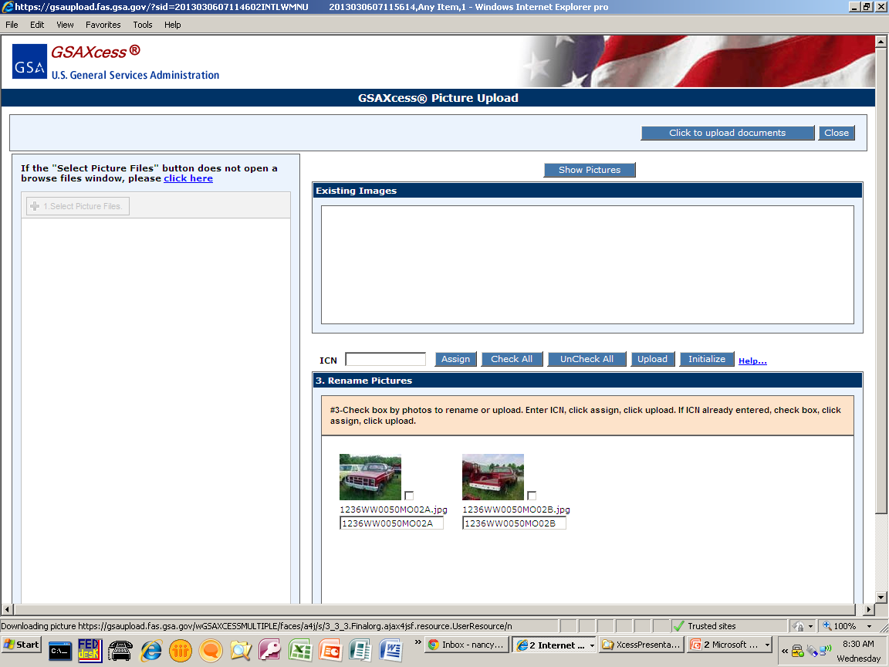
Select Picture Files
Notes:
To rename photos, click the checkbox of the items that need to be renamed.

Slide 15
Select Picture Files
Notes:
Enter the Item Control Number that matches your report. Click Assign. The pictures will now be renamed with the property ICNs and suffixes. If you wish a particular picture to display as the Main picture, change the suffix to “A”.

Slide 16
Upload Picture Files
Notes:
Once the ICNs and suffixes are correct, click Upload to upload your pictures.

Slide 17
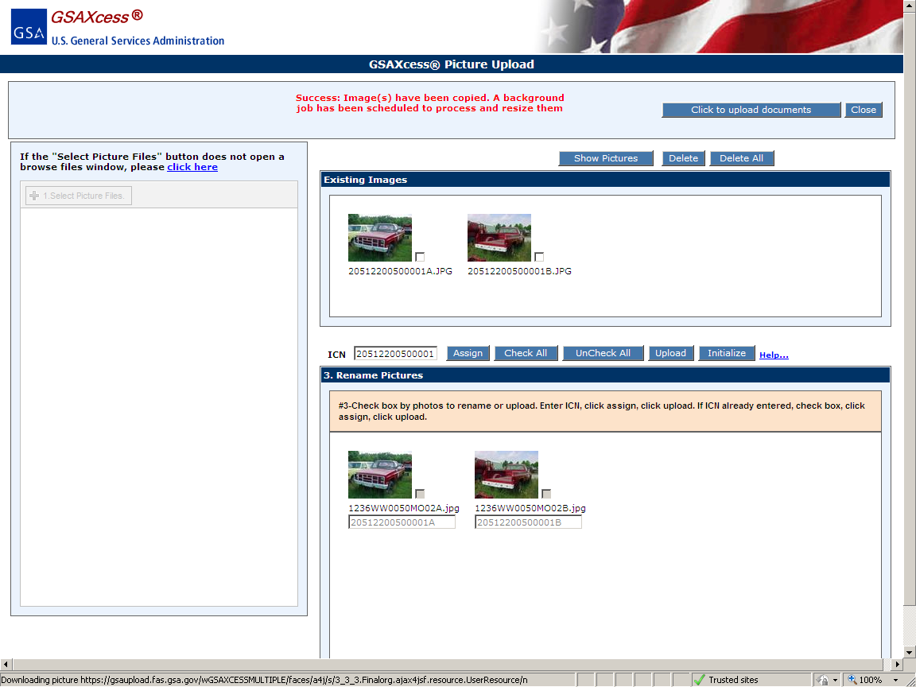
Upload Picture Files
Notes:
A success message will appear in Red, saying that they have been scheduled to process.

Slide 18
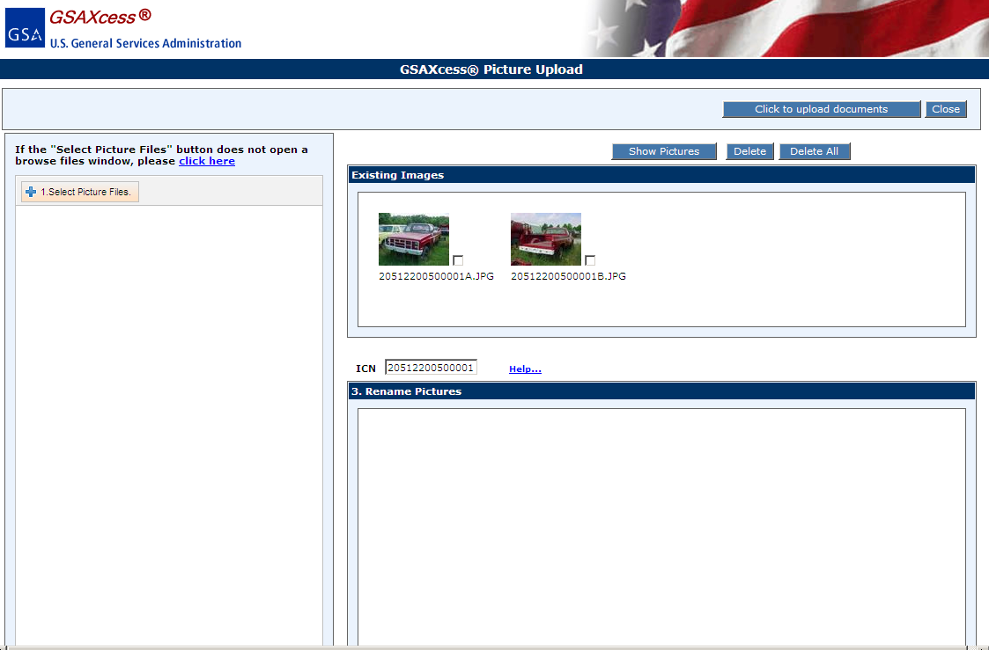
Delete Picture Files
Notes:
Enter Item Control Number and click on Show Pictures. If there are pictures input in the system, they will display under Existing Images.

Slide 19
Delete Picture Files

Slide 20
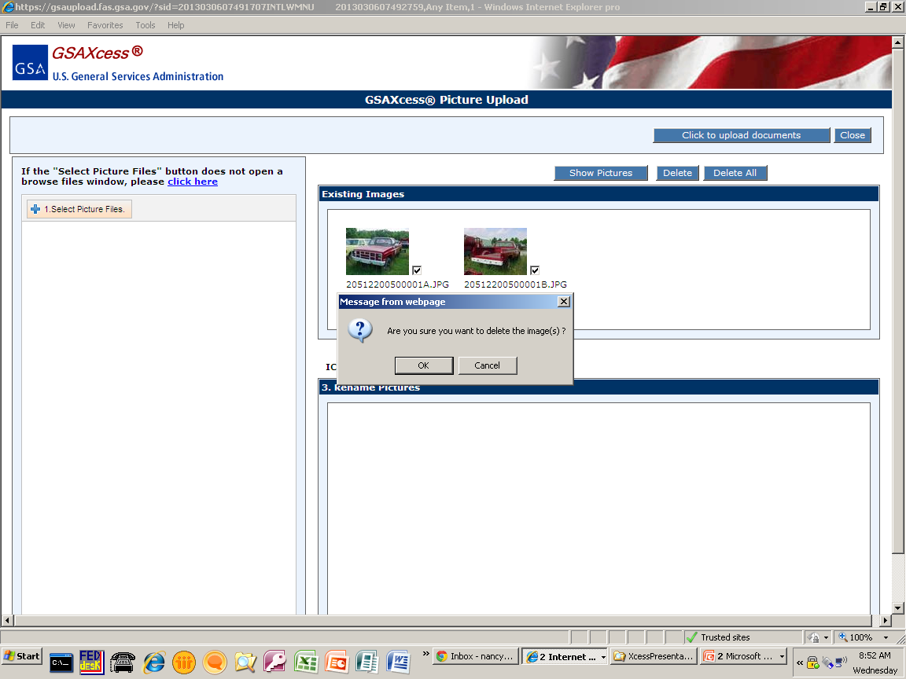
Upload Picture Button – Create Report
Notes:
Click the checkbox by each picture and then click Delete or click Delete All.

Slide 21
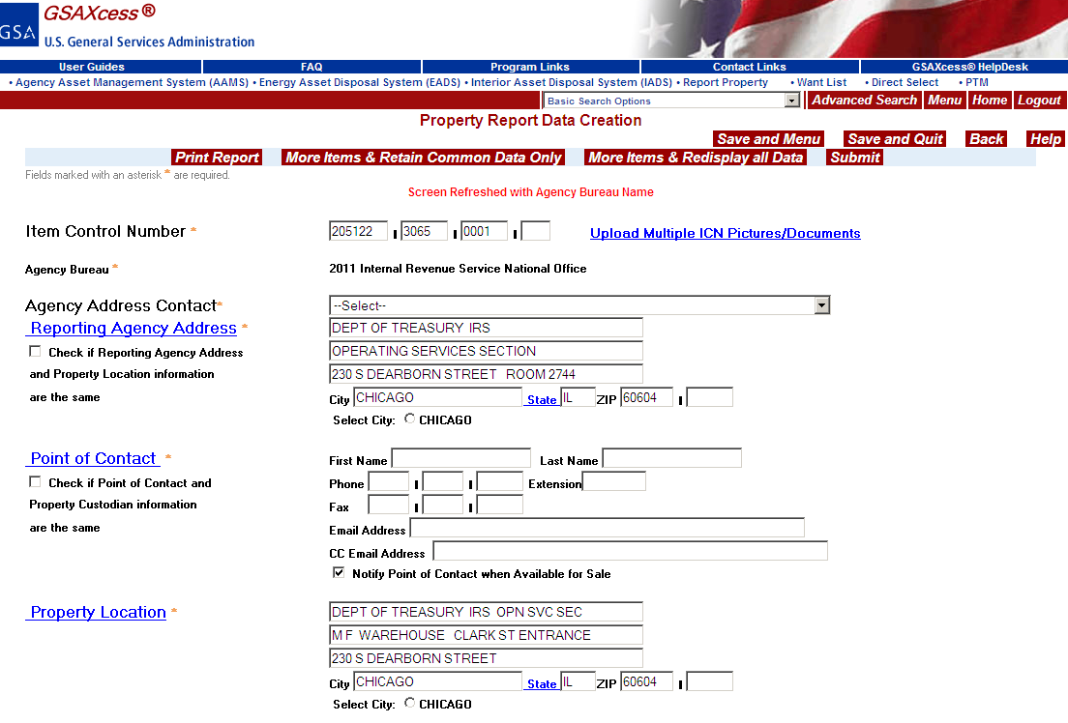
Upload Picture Button – Create Report
Notes:
You can add or delete pictures from Create Report, Modify Report or the Main Menu Upload Multiple Pictures.

Slide 22
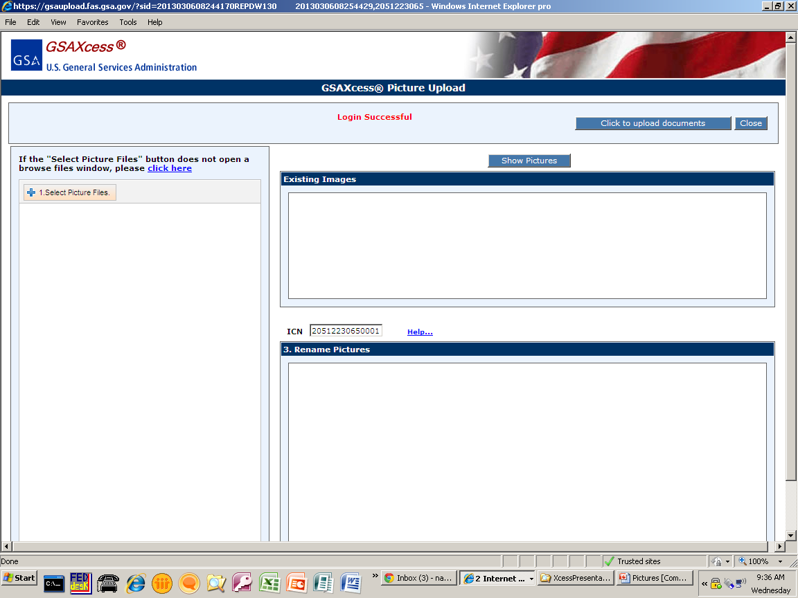
Upload Picture Button – Create Report
Notes:
The ICN is already entered for you when you enter photos from the Create Report screen. Then just follow the steps #1 Select Picture Files as shown previously.

Slide 23
To View Picture
Go to Search and Select or Select from Category Basic Search
Go to Property Inquiry
Go to AAMS/EADS/IADS Search and Select
Click on Modify Report
Enter ICN
Click ‘Submit’ button

Slide 24
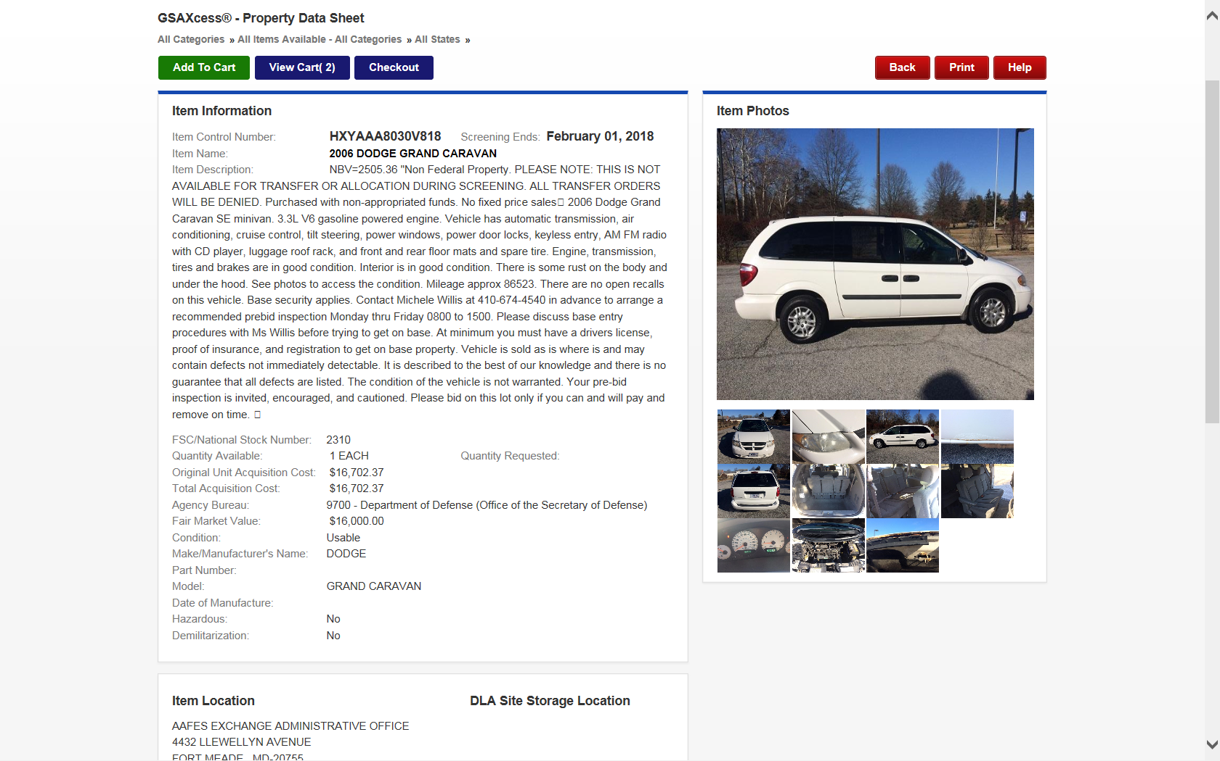
View Picture – Property Data Sheet
The picture with an “A” suffix will default to be your main picture.

Slide 25
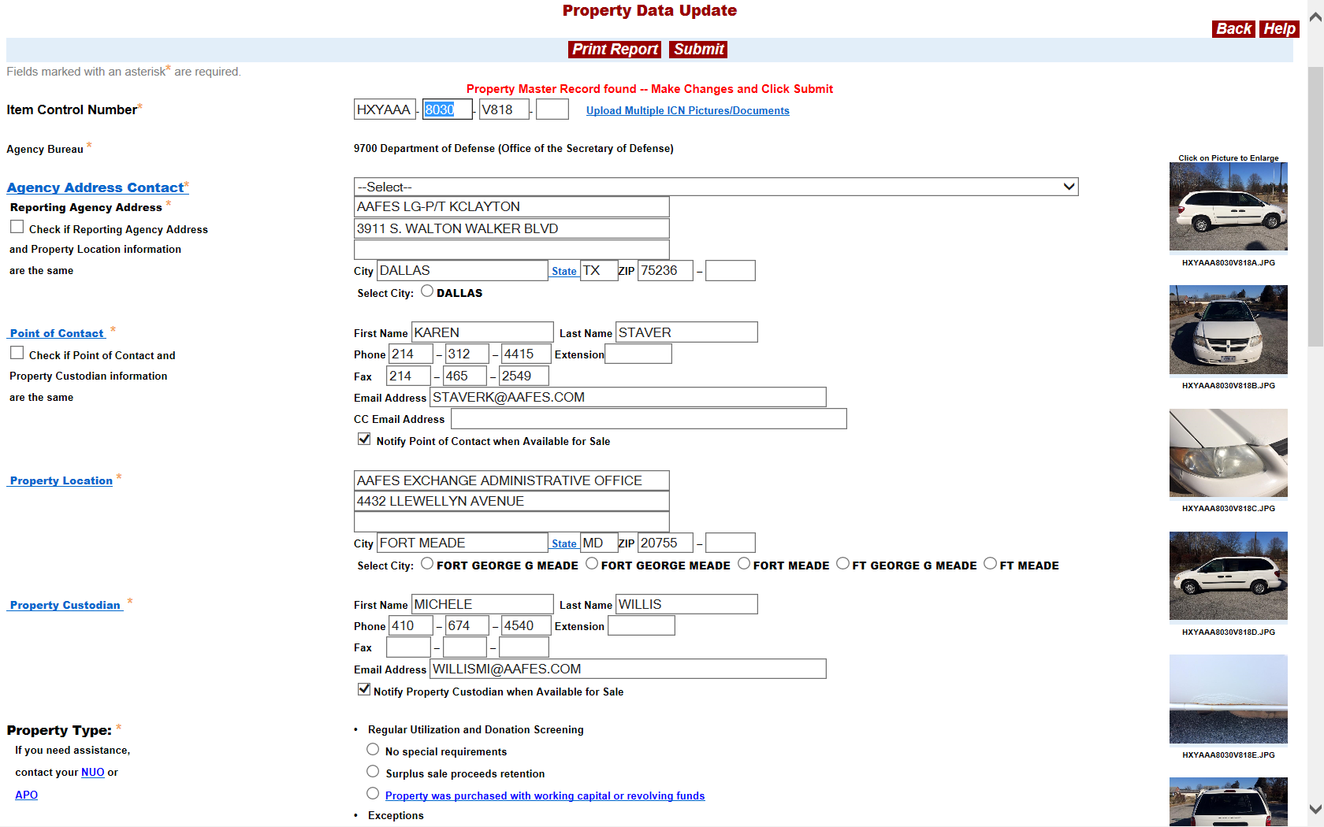
Modify Report

Slide 26
BATCH CUSTOMERS ONLY
Each photograph must be identified by a separate photograph filename.
The photograph filename begins with the ICN (a 15 position field with the 15th space blank or with a suffix), identifying the item being reported for excess by the reporting agency.

Slide 27
NAMING THE PICTURE – BATCH CUSTOMERS ONLY
The 1ST photograph (full view) will end with the
photograph suffix ‘A’, and any other pictures
(thumbnails) for that item will be from suffix “B through M, excluding the letter I.”
Please note that all alphabetical letters are capitalized.

Slide 28
NAMING THE PICTURE – BATCH CUSTOMERS ONLY
ICN: 1236WW70580001 (without suffix)
Picture Name: 1236WW70580001A
File Name: 1236WW70580001A.JPG
ICN: 1236WW70580001A (with suffix)
Picture Name: 1236WW70580001AA
File Name: 1236WW70580001AA.JPG

Slide 29
NAMING THE PICTURE – BATCH CUSTOMERS ONLY
Example of 1 item, which have 12 different photos of that item..
1st Photo – 1236WW70600001A.JPG
2nd Photo – 1236WW70600001B.JPG
3rd Photo – 1236WW70600001C.JPG
4th Photo – 1236WW70600001D.JPG
5th Photo – 1236WW70600001E.JPG
6th Photo – 1236WW70600001F.JPG
7th Photo – 1236WW70600001G.JPG
8th Photo – 1236WW70600001H.JPG
9th Photo – 1236WW70600001J.JPG
10th Photo – 1236WW70600001K.JPG
11th Photo – 1236WW70600001L.JPG
12th Photo – 1236WW70600001M.JPG

Slide 30
EMAIL REGARDING PICTURES
Notes:
If you reported property that meet the criteria specified previously and did not report pictures with the property item within five days, you will receive an Email from GSAXcess requesting reminding you to submit pictures.

Slide 31
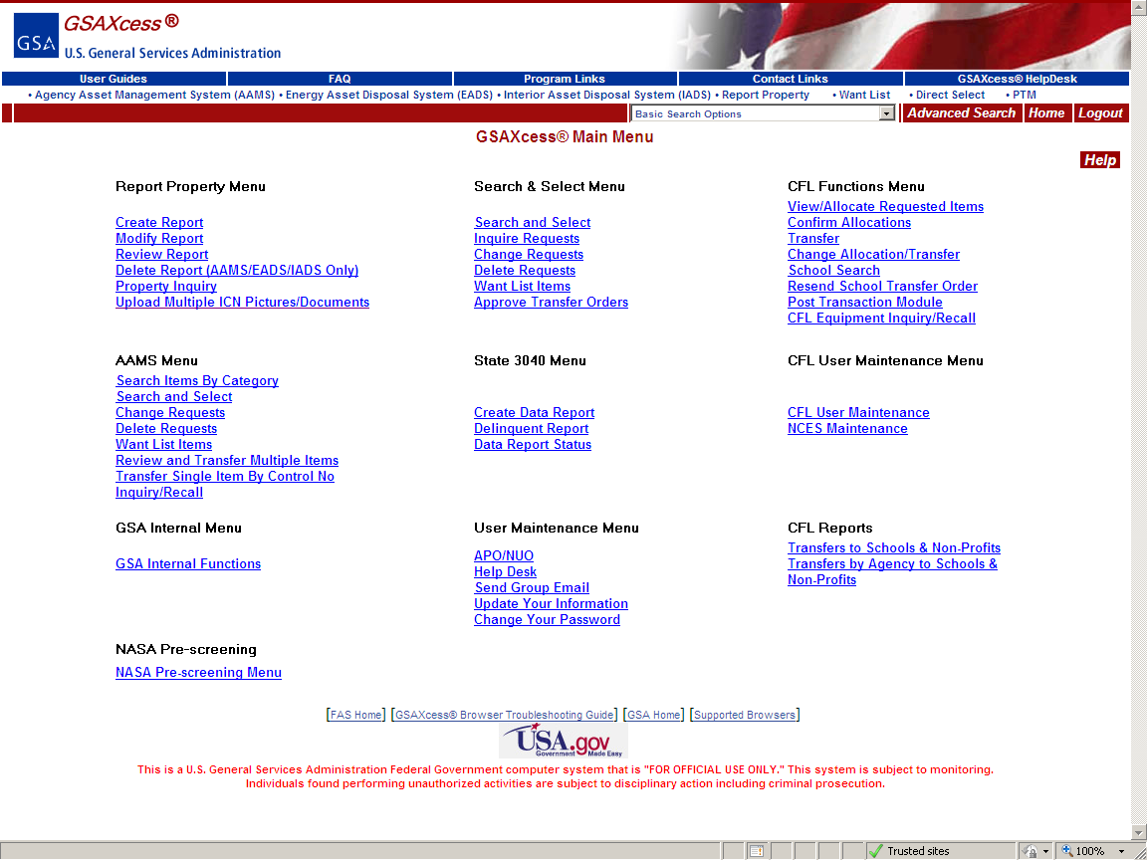
Upload Picture Hypertext
Notes:
Click on the hypertext to upload documents button.

Slide 32
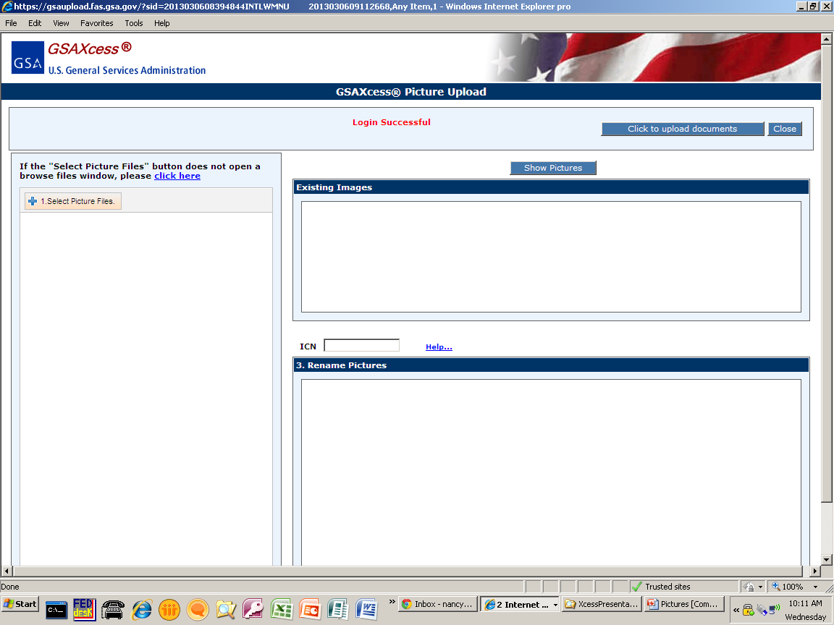
Upload Document Button – Main Menu
Notes:
Click on the Click to upload documents button.

Slide 33
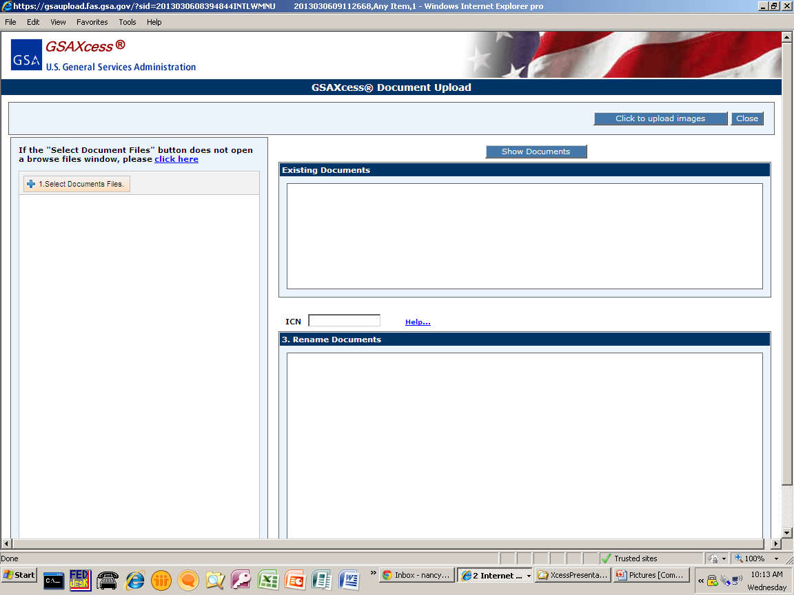
Upload Document Button – Main Menu

Slide 34
Upload Document Button – Main Menu

Slide 35
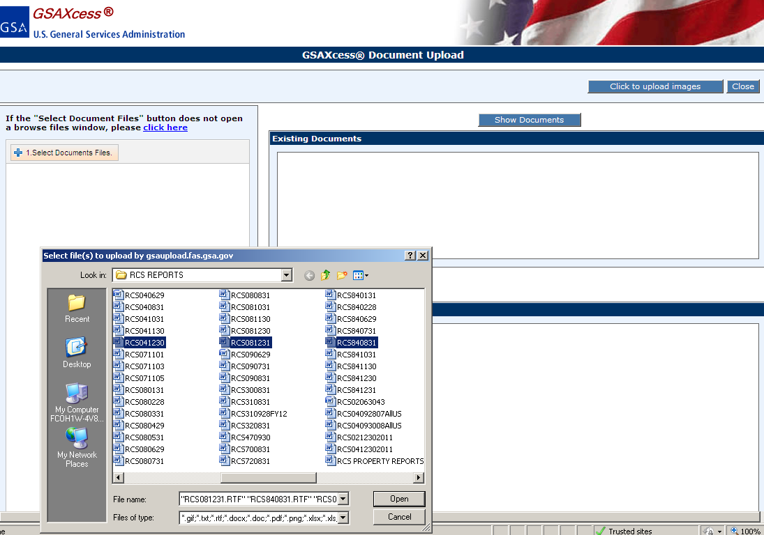
Upload Document Button – Main Menu
Notes:
Select your documents and click “Open”.

Slide 36
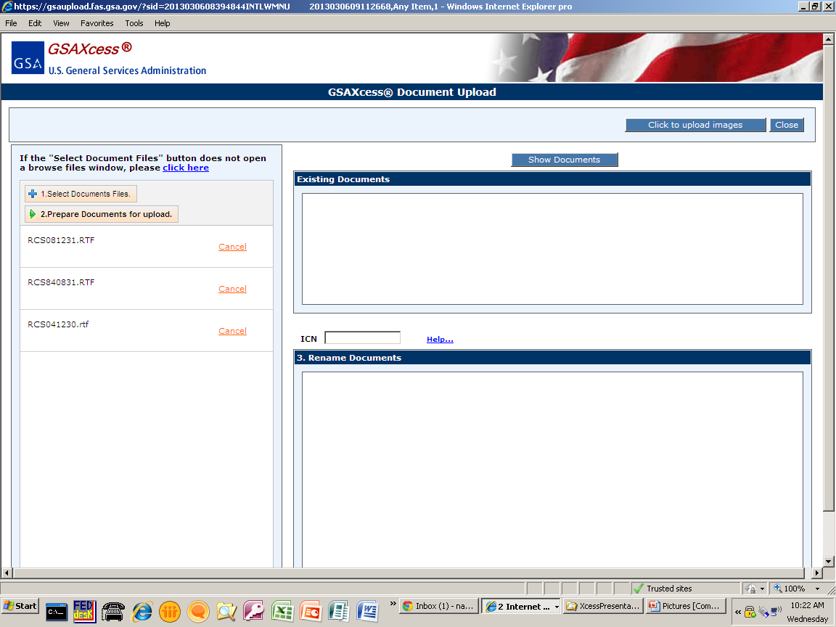
Upload Document Button – Main Menu
Notes:
The document files selected will appear in the screen below #1. Select Document Files. #2 will appear, that says prepare documents for upload. Click #2 and the system transfers your documents to the Rename documents area to be renamed if needed.

Slide 37
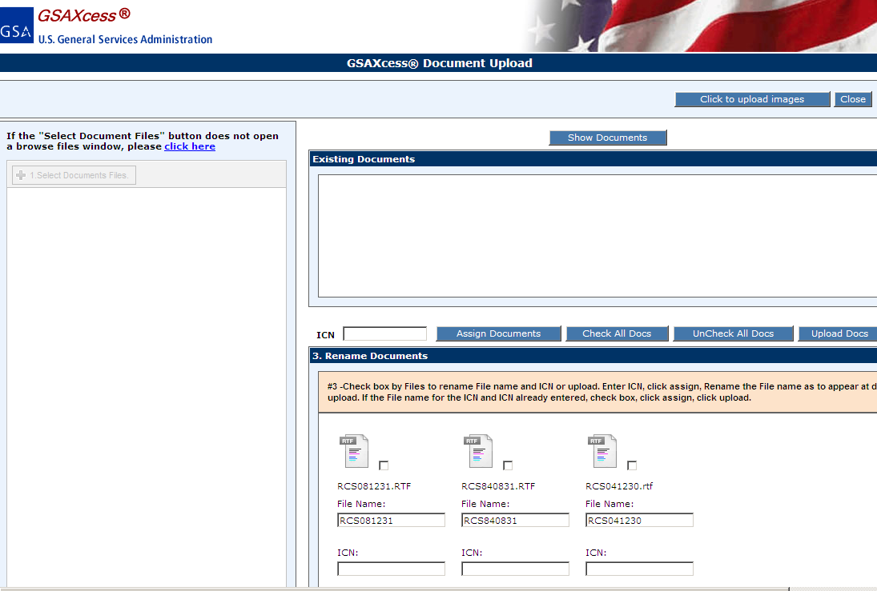
Upload Document Button – Main Menu
Notes:
To rename documents click the checkbox of the items that need to be renamed.

Slide 38
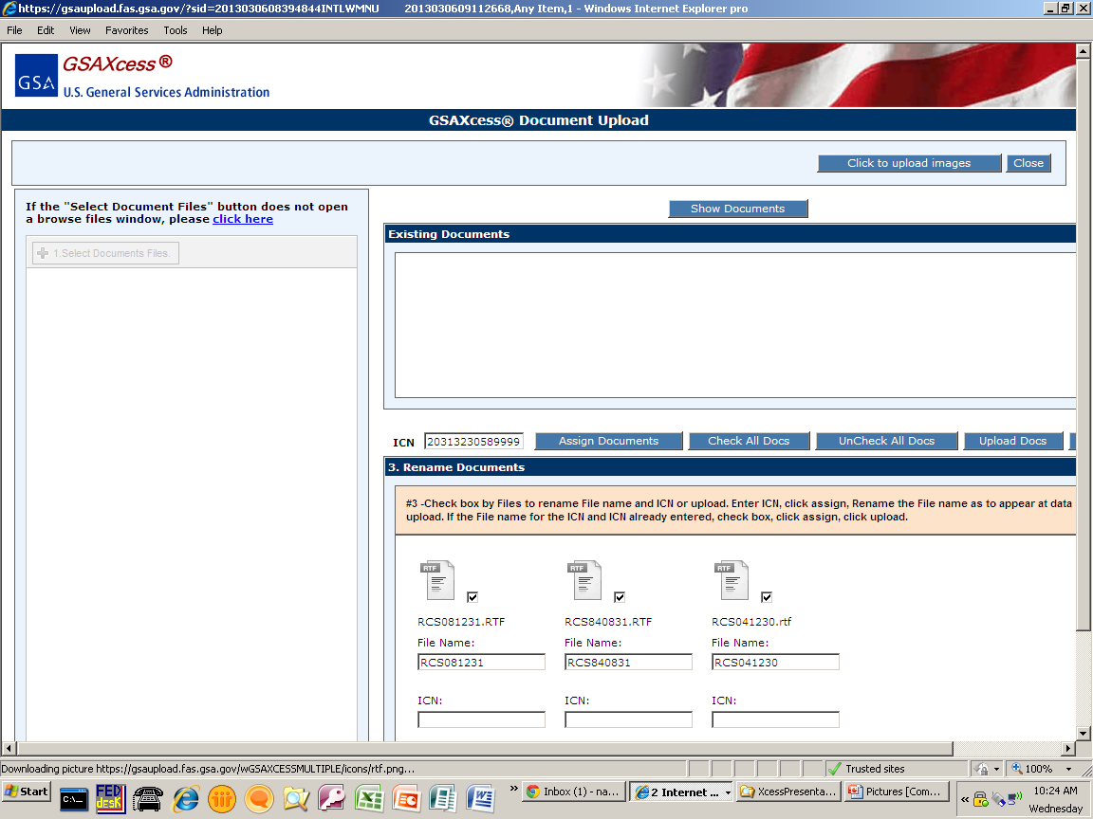
Upload Document Button – Main Menu
Notes:
Enter the Item Control Number that matches your report. Click Assign. The documents will now be renamed with the property ICN.

Slide 39
Upload Document Button – Main Menu
Notes:
Once the ICN is correct, click Upload Documents to upload your documents.

Slide 40
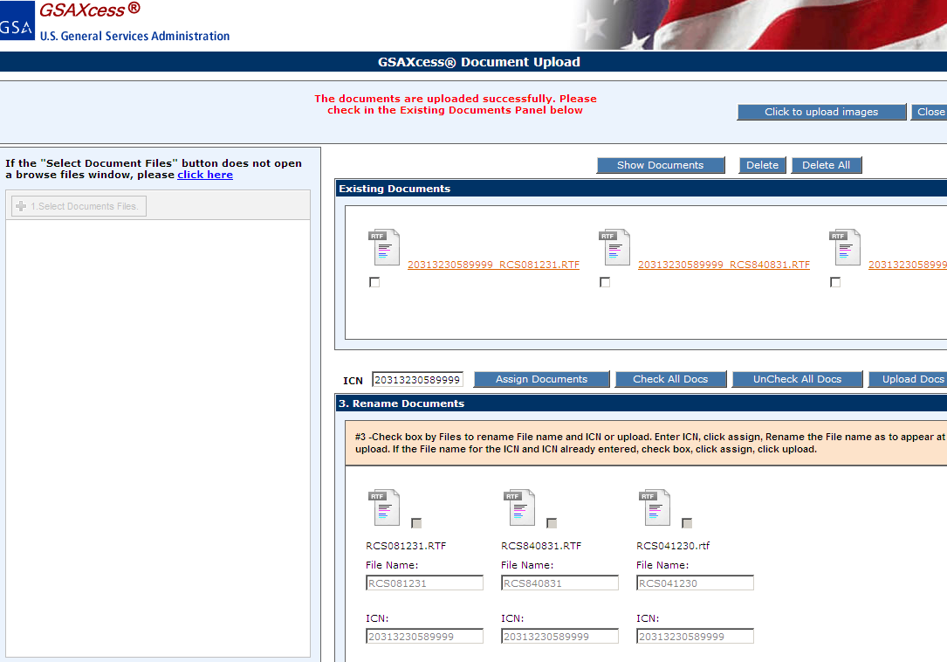
Upload Document Button – Main Menu
Notes:
You will receive a success message and the documents will display in the Existing documents area.

Slide 41
Upload Document Button – Main Menu
Notes:
Click on the Upload Multiple ICN Pictures/Documents hypertext.

Slide 42
Upload Document Button – Main Menu
Notes:
Click on the Click to upload documents button and follow the instructions given previously. The Item Control Number is pre-filled.

Slide 43
QUESTIONS?

