Slide 1
Federal Acquisition Service
National Firearms Program
Annual Inventory Training
Southwest Central Zone
Firearms Center of Expertise (COE)
Personal Property Management (PPM)
April 2023

Slide 2
Overview
U.S. General Services Administration
Firearms Program Background
Participants
Terms and Definitions
Inventory Compliance
Requirements
Timeline
Process Steps
GSAXcess
Login in
Profile Update
Inventory Listing
Inputting Results
Points of Contact

Slide 3
Firearms Program

Slide 4
Background
U.S. General Services Administration
The Office of Personal Property Management donates firearms to state and local law enforcement as a specialized commodity within the Federal Surplus Personal Property Donation Program.
Donation of firearms is specifically authorized in the Federal Management Regulation (FMR) in 41 Code of Federal Regulations (CFR), § 102-40.175.
GSA established the Firearm Program in November 1999 and works with State Agency for Surplus Property (SASP)for firearm donations.
Donated firearms are transferred to state Law Enforcement Agencies (LEAs) such as Police, Sheriff offices and Correctional Facilities.

Slide 5
Firearm Program Participation
U.S. General Services Administration
Active Firearms Assigned to LEAs – approximately 5243 weapons.
Participating States – 28 States and 2 Territories, Puerto Rico and District of Columbia.
Participating LEAs – 525 Law Enforcement Agencies.

Slide 6
Terms and Definitions
U.S. General Services Administration
AGENCIES
LEA: Law Enforcement Agencies
SASP: State Agency for Surplus Property
LESO: Law Enforcement Support Office
IG: Inspector General
NCIC: National Crime Information Center
ATF: Bureau of Alcohol, Tobacco, Firearms and Explosives
DOCUMENTATION
LOI: Letter of Intent
SF-122: Manual Transfer form for property
CTD: Conditional Transfer Document
TO: Transfer Order
ATF-10: Required form for National Firearms Act
TERMS
FSC: Federal Supply Class
ICN: Item Control Number used for reporting property
S/N: Serial Number
REGULATIONS
FMR: Federal Management Regulation
CFR: Code of Federal Regulations

Slide 7
Inventory Compliance

Slide 8
Annual Inventory Compliance
U.S. General Services Administration
Required in accordance with the CTD terms and conditions.
Reported in GSAXcess by deadlines specified.
Conducted in three parts/phases.

Slide 9
Annual Inventory Documentation
U.S. General Services Administration
Inventory Listing: Downloaded and Physically inspect all weapons on listing provided in GSAXcess
Certification Letter: Provided by each LEA using the required template
Verification Letter: Provided by each state/territory SASP using the required template

Slide 10
Inventory Timeline FY2023
U.S. General Services Administration
April 14, 2023
May 1, 2023
June 30, 2023
July 10, 2023
October 6, 2023
Inventory Announcement. Email notification sent out to all applicable LEAs and SASPs.
Inventory Start Date. LEAs log into GSAXcess to (1) Verify POC info, (2) Download firearms inventory listing, (3) Conduct physical inventory of all weapons listed and submit results.
Inventory Due Date. LEAs must submit firearm physical inventory results in GSAXcess by this due date.
Certification Statements Due. The certification signed by Senior LEA Official is due within 10 days of inventory submission into GSAXcess and provided to SASP for review. The final date for certification submissions.
Verification Statements Due. SASPs are required to conduct visual inspections of LEAs weapons and Verification Statements are submitted to GSA. The final date for verification submissions.

Slide 11
Annual Inventory Phases
U.S. General Services Administration
Part 1: The first part is to conduct and submit the physical inventory results in GSAXcess.
Inventory will be activated in GSAXcess with the Inventory Start Date of May 1, 2023.
Completed by the Law Enforcement Agency (LEA).
Verifies contact information in GSAXcess
Downloads Firearms Inventory Listing from GSAXcess
Conducts physical inspection of all firearms listed
Submits inventory results in GSAXcess, NLT June 30, 2023

Slide 12
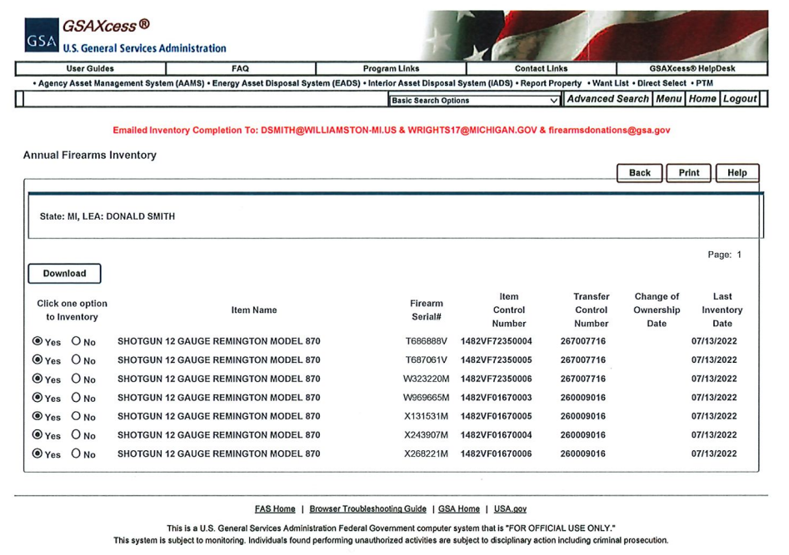
Inventory Listing (Example)
U.S. General Services Administration

Slide 13
Annual Inventory Phases
U.S. General Services Administration
Part 2: The second part requires the senior official of the LEA to complete a Certification Statement.
Following the completion of the inventory; the Certification Statement must be signed no later than ten (10) days following submission of the inventory results in GSAXcess.
LEAs submit completed Certification Statements to SASPs. Final day for submissions is July 10, 2023.
SASPs are required to compile the signed certifications from donees and submit these certifications to GSA at surplusfirearms@gsa.gov

Slide 14
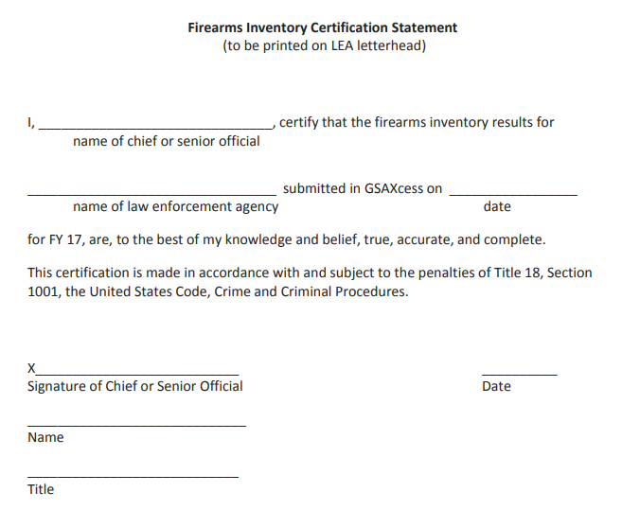
Certification (Template)
U.S. General Services Administration

Slide 15
Annual Inventory Phases
U.S. General Services Administration
Part 3: The third part, SASPs are required to complete a visual inventory inspection and Verification Statement.
There are three options for completing the visual inspection:
(1) In person visit by the SASP to the LEA location. Physically verifying each firearm on listing by serial number.
(2) Digital visit by LEA providing date stamped photos of the firearms with the serial number visible to SASP and then attached to Verification Statement (If the camera cannot date stamp photos, then the firearms must be photographed in front of a daily newspaper with the date visible).
(3) Virtual visit by conducting a video conference or other virtual visual means to inspect firearms and verify serial numbers.
Upon completion of visual inspections of all LEA weapons; SASP completes Verification Statement and submits to surplusfirearms@gsa.gov NTL October 6, 2023

Slide 16
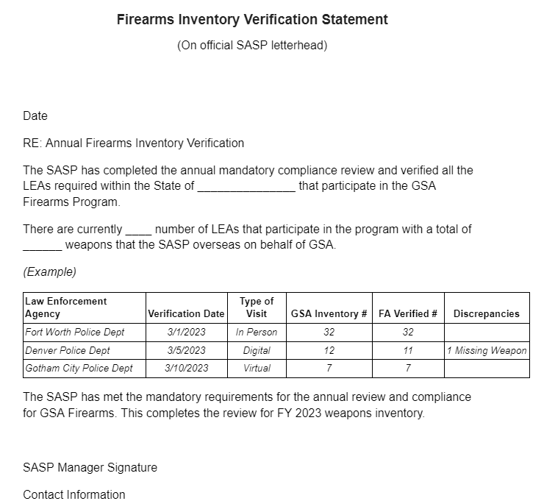
Verification (Template)
U.S. General Services Administration

Slide 17
GSAXcess

Slide 18
GSAXcess for LEA
U.S. General Services Administration
Login to www.gsaxcess.gov
GSAXcess Access Granted Email, by April 30, 2023
Helpdesk, GSAXcess technical issues
Hours of Operations, 8:00 a.m. - 7:00 p.m. EST
1-866-333-7472
gsaxcesshelp@gsa.gov
Verify Point of Contact Information
Download Firearm Inventory Listing
Submit Inventory Results

Slide 19
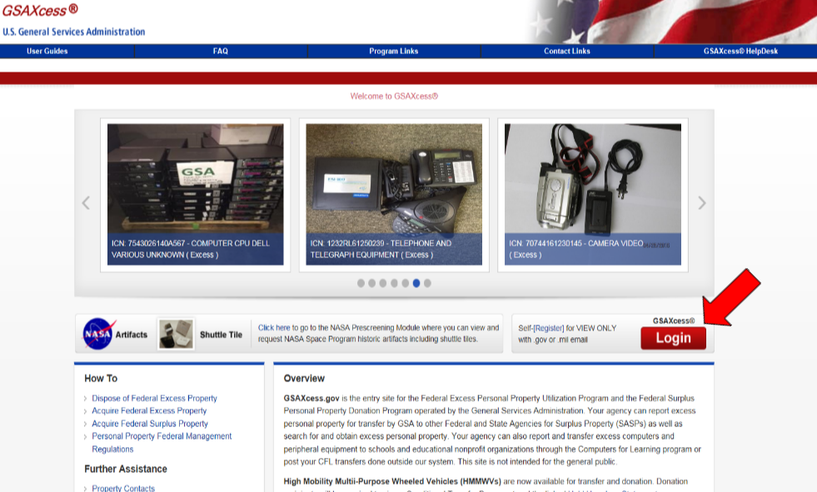
Login
U.S. General Services Administration
Select
Button

Slide 20
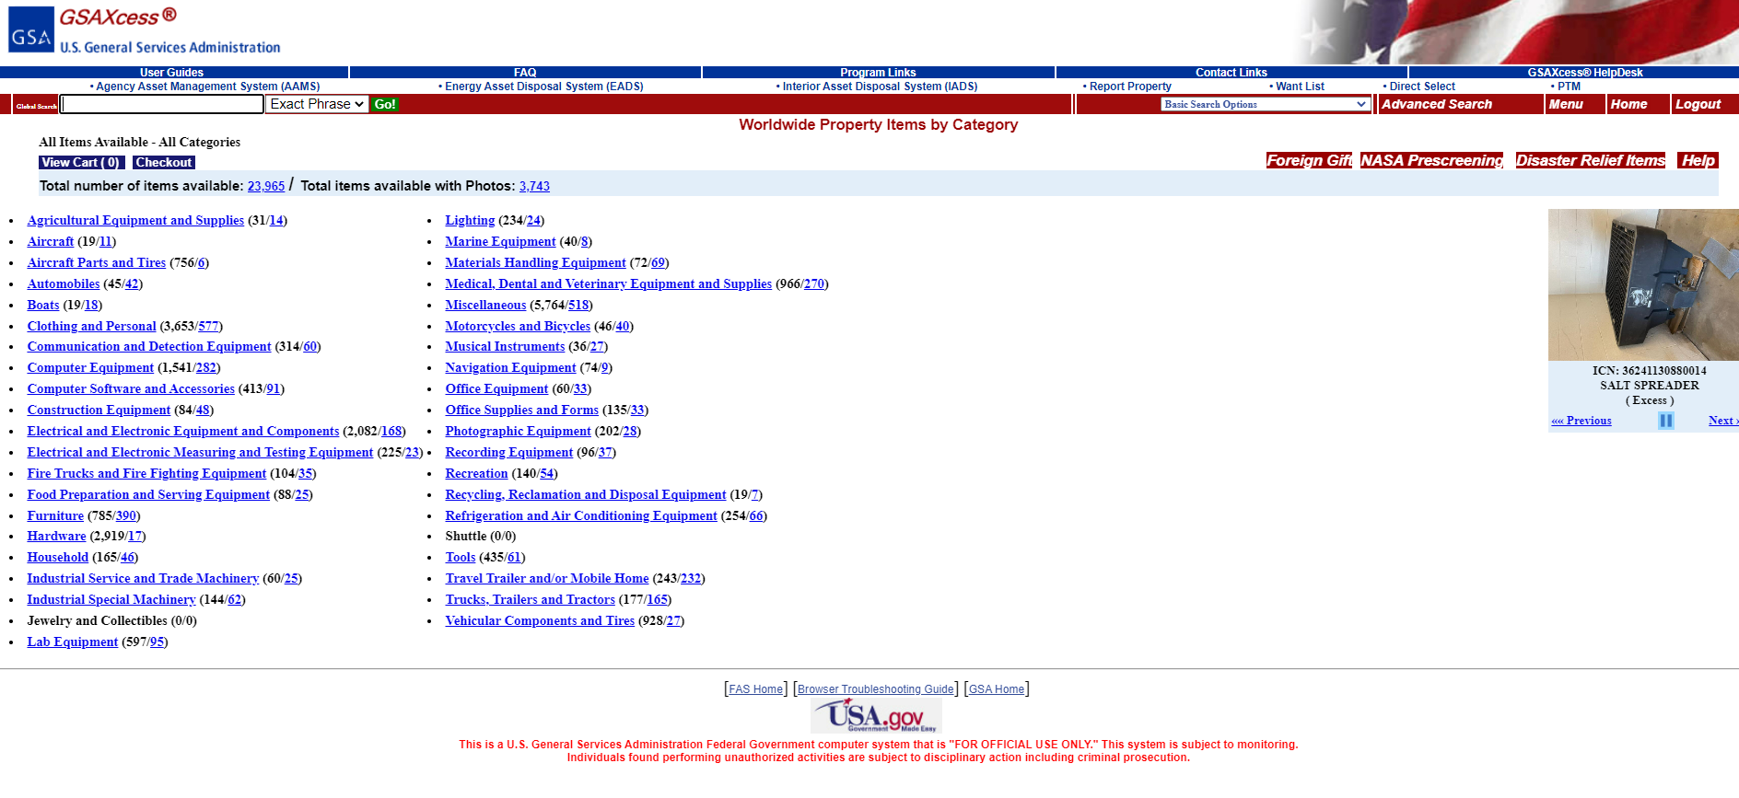
Menu
U.S. General Services Administration
Select Menu

Slide 21
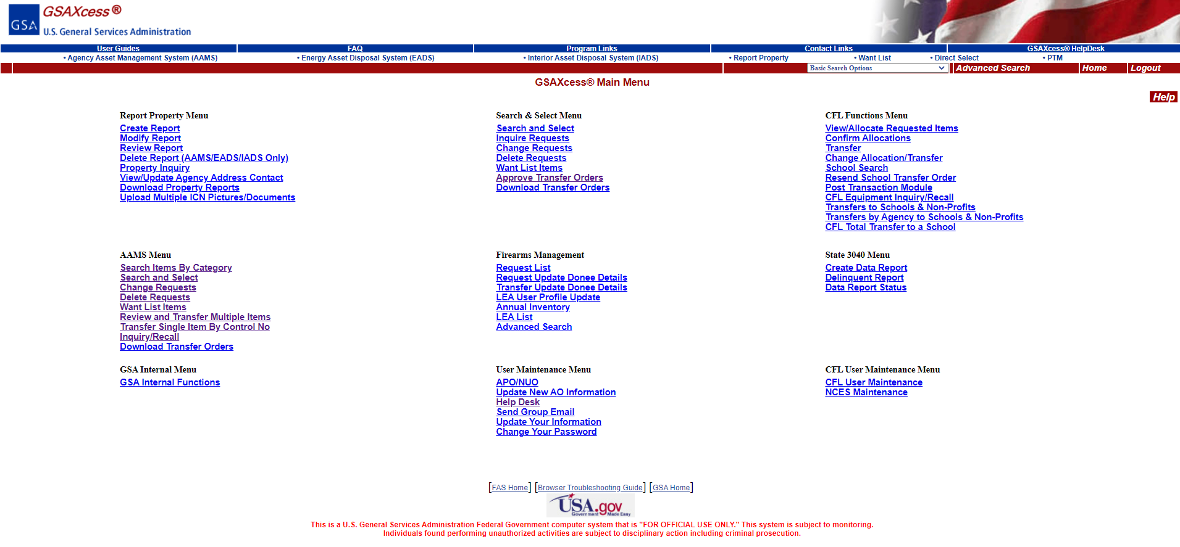
Update Profile
U.S. General Services Administration
LEA User Profile

Slide 22
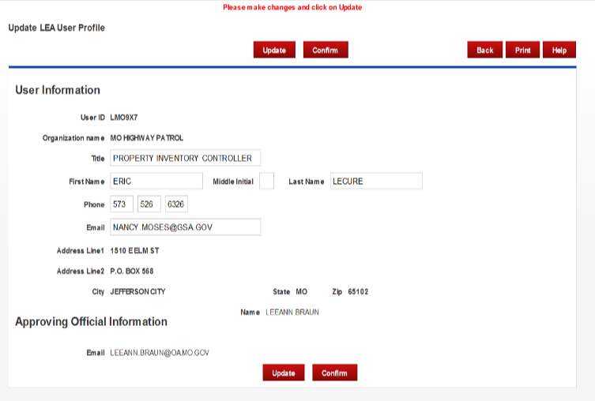
Verify POC
U.S. General Services Administration
Search by LEA User ID
Verify Info, Edit as Required
Select Update

Slide 23
Inventory Listing
U.S. General Services Administration
Annual Inventory

Slide 24
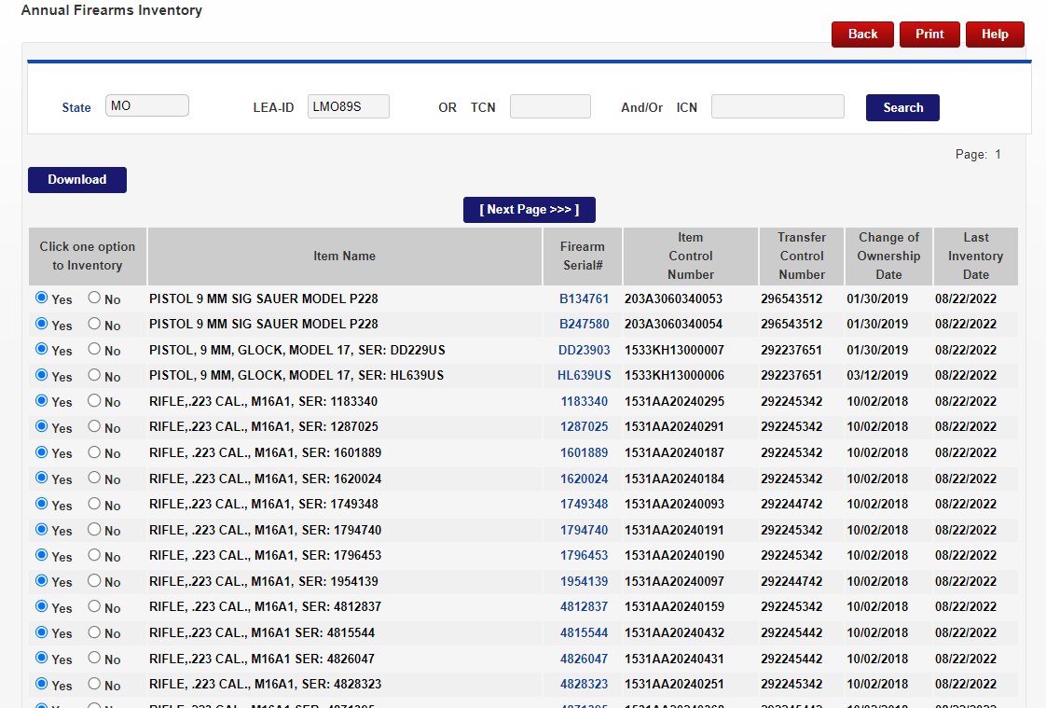
Find LEA
U.S. General Services Administration
Enter LEA User ID
Select Search for results

Slide 25
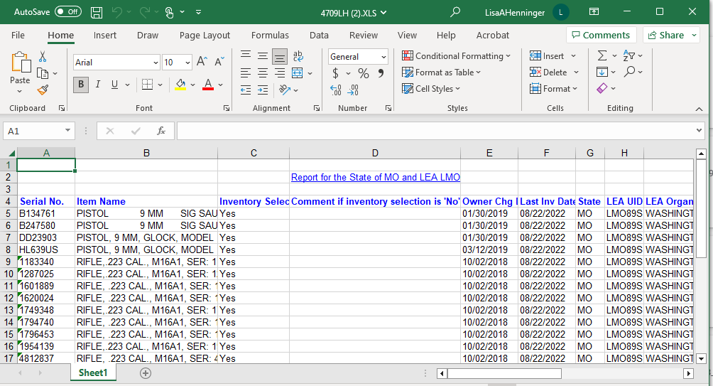
Download Listing
U.S. General Services Administration
Select Download Button
Listing will open in Excel file

Slide 26
Input Results
U.S. General Services Administration
Verify YES or NO for inventory Results

Slide 27
Points of Contact
U.S. General Services Administration
State Agencies for Surplus Property (SASPs), www.gsa.gov/sasp
GSAXcess Coordinator, GSAXcesshelp@gsa.gov
GSA Firearms Program, surplusfirearms@gsa.gov
GSA Firearms Program, Inventory Managers
Lisa Henninger (West States), 817-201-8148
Mat Shortledge (East States), 682-299-9015

Slide 28
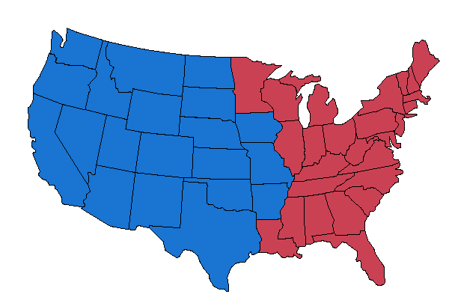
State Inventory Zones
U.S. General Services Administration
West States Zone
East States Zone

Slide 29
Questions?
U.S. General Services Administration

