Slide 1
Term Contracts
Deone McMillan
Sales Contracting Officer
Federal Acquisition Services

Slide 2
  What is a Term Contract?
  Term Contract
    A method of sale using a sealed bid
    Term contracts are created for the sale of federally owned scrap metal
    Property is usually sold as condition code S (scrap)
    Property may include electronics, iron & steel, aluminum or copper
Notes:
Term Contract are generally awarded for 1 base year period, and up to 4 option period years. The option period are only awarded through the mutually agreed approvals of the federal owning agency and the winning bidder of the originally awarded bid of the contract. This contract my be terminated anytime after the base year period when deemed to be in the best interest of the Government.

Slide 3
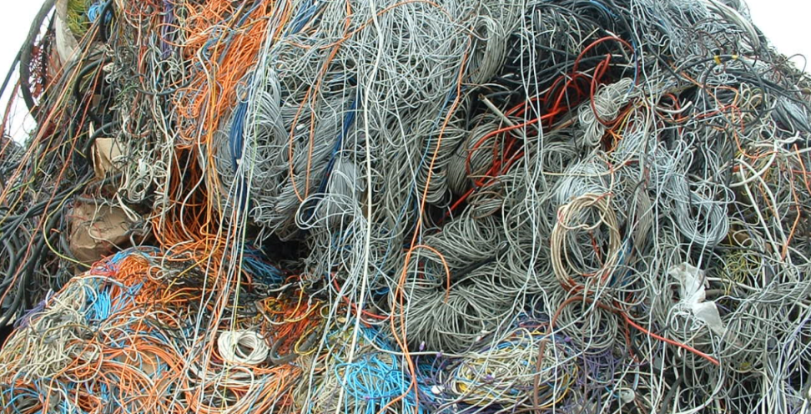
Benefits of Term Contracts
  Another disposal option for federal agencies.
  Agencies don’t have to report property monthly.
  Recycling program credit to your agency.
  Optimizes return to the US Government.

Slide 4
  Regulations that govern the sale through Term Contracts
  Surplus Property
    FMR Part 102-38 - Sale of Personal Property
  Term Contract Sales Proceeds
    FMR Part 102-38.295 – Holding agency may retain the balance of proceeds from the sales of its agency’s personal property when -

Slide 5
  Regulations that govern the sale through Term Contracts
  Term Contract Sales Proceeds (continued)
    If the property sold was related to waste prevention and recycling programs, under the authority of Section 607 of Public Law 107-67.
Notes:
Consult your General Counsel or Chief Financial Officer for guidance on use of this authority.

Slide 6

What’s Next
  Create the Term Contract Sales:
    Draft the requirements through a Terms and Conditions contract agreement
    Prepare an Invitation For Bid (IFB) form

Slide 7
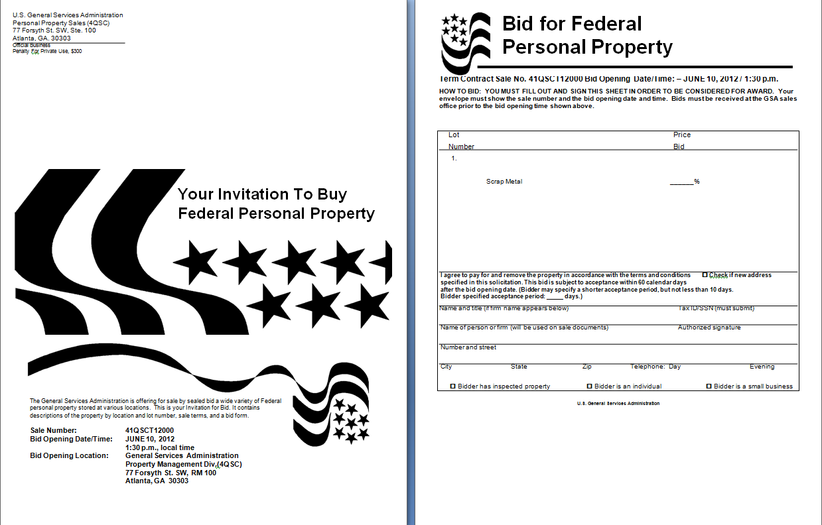
Solicitation Documents

Slide 8
Sealed Bid Requirements
IFB to include a copy of the specifications for the particular proposed purchase
Instructions for preparation of bids
The conditions of purchase
Delivery and payment schedule
The IFB also designates the date and time of bid opening
Notes:
Sealed bidding (defined in FAR Part 14) is a procurement method used when the best value is expected to result from the selection of the lowest evaluated priced offer. This contracting method solicits, in a document called invitation for bids (IFB), prospective providers for submitting offers, called sealed bids.

Slide 9
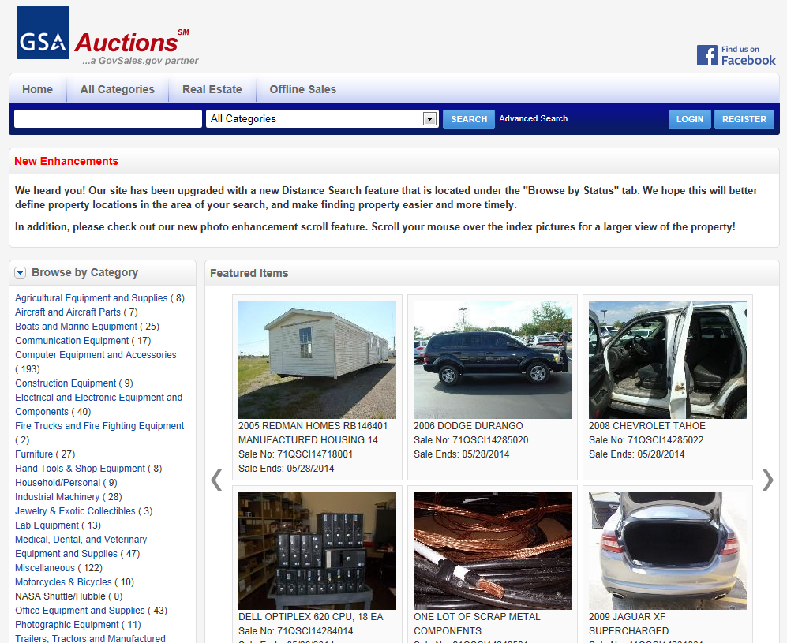
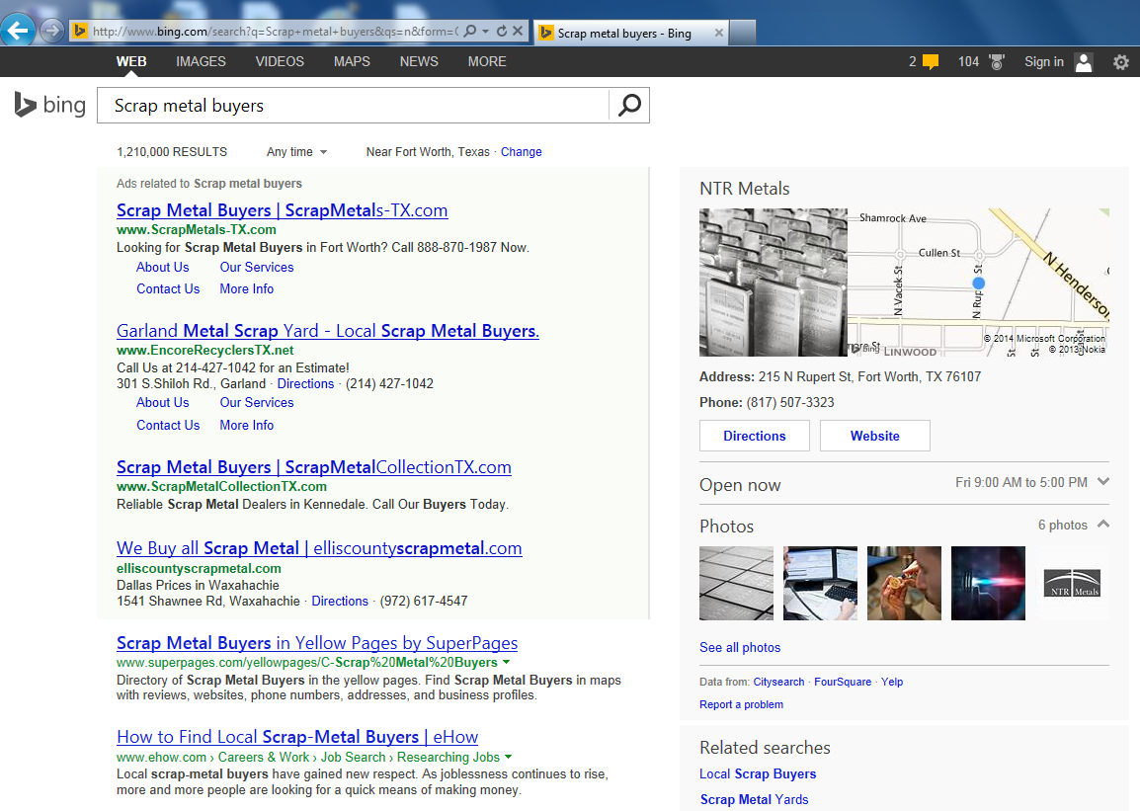
Advertising the Sale
FAR Subpart 14.2—Solicitation of Bids
14.203 Methods of soliciting bids.
Notes:
Those responding through GSA Auctions are instructed to email me a request for a copy of the Terms and Conditions and the IFB Bid Sheet.

Slide 10
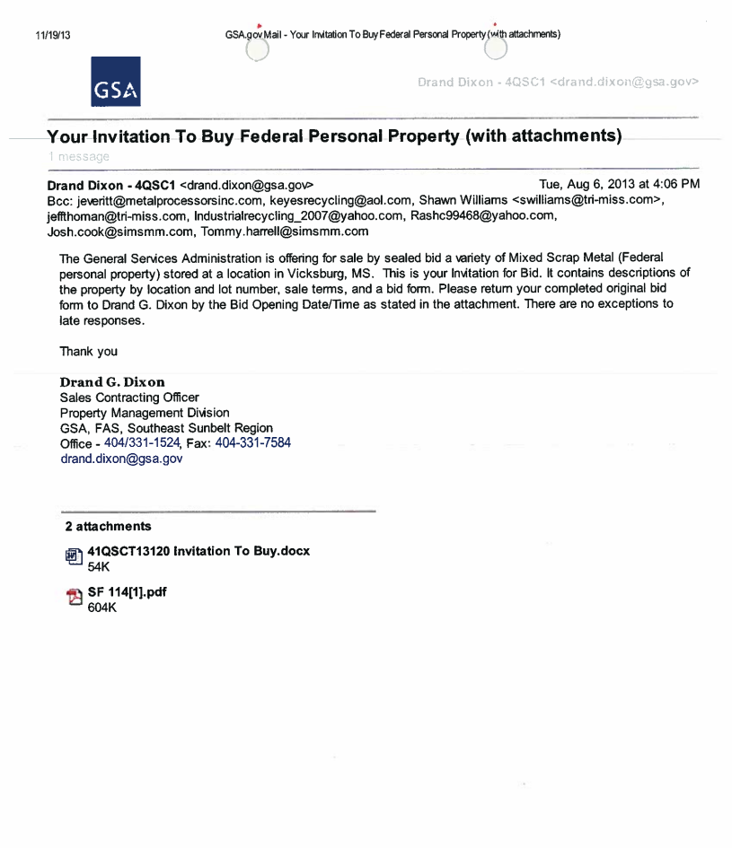
Bid Invitation

Slide 11
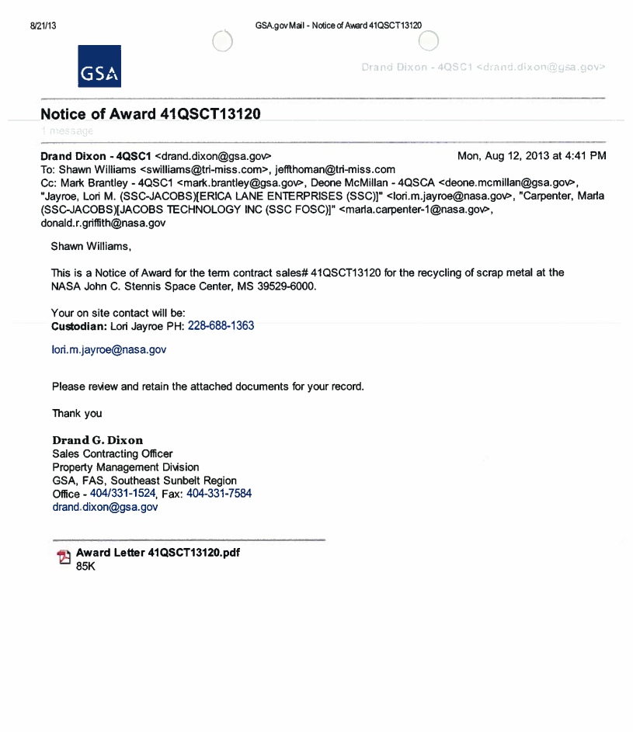
Award Notification

Slide 12
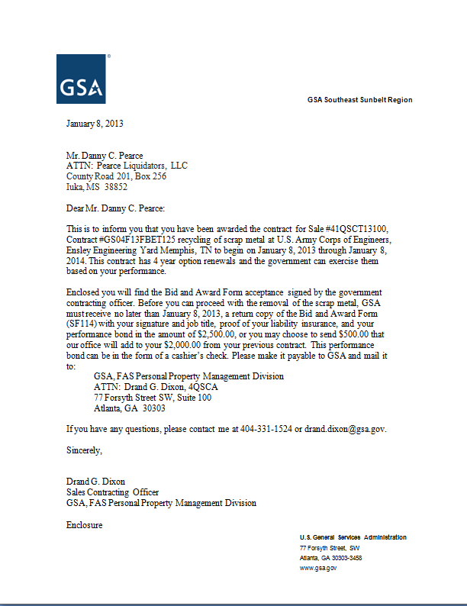
Award Letter

Slide 13

Awarded Bidding Required Documents
Completed GSA Standard Form 114
  Sale of Government Property – Bid and Award
Certificate of Liability Insurance
Performance Bond Payment
  20% of the estimated award value

Slide 14
Roles and Responsibilities
  Owning Agency Shall
    Identify a key contact and contact info
    Notify GSA of any change requirements
    Approve property to be removed
    Provide witness for all removals
    Verify quantities removed with GSA

Slide 15
Roles and Responsibilities
  Winning Bidder Shall
    Identify a key contact and contact info
    Notify GSA of any change requirements
    Read and understand the Contract
    Provide removal tickets for all removals
    Verify quantities removed with GSA

Slide 16
Roles and Responsibilities
  GSA Contracting Officer Shall
    Advise key contacts as needed
    Notification of any change requirements
    Manage the Term Contract
    Collect removal tickets for all removals
    Submit Invoices for payments

Slide 17

Questions
Notes:
Any questions about the sales process?

