Slide 1
Foreign Gifts
Juan Mclemore - Area Property Officer (APO)
Personal Property Management (PPM)
General Services Administration
Notes:
Disposal of Specialized Categories of Property

Slide 2
Can my Agency Keep Gifts?
Yes, if your agency has gift retention authority. Gift becomes normal property – looses its identity as a gift.
Otherwise, report to GSA on SF 120.
If no authority to keep, but agency wants gift, note on 120 your interest and submit SF 122 to GSA.
FMR 102-36.405 thru 420
Notes:
Your agency may keep gifts only if it has gift retention authority, otherwise the foreign gift becomes normal property and loses it’s identity as a gift. Report to GSA on SF120.

Slide 3
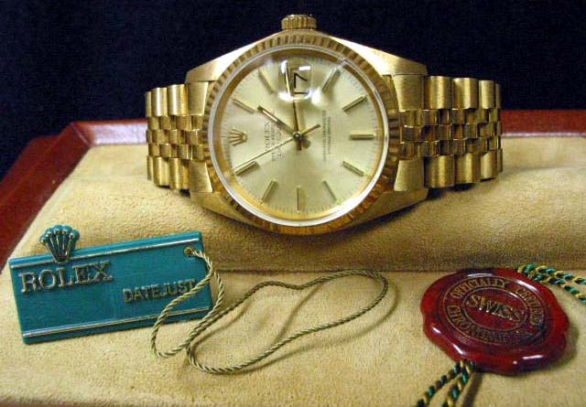
Can Employees Keep Foreign Gifts and Decorations?
Yes, with employing agency approval if:
  Gift has minimal value
($305 or less – but subject to change);
  Decorations for outstanding or
unusually meritorious performance.
If employing agency disapproves, gift becomes property of
the U.S. Government and is reported as excess to GSA.
Employees must report all gifts to agency within 60 days.
FMR 102-42
Notes:
Employees may keep Foreign gifts only if it has minimal value, or a decoration for outstanding or unusually meritorious performance. Otherwise, gift becomes property of U.S. Government and is reported to GSA. Note that employees must report all gifts to their agency within 60 days.

Slide 4
What if Employee Wants to Keep a Gift Disapproved by Agency, or, above Minimal Value?
If the Agency does not keep the gift for official purposes, Gift is reported to GSA.
GSA will offer Gift to other Federal Agencies
If no Federal Agency wants the gift, the employee can buy the gift for the appraised value.
Notes:
If no other Federal agency wants the gift, the employee may buy the gift for it’s appraised value.

Slide 5

Questions & Answers
Notes:
Questions and Answers

