Slide 1
Federal U&D Program, Legislative History, Statutes, Organizations, & Functions
David Tran, CPPA

Slide 2
Agenda
Legislature History
Regulations
Responsibilities
Organizational Structure
Stakeholders

Slide 3
Legislative History
Constitution
Forces of Evolution

Slide 4
Constitution
Article IV
Vested in Congress the authority to acquire & dispose of property on behalf of the U.S.
Passed legislation establishing policies to serve the interests of taxpayers.
Congress remains the ultimate arbitrator in determining the public’s best interest in federal property disposition.

Slide 5
Forces of Evolution
World Wars
Program Fragmentation
Presidents & Congress

Slide 6
Forces of Evolution
EO 3019 (1918)
Directed war surplus materials, supplies, & equipment be transferred to federal agencies.
Administered by SEC of Treasury.
PL 66-91 (1919)
Authorized SEC of War to sell surplus machine tools at 15% of cost to educational institutions.
PL 70-254 (1928)
Allowed aeronautical equipment be given to museums for display.
PL 71-249 (1930)
Authorized the SEC of Navy to provide property “without cost”.

Slide 7
Forces of Evolution
PL 78-457 aka Surplus Property Act of 1944
Temporary statute to address massive WWII surplus.
Enabled several entities to manage disposal process:
Reconstruction Finance Corp
Surplus Property Administration
War Assets Corp
War Assets Administration
Federal Security Administration
Allowed donation of property to educational, public health, local government, & non-profit institutions at reduced or no cost for public benefit.

Slide 8
Regulations
GSA, Office of Government-wide Policy (OGP)
Federal Acquisition Regulations (FAR)
Federal Property Management Regulations (FPMR)
Federal Management Regulations (FMR)

Slide 9
Regulations
FMR
Utilization (102-36)
Donation (102-37)
Sales (102-38)
Exchange/Sale (102-39)
Special Handling Requirements (102-40)
Seized, Forfeited, Voluntarily Abandoned, & Unclaimed (102-41)
Foreign Gifts & Decorations (102-42)

Slide 10
Responsibilities
Office of Government-wide Policy (OGP)
Creates & revises regulations for the procurement, management, & disposal of property for all executive agencies.
Federal Acquisition Service (FAS)
Manages operations including nation-wide property management disposal system.

Slide 11
Responsibilities
GSA Zonal & Field Offices
Provides training.
Reviews & screens available excess/surplus for agency needs.
Expedites disposal process with online, onsite, & virtual screening.
Allocates/approves transfers & donations.
Provides State Agencies for Surplus Property (SASP) oversight.
Conducts sale of surplus & exchange/sale property.
Provides expert customer field support.

Slide 12
Organizational Structure
Central Office
Plans, directs, and coordinates U&D and sale of personal property.
Maintains national database for consolidating excess & surplus personal property.
Zones
Mid-Atlantic Zone (Philadelphia, PA)
Southeast-Great Lakes Zone (Atlanta, GA)
Southwest-Central Zone (FT Worth, TX)
Pacific Rim Zone (San Francisco, CA)
National Capital Zone (Washington, DC)

Slide 13
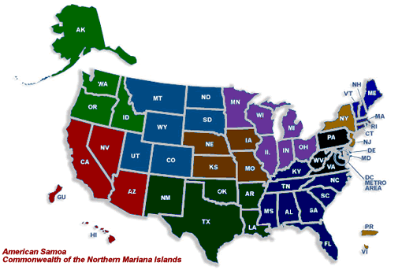

Slide 14
Stakeholders
Users & Screeners Association-Federal Excess Personal Property (USA-FEPP)
Independent, non-profit consortium of federal agencies, contractors, project grantees, universities, & others.
Acknowledge the prime directive to use excess personal property as first source of supply.
Purpose: share expertise, alert members to program changes, promote use of excess, develop professionalism, & provide a unified voice concerning federal personal property management.

Slide 15
Stakeholders
National Association of State Agencies for Surplus Property (NASASP)
Purpose: To partner with GSA and save taxpayer dollars by extending the useful life of surplus to public agencies, non-profit organizations in health, education, low income, & homeless, veterans organizations, SEAs, and small businesses.

Slide 16
Stakeholders
National Property Management Association (NPMA)
Largest association for asset property management professionals in the world (60 local chapters).
Non-profit, membership association for professionals whom are responsible for effective & efficient management of equipment, materials, & other moveable and durable assets for their organization.

Slide 17
Before the exam…

