Slide 1
Disposal of Specialized Categories of Property
Phar`is D. Allen, Ph.D., DRM
Georgia, North Carolina, South Carolina
Area Property Officer
Personal Property Management
Notes:
Disposal of Specialized Categories of Property

Slide 2
Disposal of Specialized Categories of Property
Categories of Property Requiring Special Handling:
1. Aircraft
2. Firearms
3. Vessels
4. Animals
Notes:
Disposal of Specialized Categories of Property

Slide 3
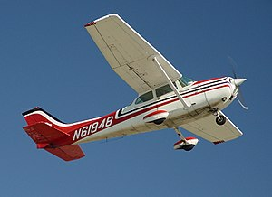
Reporting Aircraft & Federal Screening Region 9
POC: Sandra Klar Email: sandra.klar@gsa.gov
Telephone: 415-522-3041 Fax: 415-422-3043
Field and Customer Support Branch
450 Golden Gate Ave
San Francisco, CA 94012
*FSC 1510 ~ Fixed Wing
*FSC 1520 ~ Rotary Wing
*41 CFR 102-36-340
*Aircraft Components & Engines – Regional Office property is located
Notes:
Disposal of Specialized Categories of Property

Slide 4
Aircraft Donation and Screening Region 9
POC: Lisa Schrad Email: lisa.schrad@gsa.gog
Telephone: 415-522-3041 Fax: 415-422-3043
Field and Customer Support Branch
450 Golden Gate Ave
San Francisco, CA 94012
Notes:
Disposal of Specialized Categories of Property

Slide 5
Firearms Region 8
POC: Debbie Rojas Cook Email: debbie.rojascook@gsa.gov
Telephone: 303-236-7707 Fax: 303-236-7544
Property Management Division (7FP-8) National Firearm Program Manager
Notes:
Disposal of Specialized Categories of Property

Slide 6
Reporting Criteria
*Executive Branch Agencies
*Handguns, rifles, shotguns, light auto, less than .50 cal
(FSC-1005)
*Rifle and shoulder-fired grenade launchers (FSC-1010)
Condition code 4 or better
*Regardless of unit acquisition cost
Notes:
Disposal of Specialized Categories of Property

Slide 7
Reporting Process
*GSAXcess.gov
*Report as a single line item (GSA Bulletin
FPMR H-75)
*Drop-down menu feature allows you to select type of firearm from existing lists
*Manual paper submission on SF-120
Notes:
Disposal of Specialized Categories of Property

Slide 8
Who is Eligible to Acquire Firearms
Unless the agency has specific statutory authority to do so, excess firearms may be transferred only to those federal agencies authorized to acquire firearms for official use, reference Section 101-42.1102-10(a)(2). Firearms not transferred or donated must be destroyed and sold as scrap, Section 102-36.375.
Notes:
Disposal of Specialized Categories of Property

Slide 9
Regulatory Change
Federal Register - July 28, 1999
Removed the prohibition on donation of surplus Federal firearms to eligible law enforcement activities
Notes:
Disposal of Specialized Categories of Property

Slide 10
Donation Program
*Requires participation of State Agency for Surplus Property
*Open to state/local law enforcement with the primary
Function of enforcement of federal, state, and local laws
*Officers must have apprehension and arrest authority
Notes:
Disposal of Specialized Categories of Property

Slide 11
Donation Program Controls
*Prequalification process
*Federal government retains title
*Special terms and conditions apply
*Yearly inventory report required
*Must comply with applicable registration
and use requirements
Notes:
Prequalification – Letter of Intent and “want list” from donee (official letterhead, signed by authorizing official)
Title to firearms remains with federal government
Special terms (Firearms Conditional Transfer document-signed and notarized by SASP and donee)

Slide 12
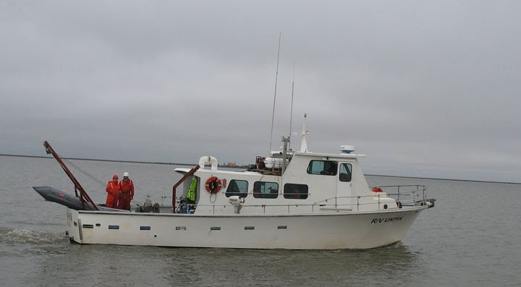
Vessels 50 Feet or Larger and Civilian Agency
POC: Brent Crawley Email: brent.crawley@gsa.gov
Telephone: 404-331-3052 Fax: 404-331-1877
GSA, FAS Property Management
77 Forsyth St. SW Suite 100
Atlanta GA 30303
Notes:
Civilian vessels more than 50 feet in length are coordinated by GSA Property Office in Atlanta, GA, Brent Crawley is the Point of Contact.

Slide 13
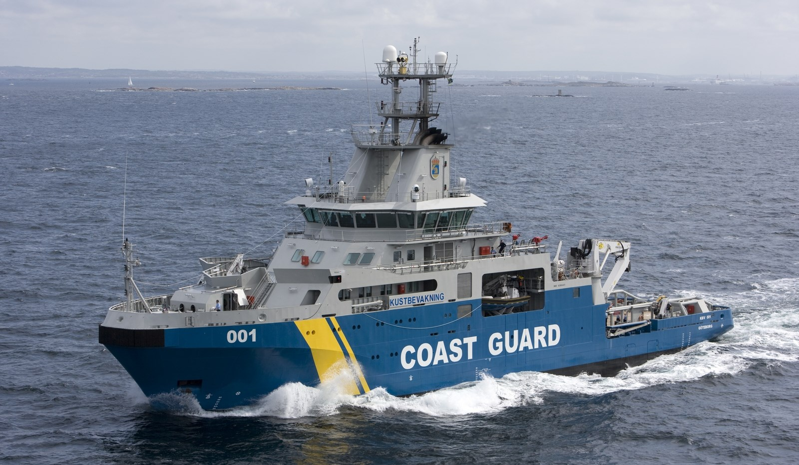
Vessels 50 Feet or Larger and Military
POC: Ryan Oliver Email: ryan.oliver@gsa.gov
Telephone: 215-446-2851
Personal Property Division
100 S Independence Mall W
Philadelphia, PA 19106-3400
Notes:
DOD Vessels more than 50 feet long are coordinated by GSA Philadelphia office. All vessels smaller than 50 feet are reported to the GSA Region in which the vessel is located. They can be reported either electronically on GSAXcess or manually on the Standard Form 120.

Slide 14
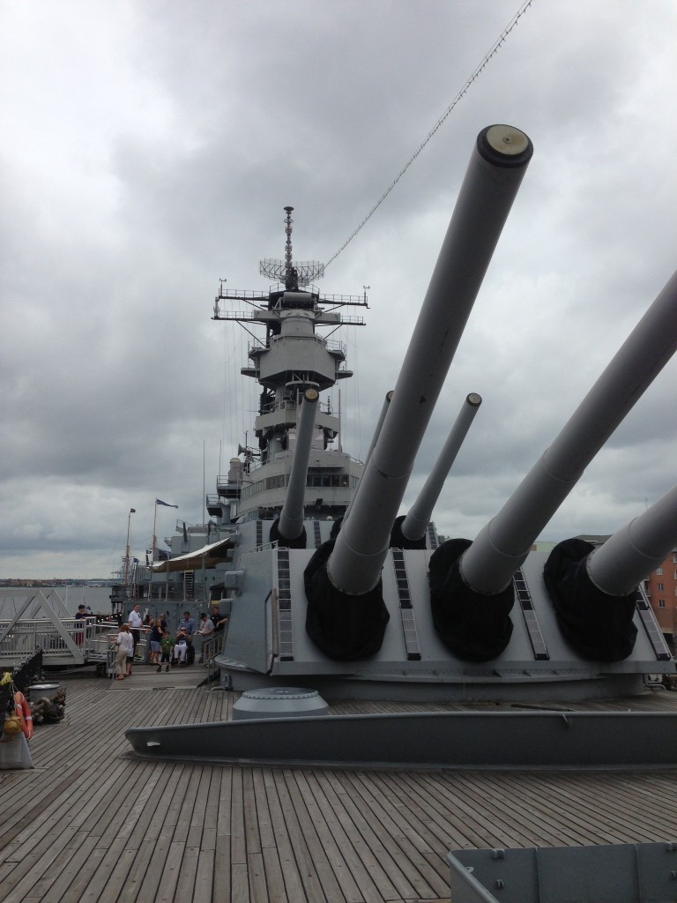
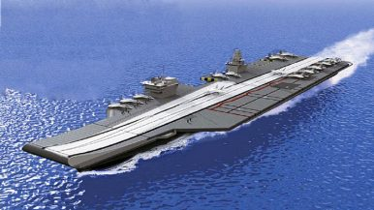
Disposal of Vessels Merchant Marine Act 1936.
*Battleships
*Cruisers
*Aircraft Carriers
*Destroyers
*Submarines
Notes:
Vessels should be disposed of in accordance with the Merchant marine Act 1936 and other laws authorizing sale of such vessels. Disposal instructions regarding vessels do not apply to battleships, cruisers, aircraft carriers, destroyers, or submarines.

Slide 15
Disposal of Vessels Merchant Marine Act 1936.
VESSELS 1,500 GROSS TONS OR MORE:
*These vessels are reported to GSA
*GSA will then offer them first to the Federal Maritime
Administration
* The Maritime Administration will determine if the vessel is capable of conversion to merchant use
Notes:
Vessels should be disposed of in accordance with the Merchant marine Act 1936 and other laws authorizing sale of such vessels. Disposal instructions regarding vessels do not apply to battleships, cruisers, aircraft carriers, destroyers, or submarines.

Slide 16
Animals
POC: Cynthia Smith Email: cynthia.smith@gsa.gov
Telephone: 215-446-5064 Fax: 215-829-2764
Personal Property Division
100 S Independence Mall W Room: 10th Floor
Philadelphia, PA 19106-3400
Notes:
Civilian agencies should report their excess animals to the GSA Mid-Atlantic Regional Office in Philadelphia, PA. Region 3

Slide 17
Animals
FMR102-36 does not stipulate special handling requirements for most animals, so the traditional disposal process typically applies. However, optional methods exist for some species and may be exercised without GSA’s approval or involvement
Notes:
Special disposal authorities exist for Unfit Horses and Mules, Canines and Non-human primates and may be exercised without GSA’s approval or involvement.

Slide 18
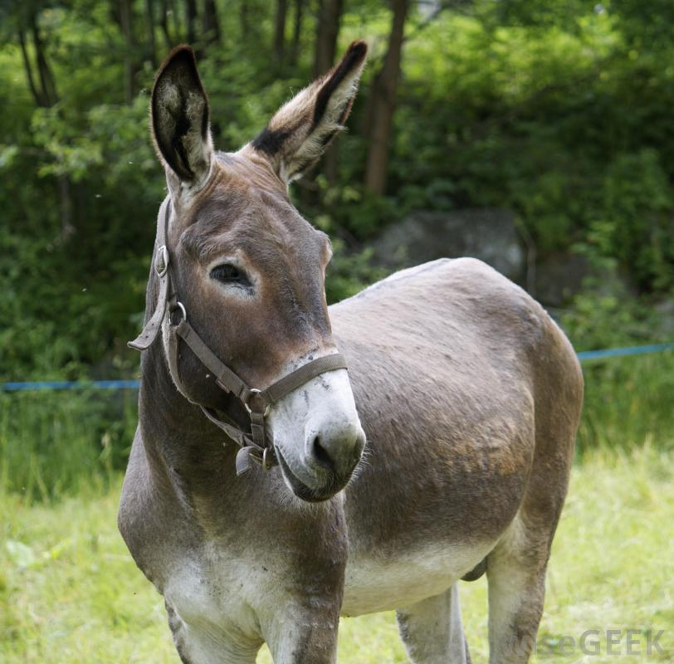
Animals
*40 USC 1308 - Unfit Horses and Mules
*41 CFR 102-36.365 - Canines (allows for direct donation to an individual who has experience handling K9s in the performance of those official duties)
*42 CFR 71 - Non-human primates
Notes:
The following list of regulations are the governing authorities for unfit horses,mules, canines, and non-human primates.

Slide 19
Animals (continue)
*Canines may be donated to an individual who has experience handling canines in the performance of those official duties FMR 102-36.365
*Typical disposal process applies to nonhuman primates but transfer, donation, and sale documents must address appropriate uses of non-human primates per 42 CFR 71.53
1. Scientific Research
2. Education
3. Exhibition
Notes:
Canines may be donated to an individual who has experience handling canines in the performance of those official duties, FMR 102-36.365. Typical disposal process applies to nonhuman primates but transfer, donation, and sale documents must address appropriate uses of non-human primates per 42 CFR 71.53

Slide 20
Questions
Notes:
What are your questions pertaining to Disposal of Property Requiring Specialized Handling?

