Slide 1
Franconia
Personal Property Center

Slide 2
Key Topics
Options for Disposal
Computers for Learning
Reporting Surplus Property
Personal Property Center
Interagency Agreement/Abandonment and Destruction
Agency Visits
Points of Contact

Slide 3
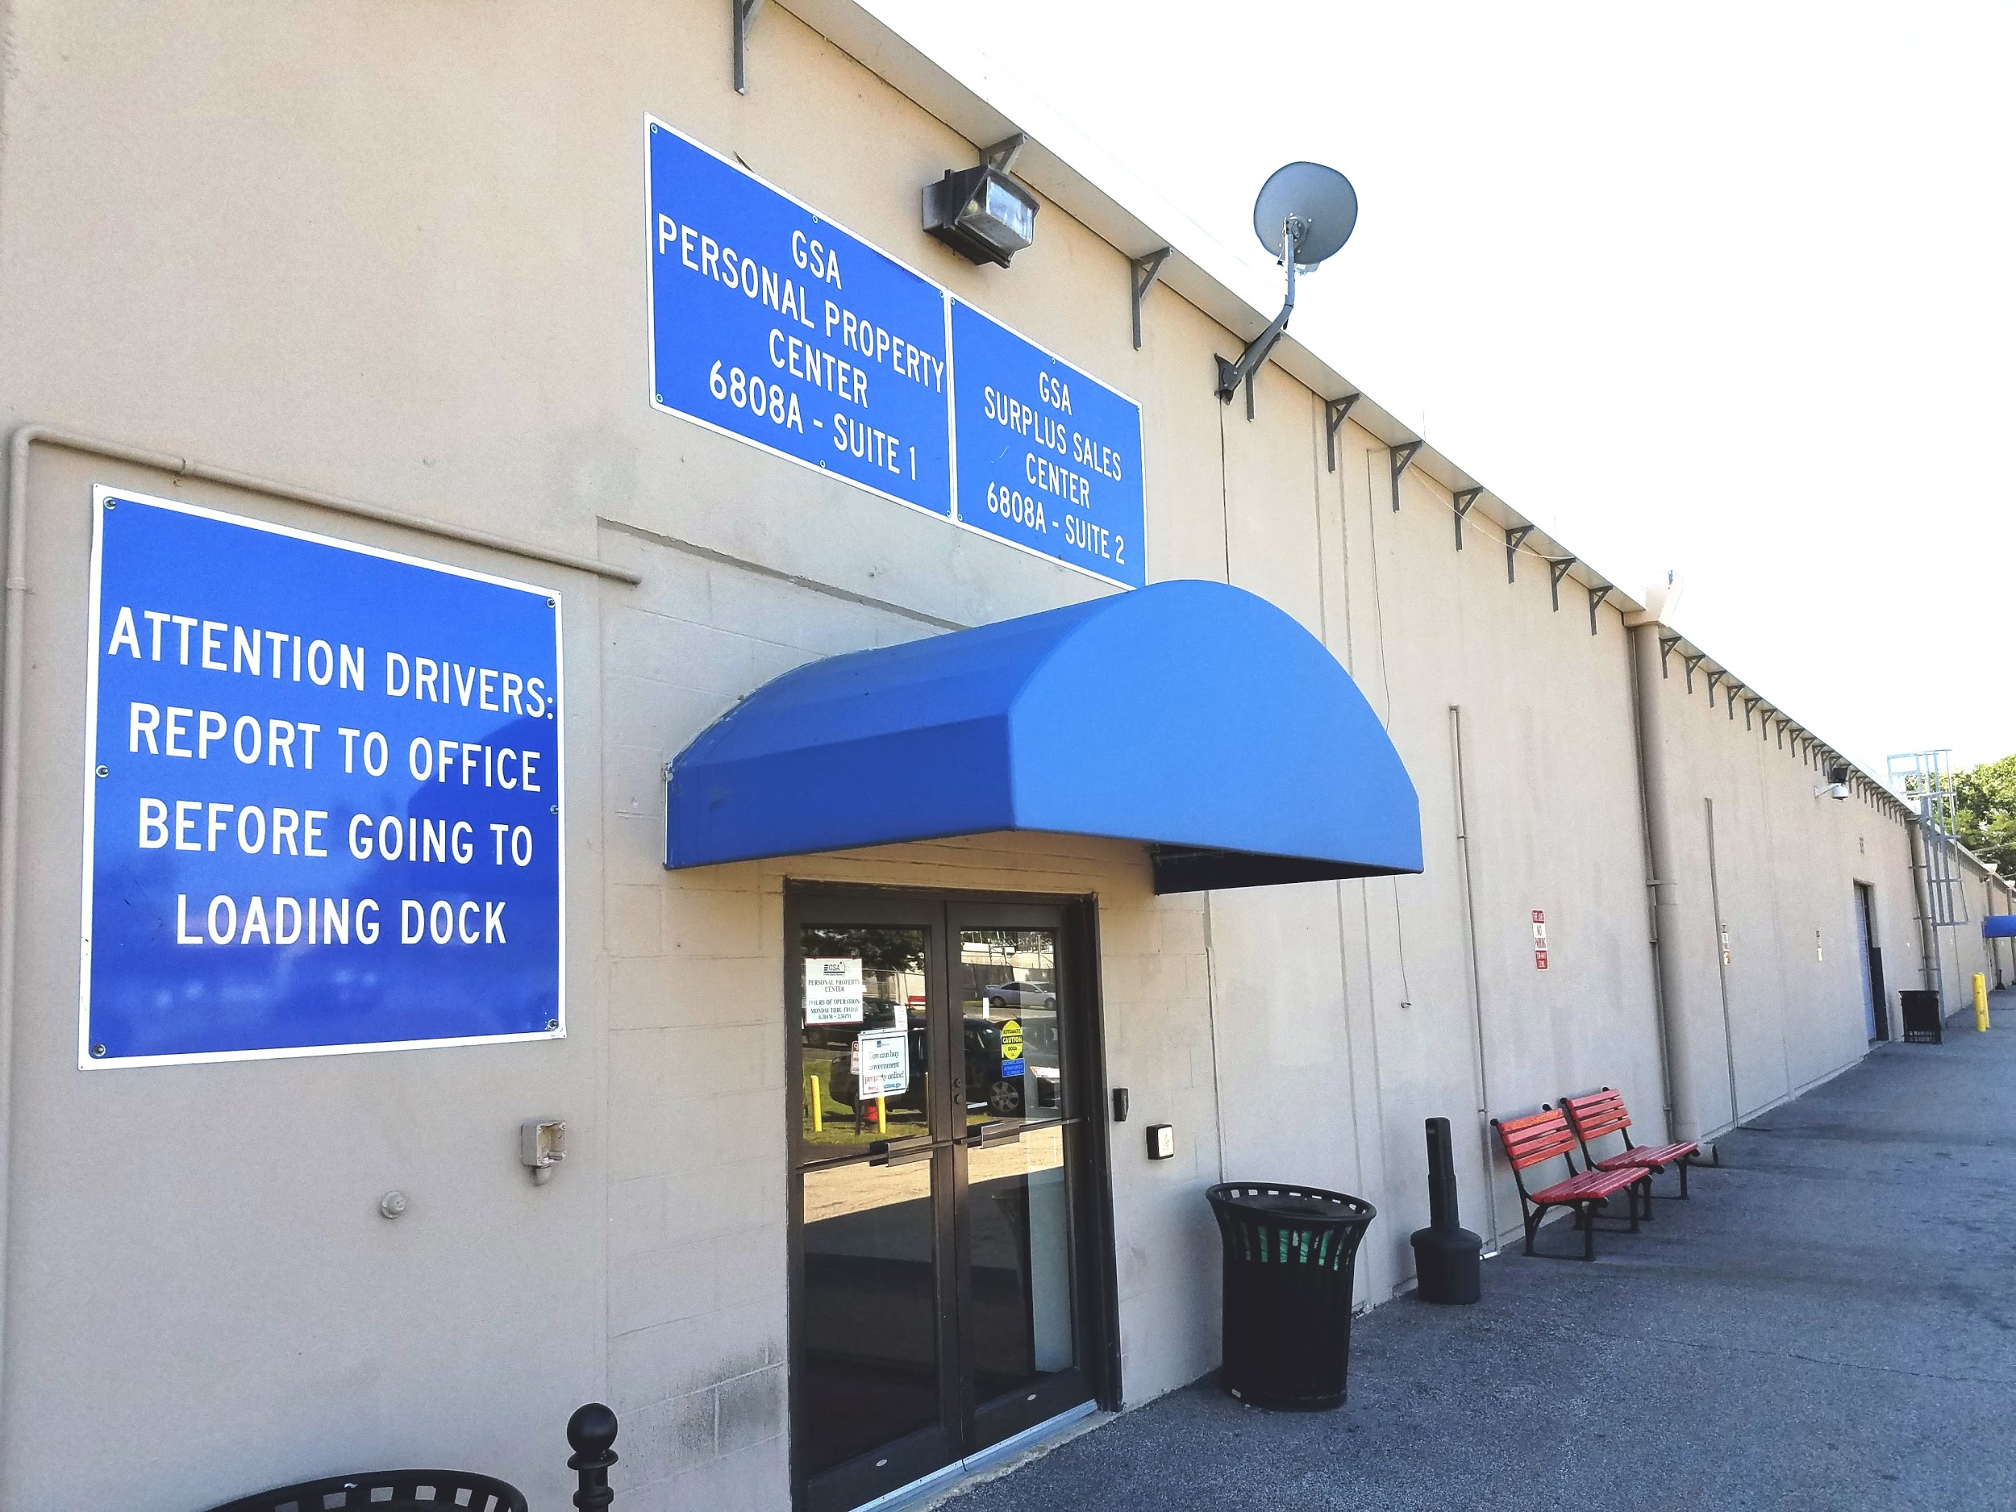
Strategically Sustainable
Our Mission
The GSA Personal Property mission is to dispose of surplus federal property in the most sustainable, efficient, and cost effective way to serve the federal government and the American taxpayer

Slide 4
The GSA Advantage: Options for Disposal
GSA is developing 21st century solutions for transferring, donating, and recycling your agency’s property. GSA offers each agency customized and flexible options to ensure efficiency, transparency, and accountability in federal property disposal.
Our services include:
Federal transfer
Scrap Metal Pick Up
Agency Internal Disposal: Abandonment and Destruction
E-Waste (Electronics)
Computers for Learning

Slide 5
Computers for Learning
GSA offers customer agencies the option of disposing through the Computers for Learning program. We put your working, good condition computers to use in classrooms in the Washington DC metro area. You can help kids learn and maximize American tax dollars by visiting www.computersforlearning.gov to get started.

Slide 6
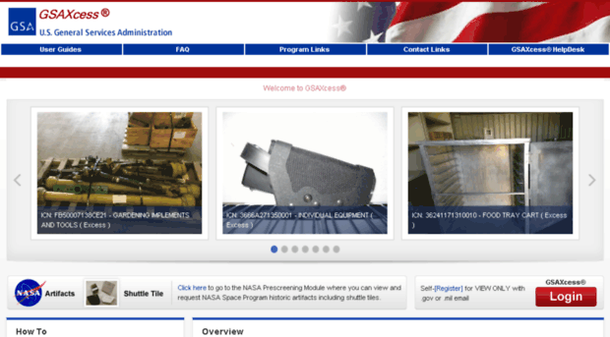
Reporting Property: Choose GSAxcess or the Personal Property Center
Agencies can report surplus property through the GSAXcess website or bypass this method by entering into an Interagency Agreement with GSA Personal Property Center (PPC).
GSAXcess provides agencies with a means of electronically reporting their surplus personal property to GSA.
GSAXcess is also used as a source of supply for other agencies seeking property that has been reported as available for transfer.
After entering your surplus items into GSAXcess, other federal agencies can browse the inventory and request a transfer of the property during a 21 day screening cycle period.
If requested, the customer agency may arrange for transfer of the property from the holding agency to the requesting agency.

Slide 7
The Personal Property Center
The Personal Property Center serves as an excellent alternative for federal agencies facing property disposal dilemmas. The PPC acts as a repository for deliveries of unneeded property (mostly office furniture and office equipment) from federal agencies that are looking for green disposal solutions. For a nominal fee, the PPC takes full accountability and physical control of excess property and handles all of the details of the utilization and donation processes. It regularly offers the useable property to federal offices, military offices, state offices, and eligible non-profit groups at no cost. In addition to collaborating with its fellow GSA organization (Public Building Services) on agency moves, the PPC provides Material Handling Equipment repair and maintenance services for a small number of federal clients. The PPC also plays a major role in transferring computer equipment to schools and allows schools to visit regularly to screen and select needed equipment. It also hosts an annual CFL event at its facility where area school officials can learn more about how they can take advantage of the program benefits. The National Capital Region Personal Property Center serves customers throughout the East Coast, but is available to agencies nationwide.

Slide 8
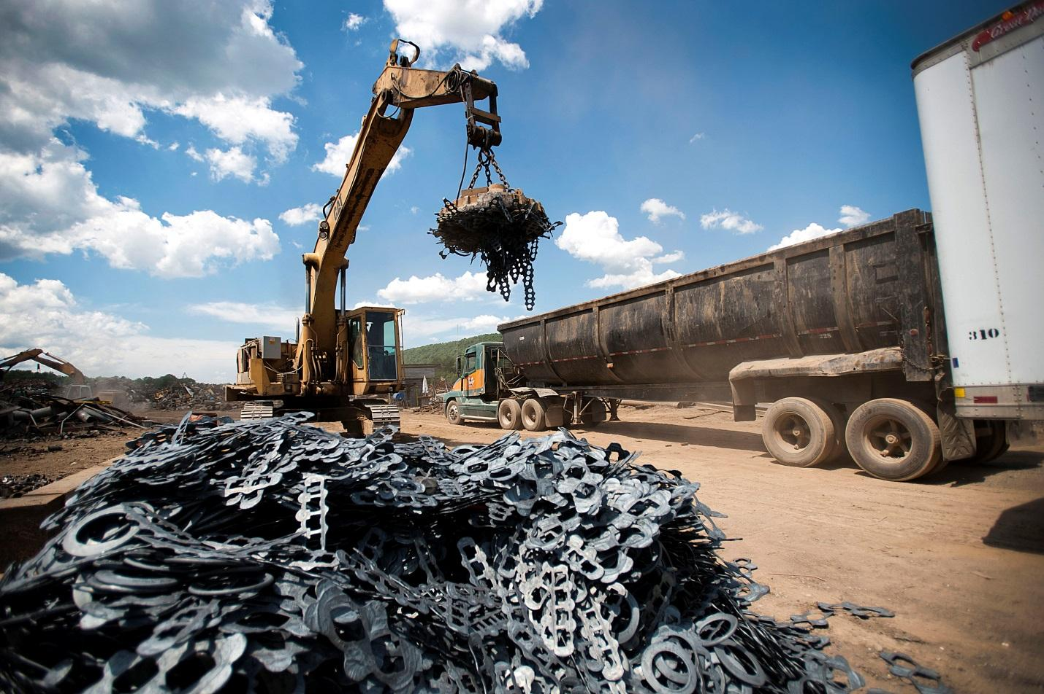
Entering into an Interagency Agreement will:
Allow GSA to complete a full inventory with the results forwarded back to you.
Eliminate the guesswork such as which condition codes to use and or applying the correct acquisition cost.
Provide a scrap metal pick up service at your location.
Provide expert advice when needed
Provide personnel to visit your location and assist in reutilization efforts.
Abandonment and Destruction Examples
When an item has no scrap/commercial value, you can save the American taxpayer and federal government money by disposing of the items internally with an Abandonment and Destruction Order. Contact Peter Hamilton at Peter.Hamilton@gsa.gov to learn more.

Slide 9
Agency visits
GSA Property Disposal Specialists want to visit your agency to build partnerships that work for you. We will work with you to ensure a smooth, accountable, and efficient property disposal process is in place for your agency. Contact us today to set up a meeting, for questions, or for more information

Slide 10
Contacts:
Manager: Peter Hamilton 571 414-6712 Peter.Hamilton@gsa.gov
Finance/Team Leader: Carlton Lawrence 703 605-9317 Carl.Lawrence@gsa.gov
Appointments: Marlo Williams 703 605-9312 Marlo.Williams@gsa.gov
Appointments (Equipment): Juan Ward 703 605-9316 Juan.Ward@gsa.gov
Assistant Director: Charles Robinson 202 619-8986 Charles.Robinson@gsa.gov
Director: Denise Webster 703 965-9568 Denise.Webster@gsa.gov
Computers for Learning: Tamela Samuels Tamela.Samuels@gsa.gov
GSA will work with you to develop a unique relationship and understanding that meets the needs of your agency and our own. Thank you for working with us!

Slide 11
Questions?

