Slide 1
Abandonment & Destruction FMR 102-36.305 - 330
February 2018
Notes:
Last step in the disposal process, after all other efforts are unsuccessful.

Slide 2
May we abandon or destroy excess personal property without reporting it to GSA?
Yes, you may abandon or destroy excess personal property when you have made a written determination that the property has no commercial value or the estimated cost of its continued care and handling would exceed the estimated proceeds from its sale.

Slide 3
When Does Property Have No Commercial Value?
An item has no commercial value when it has neither utility nor monetary value (either as an item or as scrap)
If utilization, donation, and sales efforts produce no results
Determination can be made at any time during disposal
Notes:
A/D is the final stage in the disposal process; when all other disposal efforts have been exhausted.

Slide 4
Who makes the determination to abandon or destroy excess personal property?
An authorized official of your agency makes a written finding that must be approved by a reviewing official who is not directly accountable for the property
Notes:
The decision to A/D property should be properly documented by the reviewing official. This can be written or attached to the SF120 or the notice to A/D issued by the GSA APO or SCO.

Slide 5
Are there any restrictions to the use of the A/D authority?
You must not A/D property in a manner which is detrimental or dangerous to public health or safety.
  Additional guidelines for the A/D of hazardous materials are prescribed in part 101-42 of this title.
If you become aware of an interest from an entity in purchasing the property, you must implement sales procedures in lieu of A/D.

Slide 6
May we transfer or donate excess personal property that has been determined appropriate for A/D without GSA approval?
You may donate such property only to a public body without going through GSA
  Any department, agency, special purpose district, or other instrumentality of a state or local government; any Indian tribe; or any agency of the federal government
If you become aware of an interest from an eligible non-profit organization that is not a public body, you must contact GSA and implement donation procedures in accordance with part 102-37 of this chapter.
Notes:
There are other things your agency can do instead of abandoning or destroying the property. The definition and examples of public body that were given earlier still apply here.

Slide 7
What must be done before the A/D of excess personal property?
You must provide public notice of intent to A/D personal property in a format/timeframe specified by your agency regulations
  Publish notice in local newspaper, post signs in common use facilities available to public, provide bulletins on agency website
You must also include in the notice an offer to sell in accordance with part 101-38
Notes:
Another requirement for A/D is public notice. Agency can type a notice stating that property will be abandoned or destroyed and notice shall be placed in a location where public can see it. Notice should state the property to be A/D, date and time and location of A/D.

Slide 8
Are there occasions when public notice is not needed regarding A/D of excess personal property?
Public notice not required when:
  Value of property is so little or cost of care and handling is so great that its retention for advertising is not economical
  A/D is required because of health, safety, or security reasons
  Original acquisition cost is less than $500

Slide 9
But remember…
You must not A/D property in a manner that is dangerous to public health or safety
FMR 102-36.315
Notes:
Always be cautious of how and where you dispose of property.

Slide 10
Electronic items…
Should NOT be thrown in the trash
Recycled in an environmentally safe
manner
Choose a recycler that will disassemble
property into raw components
Notes:
Refer to your agency’s internal policy regarding how to properly dispose of and recycle electronic items.

Slide 11
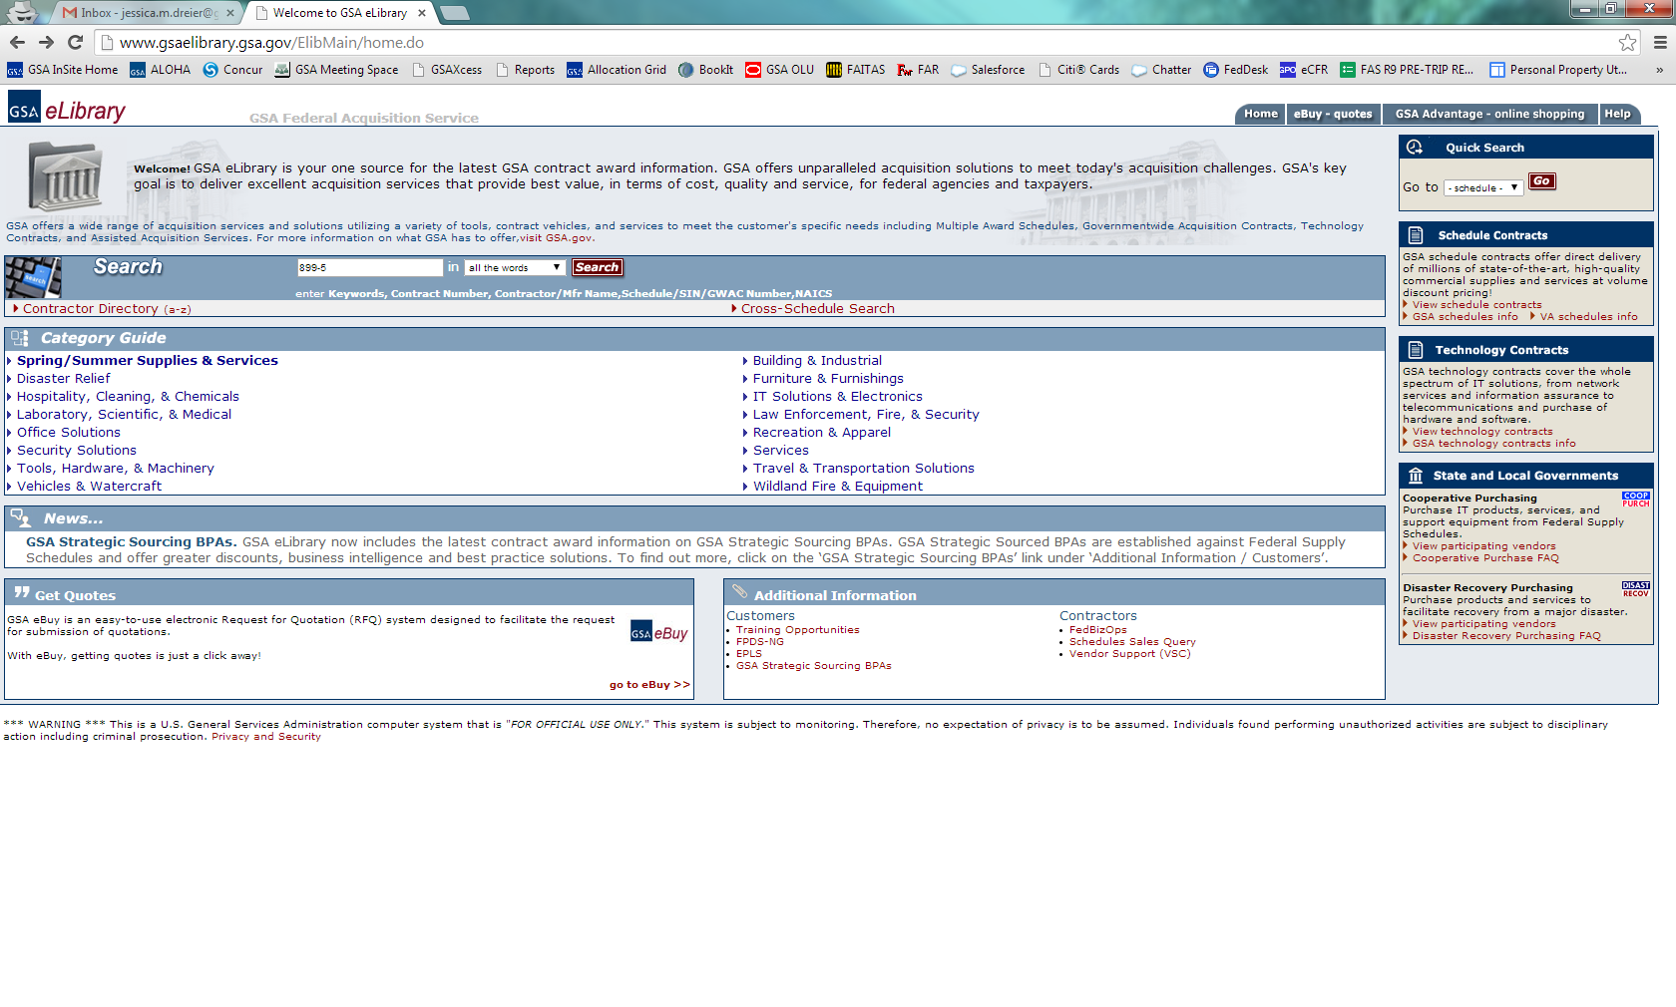
Go to www.gsaelibrary.gsa.gov and search for Schedule 899-5.
Notes:
Another good source to use to locate recycling companies.

Slide 12
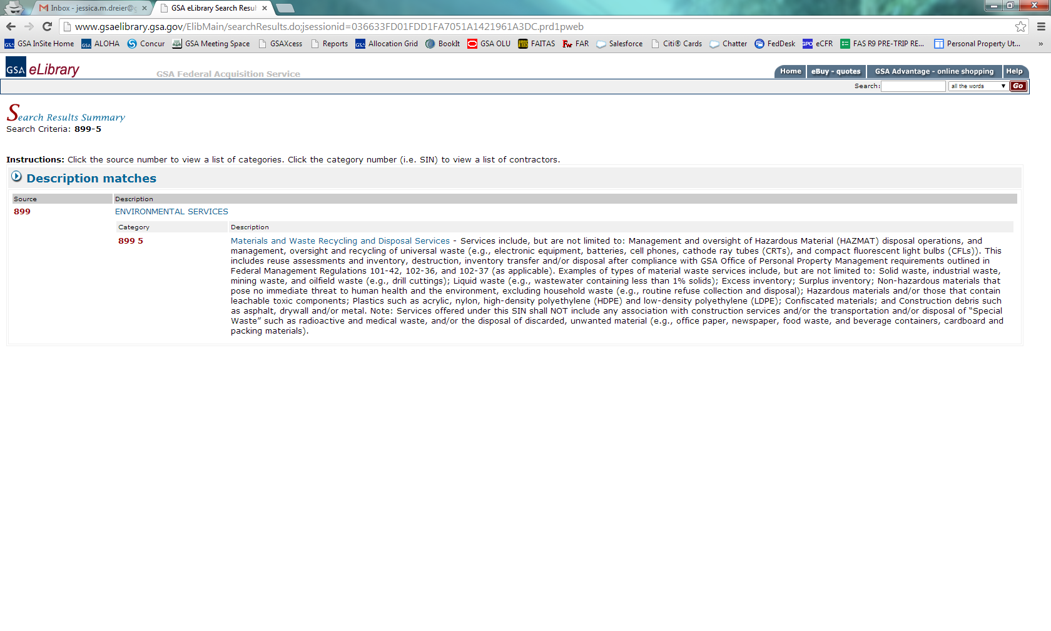

Slide 13
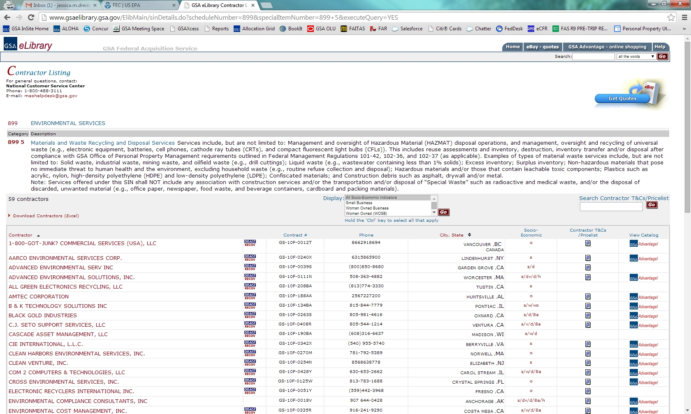

Slide 14
Questions?
Notes:
Any questions about the A/D process?

