Slide 1
GSA FORMS
Sharon Gorospe
Area Property Officer
Personal Property Management

Slide 2
FEDERAL DISPOSAL PROCESS
EXCESS
SURPLUS
SCREENING
AAMS
Non
SCREENING
And
FEDERAL TRANSFER
21 DAYS
DONATION
NOTIFICATION
5 DAYS
AGENCY
SCREENING
SALES
DONATION
REMOVAL
Internal
Agencies/Bureaus
Of your Department
Federal Agencies
Cost Reimbursable Contractors
Grantees
Public Airports
State Agencies for Surplus Property
Nonprofit Educational & Public Health Activities
Service Educational Activities
Notes:
This is a graphic portrayal of the current disposition process. The chart shows the distinction of excess and surplus property as well as highlighting the overall screening period and the systems that GSA offers to support these functions.
Internal agency screening is the first step and we offer AAMS to support agencies in this effort.
Second, is the simultaneous screening for Federal and donation customers and federal removal. Listed are the major categories of eligible activities.
Next, the 5 day notification period allows GSA’s allocating regions to make proper allocation of property to donation customers. After that, property is available for public sale, by GSA or the owning agency.

Slide 3
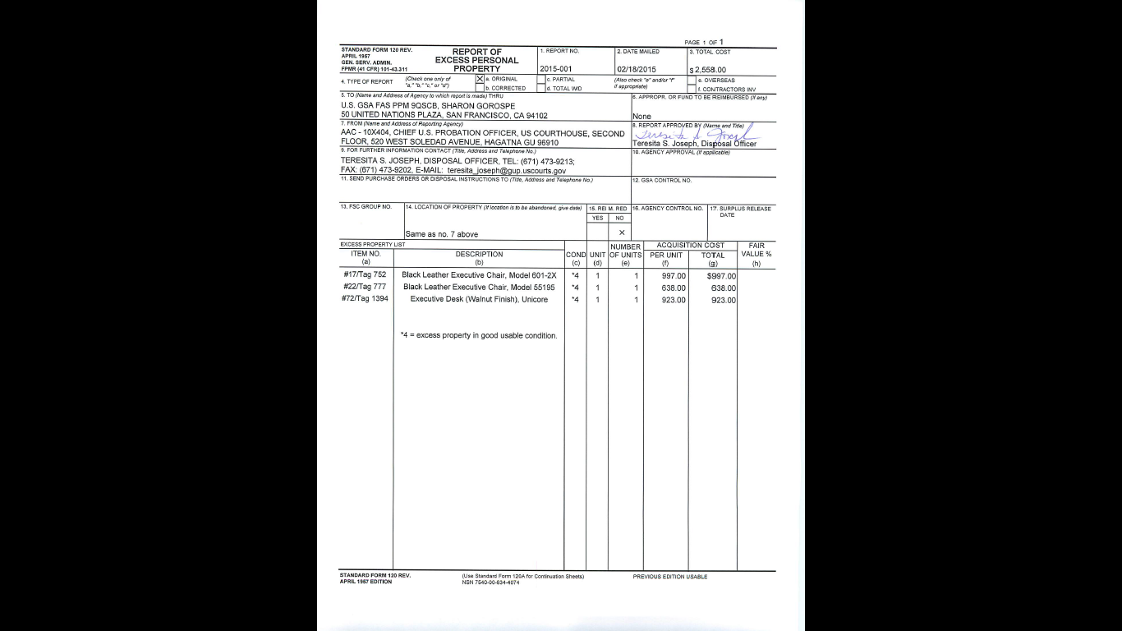
MANUAL SF-120- Report of Excess

Slide 4
Manual SF-122
SKIP 1
SECTION 3
GSA FAS 9QSCC
50 UNITED NATIONS PLAZA
SAN FRANCISCO, CA 94102-4912
SECTION 4, 5, 6, 7
AGENCY NAME
ADDRESS
POINT OF CONTACT NAME
PHONE NUMBER
FAX NUMBER
ACTIVITY ADDRESS CODE
*The activity address code is a distinct six-position alphanumeric code assigned to identify specific units, activities, or organizations that have the authority to requisition and receive excess or surplus property.
SECTION 9
Will be signed the property manager of the receiving agency
SKIP 10, 11, 12
SECTION 13
Fill-in Description, Unit, Quantity and Original Acquisition Cost.

Slide 5
GSAXcess Item Control Numbers:
Agency Information
Activity Addres Code/ DODAAC:
Agency Name:
Address:
City:
State:
Zip:
Screener's Name
First Name:
Middle Initial:
Last Name:
Email:
Phone:
Fax:
Approving Official's Contact
First Name:
Middle Initial:
Last Name:
Email:
Phone:
Fax:

Slide 6
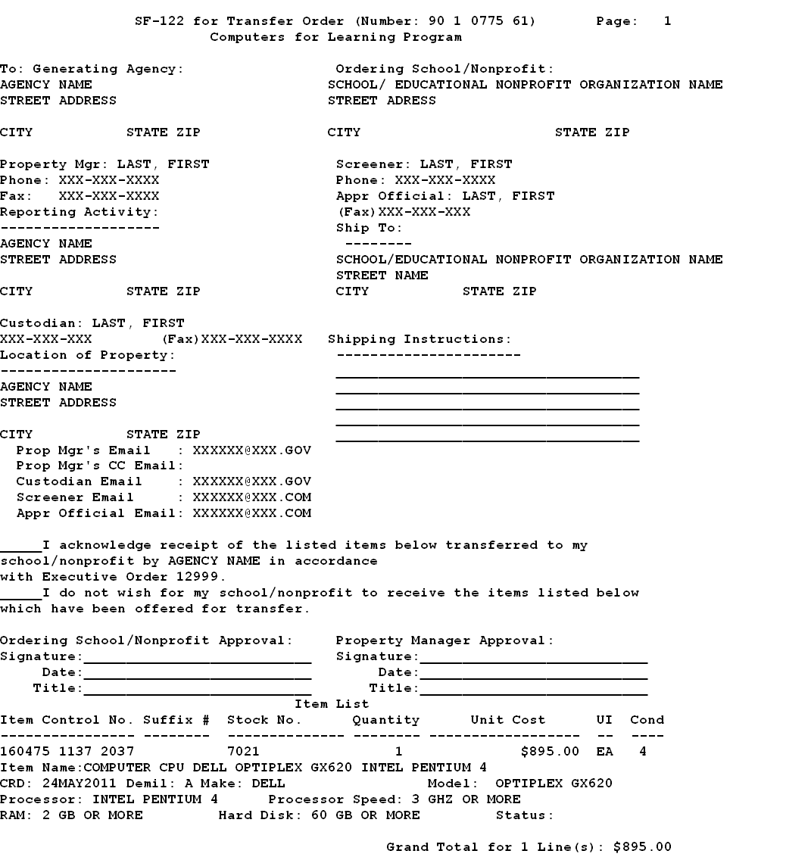

Slide 7
Download form through www.GSAxcess.gov click on Program Links and select Standard Form 122, Transfer Order – Excess Personal Property

Slide 8
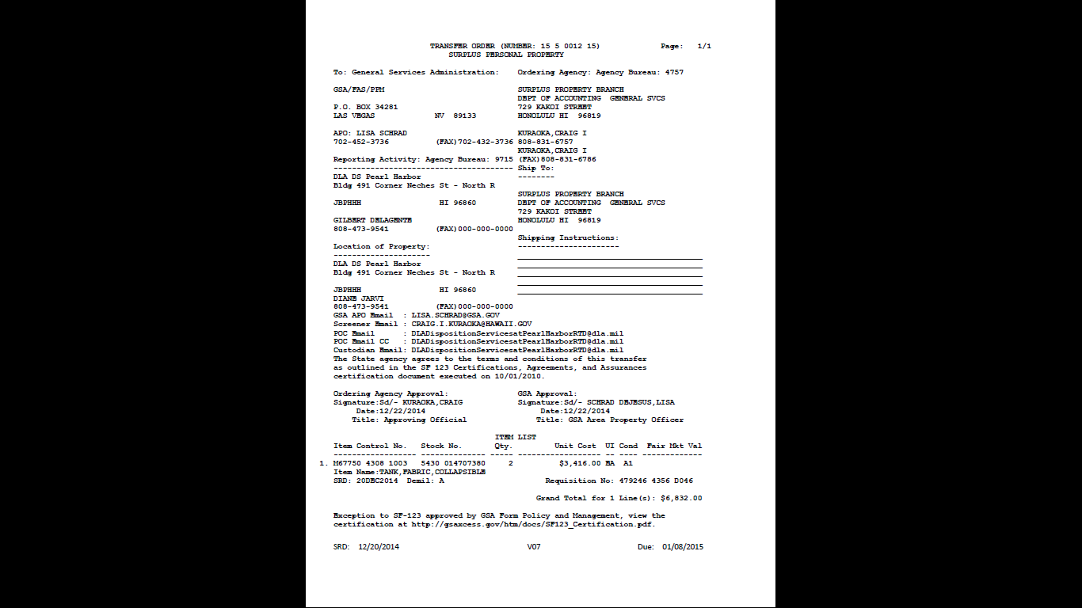
Electronic SF-123

Slide 9
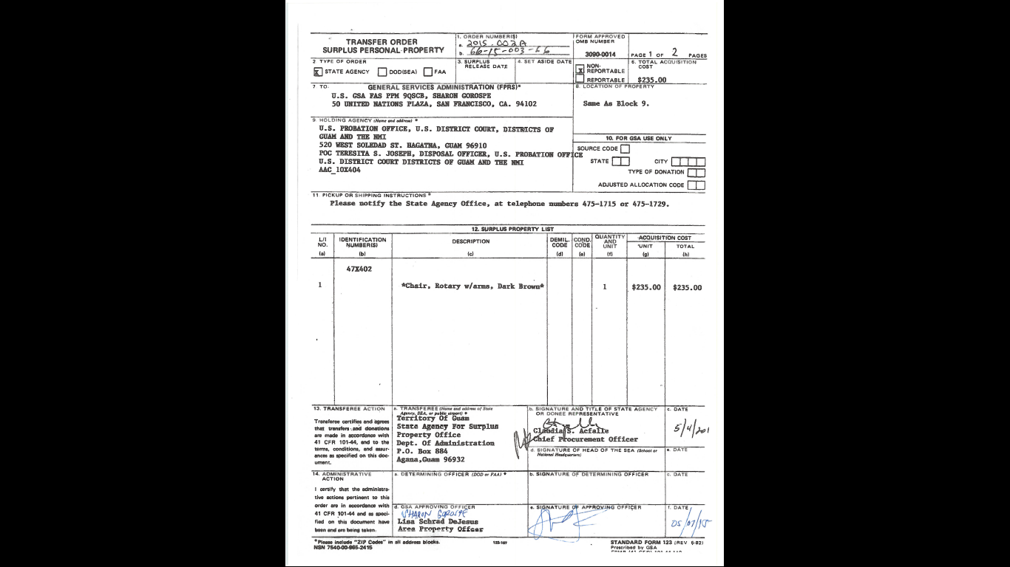
Manual SF-123 for Direct Transfers

Slide 10
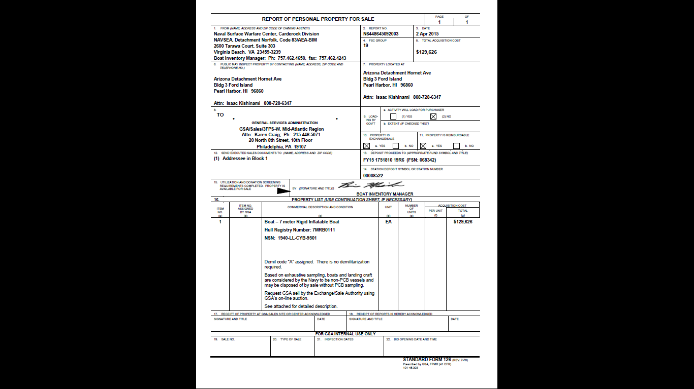
Manual SF-126 Report of Property for Sale

Slide 11
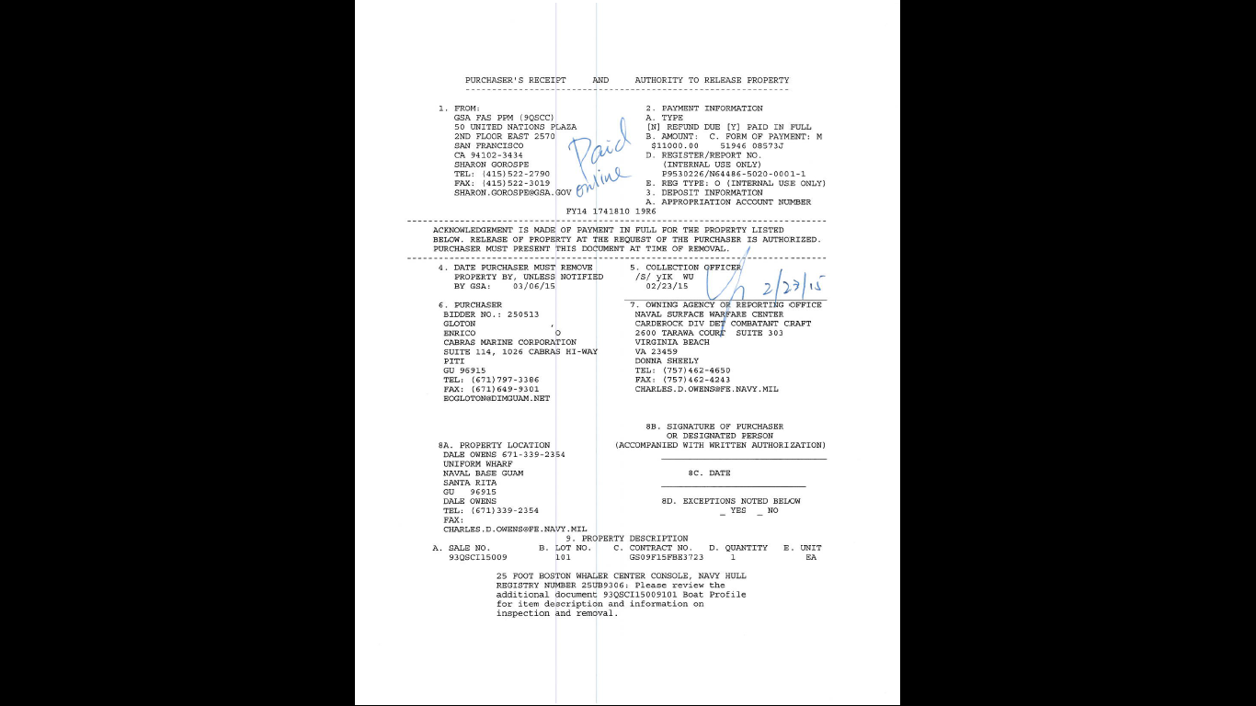
Purchaser’s Receipt Form 27a

Slide 12
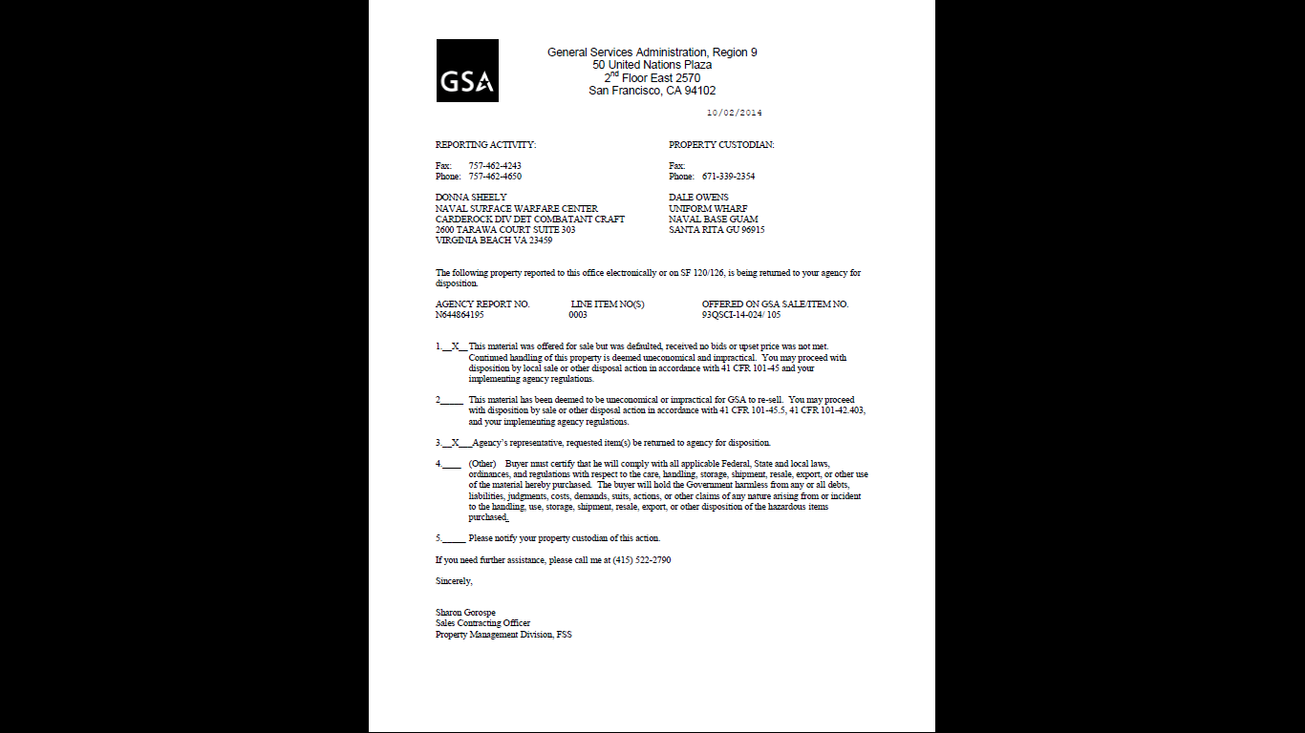
Return to Owning Agency Letter

Slide 13
GSA FORMS
RESULTS | FORM(S)
FEDERAL TRANSFER | SF-122 ***Starts with 99
STATE DONATION | SF-123 ***Starts with State Code (Hawaii is 15)
CFL TRANSFER | SF-122 (SIGNED BY OWNING AGENCY) ***Starts with 90
CFL DIRECT TRANSFER | MANUAL SF-122 + (Post Transaction Module) ***Starts with 91
SALES | PURCHASER’S RECEIPT***Start with Sale Number ( Hawaii is 93QSCI
NO RESULTS | RETURN TO OWNING AGENCY LETTER (RTOA)
ABANDONMENT AND DESTRUCTION | INTERNAL AGENCY MEMO TO THE FILE

