Slide 1
EXCHANGE/SALE FMR 102-39
Maria Lopez Area Property Officer Federal Acquisition Service

Slide 2
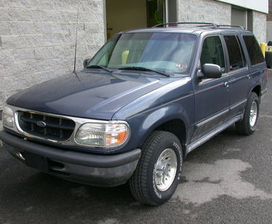
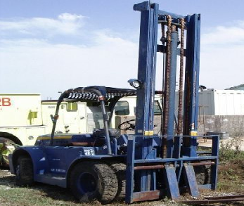
What is Exchange/Sale?
To exchange or sell non-excess, non-surplus personal property and apply the exchange allowance or proceeds of sale in whole or in part payment for the acquisition of similar property.
Notes:
Definition of exchange sale.

Slide 3
Exchange/Sale can be done two ways…
Agency can trade in the property for a credit towards the replacement property;
Or
Agency can sell the replacement property and apply the money to the purchase of the new property.
Notes:
These are the two methods of exchange sale used.

Slide 4
Important Definitions
“Acquire” means to procure or otherwise obtain personal property, including by lease.
“Replacement” means the process of acquiring property to be used in place of property that is still needed but:
(1) No longer adequately performs the tasks
for which it is used; or
(2) Does not meet the agency’s need as
well as the property to be acquired.
Notes:
Here are two primary definitions of when to use exchange sale.

Slide 5
Important Definitions continued
“Similar” means where the acquired item and the replaced item:
(1) Are identical;
(2) Are designed and constructed for the same purpose;
(3) Constitute parts or containers for identical or
similar end items; or
(4) Fall within a single Federal Supply
Classification (FSC) group of property that is eligible for handling under the exchange/sale authority.
Notes:
another reason to use exchange sale.

Slide 6
Why use Exchange/Sale?
Exchange/Sale is used to reduce your Agency’s cost of replacing personal property.
But remember, you MUST use the money from Exchange/Sale to buy a “similar” item to the item exchanged or sold.
Notes:
Reason why to use exchange sale.

Slide 7
When NOT to use Exchange/Sale…
Do NOT use Exchange/Sale if the estimated sales proceeds will be unreasonably low.
Can NOT use Exchange/Sale for certain groups of property.
Notes:
Instances when you should not use exchange sale.

Slide 8
Property that Can NOT be Exchange/Sale:
10 Weapons
11 Nuclear ordnance
12 Fire control equipment
14 Guided missiles
15 Aircraft and airframe structural components (except FSC Class 1560 Airframe Structural Components)
42 Firefighting, rescue, and safety equipment
44 Nuclear reactors (FSC Class 4472 only)
51 Hand tools
54 Prefabricated structure and scaffolding.
68 Chemicals and chemical products, except medicinal chemicals
84 Clothing, individual equipment, and insignia
Notes:
Examples of property that the exchange/sale authority can not be used.

Slide 9
Conditions for using Exchange/Sale
(a) The property exchanged or sold is similar
to the property acquired;
(b) The property exchanged or sold is not excess or surplus, and you have a continuing need for that type of property;
Notes:
Examples of conditions for using exchange/sale

Slide 10
Conditions for using Exchange/Sale cont….
(c) The property exchanged or sold was not acquired for the principal purpose of exchange or sale;
(d) When replacing personal property, the exchange allowance or sales proceeds from the disposition of that property may only be used to offset the cost of the replacement property, not services; and
Notes:
Examples of conditions for using exchange/sale continued.
Examples of conditions for using exchange/sale

Slide 11
Conditions for using Exchange/Sale cont…
(e) Except for transactions involving books and periodicals in your libraries, you document the basic facts associated with each exchange/sale transaction. At a minimum, the documentation must include:
(1) FSC Group of items exchanged or sold, and items acquired;
(2) Number of items exchanged or sold, and
number of items acquired;
Notes:
Conditions for using Exchange/Sale continued

Slide 12
Conditions for using Exchange/Sale cont…
(3) Acquisition cost , exchange allowance or net sales proceeds of items exchanged or sold, acquisition cost of the items acquired;
(4) The date of the transaction(s);
(5) The parties involved; and
(6) A statement that the transactions comply with the requirements of this part 102-39.
Notes:
Conditions for using Exchange/Sale continued

Slide 13
How Long do You have to Obligate the Money?
The money from Exchange/Sale is available to the Agency during the Fiscal Year the item was sold; and for one Fiscal year thereafter.
After this time period, the money goes back to the General Fund of the U.S. Treasury.
Notes:
Tells when the proceeds from exchange/sale can be used.

Slide 14
Questions?
Notes:
Any questions on the exchange/sale authority?

