Slide 1
Reporting Excess Personal Property

Slide 2
Use of Special Authorities
Exchange/Sale property (FMR 102-39)
Stevenson-Wydler Act
Executive Order 12999 - Computers for Learning
Dept of Defense – 13 special authorities under Defense
Appropriations Act - HAP / LESO
Direct Transfer to other Federal Agency if under
$10,000 per line item (Mandatory copy provided to GSA)
Notes:
Agencies may direct transfer excess property on a SF122 without prior approval by GSA provided the transfer is less than $10,000 and the agency provides a copy of the transfer to GSA within 10 days.

Slide 4
Reporting Excess Personal Property
Federal Management Regulation (FMR) 102-36.215
through 240.
All executive agencies are required to report their excess personal property to GSA.
All excess personal property includes excess personal property to which the government holds title but is in the custody of federal agencies’ contractors, cooperatives, or project grantees.
Notes:
On page 13 of the Personal Property Disposal Guide.

Slide 5
Who is accountable for excess property pending disposal?
YOU,
THE OWNING AGENCY,
Retain possession
Remain accountable and maintain stewardship over excess property reported to GSA pending disposal instructions
(FMR 102-36.245)
Notes:
GSA assists with the disposal process, however, we do not usually take physical custody of excess property.

Slide 6
Reporting Excess Continues…
Three Methods:
GSAXcess (Electronically)
Batch method
Report of Excess Personal Property (SF-120)
Reference: 41 CFR 102-36.210 through 102-36.240
Notes:
On page 13 of the Personal Property Disposal Guide.

Slide 7
Agency Internal Reporting Requirements
Agency Asset Management System (AAMS)
General Services Administration (GSA)
Veteran Affairs Medical Center (VAMC)
Department of Energy (DOE)
U.S. Department of Agricultural (USDA)

Slide 8
Preparing to Report Property
You must determine…
The Property Type:
Non-Reimbursable (Excess/Surplus)
Reimbursable (Exchange Sale)
Acquisition cost:
As it is recorded in the financial and accounting records of the holding agency.
The Federal Supply Class (FSC): Groups/Classes
Determine the correct FSC
Notes:
Terminology – Acquisition Cost on page 6 of the Personal Property Disposal Guide.

Slide 9
Preparing to Report Property Continues…
Disposal Condition Codes:
New (1) – Property in new or unused condition that can be used immediately without modifications or repairs.
Usable (4) - Property that shows some wear, but can be used without significant repair.
Repairable (7) - Property that is unusable in its current condition but can be economically repaired.
Notes:
On page 14 of the Personal Property Disposal Guide.

Slide 10
Preparing to Report Property Continues…
Disposal Condition Codes:
Salvage (X) - Property with value in excess of its basic material content, but repair or rehabilitation is impractical and/or uneconomical.
Scrap (S) - Property that has no value except its basic material content.
Notes:
On page 14 of the Personal Property Disposal Guide.

Slide 11
Preparing to Report Property Continues… Federal Supply Class (FSC):
The Federal Supply Classification System permits the classification of all items used by the Federal Government.
Items are classified in a four-digit class.
First two digits: group or major category of commodities.
Last two digits: the class or the subdivision within a group.
Groups cover a broad range of categories and are further broken down by classes.
Notes:
On page 39 of the Personal Property Disposal Guide. The federal supply class determines what category your property will be associated with during the U&D screening and sale at GSAAuctions®. The 1st two digits of the FSC indicate the group or major category, for example all items that fall in the category of computer would begin with 70. The last two digits of the FSC indicate the class within that group for example the FCS for computer (or ADP) software is 7030, 70 is the group and 30 the class.

Slide 12
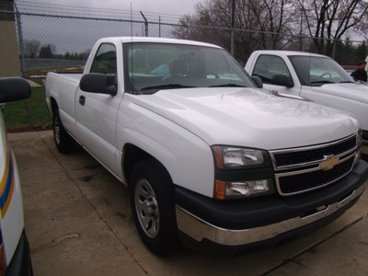
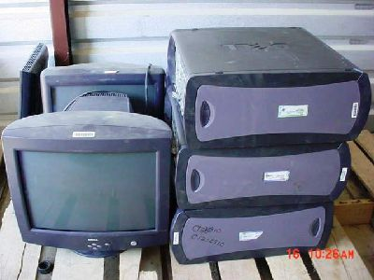
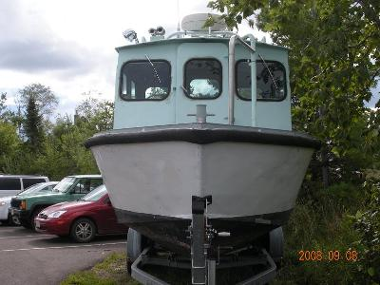
Describing Property
Property Descriptions are Significant…
Vehicles
Miscellaneous Property
Generators
Heavy Equipment
Boats & Boat Motors
Notes:
On page 13 of the Personal Property Disposal Guide. GSA has developed standard templates for a number of commodities including vehicles, miscellaneous property, generators, heavy equipment, boats and boat motors, and trailers.

Slide 13
Describing Vehicles
When reporting vehicles for disposal you must provide the:
Year of manufacture
Make – Name of manufacture
Model – Name of vehicle
Body Style - Sedan (4 door), Coupe (2 door), Pickup, Truck, Cab/Chassis
Vehicle Identification Number (VIN)
Mileage (can be estimated)
Number of Cylinders
Notes:
A complete vehicle description includes the year, make, model, and the body style.

Slide 14
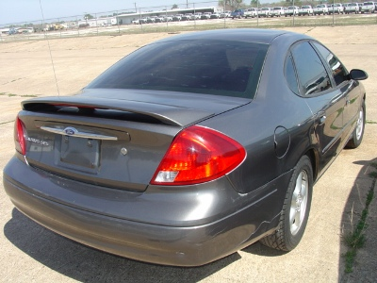
Describing Vehicles Continues…
Fuel Type – Gasoline or Diesel
Color
Number of Doors
Transmission Type – Automatic (AT), Standard (ST) (can include 4 or 5 speed)
Options List - Air Conditioning (AC), Power Steering (PS), Power Brakes (PB), Etc.
Driveline – 4X2, 4X4, 6X6
Tonnage – ¾ Ton, 2 Ton, 5 Ton
ID Number
Notes:
You property report should also include the vin, mileage, number of cylinders, fuel type, and the color of the vehicle.

Slide 15
Describing Vehicles Continues…
Condition codes repairable (7), S or X should include as much information as possible including all repairs and deficiencies.
Is the vehicle operable or inoperable.
Repairs list should include problems with:
Mechanical – Engine, Transmission, Drive Train
Electrical - Heat and Air, Power Options
Cosmetic - Cracked Windshield, Paint, Interior
Accident/Frame Damage (may require salvage title)
Flood Damage (must be disclosed on title)
Notes:
It is very important to provide as much information as possible when describing the condition and repairs associated with a vehicle. Your report should indicate if the vehicle is operable or inoperable. You should also list any known mechanical, electrical and cosmetic problems. If the vehicle has been involved in an accident it may require a salvage title depending on the extent of the damage. All flood damage must be disclosed and noted to the certificate to obtain title.

Slide 16
Describing Vehicles Continues…
FSC’s 2310 and 2320 – all fields are mandatory except Color Gradient
Notes:
If you are reporting your vehicle directly into GSAXcess® you will see this pop up box when you enter an FSC of 2310 or 2320. All of the fields are mandatory except color gradient. Fields that are not specified should be included in the property description block. If your system or form does not include a field mentioned you can incorporate the information in your item description.

Slide 17
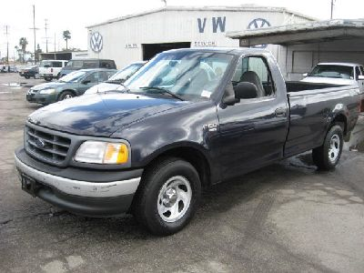
Description of a Vehicle
Example:
2000 Ford F150 Regular Cab Pickup, VIN: 1F456123H12345687, Mi: 87,000, V8, Gasoline, Dark Blue, 2-DR, AT/AC/PS/PB/PDL/PW/CC. Repairs required but not limited to oil leak, air conditioner, flat tire, vehicle is in operable
condition.
Notes:
Picture of Government vehicle for auction.

Slide 18
Describing Miscellaneous Property
Descriptions for miscellaneous property should include:
Manufactures name
Model number
Serial Number/Part Number
Quantity
Other details such as color and size
Condition of property should indicate any known repairs or deficiencies such as parts that are missing or broken
Notes:
When you are reporting a lot of miscellaneous property you need to provide the manufactures name, model, serial or part number, the quantity, and any other details that may be available.

Slide 19
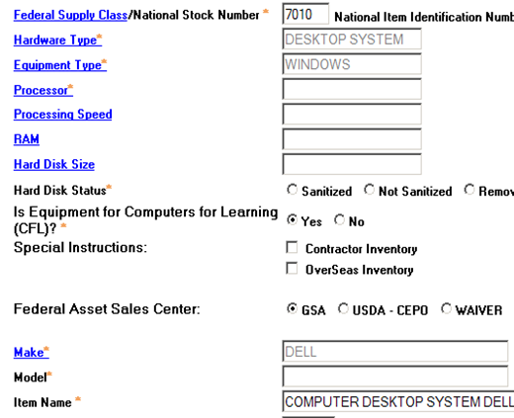
GSAXcess® required fields for ADP are:
Hardware Type
Equipment Type
Processor
You can also include:
Processor Speed
Ram
Hard Disk Size
Hard Disk Status
The system default is set to yes
for Computers for Learning
Notes:
On page 16 through 19 of the Personal Property Disposal Guide. If you are reporting your ADP equipment directly to GSAXcess® you will be prompted to provide additional information including hardware type, equipment type and processor. Each field provides a list or drop down for your selection. To complete your description the system provides several other options. All ADP equipment will be offered for Computers for Learning unless you select “No” in this field.

Slide 20
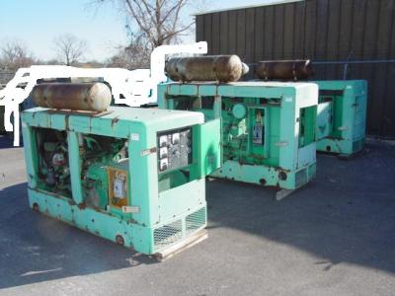
Describing Generators
Generator descriptions should include all the information required for miscellaneous property…
Manufacture Name
Model Number
Serial Number
Quantity
They will also include:
Fuel Type – Gasoline, Diesel
Kilowatts
Hours
Notes:
Picture of Generators. Generators will have the same basic information that all property reports require, the manufactures name, model and serial or part number and the quantity. In addition you will include the fuel type, kilowatts, and hours. As with all property reports the condition and any known repairs or deficiencies.

Slide 21
Example Description of Generators
One lot consisting of: Two Generators, Onan, mdl: 45G628,45KW, 23 hrs, Gasoline. Repairs Required, parts missing, battery missing, weathered stored outdoors.

Slide 22
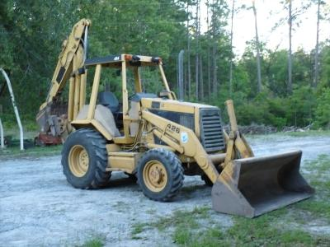
Describing Heavy Equipment
Descriptions include:
Manufacture
Model
Engine Type and Size
Serial Number
Hours
Fuel Type
Tonnage
Condition should indicate if the equipment is operational.
Notes:
Picture of Backhoe Loader. Heavy equipment reports also have some additional requirements such as the engine type and size, the hours, the fuel type and tonnage. Again you will end all descriptions with a complete condition report.

Slide 23
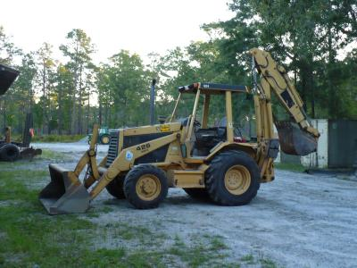
Description of Heavy Equipment
Example:
Backhoe Loader, 1989 Caterpillar, mdl: 426, Perkins diesel engine, shuttle shift w/ manual transmission, 4x4, 10,226 hrs., SN: 7BC04169; Used/Operable.
Notes:
Picture of Backhoe Loader

Slide 24
Describing Boats and Boat Motors
When reporting boats for disposal you will be required to provide:
Hull ID Number
Year
Manufacture/Make
Model
Body Style (such as pontoon or runabout)
Fuel Type
Number of Cylinders
This information is necessary for the Certificate to Obtain Title (SF97).
Notes:
Picture of 24’ Lobster Ellis. When you report a boat for disposal you are required to provide the hull ID number, year, manufacture, model, body style, fuel type and the number of cylinders. This information is required for the Certificate to Obtain Title (SF97) when the property is sold.

Slide 25
Describing Boats and Boat Motors Continues…
Your property description should also include the following information:
Engine type (inboard or outboard)
Engine size
Length
Horse power
Number of hours on the engine
And trailer information if necessary
Some states require outboard boat motors to be titled.

Slide 26
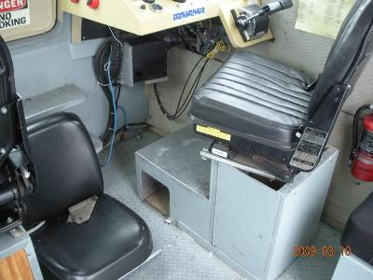
Description of Boat and Boat Motor
Example:
1979, Monark, Seville, 26 ft Sport-Boat, SN: MAK353030379, Gasoline Stern drive. Repairs required but not limited to cracked hull, engine needs repairs.
Notes:
Pictures (Outside and inside) of a 1979 Monark Sport-Boat.

Slide 27
Descriptions and Photos
Providing accurate and complete descriptions along
with clear detailed pictures of your excess and surplus
property will….
Ensure Maximum Return on Investment
Save you time
Limits Rejection/Claims
Notes:
This is a significant part of the reporting process.

Slide 28
Must we report all excess personal property to GSA? FMR 102-36.220
Generally yes, regardless of the condition codes, except as
authorized in section 102-36.145 for direct transfers or as
exempted in paragraph (b).

Slide 29
Not required to be reported to GSA:
Abandonment/Destruction Property;
Foreign Excess Property;
Nonappropriated Fund Property;
Scrap (except aircraft);
Perishables;
Trading Stamps and Bonus Goods;
Hazardous Waste;
Controlled Substances;
Nuclear Regulatory Commission – controlled material;
Property Dangerous to Public Health and Safety;
and
Classified or Property Sensitive for Reasons of National Security

Slide 30
Shelf-Life Items
Report to GSA prior to expiration date, if vendor credit can not be obtained.
.
If expired, abandonment/destruction.
.
When reporting to GSA, indicate the
expiration date and if it is the original date or an extension, and, if it can be further extended.
FMR 102-36.450 thru 465

Slide 31
Canines, Law Enforcement
Public Law 105-27 (111 Stat. 244):
Canines no longer needed for law enforcement, can be donated to an individual experienced handling canines in official duties.
FMR 102.36-365

Slide 32
Any Questions?

