Slide 1
UNICOR
Federal Prison Industries, Inc.
Electronics Recycling Overview
June 7th, 2017

Slide 2
Federal Prison Industries, Inc.
Component of Federal Bureau of Prisons
Established in 1934 by statute & Executive Order
Provides training & work experience to Federal inmates
Receives NO appropriations – entirely self-sustaining
Trade name - UNICOR

Slide 3

UNICOR’s Positive Impact
Inmates in UNICOR are 24% less likely to recidivate upon release
Supports small businesses (more
than 50% of UNICOR purchases)
Essential to maintaining safe and
secure correctional facilities

Slide 4

UNICOR – 5 Business Groups
Clothing/Textiles
Electronics/Fleet
Office Furniture
Recycling
Services

Slide 5
UNICOR Recycling Locations
2 processing factories
Atwater, CA
Schuylkill, PA
11 collection centers
Atlanta Denver Marianna FL
Miami New York Landover MD/DC
San Francisco Sheridan, OR Leavenworth KS
Texarkana New Jersey

Slide 6
Electronics Recycling
Industry Standards – R2
Developed by multi-stakeholder group led by EPA in 2008
Goal - develop safe & environmentally sound standards
Result – “Responsible Recycling Practices for Electronics Recyclers” a.k.a. “R2”
Ensure best practices & provide assurances to customers
An electronics recycler may only be certified as meeting the R2 standards by a 3rd party auditor – very rigorous

Slide 7
UNICOR Recycling Factories
R2 Certified
Schuylkill, PA – R2 Certified
Atwater, CA – R2 Certified

Slide 8
UNICOR Recycling Factories
Additional Certifications
ISO 9001 – Quality
ISO 14001 – Environmental Management
OHSAS 18001 – Occupational Health & Safety

Slide 9

GSA Guidance on Disposal of =
Federal Electronic Assets
GSA Bulletin FMR B-34 (issued Feb 29, 2012)
  Cites Exec Order #13514 – Federal Leadership in Environmental Performance and National Strategy for Electronic Stewardship
  Use certified recyclers when disposing of FEA
  www.gsa.gov/graphics/ogp/FMR_Bulletin_B-34.pdf

Slide 10


Internal Revenue Service (IRS)
Donations to UNICOR
Internal Revenue Service (IRS)
  Official determination – “Contributions to FPI are tax-deductible under section 170(c)(1) of the Internal Revenue Code, provided that the contributions are made for exclusively public purposes.”
  Item donated to UNICOR for recycling = tax deduction

Slide 11



National Strategy for Electronic Stewardship
Interagency task force co-chaired by:
  White House Council on Environmental Quality
  Environmental Protection Agency
  General Services Administration

Slide 12


National Strategy for Electronic Stewardship
Issued July, 2011 - four primary goals:
  Build incentives for design of greener electronics
  Ensure Federal Government leads by example
  Increase safe/effective management & handling of used electronics
  Reduce harm from U.S. exports of e-waste; improve safe handling of used electronics in developing countries

Slide 13
National Strategy for Electronic Stewardship
Ensure Federal Government leads by example
Establish policy on used Federal electronics to:
  Maximize re-use (UNICOR does!)
  Clear data stored on used equip (UNICOR does!)
  Ensure all Federal electronics processed by certified recyclers (UNICOR is R2 Certified!)
  Improve tracking used electronics throughout lifecycle – make data available (UNICOR does!)

Slide 14
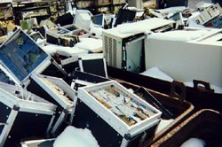
UNICOR’s Solution
Donation in lieu of
abandonment and
destruction
Landfill - avoidance
40 million lbs of material
collected in FY 2013
Benefits the donating agency, the environment, and public safety & health

Slide 15
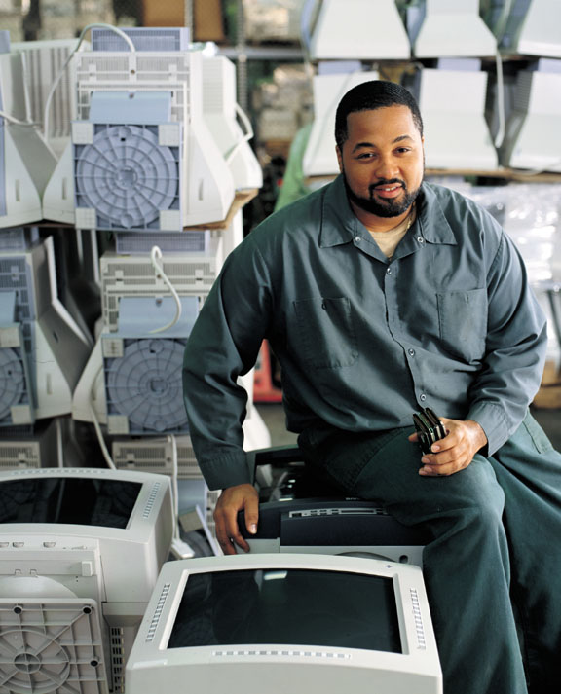
UNICOR Recycling
Process for Incoming Material
Shipping
Sorting
Testing
Reconditioning / Refurbishing
Component Recovery
Residual Material Recovery

Slide 16
UNICOR - Data Security
Emphasized in National Strategy!
All hard drives & media-storage devices from Federal Gov’t agencies destroyed.
  (Non-Gov’t hard-drives & media storage devices destroyed upon request)
State-of-the-art equipment to shred all hard drives & other media to no more than ¾ of inch

Slide 17
UNICOR – Material Tracking
Emphasized in National Strategy!
Track FEA by agency & location, item (computer, monitor, printer), serial number, disposition (re-use or de-manufactured for scrap)
Tracking data provided to Federal Agencies starting in 2014

Slide 18

UNICOR - the BEST Option for E-Waste Disposal
FREE shipping (full trailer load)
FREE refurbishment
FREE recycling
FREE data destruction
Costs avoided!!!
Every pound of electronic material donated to UNICOR results in savings of $0.20 in Federal appropriations otherwise required by Department of Justice for inmate program costs.

Slide 19

UNICOR – Revenue Sharing for E-Waste Donations
Department of Justice authority
Available to all donors (Federal & non-Federal)
Dependent on value of the material
  Volume (the bigger the better!)
  Location (shipping costs $$$)
  Equipment (high-value items)
Memorandum of Agreement
  All terms disclosed
  Completely transparent

Slide 20
UNICOR -- Accepted Items
Computer equipment (desktops, laptops, printers, monitors, mainframes/servers, modems, CD-ROM drives, plotters, circuit boards, memory sticks/boards, hard drives/floppy drives, power supplies)
Office equipment (copiers, fax machines, shredders, power strips)
Communication equipment (phones, Blackberry's, PDAs )
A/V equipment (TVs, radios, cable boxes, TiVo, DVRs, MP3s)
Games (X-box, iPod, Game Boy, Play station, Nintendo, Wii)
Other devices w/ circuit boards (calculators, cameras)

Slide 21
UNICOR -- Accepted Items (con’t)
Metal equipment (metal file cabinets, metal storage cabinets, metal lockers, metal shelving, metal folding chairs)
Batteries (all types of batteries except for alkaline batteries. For example, UNICOR accepts lead acid batteries, nickel-cadmium batteries, lithium batteries, carbon-zinc batteries, etc.)
Communication Wire (copper wire, phone wire, coaxial cable, and computer wire are all accepted, but no fiber optic cable)

Slide 22
UNICOR Recycling
Items NOT Accepted
No furniture with any wood or fabric
No tapes of any kind – VCR tapes, backup tapes
No Hazardous Equipment
    Oils / PCBs
    Acids
    Refrigerants
    Paints or liquids of any kind
    Radioactive material

Slide 23
UNICOR
Environmental Stewardship
R2 Certified (also ISO 9001, 14001 & OHSAS 18001)
OSHA compliant
Compliant with all Federal, state and local environmental regulations
Full-time Safety Manager at each location
3RD party audits

Slide 24
Jerry L. Sanchez, Jr
Industrial Specialist
UNICOR Recycling Business Group
(925) 833-7500 x476 office
(202) 536-9186 cell
Jerry.Sanchez2@usdoj.gov www.unicor.gov/recycling/
Questions?
Recycling Business Group

