Slide 1
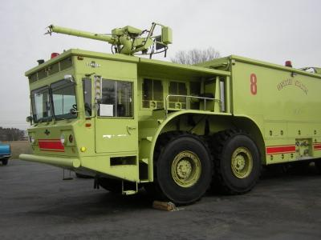
Uploading Pictures in GSAXcess

Slide 2
Desired Pictures - GSA Bulletin FMR B-14 Utilization and Disposal - 12/1/2006
Purpose - Guide Federal agencies in the use of photographs when reporting excess property and when selling property
Result – Plan to provide photographs or digital images of excess property, which meets the criteria specified by this bulletin

Slide 3
DESIRED PICTURE CRITERIA
Property reported for utilization or sale meeting
The following criteria should be accompanied by
informative and good quality photographs.
Property at or above the agency financial accountability threshold; or
Property in the following Federal Supply Groups (FSG)/Classes (FSC) with an original acquisition cost exceeding $300.

Slide 4
DESIRED FSGs and FSCs PICTURES
Group 19 – Ships, Small Craft, Pontoons, and Floating Docks
Group 23 – Ground Effect Vehicles, Motor Vehicles, Trailers, and Cycles
Group 24 – Tractors
Group 34 – Metalworking Machinery
Group 38 – Construction, Mining, Excavating, and Highway Maintenance Equipment
Notes:
Considered High-Value items

Slide 5
DESIRED FSGs and FSCs PICTURES
Group 39 – Materials Handling Equipment
Group 42 – Firefighting, rescue, and Safety Equipment; and Environmental Protection Equipment and Materials
Group 54 – Prefabricated Structures and Scaffolding
Class 6115 – Generators and Generator Sets, Electrical
Class 6515 – Medical and Surgical Instruments, Equipment and Supplies

Slide 6
TAKING THE PICTURE
Type: Only digital or scanned photographs are acceptable.
Format: Only the .jpg, Joint Photographic Experts Group (JPEG), file extension is acceptable.
Size: Submit any size photograph; the large (full view) picture is displayed in GSAXcess® in a rectangular format at 600 X 400 pixels. Reporting activities should submit rectangular pictures.

Slide 7
TAKING THE PICTURE
Additional photos: Up to 11 thumbnails showing different views of the item will be displayed on the same screen in a square format at 70 X 70 pixels.
Quantity: No more than 12 photographs can be submitted per Item Control Number (ICN).
Notes:
Us Microsoft Office Picture Manager to help resize photos

Slide 8
UPLOADING PICTURES

Slide 9
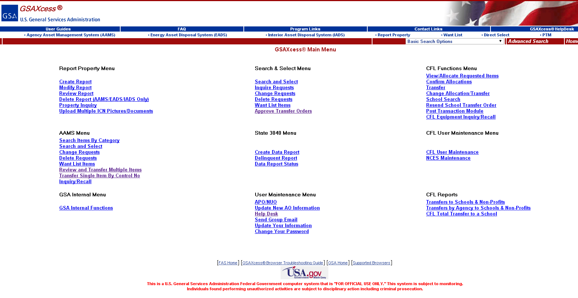
UPLOAD PICTURE BUTTON (Main Menu)

Slide 10
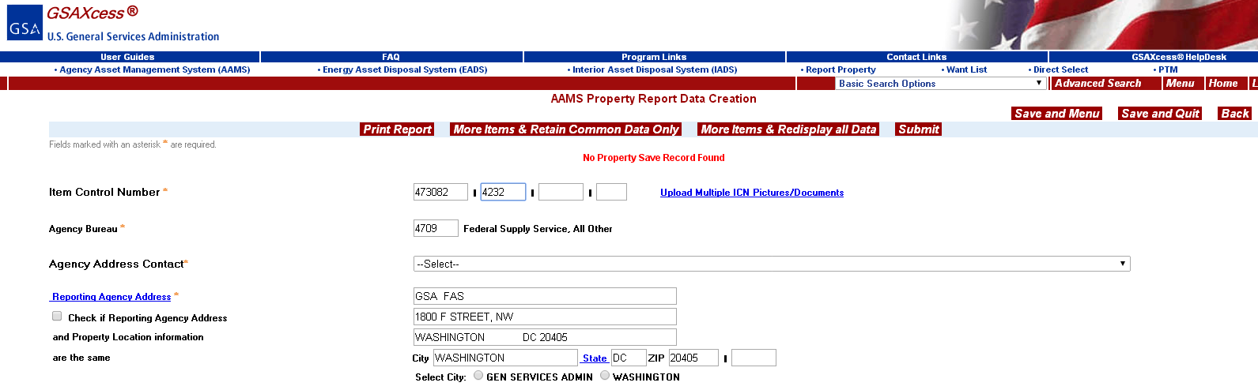
UPLOAD PICTURE BUTTON (Report Property Menu)

Slide 11
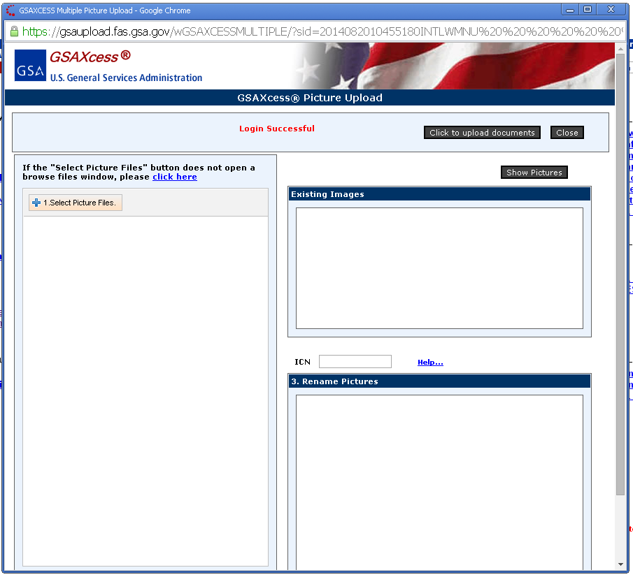
SELECT PICTURE FILES

Slide 12
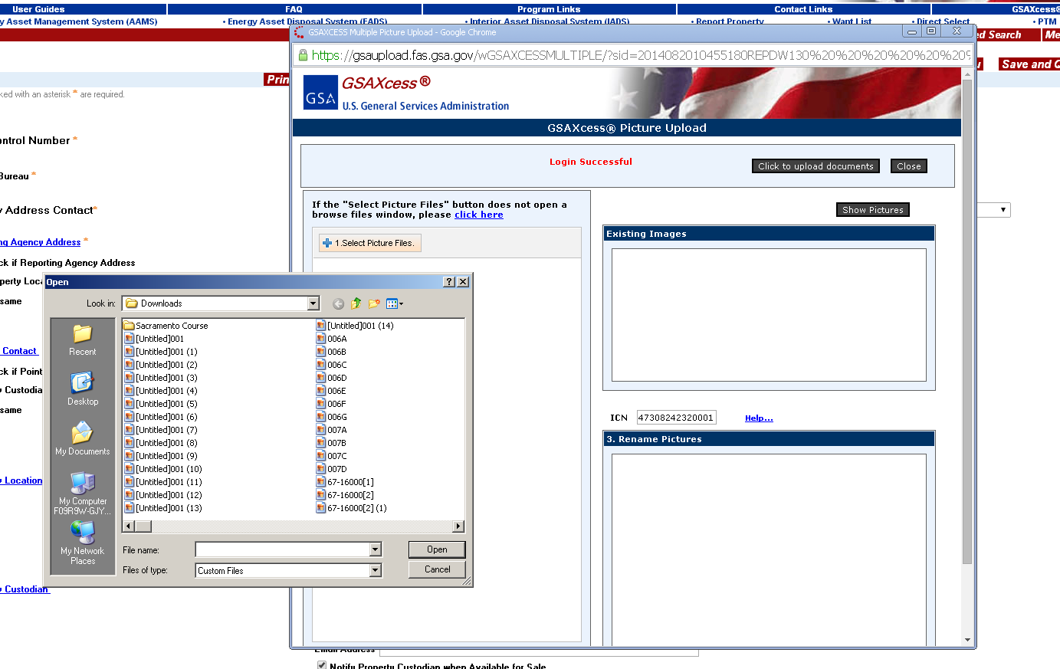

Slide 13
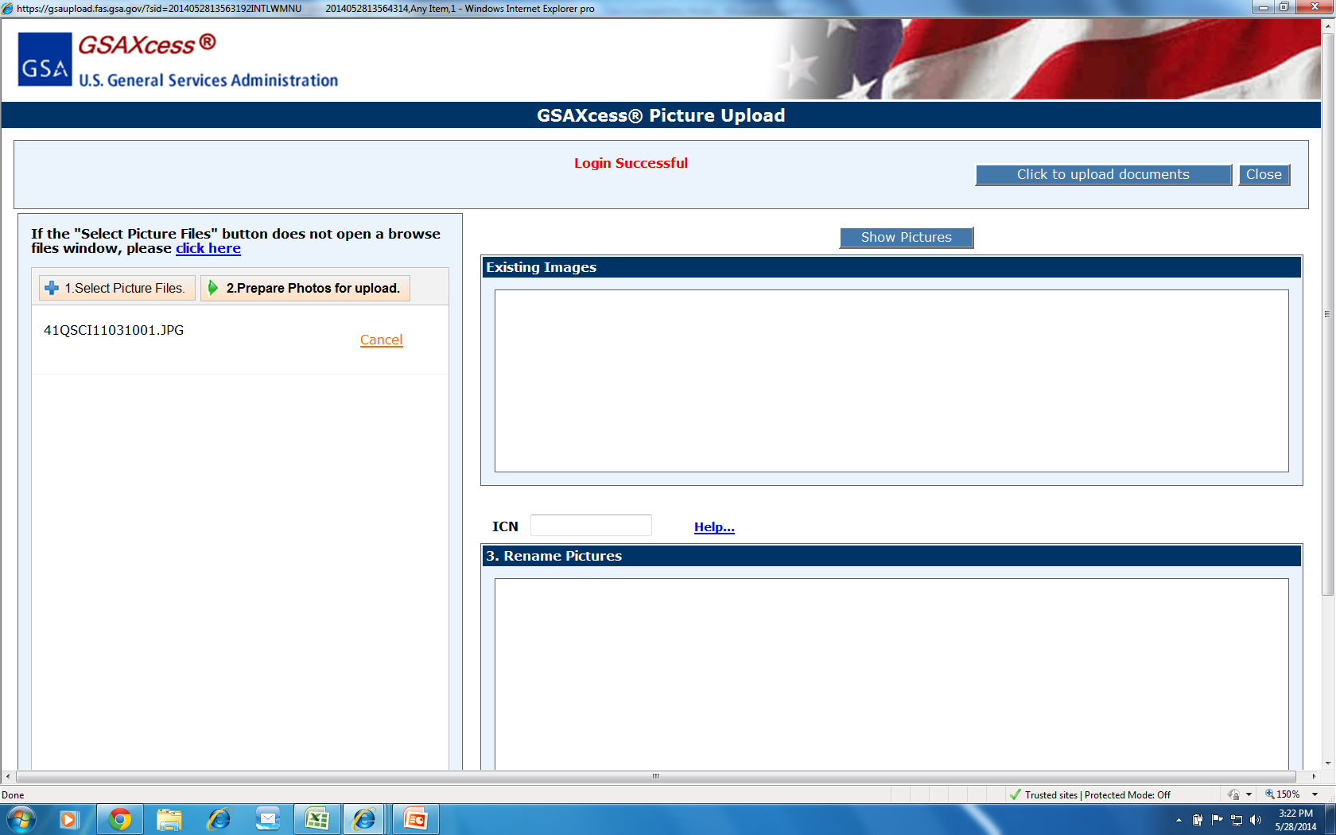
Select one to twelve pictures per Item Control Number.
No renaming or resizing required.

Slide 15
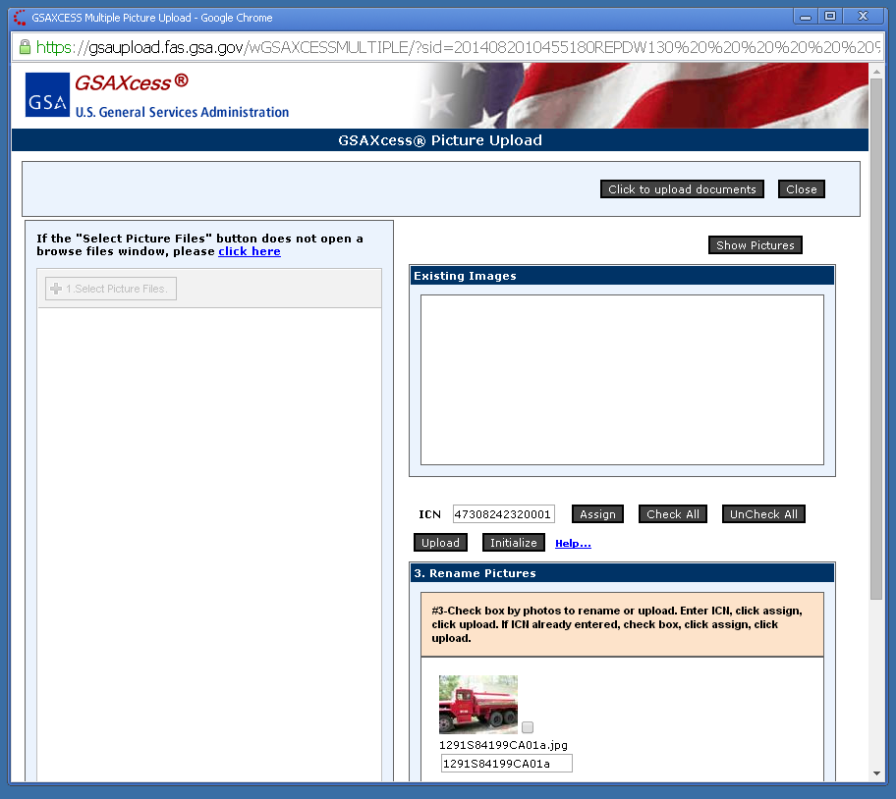
Click “Check All” then “Assign” to rename and assign all the pictures to the Item Control Number

Slide 16
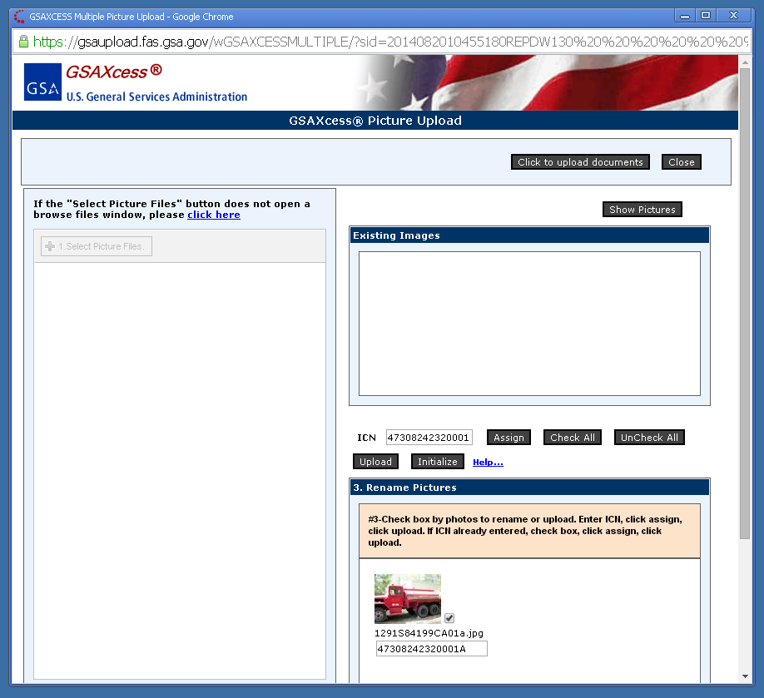
Click “Upload” to complete renaming and assigning the pictures to your Item Control Number

Slide 17
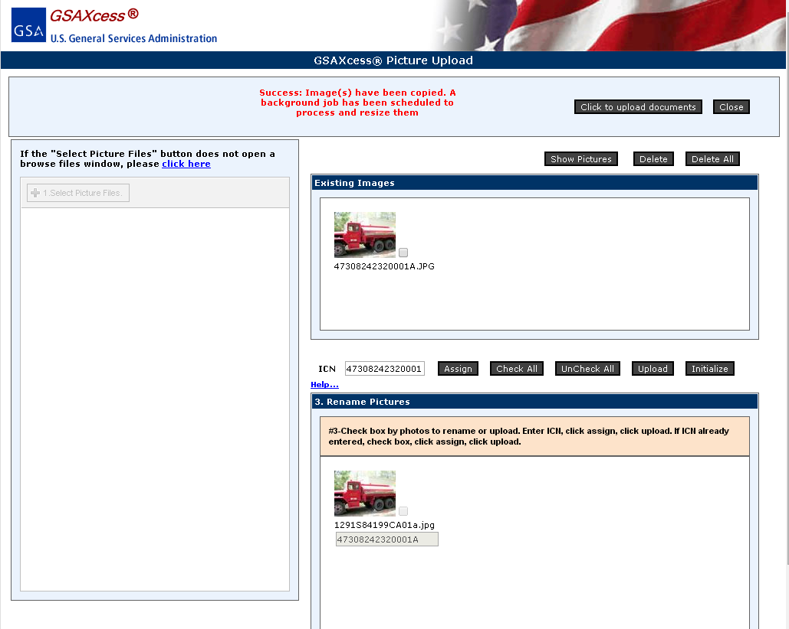
After renaming the photos, click here to upload to your report.

Slide 18
Two Ways to View Pictures
Go to Search and Select or Select from Category Basic Search
Enter Item Control Number
Click ‘Submit’ button
OR
Click on Modify Report
Enter ICN
Click ‘Submit’ button
(If you are still in the process of reporting, the pictures will be visible on the Report Property screen.)

Slide 19
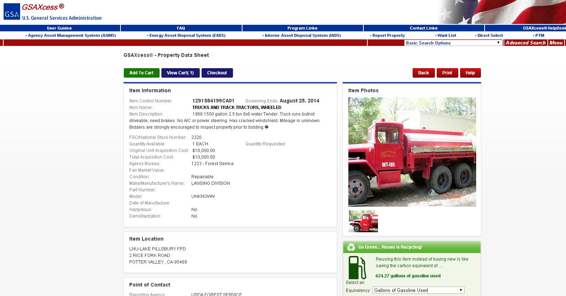
The first picture you select will default as the main picture.

Slide 20
