Slide 1
WHERE IS MY PROPERTY?
Notes:
Welcome

Slide 2
Where Is My Property?
I have reported my property, now how can I find the status?
Once you report your property in GSAXcess®, it goes through a screening period of approximately 21 days (depending on the type of property).
If there are no requests for your property, it rolls to the Sales Center you selected when you reported the property.
Notes:
Rule of thumb is 21 days of GSAXcess screening. 14 days for furniture, FSG 71, 14 days for FSG 70 that has undergone the 7 days of Computers for Learning screening. Internal screening timing is set by the Agency. The same functions are available for internal screening customers as well.

Slide 3
Where Is My Property?
GSAXcess® has several methods for you
to find your property’s status
Property Inquiry – displays history of item from input to Sales
Download Property Reports – same as Property Inquiry but you can download to a spreadsheet
Download Transfer Orders – displays any requests on your reported items, allocations on your requested items, and history of your property requests
Notes:
The Property Inquiry function displays current and historical records relating to an item. The Download Transfer Orders function displays all requests for property by you and also requests by agencies of your property, allocations, transfers and denials of an item.

Slide 4
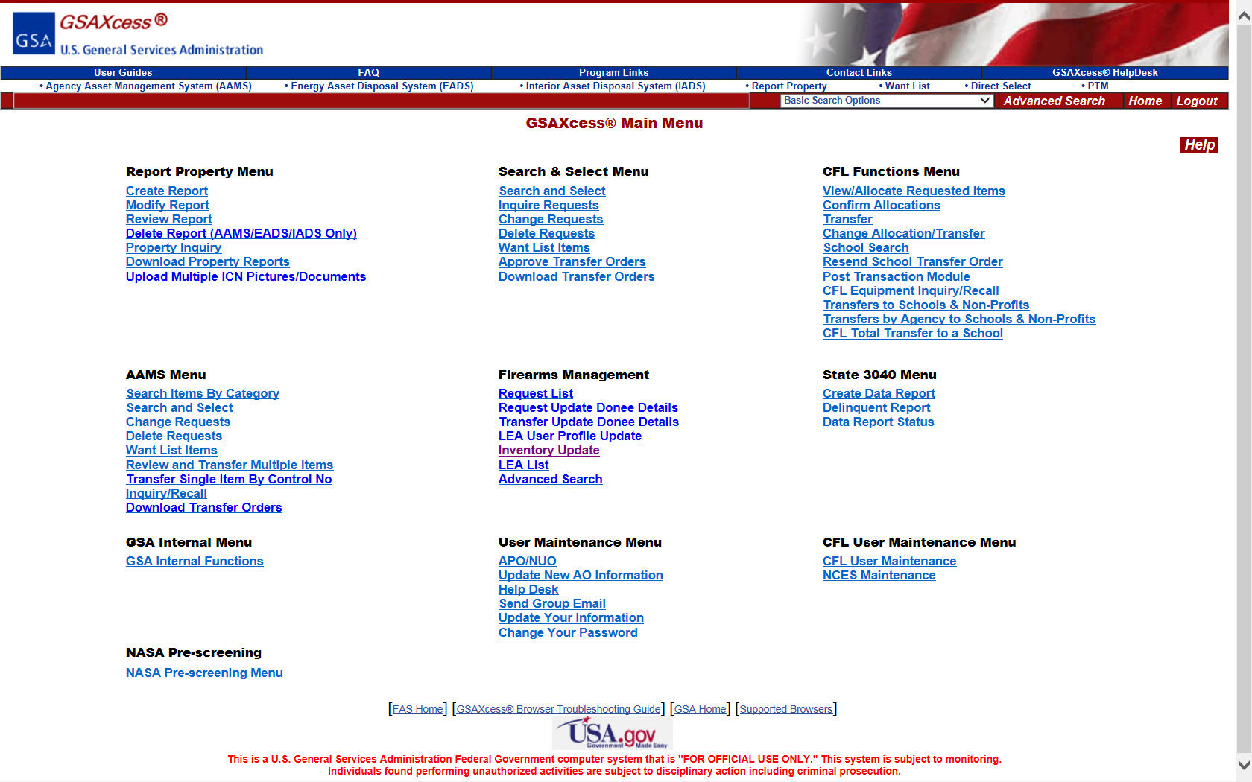
GSAXcess® Property Inquiry– Main Menu
Notes:
Go to the Main Menu on www.gsaxcess.gov and select Property Inquiry.

Slide 5
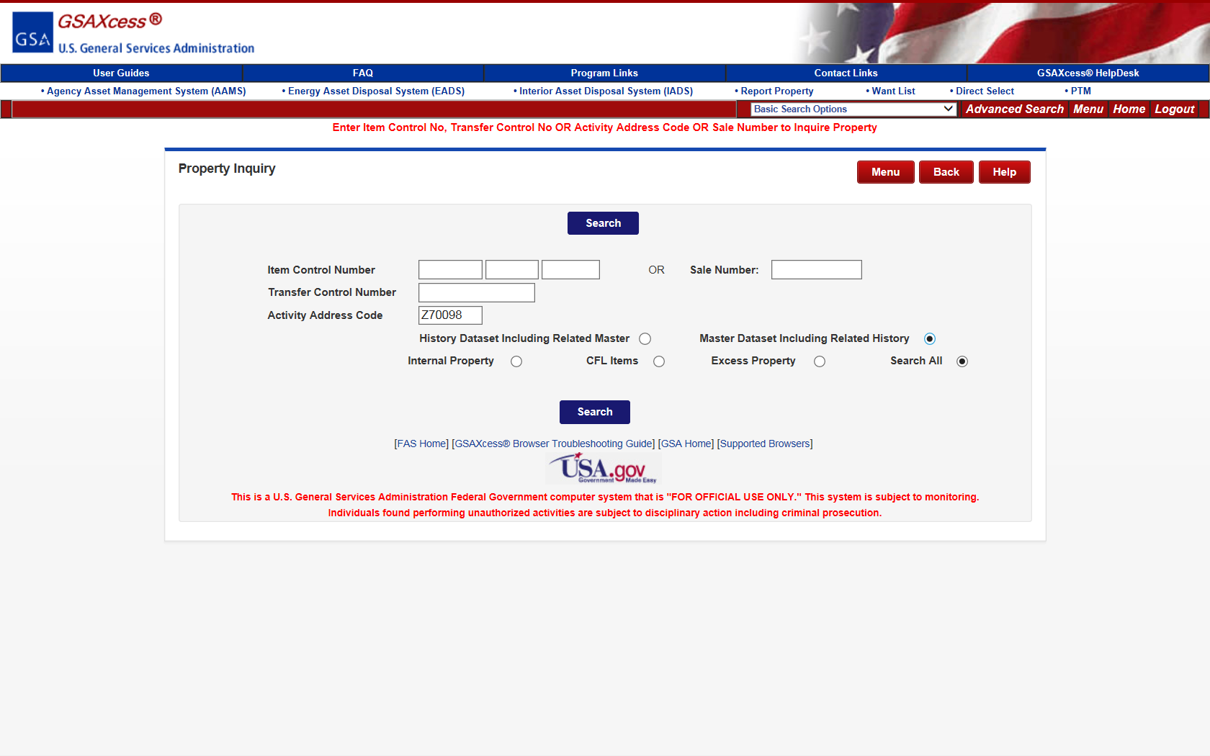
GSAXcess® Property Inquiry
Notes:
You can enter the Item Control Number, Transfer Control Number of Activity Address Code. If you don’t know the Item Control Number, enter the Activity Address Code. The system will display choices that must be selected. History files and Master files. History files are for all items that have completed screening with related records and Master files are all items that are currently still in GSAXcess screening and related history files. Select Internal Property, CFL Items, Excess Property or Search All as appropriate.

Slide 6
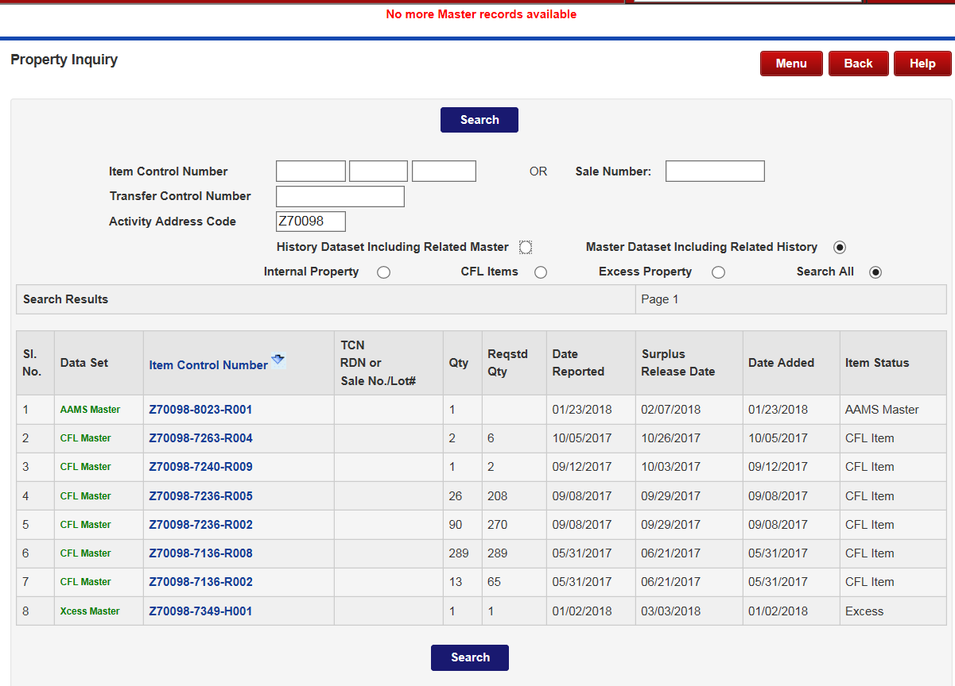
GSAXcess® Property Inquiry
Notes:
This screen displays all items currently screening displayed by internal screening first, Computers for Learning, then GSAXcess. There are 40 lines listed on each page. The Item Status column displays the Status of the item. It will tell you if the item is AAMS Master, which is screening in internal screening, Xcess, which is GSAXcess screening, CFL, which is Computers for Learning screening, Transfer Completed, which means it has been transferred, Surplus, which means it has a request from a SASP on it and it waiting for five days for completion or Donation Completed, which means it has been donated, Withdrawn, which means the agency has withdrawn the item, Waiver, which means that the items control goes back to the Agency or Sales, which means that the item is going to GSA Sales.

Slide 7
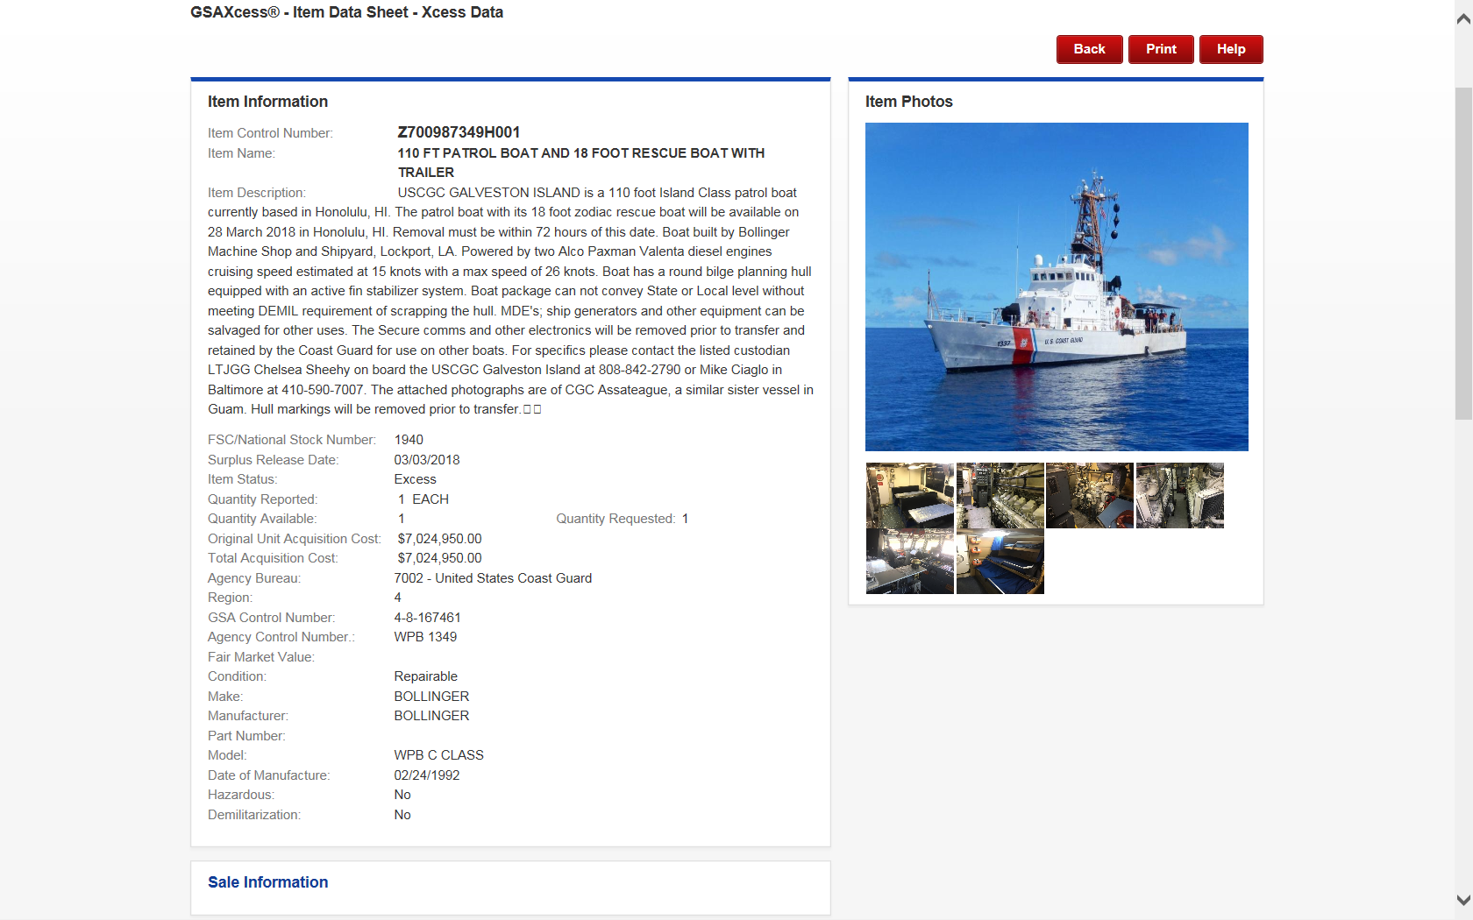
GSAXcess® Property Data Sheet
Notes:
This screen displays all the pertinent data for the property item.

Slide 8
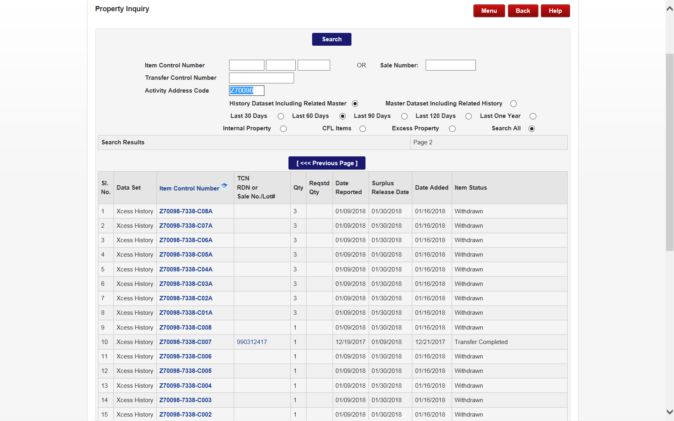
GSAXcess® Property Inquiry - History
Notes:
This screen displays all items that have completed screening and the functionality is the exact same as current screening. The statuses are somewhat different because they normally say History. This is where you will see Sales status. Notice the Sale No and status of Lotted in the status column. By clicking on the Lotted blue hypertext, you will be directed to the Property Data Sheet and Sales Information.

Slide 9
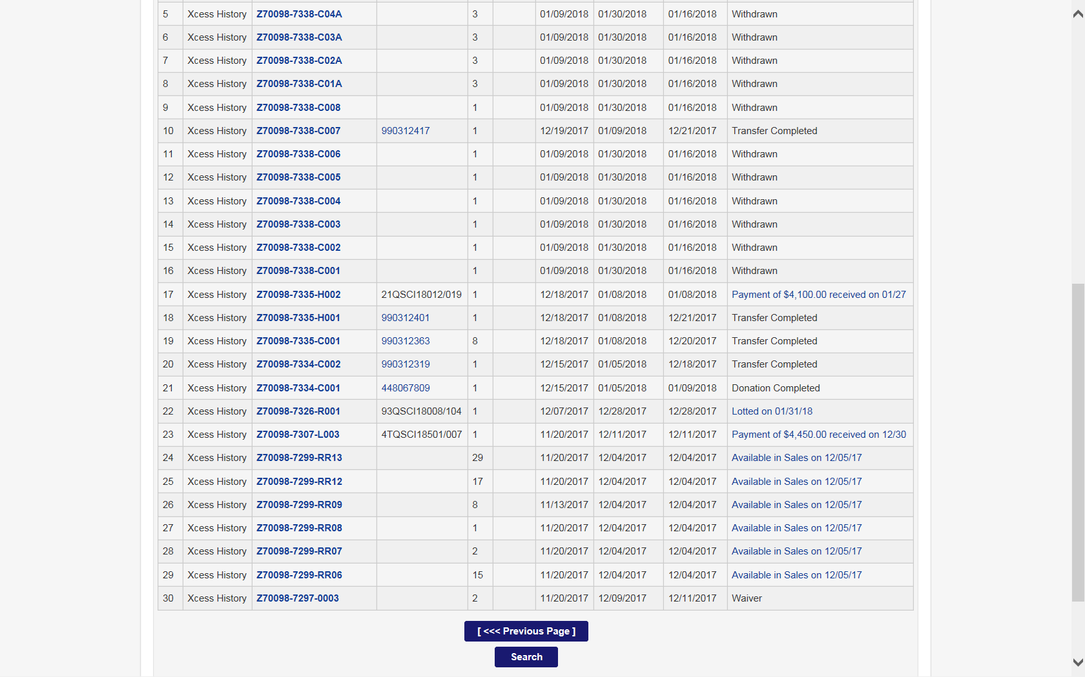
GSAXcess® Property Inquiry - Sales
Notes:
This is where you will see Sales status. Notice the Sale No and status of Lotted in the status column. By clicking on the Lotted blue hypertext, you will be directed to the Property Data Sheet and Sales Information.

Slide 10
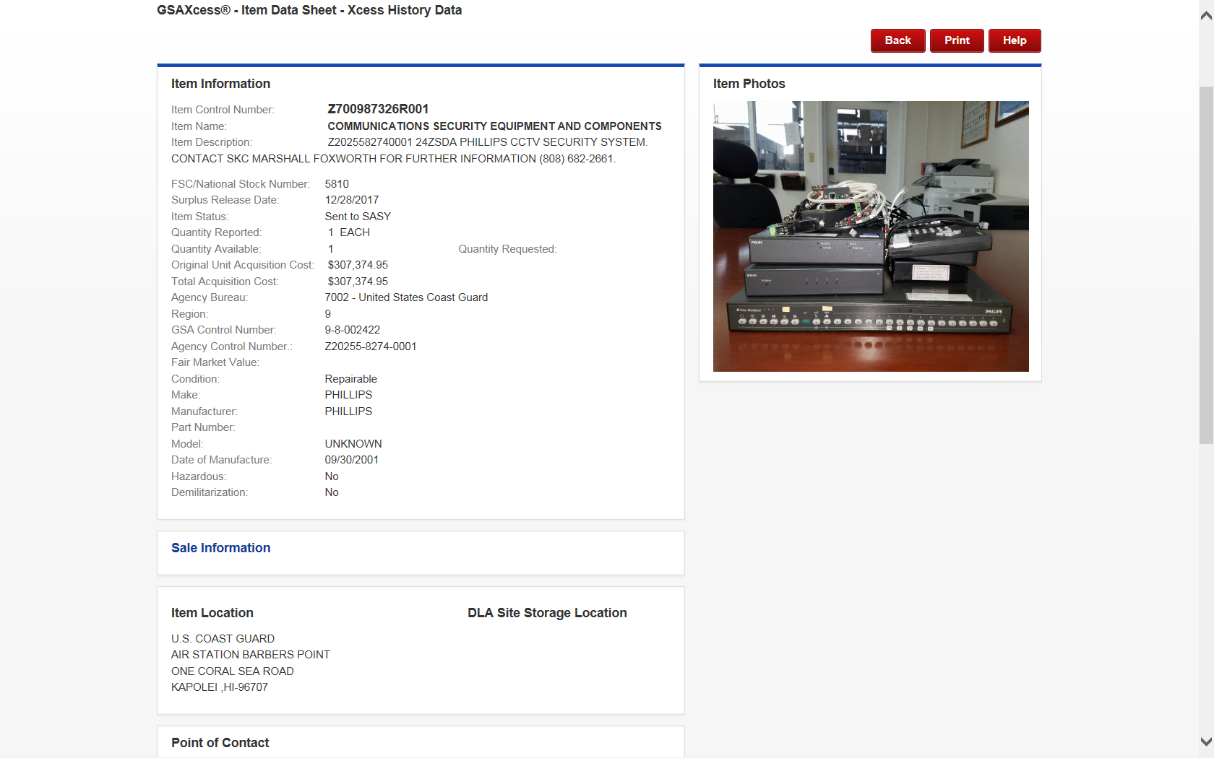
GSAXcess® Property Inquiry - History
Notes:
By clicking on the Sales Information hypertext, the current data for Sales will display for this item. Click on the blue Sale Information.

Slide 11
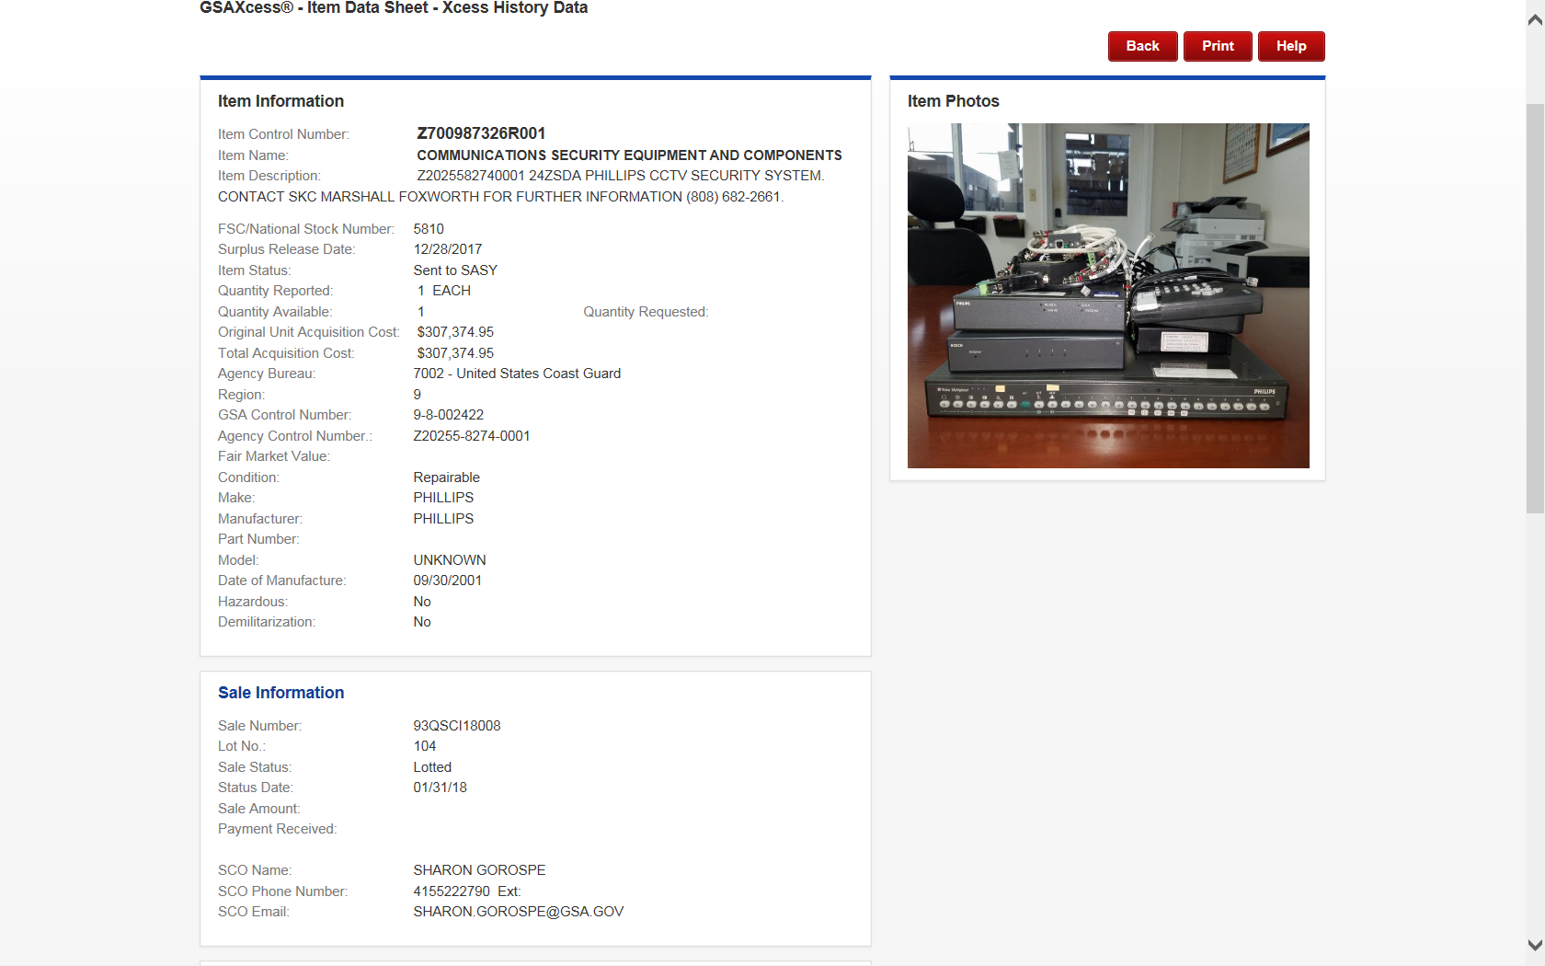
GSAXcess® Property Inquiry - History
Notes:
By clicking on the Sales Information hypertext, the current data for Sales will display for this item. This is where you can find the Sales Contracting Officer information.

Slide 12
GSAXcess® Download Property Reports
Notes:
You can find your property and save it in an excel report for historical purposes. Selecting Download Property Reports will allow you to pull the data in the same manner you did in Property Inquiry but to download to your computer in an Excel format.

Slide 13
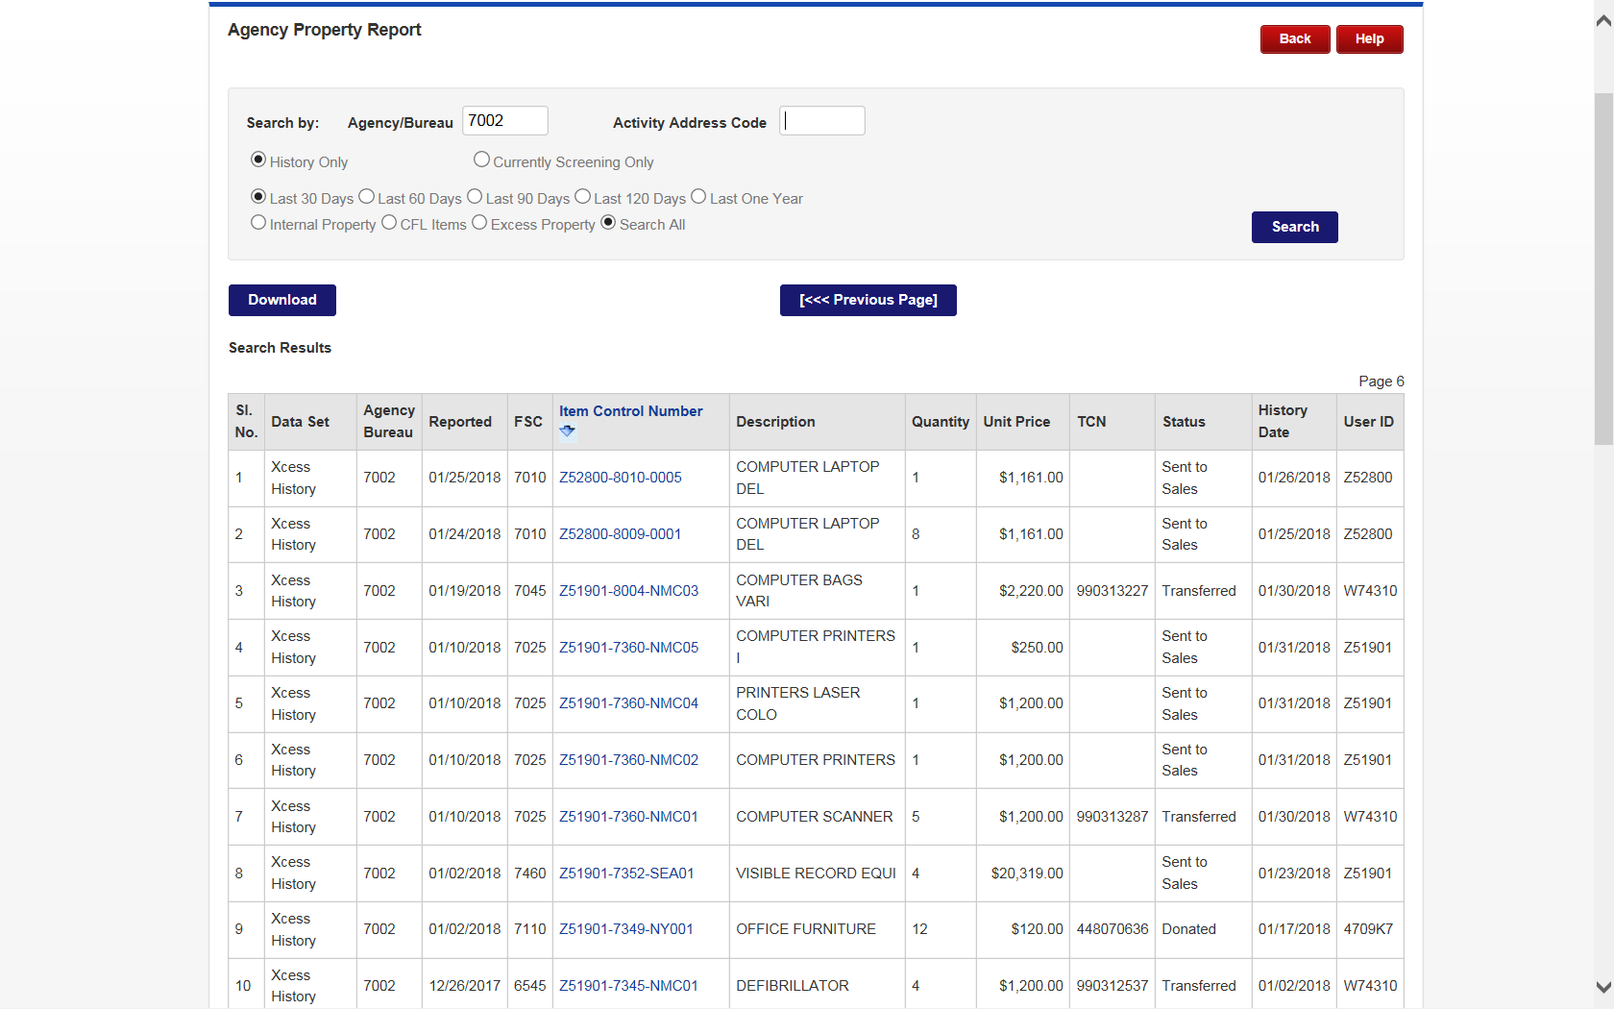
GSAXcess® Download Property Reports
Notes:
This is the screen where you can download your property reports. You can obtain 30 days, 60 days, 90 days, 120 days or one year from the date you request of items that have completed screening. You can also request a file of all your items currently screening in the system. Click Download to save as

Slide 14
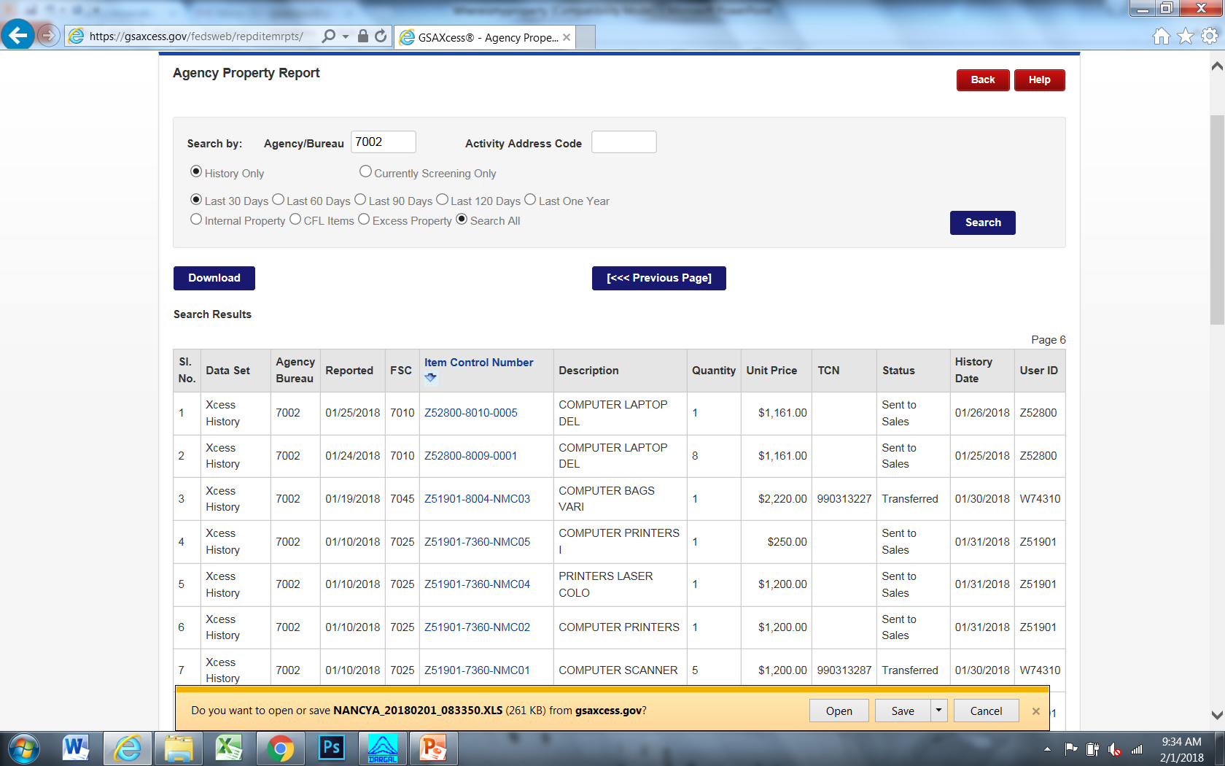
GSAXcess® Download Property Reports
Notes:
This is the screen where you can download your property reports. You can obtain 30 days, 60 days, 90 days, 120 days or one year from the date you request of items that have completed screening. You can also request a file of all your items currently screening in the system. Click Download to save. When opening it will give you an error message, click yes and you will see displayed an excel listing of all your items.

Slide 15
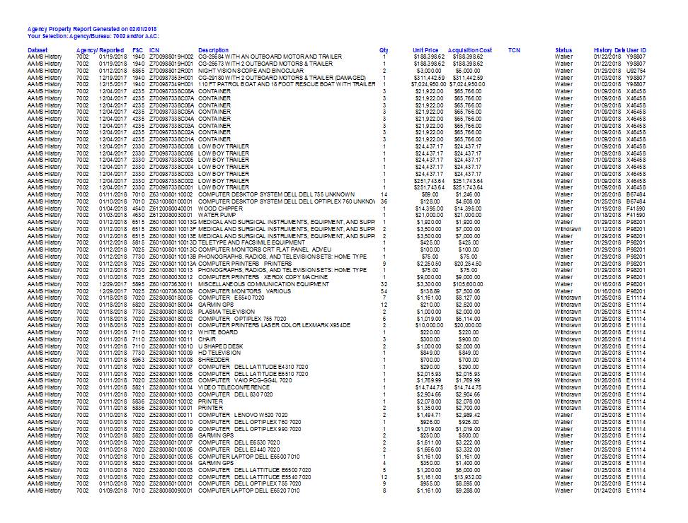
GSAXcess® Download Property Reports
Notes:
The excel file.

Slide 16
GSAXcess® Download Transfer Orders
Notes:
You can find your property by going to Download Transfer Orders. This is a very powerful tool, as all items reported that have requests on them are displayed for you and all items you have requested are in this function.

Slide 17
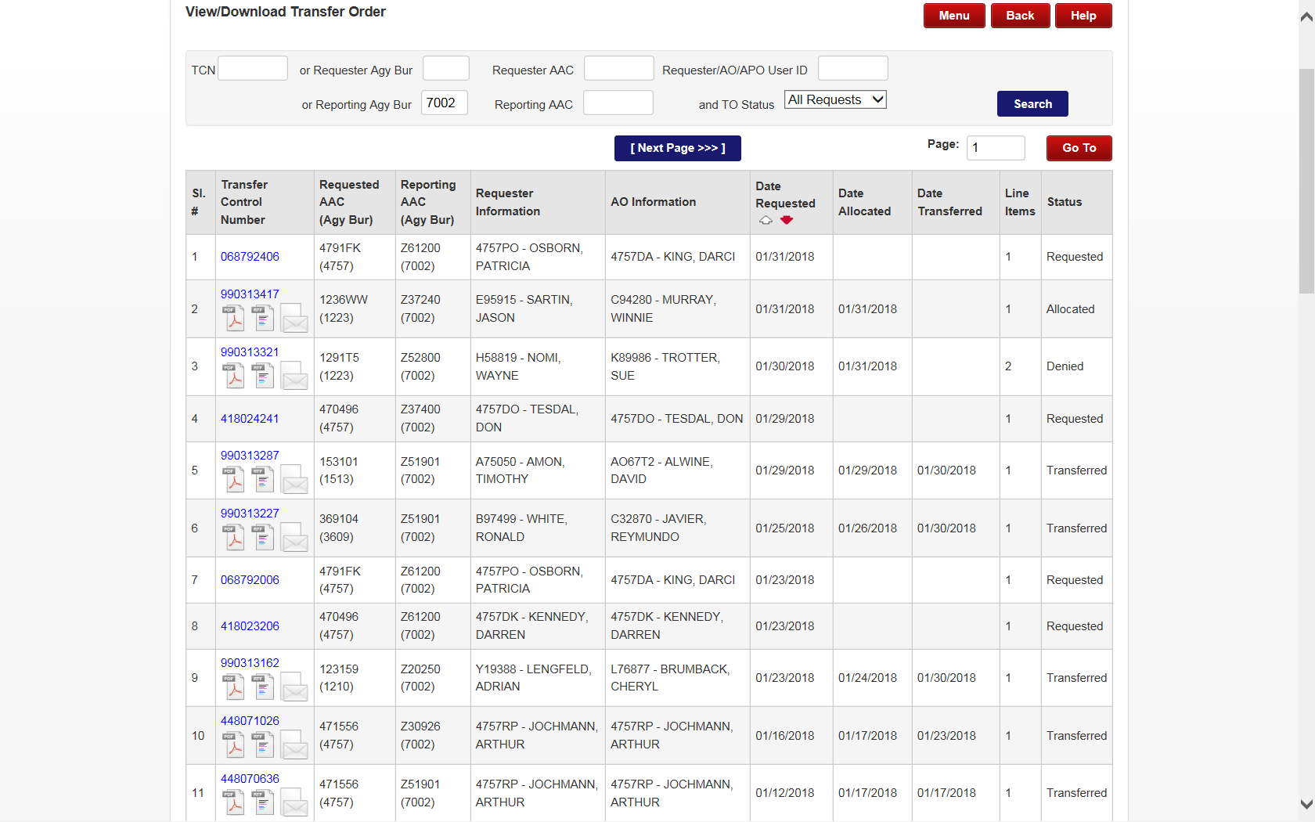
GSAXcess® Download Property Orders
Notes:
Enter your reporting Agency Bureau and the select Search. All records that have requests on them that you have reported will display and their status. From this screen you can print the Transfer Order or download them to your computer by clicking on the pdf or word icons. This same functionality is available for internal screening customers under the Internal Screening (AAMS/EADS/IADS) menu.

Slide 18
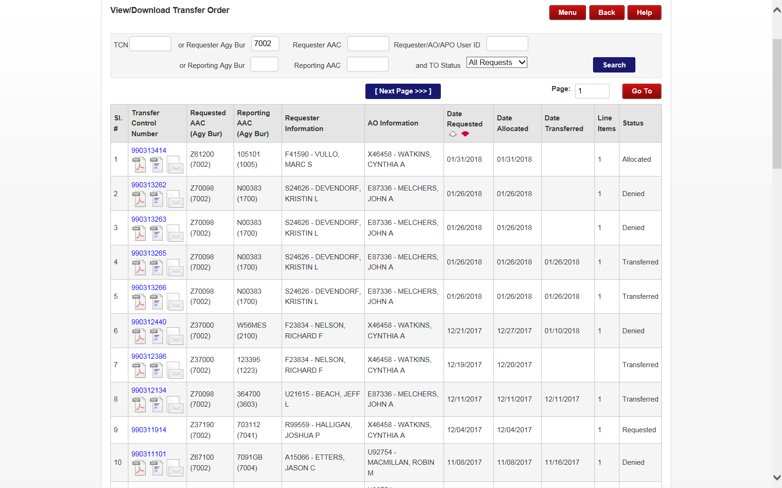
GSAXcess® Download Property Orders
Notes:
Enter your requesting Agency Bureau and select Search. All records that have requests on them that you have reported will display and their status. From this screen you can print the Transfer Order or download them to your computer by clicking on the pdf or word icons. This same functionality is available for internal screening customers under the Internal Screening (AAMS/EADS/IADS) menu.

Slide 19
QUESTIONS?

